Slide 1
ABO Wind in Ireland
Emmet Egan Director ABO Wind Ireland Ltd

Slide 2
ABO Wind AG
Managing Directors
Pioneer of Renewables
Founded in 1996 in Wiesbaden, Germany
Around 550 employees worldwide
Annual project volume of around EUR 300 million
2 GW developed and sold, of which 1.5 GW also installed
Operation & Maintenance for most commissioned projects (> 1.2 GW)
Managing Directors (from left): Dr. Jochen Ahn, Andreas Höllinger, Matthias Bockholt, Dr. Karsten Schlageter
Dr. Jochen Ahn | Andreas Höllinger | Matthias Bockholt | Dr. Karsten Schlageter

Slide 3
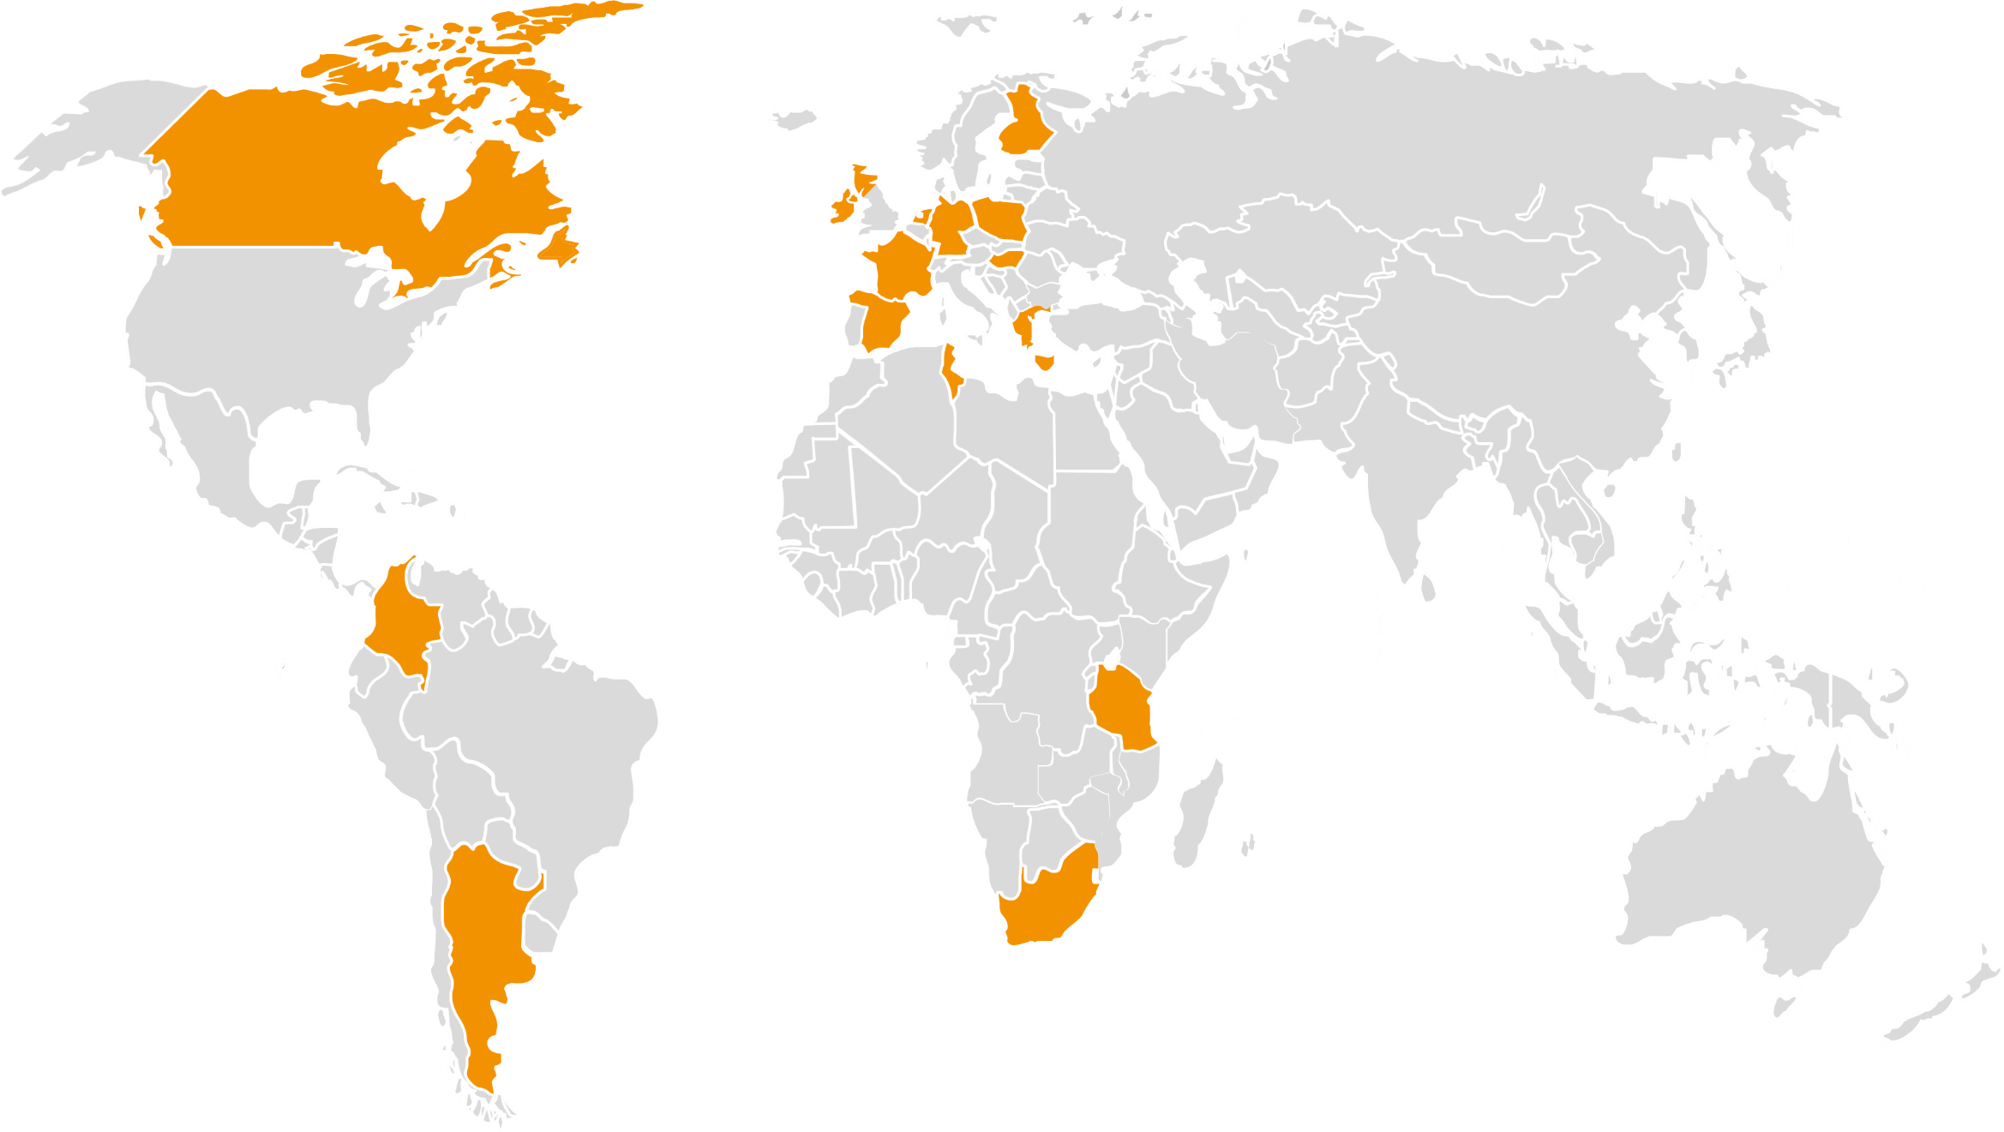
ABO Wind AG
Project Development in 16 Countries
Finland
United Kingdom
Ireland
Germany
Canada
Netherlands
Poland
Hungary
France
Greece
Spain
Tunisia
Colombia
Tanzania
South Africa
Argentina

Slide 4
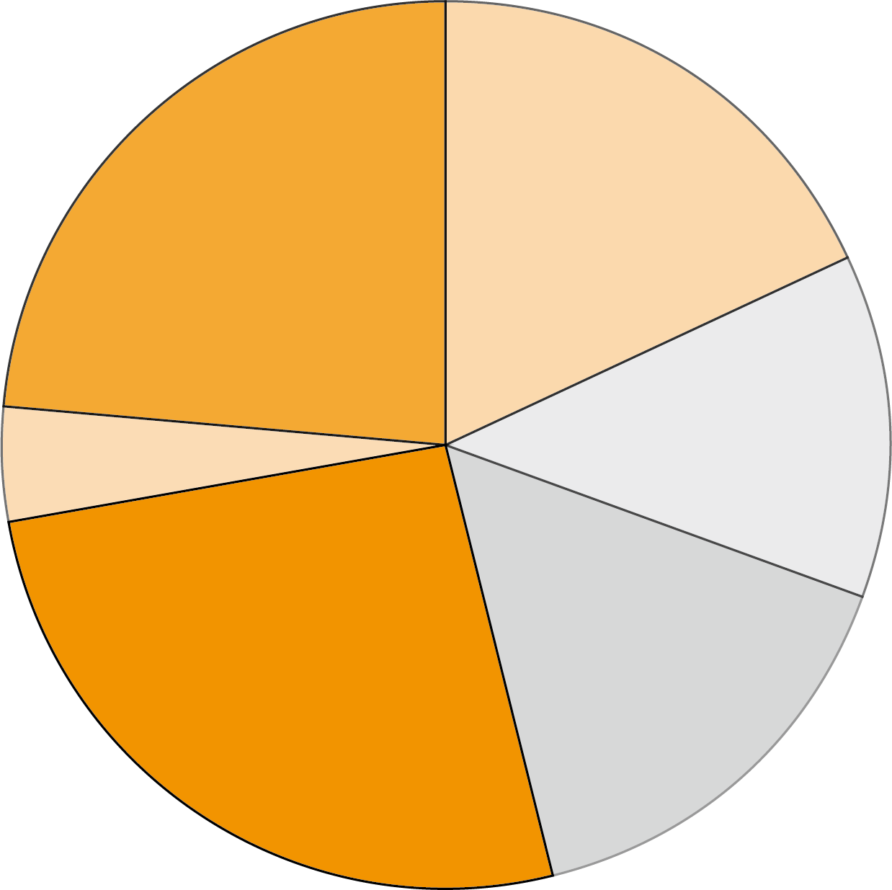
ABO Wind AG
Number of Employees (as of May 2019)
(Total: 542)
Management, Administration, IT, Communications, Future Energy Concepts
Operational Management and Services
127
98
Project Development Germany
Finance & Sales
23
68
142
84
Project Development
International
Construction, Grid Connection, Purchase, Site Assessment

Slide 5
ABO Wind AG
Developer of Renewable Energy Projects
Wind Energy
Solar Energy
Bioenergy
Energy Storage
Hybrid Energy

Slide 6
AG and subsidiaries
Local and central resource division
Local team typically made up of planning, construction and O&M staff
Local team source sites, achieve consents, construct out projects and manage for the investor
AG supports with (German based) wind resource assessment, project financing, turbine procurement and project sales team supports
NB on good working relationships between AG and local office

Slide 7
ABO Wind in Ireland
Dublin Office
Office established in 2008
Installed 84.4MW in 4 windfarms to date
Finishing Phase 1 (10.8MW) of a 20MW project in Donegal currently
Have a further 80MW in projects with planning permission and grid
Planning permission for a 44MW project (awaiting a grid connection offer)
Pipeline of optioned lands with potential for over 200MW of capacity

Slide 8
About RoI
Wind Energy in RoI
+270 wind farms in RoI
3,768 MW of wind energy installed (Aug 2019)
3,080 MW – Wind Generation record (Dec 12th 2018)
65% SNSP levels (non–predictable generation)
4,300 MW of wind energy estimated to meet 2020 40% target but
Amount of wind required could be higher subject to changes in demand, availability of other RE sources and data centre demand
RoI is a circa. 5,000MW system – comparable to the ‘Greater Manchester’ area

Slide 9
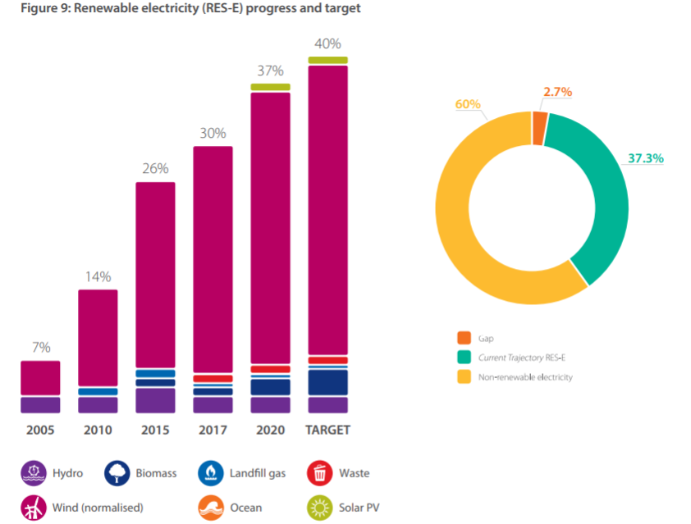
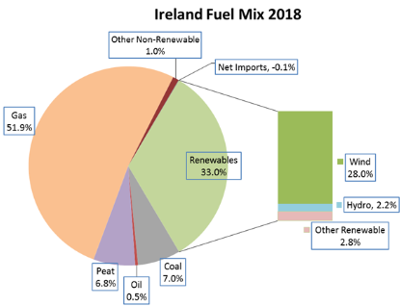
About ROI
Targets / Mix

Slide 10
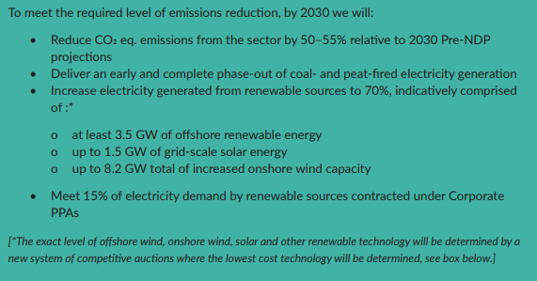
About RoI
Looking to 2030
Current Govt target is 70% RE share by 2030
Up from initial 55% (IWEA 70by30 work)
Moving from fixed feed-in tariffs (REFIT) to auctions (RESS) – 1st auction in June 2020
Targets set out in Climate Action Plan – published August 2019

Slide 11
Changing trends
Germany and international split
From the start the German market has dominated the fortunes of ABO Wind
In the past number of years the international contribution has been steadily on the rise
Increased country diversification and solar have been big wins for the group
The ability to be flexible in changing conditions is ABO Wind’s greatest attribute
In Ireland:
Office started as an acquisitions play (Gate 3; 4kMW of offers in 2008)
Moved into planning plus grid purchase and developer JVs when acquisitions dried up
Finally to a more traditional get planning; get grid (ECP); finance and build model

Slide 12
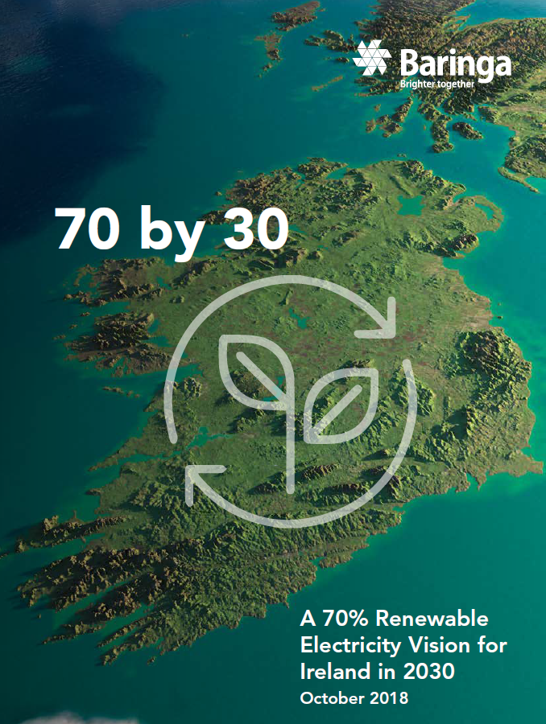
Lessons from Wind
Driving policy
Government Policy is crucial for industry, but it does not just materialize
DCCAE / Govt does not have the latitude to explore for solutions
70by30 idea developed by a no. of wind developers
Response to DCCAE 55% ambition in RESS consultation
Proposal was adopted for IWEA by respected UK consultancy
Adopted in March 2019 by Richard Bruton
Need a well funded, organised membership association
IWEA – 14 staff over 300 members
IWEA – 10 committees in critical areas (~ 50 working groups)

Slide 13
Challenges
Achieving 2030 ambitions and beyond
Community Engagement
Need to consult in detail with communities hosting wind projects (Funds / Investment).
4,000MW of onshore projects required for 2030 target (double current fleet in 10yrs)
Auction influence plus turbine size trends will mean larger projects with taller tips
New grid infrastructure required for additional wind and solar projects
Policy
New planning guidelines on wind due out in Dec 2019 (WEDGs)
Timely RESS implementation (auctions)
Grid connection costs and timelines (CRU)

Slide 14
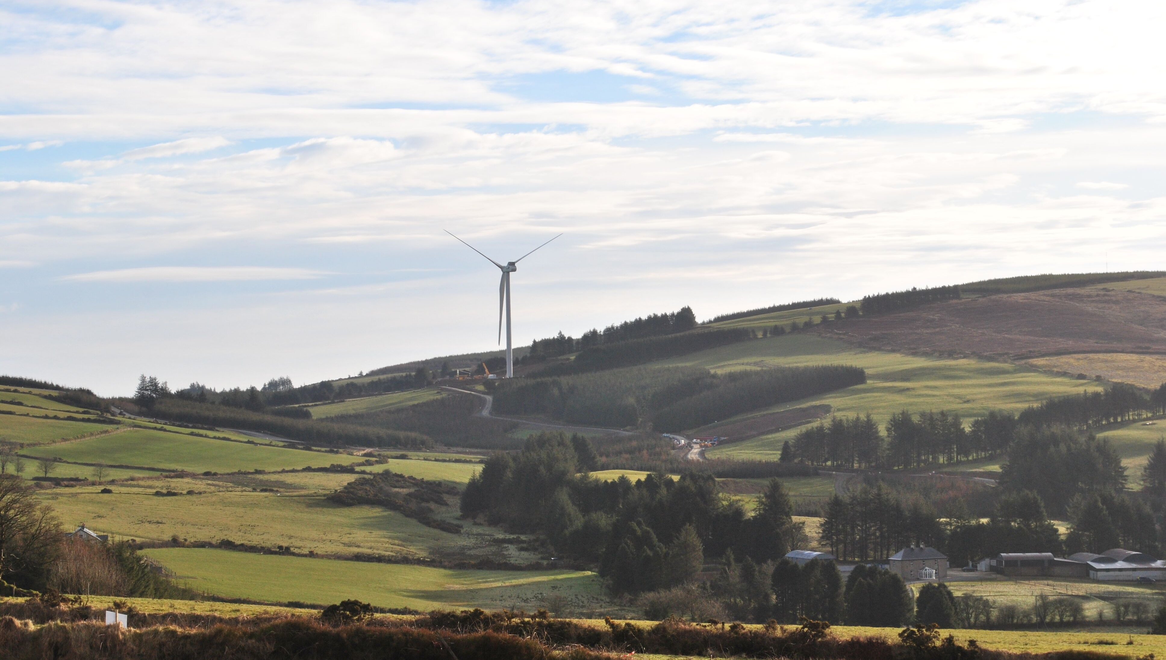
Thank you for your interest – Questions?

