Slide 1
The German Energy Solutions Initiative & the German Energy Transition
Sylvia Hartmann
Consultant on behalf of the
German Energy Solutions Initiative
Renewables Academy (RENAC) AG
October 22nd 2019
in Hanoi
Notes:
Welcome
I am…from…

Slide 2
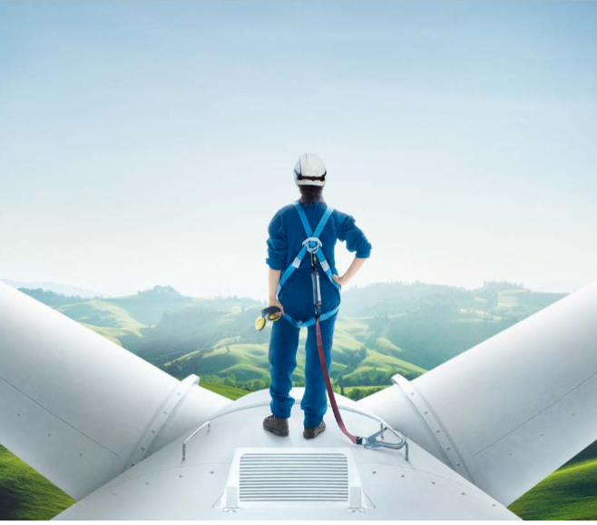
The German Energy Solutions Initiative Aims
Promotion of renewable energy and energy efficient technologies
Showcase sustainable energy solutions
Implementation of projects
Know-how transfer
Contribution to international climate protection
Notes:
The promotion of renewable energies and energy efficiency in Germany has started already in the early 90’s of last century.
This are almost 30 years, which have resulted in the establishment of a strong industry, encompassing several 100 small and medium-sized enterprises specialized in research and development, design and production of sustainable energy solutions.
Today 4 of those companies from Germany have travelled Vietnam to present you their concept and solutions in the industry.
They will present themselves in a panel later on.
Before that, let me tell you in which way you can participate an profit from our Energy Solutions Initiative:
The aims of German Energy Solutions Initiative are:
Promotion of renewable energy and energy efficient technologies
By Show casing sustainable energy solutions :
The implementation of projects using German technologies and expertise
Further, to transfer know-how into the hands of political decision-makers, key opinion leaders and market participants all over the globe
As well as contributing to international climate protection
The key word interlinking all these issues is “German Energiewende” which I will present a little bit later

Slide 3






How can you participate and meet German enterprises?
Foreign trade fairs
Networking opportunities
Know-how transfer
Information
Capacity building
Trade missions
Fact finding missions
Project development & flagship projects
Notes:
In order to achieve those aims the initiative offers a wide range of instruments. Here you can see a brief overview of those instruments:
Foreign trade fair participation:
Networking opportunities
Know-how transfer
Information about the German renewable energy sector
Trade missions for German companies to go abroad
Fact finding missions for foreign companies to come to Germany
Project development assistance and the implementation of flagship projects

Slide 4

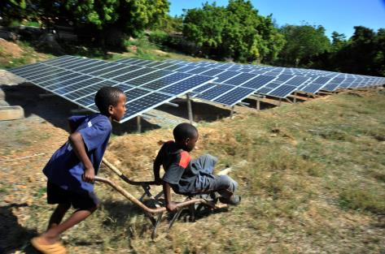
Know-how transfer
Fact finding missions
Missions to Germany for foreign companies & decision-makers
Visit of best practices and applied solutions
Project development & flagship projects
Facilitating business partnerships and know-how transfer
Capacity building
© endostock/Fotolia
© GIZ
Notes:
You as a foreign company or decision-maker can take part in fact finding missions to Germany, where you will visit best practices renewable energy installations and companies who have successfully implemented energy efficiency measures. You will also have the opportunity to get insights into the German energy technology sector as well as to establish valuable business contacts with German companies.
The initiative offers various instruments for the realization of sustainable energy projects worldwide:
The Project Development Program (PDP) is implemented by the Deutsche Gesellschaft für Internationale Zusammenarbeit (GIZ). It focuses on developing and emerging economies.
Renewable-Energy-Solution-Program (RES-Program) is implemented by dena, the German Energy Agency. Through this program flagship projects showcasing all technologies are realized worldwide.
Both programs aim at facilitating business partnerships as well as the transfer of know-how. They also include capacity building measures.
Another instrument for learning about best-practice projects in your country are Technology Showcases. These showcases present implemented projects in your country that use energy-efficient technologies and expertise “made in Germany”. During these events you can meet all the companies involved in the implementation of the projects. The showcase also comprises a workshop where you will have the opportunity to discuss technical aspects with experts.
Besides those programs there are also more capacity building activities in which representatives from renewable energy and energy efficiency companies can take part as well as foreign decision-makers.
European Energy Manager (EUREM) – Training programme offered by selected German chambers of commerce abroad. Corporate decisions-makers get the opportunity to acquire and extend their knowledge and expertise about energy efficiency.
Manager Training Programme – „Fit for Partnership with Germany“ – The programme is implemented by the GIZ. Participating managers get the opportunity to establish contact with potential business partners in Germany while acquiring management skills and useful skills for international cooperation.

Slide 5
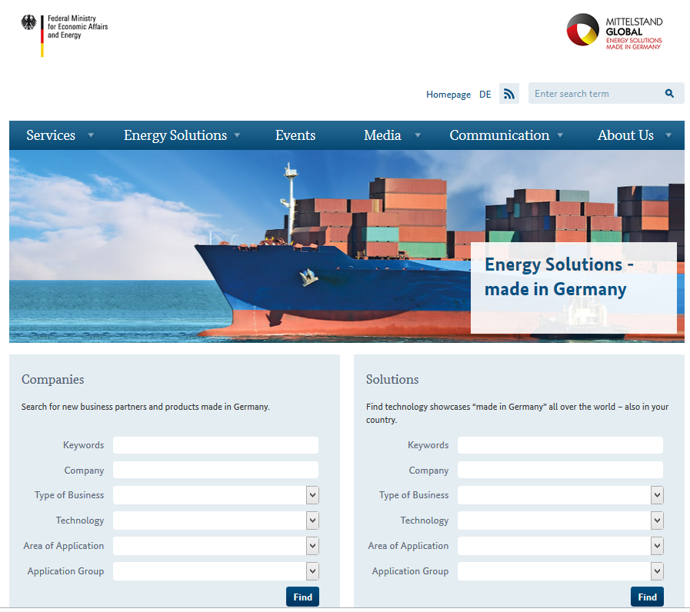
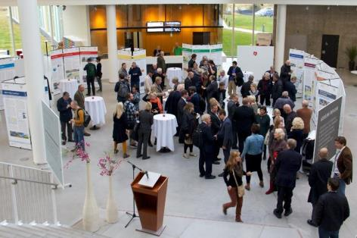
Information about Events and German companies
On our website you can find:
  Information about technologies made in Germany on a Database
  Current news and upcoming events
  www.german-energy-solutions.de
  You may also always contact us!
Notes:
On the website of the Germany Energy Solutions Initiative you find a wide range of information.
When browsing the company directory, you can also find suitable business partners.
A contact adress when you want to figure out more about activities concerning your region

Slide 6
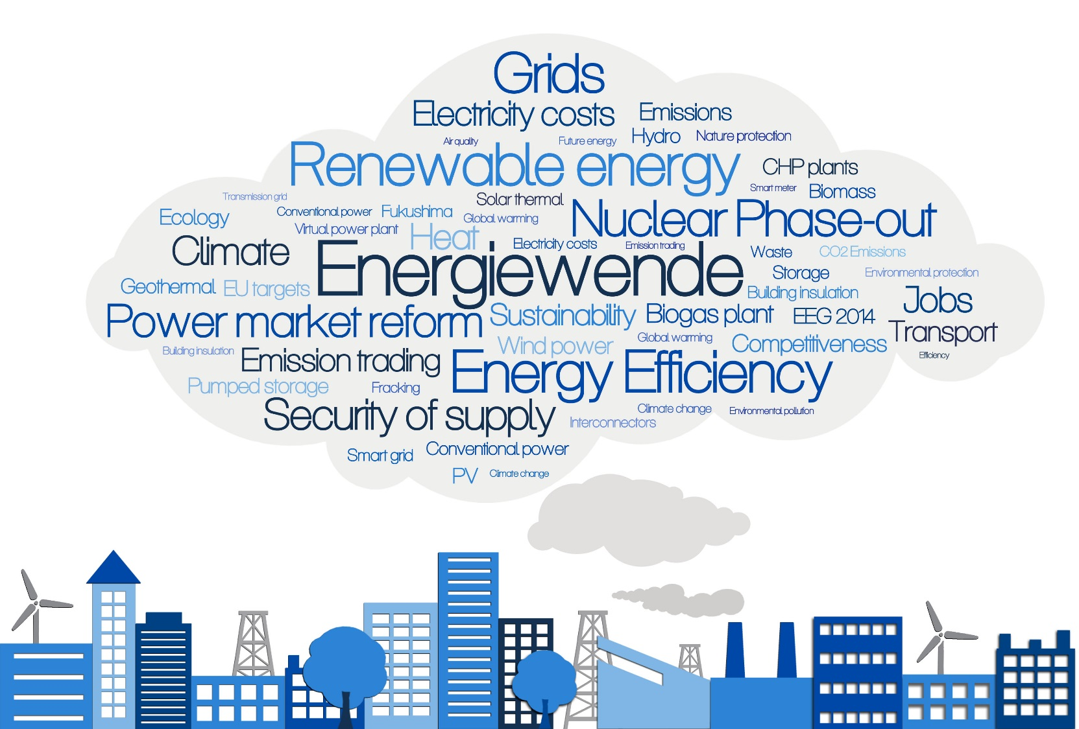
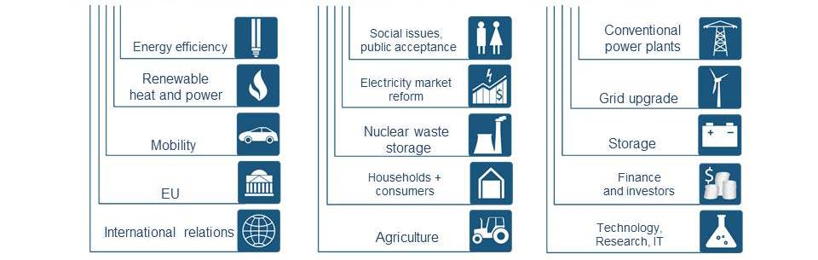
What is the Energiewende?
The Energiewende is a fundamental transformation of the energy system and re-alignment of energy policy. It is multidimensional and affects many areas.
Seite 6
Notes:
Notes
The slide visualizes the many dimensions of the Energiewende.
The Energiewende is a fundamental restructuring and re-alignment of German energy policy.
In the public discourse, however, the Energiewende is often narrowed to the electricity sector.
Yet, the Energiewende is multi-dimensional, has a much larger scope and goes far beyond the power sector.
The formulated targets of the energy transition cannot be reached without considering, inter alia, energy efficiency, the transport sector, the heating sector, the modernization and new construction of transmission grids, energetic modernization of buildings, ongoing research and development of storage technologies, the consideration of the conventional power plants, increased international coordination with European partners, and last but not least the broad social and public acceptance of the Energiewende which includes new means of public participation in energy matters.
The Energiewende:
is a technological shift away from fossil and nuclear energy towards renewables and energy efficiency.
is a fundamental transformation of the energy system and re-alignment of energy policy.
is an inter-generational long-term process with a time horizon until 2050 and beyond.
is a public discourse in society about the future of energy supply.

Slide 7
Objectives of the energy transition
Affordable energy supply
Secure energy supply
Clean energy supply
Energy Transition
Reliability, affordability, and environmental protection are interlinked and the ultimate objectives of the Energiewende and German energy policy.
7
Notes:
Notes
The slide shows the so called energy triangle. This stresses the balance of all three major objectives of German energy policy and the Energiewende: affordable, secure and clean energy.
With the “energy transition”, Germany aims to create an “environmentally sound, secure and affordable energy supply”. (energy policy triangle)
The transformation of Germany’s energy supply system towards renewable energy sources is key to achieve effective environmental protection and long-term climate goals.
At the same time, a high level of energy security and cost-­effective solutions are crucial to ensuring that energy remains affordable and for Germany to remain a competitive industrial base in the long term.
Background information
The Energy Concept 2010 serves as the compass for steering the “energy transition” – the transformation of Germany’s energy supply system to renewable energy sources.
The Energy Concept describes the road to a reliable, economical and environmentally compatible future for the energy supply system.
These objectives of the “energy transition” are further detailed in the five reasons for the Energiewende (see next slide).
Security of supply includes the dimensions
Resource availability
Reserve capacity
Grid stability
Price stability
Market stability
Geopolitical stability
Environmentally sound energy
Climate protection
Low or no emissions
Nature conservation
Resource efficiency
Low-risk energy
Affordable Energy
Cost effectiveness
Predictable energy prices for all consumers
Competition in energy markets
Fair distribution of costs by all consumer groups
Sources
BMWi 2019: Draft of the Integrated National Energy and Climate Plan, https://ec.europa.eu/energy/sites/ener/files/documents/ger_draft_necp_eng.pdf, page 13.
BMWi/BMU (2010): Energy Concept for an Environmentally Sound, Reliable and Affordable Energy Supply. 28. September 2010: http://www.germany.info/contentblob/3043402/Daten/1097719/BMUBMWi_Energy_Concept_DD.pdf (last accessed 02.01.17)
BMWi 2014: The Energy of the Future, First “Energy Transition” Progress Report – Summary, https://www.bmwi.de/English/Redaktion/Pdf/first-monitoring-report-energy-of-the-future,property=pdf,bereich=bmwi2012,sprache=de,rwb=true.pdf, page 4. last accessed May 2015.

Slide 8
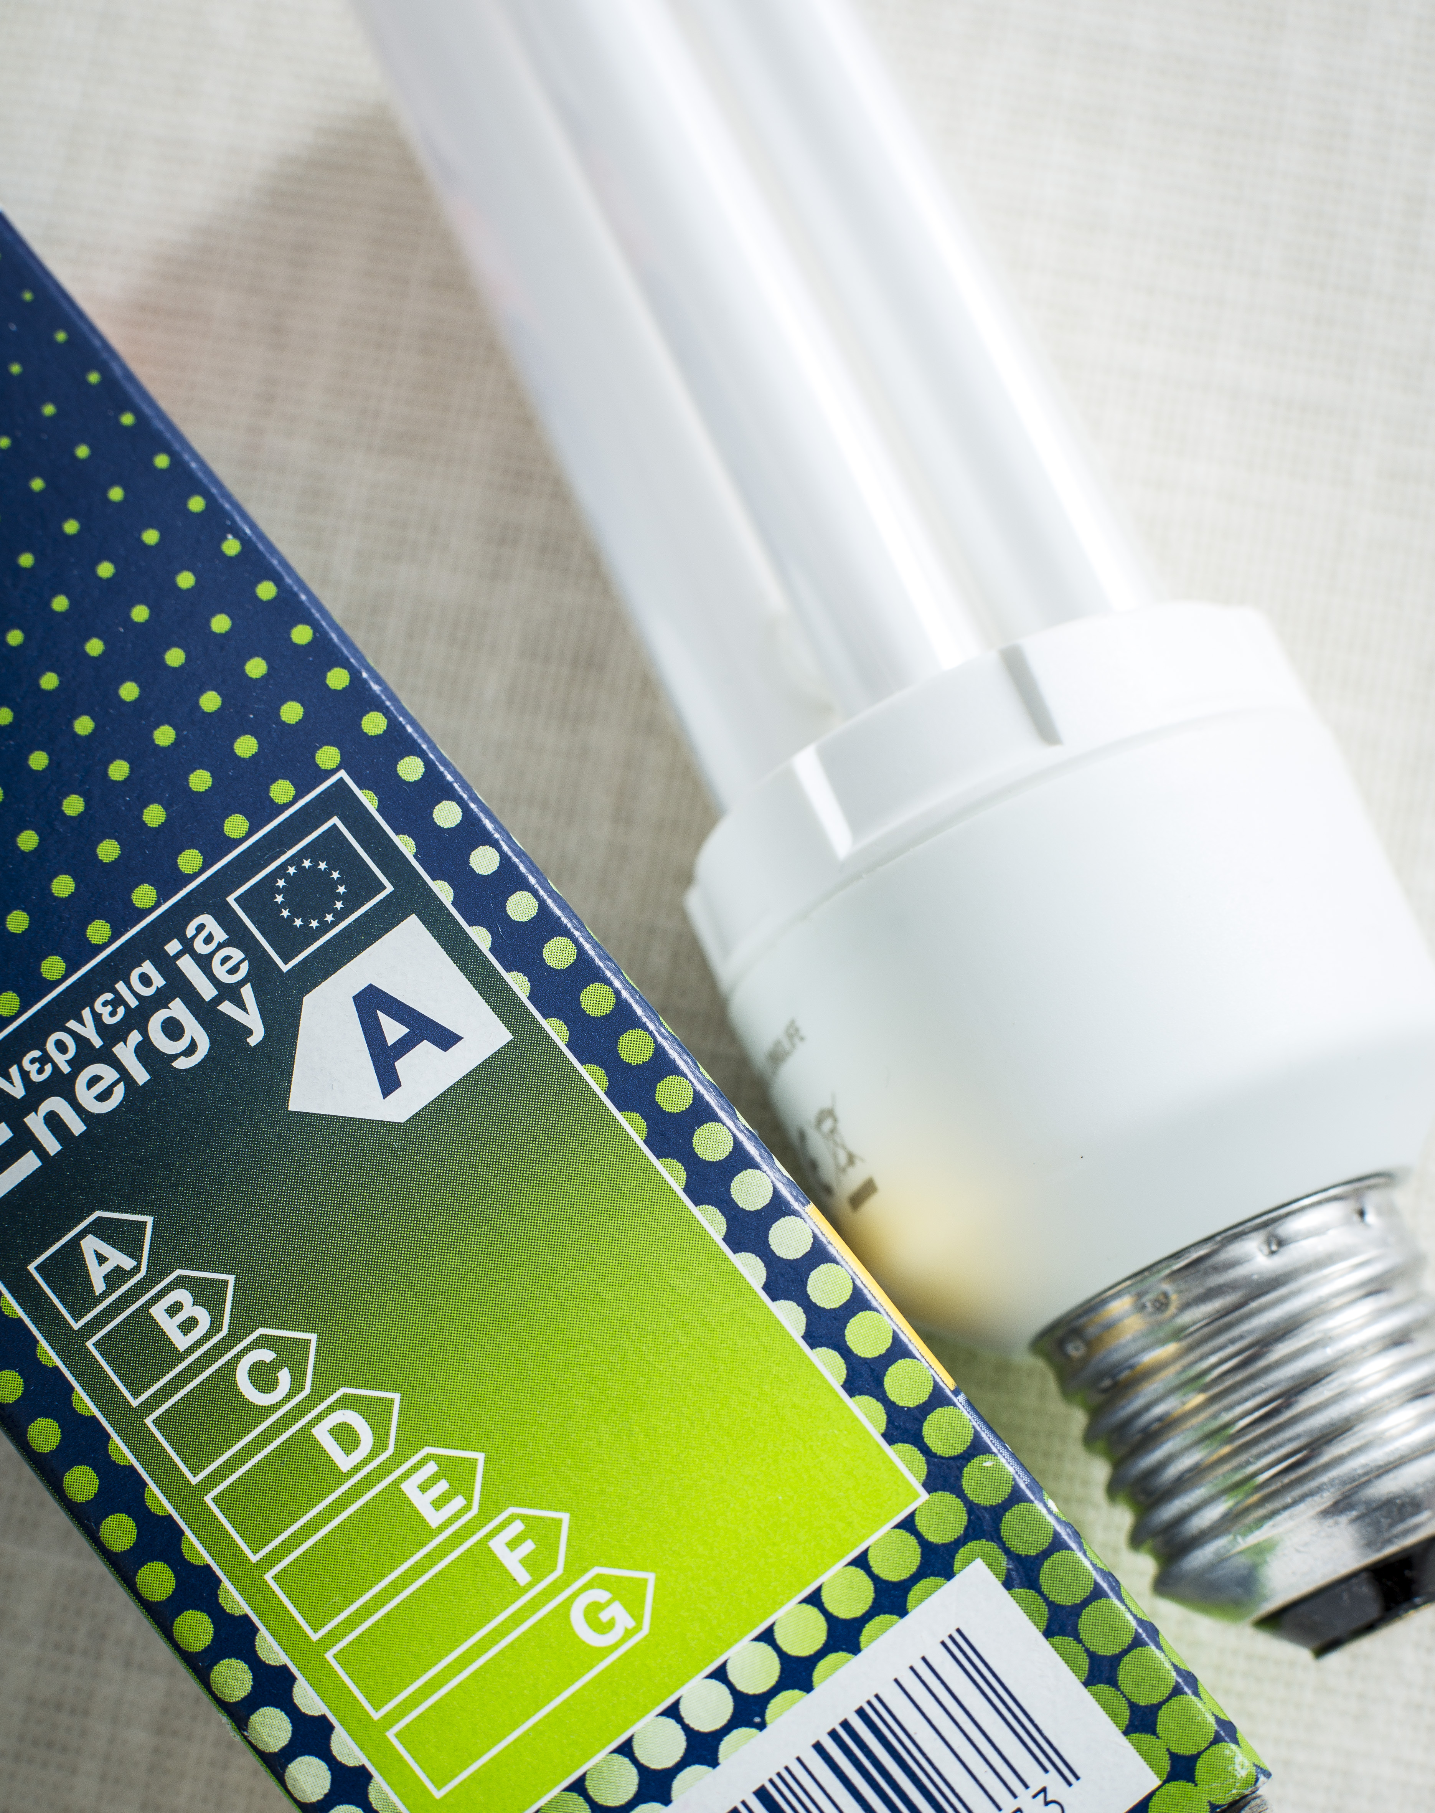
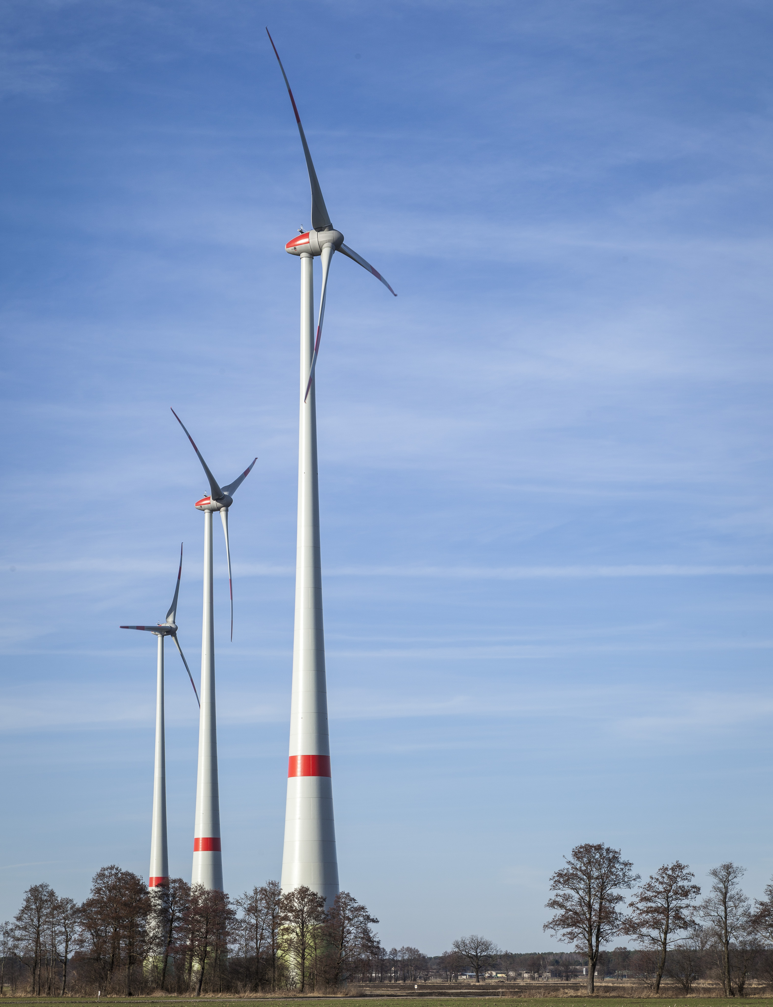
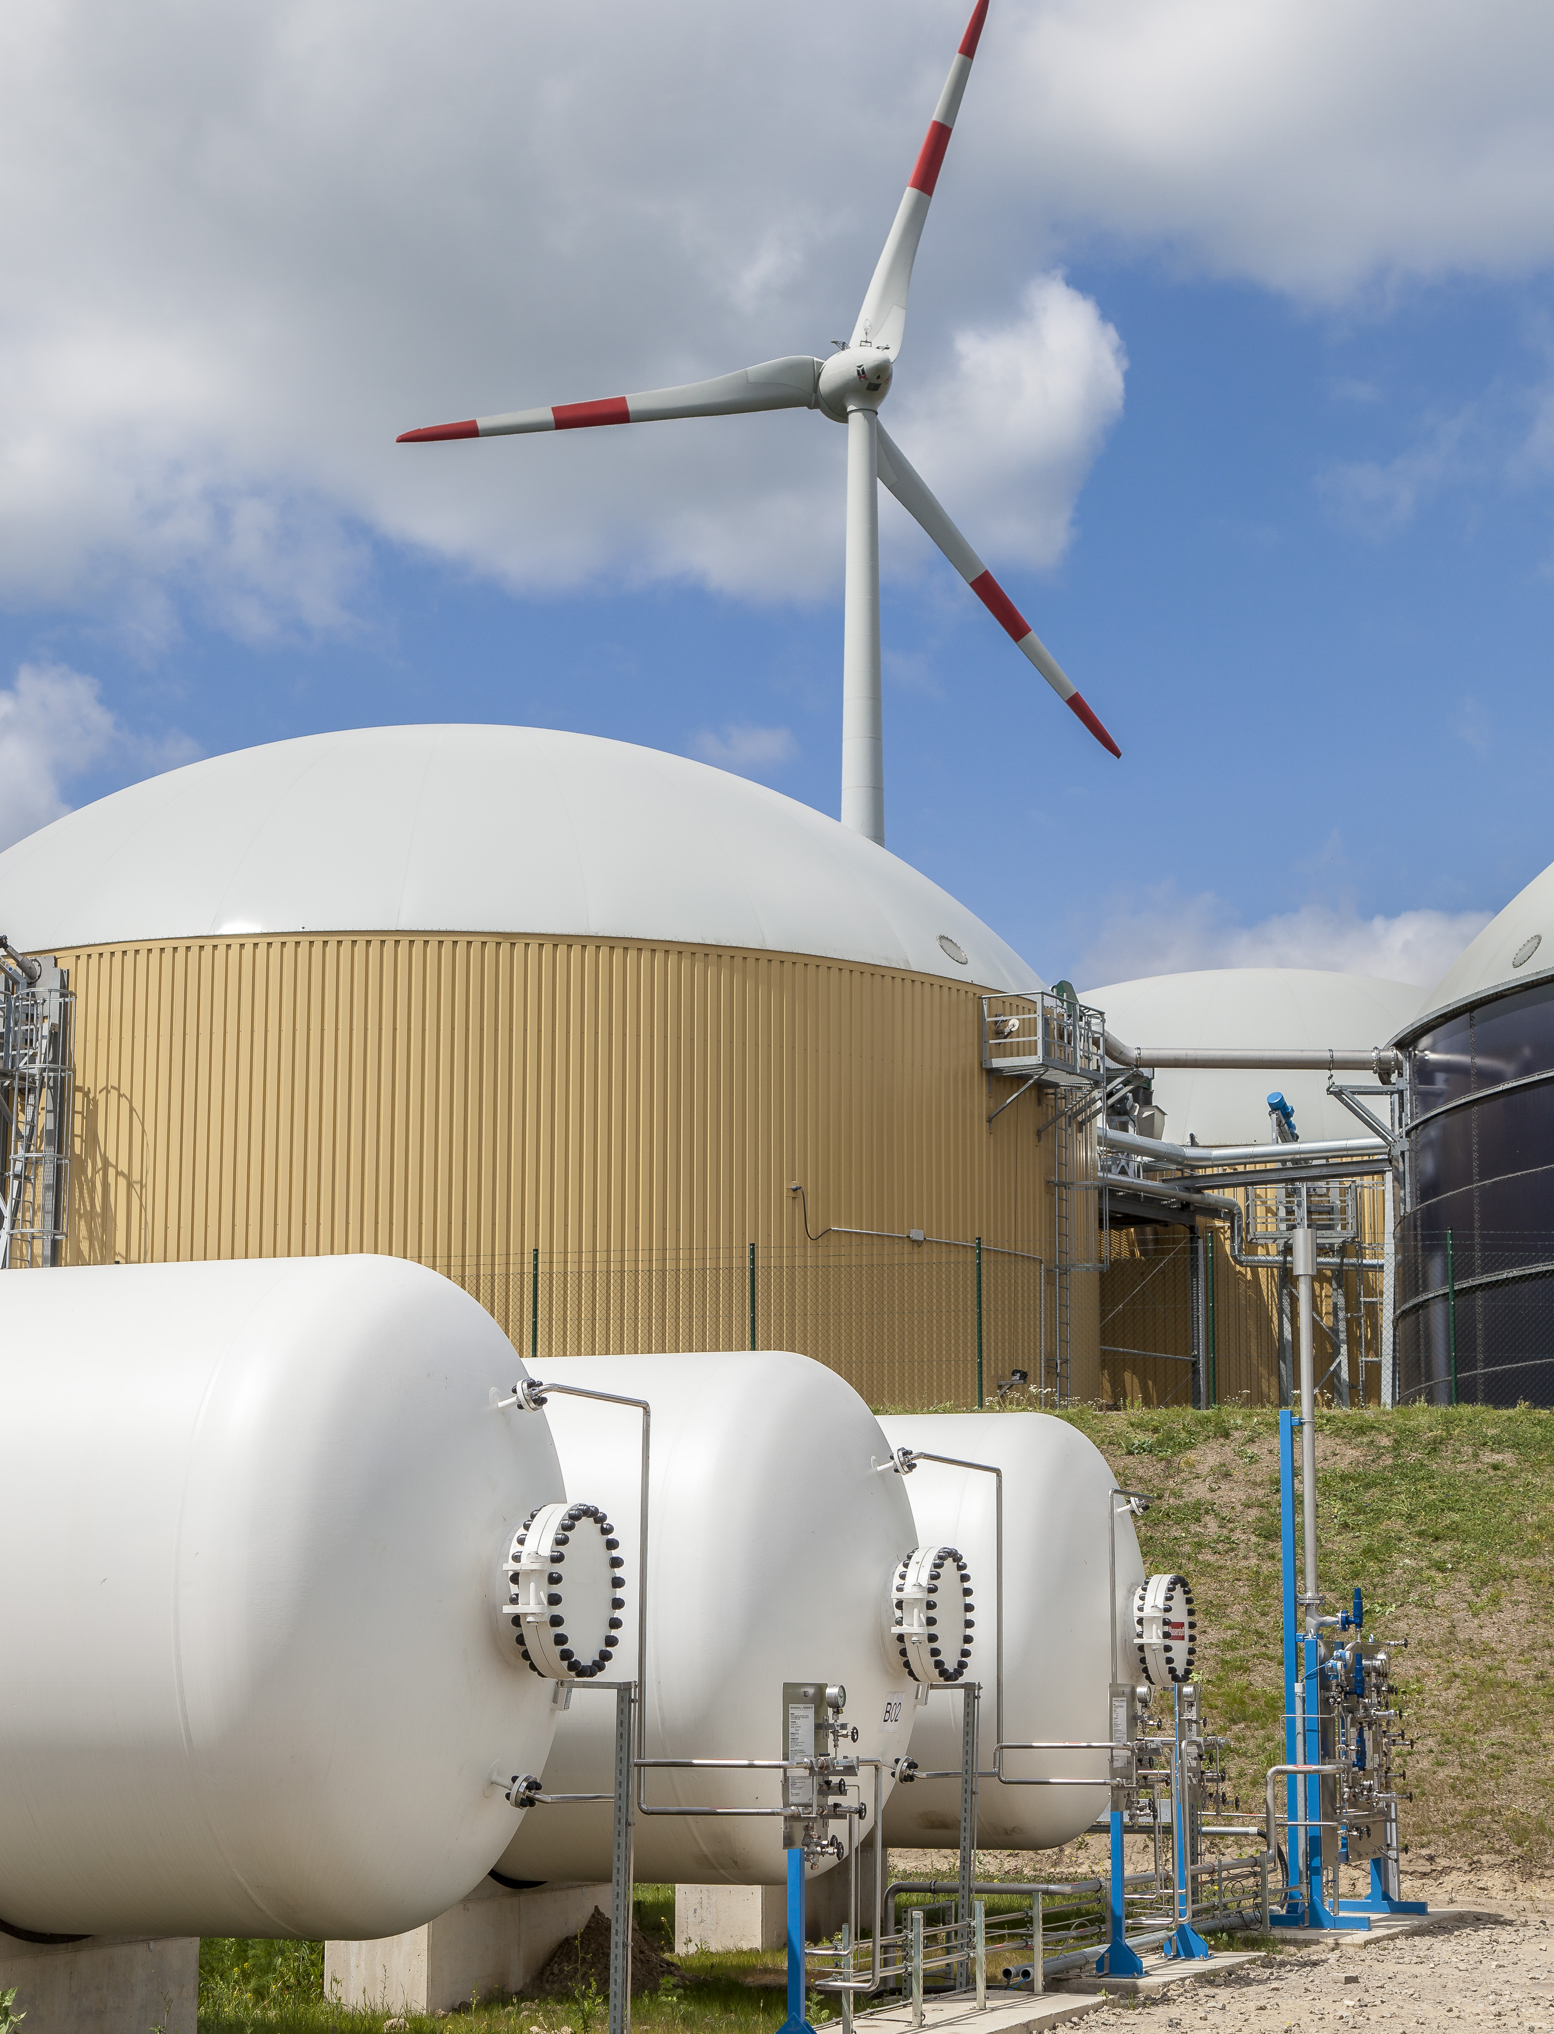
Cornerstones of the Energiewende
Efficiency first
Direct use of renewables
Sector coupling
The energy transition triad combines efficiency, direct use of renewables and sector coupling
Source: BMWi 2017
Notes:
Notes for presentation
Efficiency first, the direct use of renewables, and sector coupling form the energy transition triad.
‘Efficiency first’ means ‘prioritizing energy efficiency’, and doing so wherever measures to raise energy efficiency are cheaper than providing energy.
The greatest share of the remaining energy demand (i.e. that not covered by improving energy efficiency) is to be covered by the direct use of renewables.
Sector coupling means using electricity from renewables to bring the energy transition to other sectors (heating & cooling, transport), and so reduce the amount of fossil energy required.
Background information
European energy and climate policy
The EU's 2030 framework for climate and energy policies is a decisive factor in the future direction of national energy policy, and the successful delivery of the energy transition
Current wording speaks of Energy Efficiency and Renewables as “fundamental strategies” and “core objectives”. Past documents mentioned them as “key pillars” (e.g. the coalition agreement, KoaV 2013), and the “cornerstones” of the Energiewende (Eckpunkte 1.7.2015). “Key pillars” is outdated
Alternative ways to structure the main elements of the Energiewende are the 10 items of the German energy agenda („10-Punkte-Energie-Agenda). These areas are tackled in the 10 central projects of the Energiewende (see slide on the implementation of the most important projects)
Sources
BMWi/BMU (2010): Energy Concept for an Environmentally Sound, Reliable and Affordable Energy Supply 28. September 2010, p. 7; p. 11-13; p. 18-21: http://www.germany.info/contentblob/3043402/Daten/1097719/BMUBMWi_Energy_Concept_DD.pdf (last accessed 06.05.14)
Pictures: BMU.
BMWi (2017) website, A target architecture for the energy transition: from policy goals to specific measures, http://www.bmwi.de/Redaktion/EN/Artikel/Energy/target-architecture.html, last accessed: 01.02.2017
BMWi (2017): What does ‘Efficiency First’ actually mean?, http://www.bmwi-energiewende.de/EWD/Redaktion/EN/Newsletter/2017/02/Meldung/direkt-account.html, last accessed: 20.02.2017
Keywords
Region: Germany
Topic: Basics Energiewende
Keywords: Pillars of the Energiewende, policies, context, background information

Slide 9

The Energiewende started decades ago: Milestones
1990: PV programme “1.000 Roofs”
1991: Electricity Feed-In Law
2000: First EEG
2010: Energy Concept
2011: Energiewende package, nuclear phase out
2016: EEG Amendment
2017: Auctions
Continuously developed policy support has fostered steady growth of renewables in Germany.
Source: AGEB 2018, AGEE-Stat 2018
.
Seite 9
Notes:
Notes
The slide illustrates the development of renewable electricity generation between 1990 and 2018
Renewables in Germany were limited to hydropower in the early nineties.
In order to support Solar PV pioneers, the „1000 Roofs Programme (1000 Dächer Programm) was established, which supported the installation of roughly 2000 PV installations between 1990 and 1992.
In 1991 the „Electricity Feed-In Law“ obliged power corporations to buy renewable electricity for predefined price. (16.61 Pfennige/kWh for Wind and Solar). This was a milestone for RES support policies in Germany.
In 2000 the electricity feed-in law was replaced by the first „Renewable Energy Sources Act“ (EEG)
2010: The Integrated Energy and Climate Programme (IEKP) translates the corresponding EU policies into German law and tackles all areas of sustainable energy supply, not only renewables, but also efficiency in the various sectors.
The 2011 nuclear disaster in Fukushima, Japan, led the German government to re-think their nuclear power strategy. A phase-out of all nuclear power generation by 2022 was agreed and a corresponding ramp up of renewables (Energiewende package).
The EEG was amended several time. Major changes occurred in 2014 when feed-in tariffs were substantially lowered. In 2016 a major novelty was the introduction of tenders for PV, Wind and Biomass, representing a shift away from the well-established feed-in tariff system.
After initial tenders in PV in 2016, the new auctioning/tender support instruments will be in place from 2017 onwards. Smaller RE systems (PV below 100 kW) are not affected.
Background info
The Electricity Feed-In Law entered into force on 1.1.1991 and required power companies to buy electricity from renewable energy sources and to renumerate for a fixed price. This was based on the average returns of the power company in the penultimate calendar year; when introducing the price was 13,84 Pfennig per kilowatt-hour (kWh), and 16.61 cent / kWh for electricity from wind and solar energy.
In 1999 the 100,000 Roofs Program (based on the 1000 roofs program) was supposed to expand the role of photovoltaics and offered interest-reduced loans.
The first Renewable Energies Act (EEG) came into force in 2000 and defined feed-in tariffs for the different renewable energy technologies.
2007 the IEKP was adopted.
Sources
AGEB (2017): Stromerzeugung nach Energieträgern 1990-2016 http://www.ag-energiebilanzen.de/#20170207_brd_stromerzeugung1990-2016.
UBA/AGEE_Stat 2018: Entwicklung der erneuerbaren Energien in Deutschland im ersten Halbjahr 2018 Quartalsbericht der Arbeitsgruppe Erneuerbare Energien-Statistik (AGEE-Stat), https://www.umweltbundesamt.de/sites/default/files/medien/479/dokumente/180813_agee-stat_q2_2018_uba.pdf, August 2018.

Slide 10
Targets of the Energiewende until 2050
 |  | 2018 | 2020 | 2030 | 2040 | 2050
Climate | % greenhouse gas reduction (vs. 1990) | -30.8 % | -40 % | -55% | -70% | -80-95%
Renewable energy | % gross final energy consumption | 16.9 % | 18% | 30% | 45% | 60%
 | % gross electricity consumption | 38.2 % | Min 35% | Min 50% | Min. 65% | Min 80%
 | Share in heat consumption | 13.9 % | 14%
 | Share in Transport sector | 5.6 % | 10% (EU)
Energy efficiency | % primary energy consumption (vs. 2008) | -10 % | -20% |  |  | -50%
 | Final energy productivity (2008-2017) | 1.1% p.a * | 2.1% per year (2008-2050)
 | Gross electricity consumption (vs. 2008) | -3.3 %* | -10% |  |  | -25%
 | Primary energy demand (buildings) (2008) | -18.3 %* |  |  |  | - 80 %
 | Heat consumption (buildings) (vs. 2008) | -6.9%* | -20%
Transport | Final energy consumption in transport sector (vs. 2005) | +6.5%* | -10% |  |  | -40%
 | Number of Electric vehicles (1/2018) (hybrid cars) | 83.175 (341.411) | (1 million) 2022 | (6 million)
Sources: BMWi 2019, UBA 2019, AGEE-Stat 2019, BMU 2018, KBA 2019
The energy transition follows a transparent long-term strategy with specific targets.
* = 2017
Notes:
Notes
The slide summarizes the various targets of the Energiewende: there are climate, renewable energy, energy efficiency and transport targets.
The energy transition follows a transparent, long-term strategy with specific targets.
By 2018, greenhouse gas emissions had declined by an estimated 30.8% compared to 1990: roughly 865.6 million tons of greenhouse gases were emitted in 2018, about 41 million tons less than in 2017 (906.6 million tons).
These targets are set out in the 2010 Energy Concept of the Federal Government (additional electricity sector targets 2025+2035 from the coalition treaty 2013).
By 2050 Germany wants to cut emissions by 80 to 95%, boosting renewables and energy efficiency. Emission reduction goals correspond to the EU Roadmap 2050 (from 2011).
In general: Germany is largely on track concerning RENEWABLES ENERGY targets, but is likely to miss many of the 2020 ENERGY EFFICIENCY and TRANSPORT targets.
STATUS: Germany is on track to reach its Kyoto targets but must step up action to reach long-term targets of the Energiewende.
In 2017, Germany has achieved a reduction in greenhouse gas emissions of -27.7 %, the target being -40% by 2020 and -80-95% by 2050.
Germany aims to increase the share of renewable energies in electricity to 80% by 2050. With 36.0% by 2017 Germany has already passed the 35% target set for 2020. (Please note: RE in electricity consumption according to AGEE-Stat. AGEB only offers values on electricity production)
The target for renewables in final energy consumption is 60% by 2050, the current level being 15.9% (2017) with 18% by 2020 still in reach.
Regarding energy efficiency, Germany wants to reduce primary energy consumption by 50% until 2050 compared to 2008. It has so far reduced consumption only by -6.5% in 2017 against a target of -20% compared to the base year 2008.
Final energy productivity increase amounts to 1.1% annually between 2008 and 2017, thus not reaching the targeted 2.1% per year.
Buildings: the target refurbishment rate of 2% per year is not yet reached – the current status sees roughly 1% annually.
Transport: Reduce final energy consumption by -10% in 2020 and -40% in 2050. Also this target seem currently out of reach. In fact the transport sector has increased its emissions. In 2017 final energy consumption in the transport sector was even 4.2% higher compared to 2005.
The gaps that still remain are now to be closed through the measures announced in the Climate Action Programme 2020 and the National Action Plan Energy Efficiency (NAPE).
Additional targets (not illustrated on this slide):
Energy efficiency: Share of CHP (combined heat and power, KWK) at 25% in 2020
Buildings: Reduce primary energy demand to -80% by 2050 (and by -20% for heat in 2020)
Sources
UBA 2019: Klimabilanz 2018: 4,5 Prozent weniger Treibhausgasemissionen, https://www.umweltbundesamt.de/presse/pressemitteilungen/klimabilanz-2018-42-prozent-weniger, (last accessed 04.04.2019).
BMWi 2019a: Zweiter Fortschrittsbericht zur Energiewende: Die Energie der Zukunft. Berichtsjahr 2017, https://www.bmwi.de/Redaktion/DE/Publikationen/Energie/fortschrittsbericht-monitoring-energiewende.pdf?__blob=publicationFile&v=12, June 2019, page 55.
BMWi 2019: Time series for the development of renewable energy sources in Germany (February 2019), https://www.erneuerbare-energien.de/EE/Navigation/DE/Service/Erneuerbare_Energien_in_Zahlen/Zeitreihen/zeitreihen.html
KBA 2019: Jahresbilanz des Fahrzeugbestandes am 1. Januar 2019, Kraftfahrtbundesamt, https://www.kba.de/DE/Statistik/Fahrzeuge/Bestand/b_jahresbilanz.html?nn=644526.
BMWi/ AGEE Stat 2019: Zeitreihen, https://www.erneuerbare-energien.de/EE/Navigation/DE/Service/Erneuerbare_Energien_in_Zahlen/Zeitreihen/zeitreihen.html
BMU 2018: Climate Action in Figures, https://www.bmu.de/fileadmin/Daten_BMU/Pools/Broschueren/klimaschutz_in_zahlen_2018_en_bf.pdf, May 2018, page 24.
BMWi and BMU 2010: Energy Concept. for an Environmentally Sound, Reliable and Affordable Energy Supply. 28. September 2010: http://www.germany.info/contentblob/3043402/Daten/1097719/BMUBMWi_Energy_Concept_DD.pdf

Slide 11
Targets of the energy transition – renewables (I)
Germany is on track to meet its renewable energy target in electricity generation for 2020. Source: BMWi 2019, *AGEE-Stat 2019 for 2018
.
Notes:
Notes
The slide summarizes the renewable energy targets concerning final energy consumption and the actual state in 2018.
The target for renewables in final energy consumption is 50% by 2050,
the current level being 14,8 % in 2016.
Germany can achieve the 2020 target of 18 % but has some work to do.
The Directive on the promotion of the use of energy from renewable sources (2009/28/EC, RES Directive) sets the objective of reaching 20% of the EU’s energy consumption through renewable energy sources by 2020. It sets mandatory national targets for the overall share of RES in gross final consumption of energy, as well as a mandatory share of 10% RES in transport for each Member State.
In breaking down the EU target, Germany has a national target of 18% RES in gross final energy consumption by 2020.
Currently, both the EU as a whole and Germany are on track to meet their targets.
In Germany RES have reached a 13.8% share in gross final energy consumption in 2014 and RES in the EU-28 have reached 16% so far.
Background information:
The national targets vary, to reflect countries' different starting points for renewables production and ability to further increase it – from 10% in Malta to 49% in Sweden.
For example, Sweden has a high target because of its good hydro resources.
EU countries set out how they plan to meet these targets and the general course of their renewable energy policy in national renewable energy action plans.
Progress towards national targets is measured every two years when EU countries publish national renewable energy progress reports.
Source
BMWi 2019a: Zweiter Fortschrittsbericht zur Energiewende: Die Energie der Zukunft. Berichtsjahr 2017, https://www.bmwi.de/Redaktion/DE/Publikationen/Energie/fortschrittsbericht-monitoring-energiewende.pdf?__blob=publicationFile&v=12, June 2019, page 55.
BMWi 2019: Time series for the development of renewable energy sources in Germany (February 2019), https://www.erneuerbare-energien.de/EE/Navigation/DE/Service/Erneuerbare_Energien_in_Zahlen/Zeitreihen/zeitreihen.html

Slide 12
Targets of the energy transition – renewables (II)
%
Germany is well on track to meet its renewable energy target in electricity generation for 2020.
Source: BMWi 2019
.
Notes:
Notes
The slide summarizes the renewable energy targets and the actual state in 2019 with data for 2018.
Germany aims to increase the share of renewable energies in electricity to 80% by 2050, and has achieved 37.8 % in 2018.
Electricity generation (according to EEG 2014) share in the gross electricity consumption
by 2025: 40% to 45%
by 2035: 60%
by 2050: 80 %
Source
BMWi 2019: Zweiter Fortschrittsbericht zur Energiewende: Die Energie der Zukunft. Berichtsjahr 2017, https://www.bmwi.de/Redaktion/DE/Publikationen/Energie/fortschrittsbericht-monitoring-energiewende.pdf?__blob=publicationFile&v=12, June 2019, page 56.
BMWi 2019: Time series for the development of renewable energy sources in Germany (February 2019), https://www.erneuerbare-energien.de/EE/Navigation/DE/Service/Erneuerbare_Energien_in_Zahlen/Zeitreihen/zeitreihen.html
BMWi 2018: Sechster Monitoring-Bericht zur Energiewende. Berichtsjahr 2016, Juni 2018, https://www.bmwi.de/Redaktion/DE/Publikationen/Energie/sechster-monitoring-bericht-zur-energiewende.pdf?__blob=publicationFile&v=16, Page 37.
BMWi 2018: Entwicklung der erneuerbaren Energien in Deutschland im Jahr 2017. März 2018. Grafiken und Diagramme unter Verwendung aktueller Daten der Arbeitsgruppe Erneuerbare Energien-Statistik (AGEE-Stat), Stand Februar 2018, https://www.erneuerbare-energien.de/EE/Redaktion/DE/Downloads/entwicklung-der-erneuerbaren-energien-in-deutschland-2017.pdf?__blob=publicationFile&v=20.
BMWi /AGEE Stat 2017: Zeitreihen zur Entwicklung der erneuerbaren Energien in Deutschland (February 2017), http://www.erneuerbare-energien.de/EE/Redaktion/DE/Downloads/zeitreihen-zur-entwicklung-der-erneuerbaren-energien-in-deutschland-1990-2016.pdf?__blob=publicationFile&v=12, Page 5
BMWi 2016: Die Energie der Zukunft. Monitoringbericht zur Energiewende, Berichtsjahr 2015 – Kurzfassung, http://www.bmwi.de/BMWi/Redaktion/PDF/Publikationen/fuenfter-monitoring-bericht-energie-der-zukunft-kurzfassung,property=pdf,bereich=bmwi2012,sprache=de,rwb=true.pdf, Page 4, last accessed January 2017.
Ziele: BMWi and BMU 2010: Energy Concept. for an Environmentally Sound, Reliable and Affordable Energy Supply. 28. September 2010: http://www.germany.info/contentblob/3043402/Daten/1097719/BMUBMWi_Energy_Concept_DD.pdf (last accessed 06.05.14)
Status: BMWi and BMU 2014: Zweiter Monitoring-Bericht ”Energie der Zukunft” p. 11: http://www.bmwi.de/BMWi/Redaktion/PDF/Publikationen/zweiter-monitoring-bericht-energie-der-zukunft,property=pdf,bereich=bmwi2012,sprache=de,rwb=true.pdf (last accessed 06.05.14)
AGEE-Stat 2016: Development of Renewable Energy Sources in Germany 2015, Charts and figures based on statistical data from the Working Group on Renewable Energy-Statistics
(AGEE-Stat), as at February 2016, http://www.erneuerbare-energien.de/EE/Redaktion/DE/Downloads/development-of-renewable-energy-sources-in-germany-2015.pdf?__blob=publicationFile&v=9, page 6, last accessed July 2016.
UBA 2015: UBA Emissionsdaten 2014 zeigen Trendwende beim Klimaschutz, press release 31 März 2015,
http://www.umweltbundesamt.de/sites/default/files/medien/381/dokumente/pi_2015_31_03_uba-emissionsdaten_2014_zeigen_trendwende_beim_klimaschutz.pdf, (last accessed May 2015).
German Energy Blog Overview Renewable Energy Sources Act, http://www.germanenergyblog.de/?page_id=283 , last accessed June 2015.

Slide 13
Status of the energy transition –
Gross electricity production in Germany 2018
Renewables have become the biggest source of power generation.
Source: AGEB 2019
Notes:
Notes
The slide illustrates the structure of gross electricity production (Bruttostromerzeugung) in Germany in 2018.
Since 2014, Renewables (25.8%) are the biggest source of electricity, followed by lignite and hard coal.
Hard coal, brown coal (lignite) and natural gas still constitute the back bone of German electricity production.
Among renewables, wind onshore (92 TWh), solar PV (46 TWh) and Biomass (solid biomass and biogas: 45 TWh) were the most important sources of renewable electricity.
The share of nuclear power in German electricity production decreased significantly (from 27.1% in 2004 to 11.8% in 2018 (15.9% in 2014 / 15.4% in 2013), due to the Federal Government‘s decision to phase-out nuclear power. Throughout the following years, the remaining nuclear plants will be shut down, so the share will decline to zero by the end of 2022.
TOTAL 2018: 646,8 TWh
Lignite 22,5% = 145,5 TWh
Oil and other 0,8% = 5,2 TWh
Hard coal 12,9% = 83,2 TWh
Natural gas 12,9% = 83,4 TWh
Nuclear 11,8% = 76,0 TWh
Renewables 35,0% = 226,4 TWh
Sources
AGEB 2019: Bruttostromerzeugung in Deutschland ab 1990 nach Energieträgern, https://ag-energiebilanzen.de/#20181214_brd_stromerzeugung1990-2018, March 2019, last accessed May 2019.
BMWi 2018: Energiedaten, Gesamtausgabe der Energiedaten, Datensammlung des BMWi, https://www.bmwi.de/Redaktion/DE/Artikel/Energie/energiedaten-gesamtausgabe.html, August 2018.
BMWi 2018: Sechster Monitoring-Bericht zur Energiewende. Berichtsjahr 2016, Juni 2018, https://www.bmwi.de/Redaktion/DE/Publikationen/Energie/sechster-monitoring-bericht-zur-energiewende.pdf?__blob=publicationFile&v=16
UBA / AGEE-Stat 2018: Erneuerbare Energien in Deutschland, Daten zur Entwicklung im Jahr 2017, https://www.umweltbundesamt.de/sites/default/files/medien/376/publikationen/180315_uba_hg_eeinzahlen_2018_bf.pdf, page 11.
AGEB 2018: Bruttostromerzeugung in Deutschland nach Energieträgern 1990 - 2017 (Stand Februar 2018), https://ag-energiebilanzen.de/index.php?article_id=29&fileName=20171221_brd_stromerzeugung1990-2017.pdf, February 2018.

Slide 14
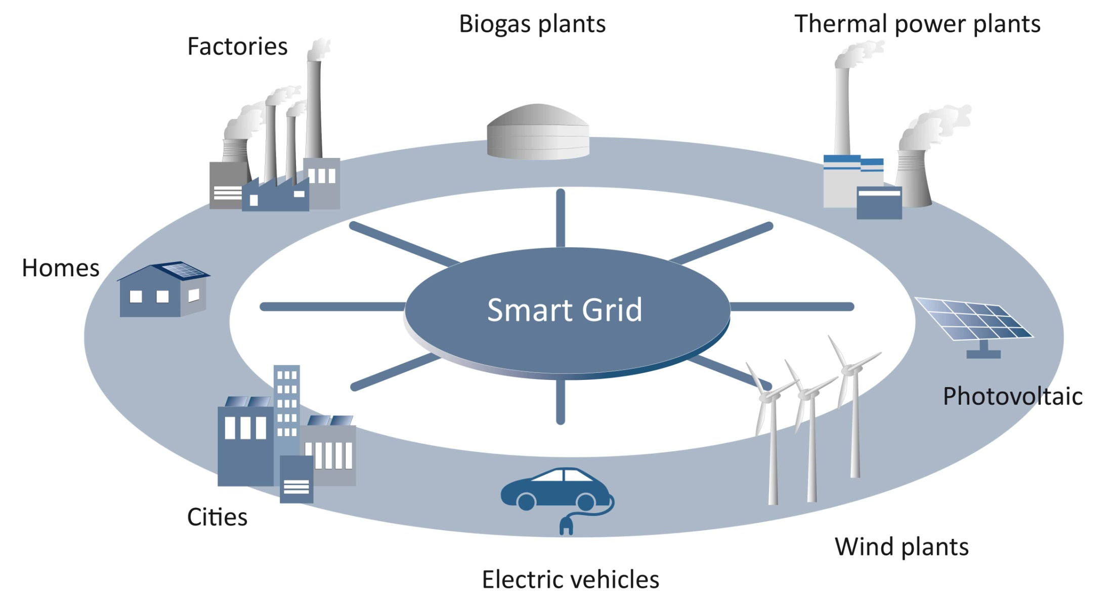
Smart Grid
Source: RENAC

Slide 15
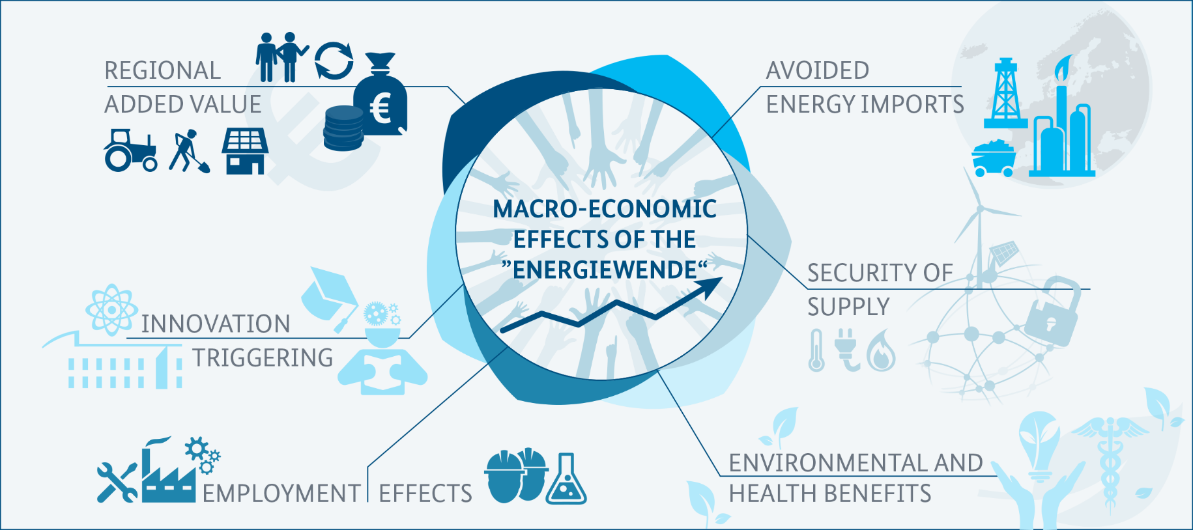
Benefits of the Energiewende
Source: BMWi 2014, ERGO Kommunikation
The energy transition has numerous positive effects on various levels.
Notes:
The Energiewende is a fundamental transformation of the energy system and re-alignment of energy policy. It is multidimensional and affects many areas.
Übernommen aus den ausgeblendeten Folien:
Import:
The Energiewende is supposed to make us more independent from fossil-fuel imports (coal, gas, oil and uranium).
As a country poor in resources, Germany has to import 97 percent of its oil and 89 percent of its gas.
Renewables replaced imports to a total value of €10 billion in 2012 and over €9.1 billion in 2013 and €8.8 billion in 2014 to 8.8 billion € in 2015.
Around €90-100 billion are spent annually for fossil fuel imports.
Jobs:
2017 Photovoltaic : 34,500
After a boom phase in 2010, 2011 and 2012, the PV sector sharply declined in 2013, 2014 and 2014 due to a reduction in the construction of new renewable plants as well as to the consolidation process in the Photovoltaic branch where many PC manufacturing jobs shifted to Asia and China.

Slide 16
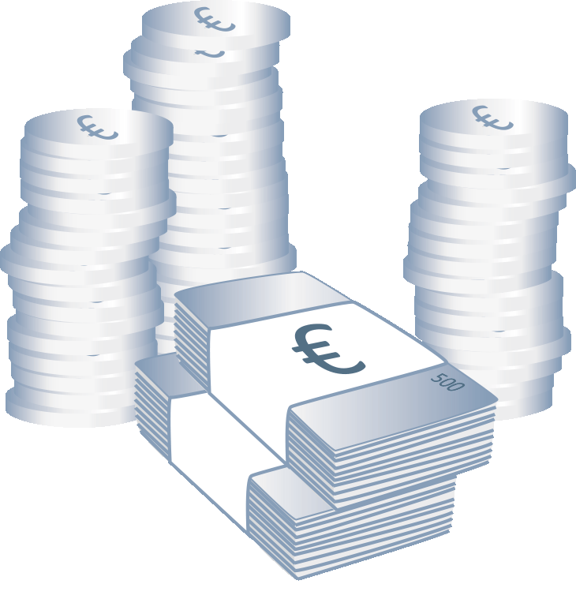
Benefits - reduce costs of energy imports
Renewable sources of energy saved € 8,8 billion in 2015.
Source: DLR/DIW/GWS 2016
Notes:
BASIC
The slide illustrates that Germany has to pay substantial amounts for the import of fossil energy and potential saving by increased renewable energy use.
The Energiewende is supposed to make us more independent from fossil-fuel imports (coal, gas, oil and uranium).
As a country poor in resources, Germany has to import 97 percent of its oil and 89 percent of its gas.
Renewables replaced imports to a total value of €10 billion in 2012 and over €9.1 billion in 2013 and €8.8 billion in 2014 to 8.8 billion € in 2015.
Around €90-100 billion are spent annually for fossil fuel imports.
Depending on the country of origin, energy imports may involve risks. These include quantity risks (loss of producers due to disaster or war) and price risks in form of an unexpected rise in prices.
Renewable energy sources can reduce this dependence on imports and thereby improve energy supply security.
Source
DLR/DIW/GWS 2016: Bruttobeschäftigung durch erneuerbare Energien in Deutschland und verringerte fossile Brennstoffimporte durch erneuerbare Energien und Energieeffizienz, Marlene O‘Sullivan (DLR), Dietmar Edler (DIW), Ulrike Lehr (GWS), September 2016, http://www.bmwi.de/BMWi/Redaktion/PDF/E/bruttobeschaeftigung-erneuerbare-energien-2016,property=pdf,bereich=bmwi2012,sprache=de,rwb=true.pdf, page 11, last accessed January 2017.
BMWi 2015: Datenübersicht zum Vierten Monitoring Bericht, September 2015, Anh 12: Rückgang fossiler Brennstoffimporte durch erneuerbare Energien und Energieeffizienz, http://www.bmwi.de/BMWi/Redaktion/Binaer/datenuebersicht-fortschrittsbericht-2014,property=blob,bereich=bmwi2012,sprache=de,rwb=true.xls, last accessed, January 2016.
BMWi 2014: Erneuerbare Energien in Zahlen- Nationale und internationale Entwicklung im Jahr 2013, http://www.bmwi.de/BMWi/Redaktion/PDF/E/erneuerbare-energien-in-zahlen,property=pdf,bereich=bmwi2012,sprache=de,rwb=true.pdf, page 23, last accessed June 2015.
BMWi 2014: Energiedaten: Gesamtausgabe, Bundesministerium für Wirtschaft und Energie (BMWi), http://bmwi.de/DE/Themen/Energie/Energiedaten-und-analysen/energiedaten.html, last update March 2015, last accessed June 2015.

Slide 17
Status of the energy transition –
Jobs in the German renewable energy sector 2017
Wind energy:
135,000
Total 2016: 338,600
Biomass: 69,800
Total 2017:
316,700 jobs
Biogas: 41,000
Photovoltaic: 34,500
Biofuels: 24,700
Geothermal: 22,000
Solar thermal + CSP: 8,200
Hydropower: 7,300
The renewable energy sector employed 316,700 people in 2017.
Source: DIW/ D LR 2019
.
Notes:
Notes
The slide illustrates the numbers of jobs in the renewable energy sector in Germany in 2017.
Bar sizes are not to scale, just illustrative!
2017: 316,700 in total
The wind sector has emerged as the largest sector in terms of employment.
Wind power : 135,000
onshore: 112,000 +
offshore: 23,000
Photovoltaic energy: 34,500
Solar thermal: 7,600
CSP: 600
Hydropower: 6,000
Deep Geothermal: 800
Near surface geothermal (heat pumps): 21,200
Biogas: 41,000
Biomass: 69,800 =
Small-scale biomass systems: 27,000 +
Biomass-fired heating plants: 18,100 +
Biofuels for transport: 24,700
2016: 347,800 in total
The wind sector has emerged as the largest sector in terms of employment.
Wind power : 160,200 =
Wind energy: 133,000 onshore +
Wind Energy: 27,200 offshore
Photovoltaic energy: 35,800 PV
Solar thermal and CSP: 9,400 (=8,800 solar thermal collectors + 600 CSP - only technology and component providers)
Hydropower: 7,300
Deep Geothermal: 800
Near surface geothermal (heat pumps): 19,500
Biogas: 41,100
Biomass: 64,500 =
Small-scale biomass systems: 25,900 +
Biomass-fired heating plants: 14,700 +
Biofuels for transport: 23,900
Publicly funded research and administration: this is no longer monitored. In 2016, 7,700 jobs were counted here.
Source
BMWi 2019: Datenübersicht zum zweiten Fortschrittsbericht “Energie der Zukunft”, https://www.bmwi.de/Redaktion/DE/Artikel/Energie/monitoring-prozess.html, Sheet 15.6 Beschäftigte EE, last accessed August 2019.
DIW /GWS 2019: Ökonomische Indikatoren der Energiebereitstellung: Methode, Abgrenzung und Ergebnisse für den Zeitraum 2000 – 2017, Marlene O’Sullivan, Dietmar Edler und Ulrike Lehr, https://www.diw.de/documents/publikationen/73/diw_01.c.617032.de/diwkompakt_2019-135.pdf, page 113.
DIW /GWS 2018: Ökonomische Indikatoren des Energiesystems Methode, Abgrenzung und Ergebnisse für den Zeitraum 2000 – 2016, Marlene O’Sullivan, Dietmar Edler, Ulrike Lehr, https://www.bmwi.de/Redaktion/DE/Publikationen/Studien/oekonomische-indikatoren-und-energiewirtschaftliche-gesamtrechnung.pdf?__blob=publicationFile&v=16 , page 99.
AGEE-Stat 2016: Zeitreihen zur Entwicklung der erneuerbaren Energien in Deutschland, 1990 -2015, Stand Februar 2016, Grafiken und Diagramme unter Verwendung aktueller Daten der Arbeitsgruppe Erneuerbare Energien-Statistik (AGEE-Stat), http://www.erneuerbare-energien.de/EE/Navigation/DE/Service/Erneuerbare_Energien_in_Zahlen/Zeitreihen/zeitreihen.html, last accessed July 2016.

Slide 18

Benefits of the energy transition – job creation
392
417
398
358
357
348
325
338
338
317
283
270
219
157
128
135
105
Source: BMWi 2019, DIW and GWS 2019
The renewables sector has positive employment effects in Germany.
.
Notes:
Notes
The slide shows the development of the renewable energy job sector from 2000 until 2017.
*Solar includes: Solar Photovoltaics (PV), solar thermal energy (heat) and solarthermal power plants (CSP technology providers)
** Geothermal includes: deep and near surface geothermal technologies and ambient heat (heat pumps)
***Biomass includes: liquid stationary biomass , biomass heating plants, small-scale biomass heating systems, biogas and biofuels.
At its peak in 2011, around 416,000 persons were working in the German renewable energy sector in Germany.
The majority of jobs over the past years were created and maintained in wind energy and biomass energy sectors.
After a boom phase in 2010, 2011 and 2012, the PV sector sharply declined in 2013, 2014 and 2014 due to a reduction in the construction of new renewable plants as well as to the consolidation process in the Photovoltaic branch where many PC manufacturing jobs shifted to Asia and China.
The calculations include both direct employments effects (e.g. people who build the wind farm) and indirect ones (e.g. catering for those that build the wind farm).
Scenarios assume that the renewables sector will create around 600,000 jobs by 2020 as well as by 2030 (gross figures, decrease of jobs in conventional power plants, other energy sectors and trade as well as consumer industries, services and investment goods industries not considered).
In 2017, a new study also featuring net employment effects was published. No new job figures have been released though.
Renewable Employment in 2017: 316,700
Wind power : 135,000
onshore: 112,000 +
offshore: 23,000
Photovoltaic energy: 34,500
Solar thermal: 7,600
CSP: 600
Hydropower: 6,000
Deep Geothermal: 800
Near surface geothermal (heat pumps): 21,200
Biogas: 41,000
Biomass: 69,800 =
Small-scale biomass systems: 27,000 +
Biomass-fired heating plants: 18,100 +
Biofuels for transport: 24,700
Sources
BMWi 2019: Datenübersicht zum zweiten Fortschrittsbericht “Energie der Zukunft”, https://www.bmwi.de/Redaktion/DE/Artikel/Energie/monitoring-prozess.html, Sheet 15.6 Beschäftigte EE, last accessed August 2019.
DLR / DIW / GWS 2019: Ökonomische Indikatoren der Energiebereitstellung: Methode, Abgrenzung und Ergebnisse für den Zeitraum 2000 – 2017, Marlene O’Sullivan, Dietmar Edler und Ulrike Lehr, https://www.diw.de/documents/publikationen/73/diw_01.c.617032.de/diwkompakt_2019-135.pdf, page 113.
DLR / DIW / GWS 2018: Ökonomische Indikatoren des Energiesystems – Methode, Abgrenzung und Ergebnisse für den Zeitraum 2000–2016. Marlene O’Sullivan, Dietmar Edler, Ulrike Lehr, eds, Forschungsvorhaben im Auftrag des Bundesministeriums für Wirtschaft und Energie (BMWi), GWS research report 2018/01, https://www.bmwi.de/Redaktion/DE/Publikationen/Studien/oekonomische-indikatoren-und-energiewirtschaftliche-gesamtrechnung.pdf?__blob=publicationFile&v=16, last accessed August 2018.

Slide 19
Planned next steps of the Energiewende
Climate Change Act (2019)
Coal phase-out by 2038 (decarbonization)
Energiewende in heat sector (buildings)
Energiewende in transport sector
Sector coupling (power, heat, transport)
Electric mobility and charging infrastructure
Grid integration of growing shares of renewables
Grid modernization / expansion
Cross-border interconnections
Seite 19

Slide 20
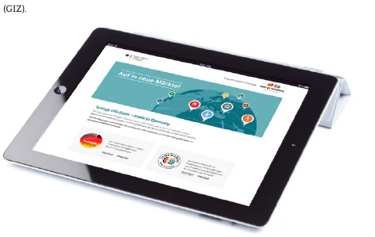
Contact
Coordination Office
German Energy Solutions Initiative
+49 (0)30 18 615- 6401/7386
office@german-energy-solutions.de
www.german-energy-solutions.de
Follow us: @export_EE
Facilitator
Renewables Academy AG
Sylvia Hartmann
+49 (0)30 5 870 870 10
sylvia.hartmann@renac.de
www.renac.de

