Slide 1
Utimaco Company Profile
Teo Poh Soon
Director, APJ
pohsoon.teo@utimaco.com
+65 96693747

Slide 2











Utimaco - Providing Security creates Trust
Utimaco is a worldwide leader in highly specialized Cyber Security markets
Deep expertise in providing security
for Critical Infrastructures
Our Global Market Leading
Position
220+ highly skilled experts
50+ years in IT and
35+ years in IT-Security
50+
35+
#1 in Telecom
Compliance Solutions
Headquarters
Aachen, Germany
Campbell (CA), USA
Worldwide offices and global partner landscape
#3 in Hardware Security Modules
1.000+ Utimaco
HSM protected infrastructures worldwide
300+ Telecom and ISP networks worldwide protected by Utimaco

Slide 3





































Utimaco Vision & Mission
Providing Security creates Trust
Vision
The leading global provider of critical data security,
identity and threat detection technologies
Mission
“Utimaco: Providing Security creates Trust”
Trusted to protect the most critical infrastructures and organizations against the most critical threats
Information Security
Telecom Compliance Solutions
GP HSM
Payment HSM
Key Management
(ESKM + Data Protection)
LI Mediation

Slide 4
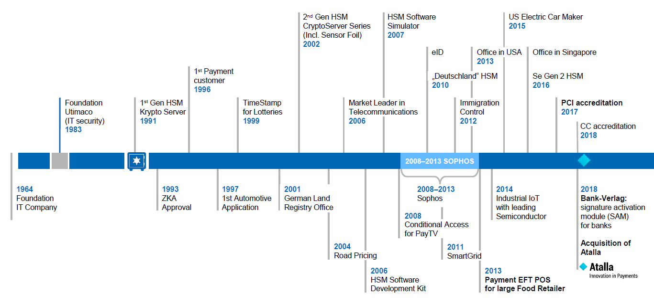
Utimaco: 25 years of experience in security

Slide 5
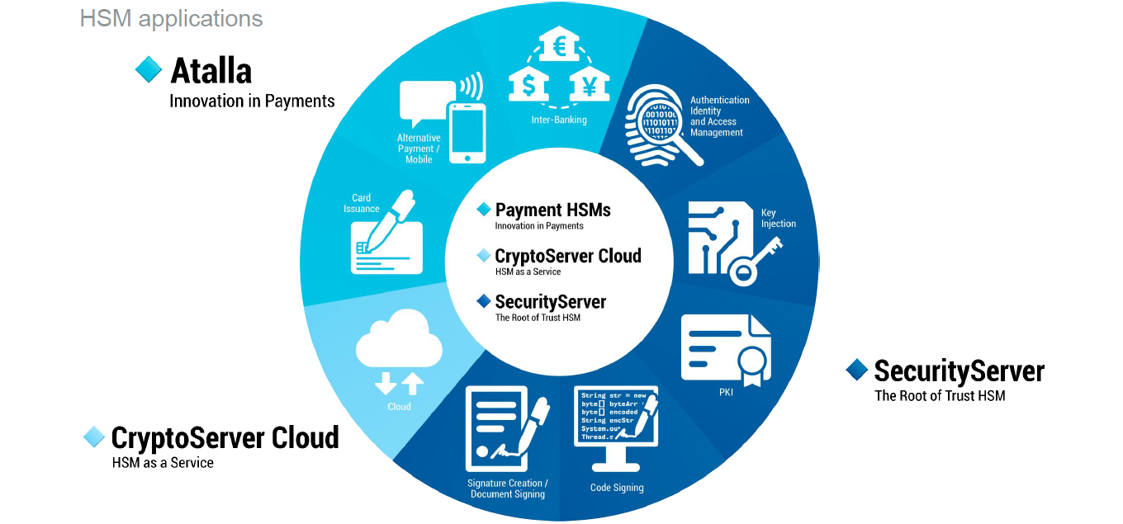
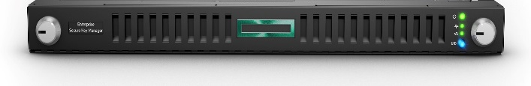
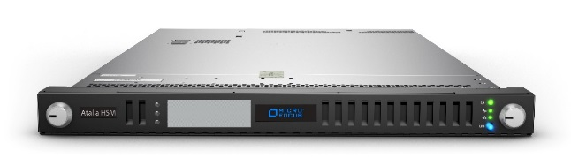
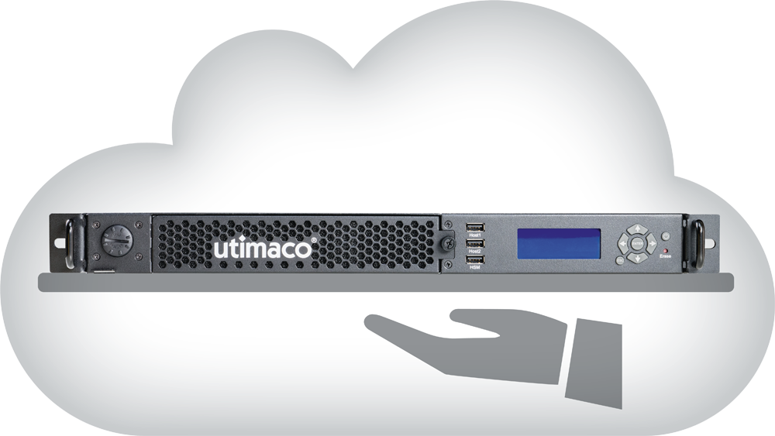
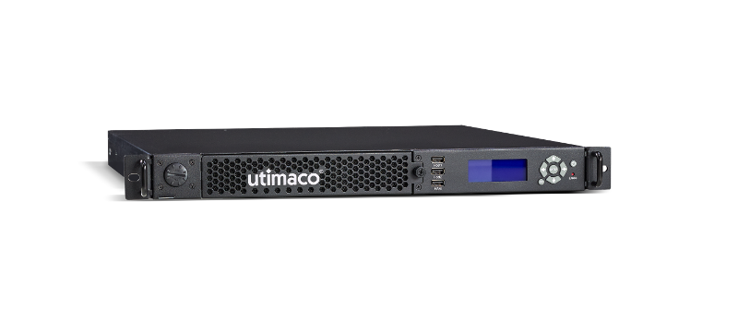
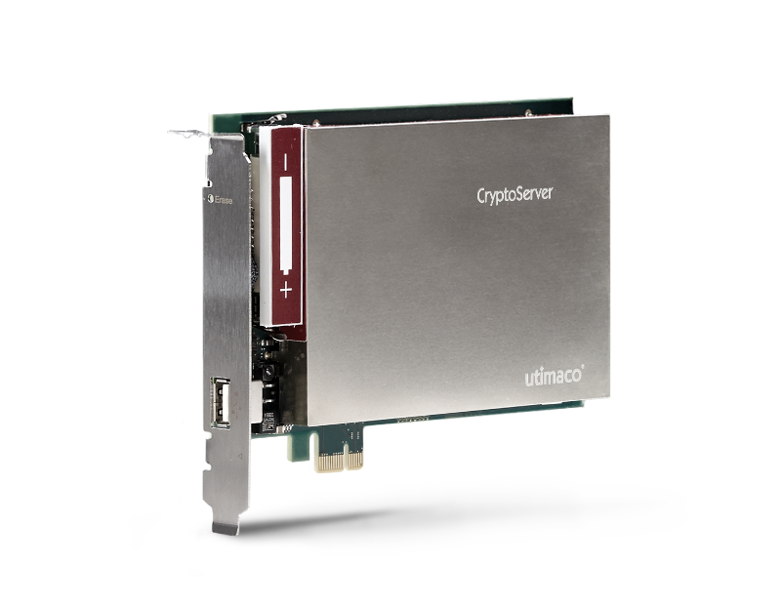
Utimaco HSM
Enterprise Secure Key Manager

Slide 6
Utimaco Product Protfolio

Slide 7
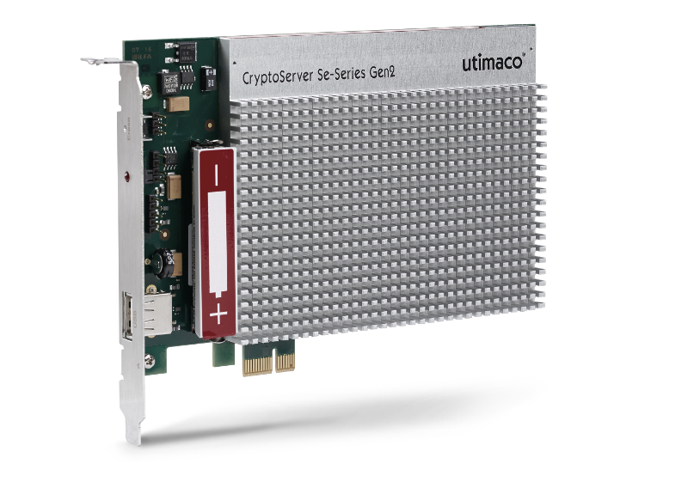
Product Portfolio
CryptoServer Hardware Security Modules
CryptoServer
Se-Series 12/52/500/1500
CryptoServer
CSe-Series 10/100
Physical
Interface
PCIe
plug-in card
Network
attached
Cloud Connection
PCIe
plug-in card
Network
attached
Cryptographic Support
(T)DES, AES, RSA, (EC)DSA, (EC)DH, SHA, …
Signing Performance
RSA 2048 Single Signing / sec
16 /75/560/750
RSA 2048 Single Signing / sec
560/750
RSA 2048 Single Signing / sec
17/90
Certifications
(* in progress)
FIPS 140-2 Level 3,
Common Criteria EAL4+, PCI-HSM*
FIPS 140-2
Level 3
FIPS 140-2 L3 w/ Phys. Security L4,
CC Evaluation w/ Attack Potential “High”,
“DK” Approval, PCI-HSM
Notes:
Our HSM portfolio is based on 2 hardware platforms: CryptoServer Se-Series, a FIPS 140-2 Level 3 validated platform; and CryptoServer CSe Series, being overall FIPS Level 3 validated, but offering a higher physical security that is FIPS Level 4 compliant.
Both platforms come with multiple performance grades, where the high-speed models of CryptoServer Se-Series incorporate a hardware crypto accelerator.
All models are available both as PCI Express plug-in card and as 19” network attached appliance. CryptoServer Se-Series HSMs can additionally be rented in the cloud, i.e. in a HSM as a Service business model.
They all share the same software architecture, functionality, cryptographic support, administration concepts etc. They all behave the same from an application and user perspective; and mixed installations of CryptoServer CSe-Series and Se-Series, as well as mixed installations of PCIe plug-in cards and CryptoServer LAN appliances, can be setup.
CryptoServer Se-Series and CSe-Series platforms are both FIPS 140-2 validated. CryptoServer CSe-Series has in addition received „DK“ approval (Deutsche Kreditwirtschaft, a pre-requisite for processing payment transactions in the German payment networks) and PCI HSM certification. CryptoServer Se-Series is Common Criteria EAL4+ evaluated and PCI HSM certified; details will follow in a few minutes.

Slide 8
Product Portfolio
Product Packages
CryptoServer
Se-Series 12/52/500/1500
CryptoServer
CSe-Series 10/100
SecurityServer
PKCS#11, JCE, MS CSP/CNG/SQL EKM, CXI
TimestampServer
RFC 3161,
CTS API
RFC 3161,
CTS API
PaymentServer
EFTPOS
CryptoServer SDK
Development Kit for CryptoServer Firmware Development
CryptoScript
SDK
Development Kit for Scripting HSM Extensions
Notes:
We offer several product packages with our HSMs:
SecurityServer provides standard cryptographic APIs like PKCS#11, JCE, Microsoft CSP/CNG, Microsoft SQL Server Extensible Key Management, and a proprietary called CXI. The rich feature set and algorithm support of our SecurityServer package makes our CryptoServer HSMs the best suited general purpose HSMs for integrations with PKI applications, database server, authentication server, etc.
TimestampServer is a dedicated product package for processing timestamp requests according RFC3161, and creating timestamp responses using signing keys stored inside the HSM.
PaymentServer is Utimaco‘s most recent product package, supporting financial transactions, electronic fonds transfer (EFT), personalization of payment cards and Point of Sales (POS) initialization. PaymentServer firmware has recently received PCI HSM approval by the Payment Card Industry (PCI) Council.
Customers with specific requirements that can not, or not easily, use these standard cryptographic APIs will enjoy the capabilities of our CryptoServer Software Development Kit (SDK). CryptoServer SDK enables you to develop firmware modules that run inside the secure boundary of our CryptoServer HSM, and that implement custom cryptographic algorithms, key derivation functions, or complete sequences of operations that would otherwise require multiple calls to the HSM and possibly let intermediate results leave the HSM.
Customers or integrators requesting some extensions of the HSM functionality should also consider Utimaco’s CryptoScript SDK. Basically, CryptoScripts are text files that are loaded into the HSM, then interpreted and executed inside the secure boundary of the HSM. Compared to the CryptoServer SDK, CryptoScripts are executed inside their own virtual machine, thus providing separation from the underlying CryptoServer firmware as well as separation between scripts of different tenants. Furthermore CryptoScripts do not “break” the FIPS mode when being executed inside the HSM (once CryptoScript has been FIPS validated).
All these packages mentioned previously can also be deployed in the cloud, taking advantage of our new CryptoServer Cloud offering.

Slide 9
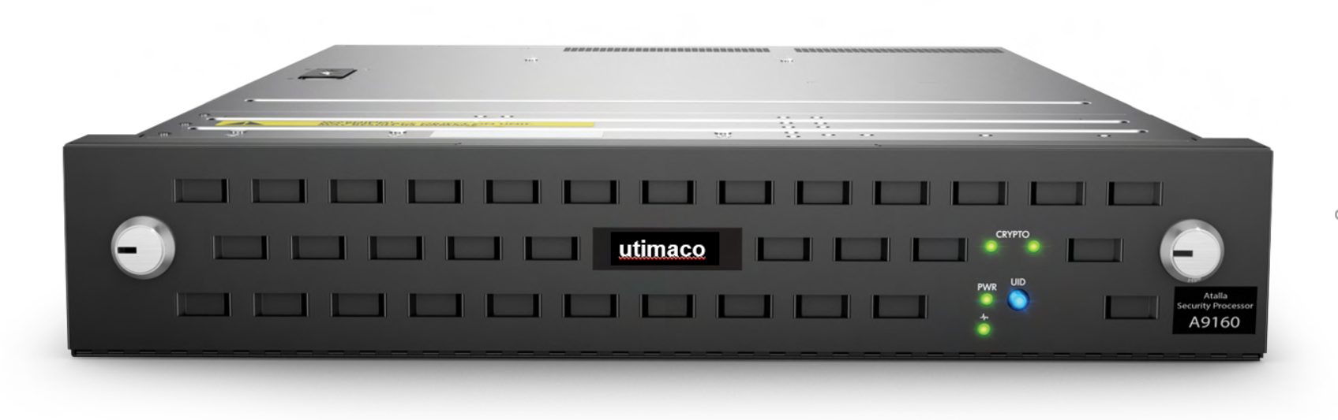
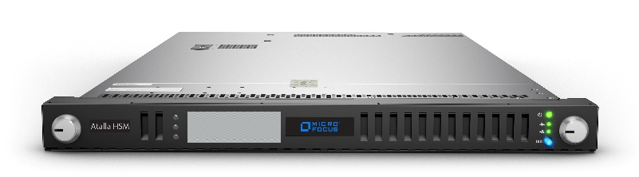
Atalla Payment Product Portfolio
Atalla Hardware Security Modules
Ax160-Series*
AT1000-Series
Physical
Interface
Network
attached
Network
attached
Cryptographic Support
(T)DES, AES, RSA, SHA, …
Certifications
FIPS 140-2 Level 3,
PCI-HSM V1
FIPS 140-2 Level 3,
PCI-HSM V3**
PIN Performance
80/100/1060
80/280/1060/10000
* EoS and EoSL announced
** in progress

Slide 10
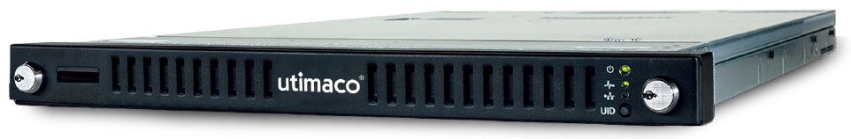
Utimaco Enterprise Secure Key Manager Overview
Converged key management for the Enterprise
  Reduce the risk and complexity of deploying encryption
  Protect and preserve access to business-critical encryption keys
  FIPS 140-2 level 2 validated
  1U Chassis
Notes:
Hardened device with Medeco locks to prevent unauthorized access to key vaults. 1U rack form factor.

Slide 11


SecurityServer
Free HSM simulator
Fully functional software simulator for Windows and Linux
  HSM administration, user authentication, key management, cryptography, etc.
Ideal for
  Product evaluation
  Dry-run before setup of production HSM
  Integration testing
  Training
Available for free from Utimaco website

Slide 12
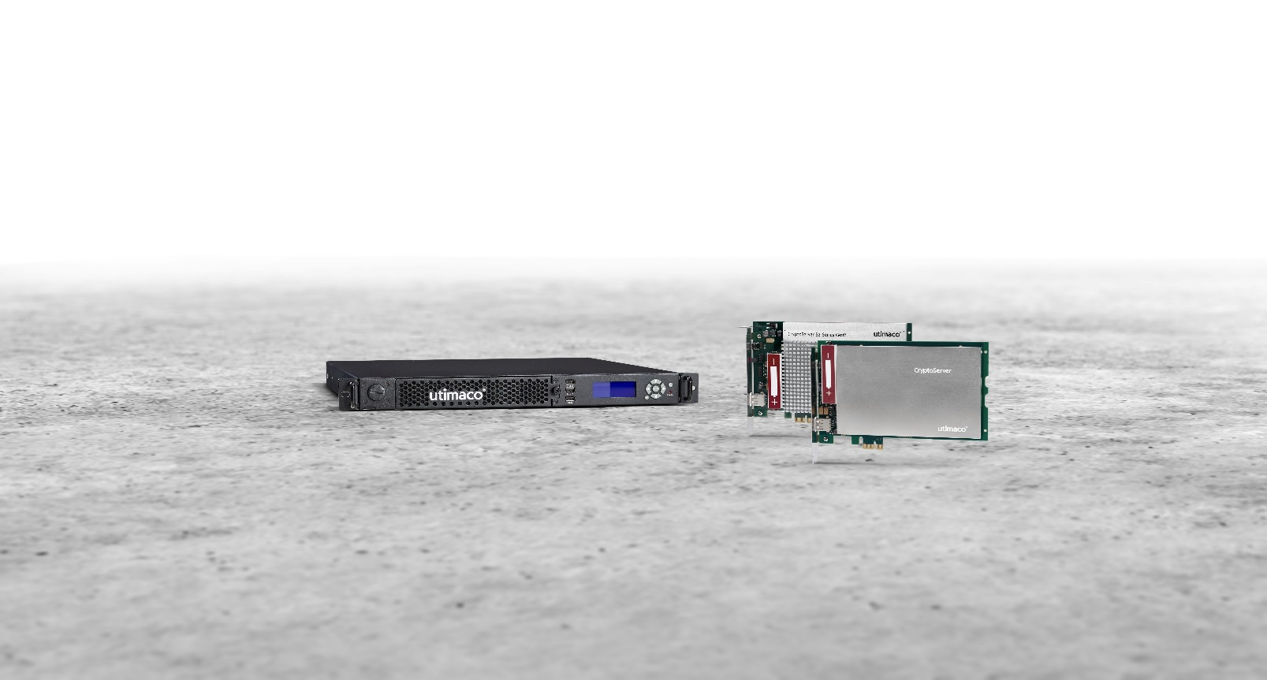
Thank you for your attention
Teo Poh Soon
Director, APAC
Pohsoon.teo@utimaco.com

