Slide 1
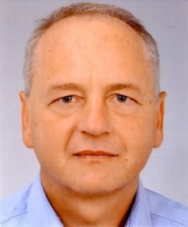

CLean Intelligent Building Technology
CLIBTec • Engineers Office for Energy
and Resource Efficiency
In a holistic analysis of customer requirements, we take into account all energy-related processes and develop customized energy- and resource-efficient solutions to support the achievement of climate targets and cost reductions.
AHK Business Trip Estonia-Lithuania / Online
Low-Energy Efficiency Buildings
Focus on Smart home Products
And Energy Savings Systems
11.10.2021 – 15.10.2021
Wolfram Mallow
Dipl.-Ing. (FH)
Singener Strasse 20
78267 Aach
Germany
www.clibtec.de
Energy- and Resource Efficiency
Building Automation
Analysing, Consulting, Planning & Audit
T +49 7774 3486 71
M +49 1523 1805 879
F +49 7774 3486 72
info@clibtec.de

Slide 2
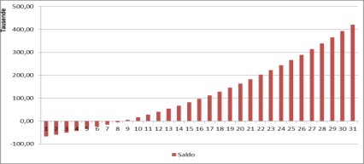
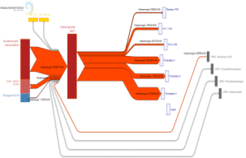
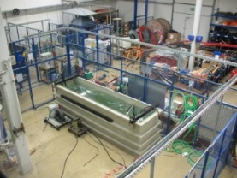
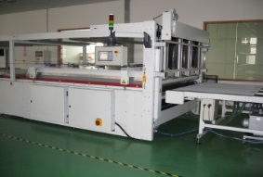
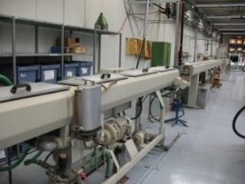
Company Competence and Services (Excerpt)
Efficiency Analysis
Buildings
Manufacturing
Material Flow Cost Accounting
Profitability analysis
Energy Data Acquisition
Energy Measurement / Measurement Concepts
Load Profile Analyzing
Expertise / Energy supply concepts
Energy Management System / Energy Audits
Energetic Inspection of Air Conditioning Systems
Analyzing Refrigeration Systems
Technical Controlling
Energetic building simulation
PV design and simulation
Heat pumps dimensioning and simulation
Trigeneration / ORC
Building Automation
Purpose and content of the energy optimization
Climate neutrality
Cost efficiency
Generation
Transport
Storage
Supply
Conversion
Recovery
Efficiency measure in production
Cross section technologies
Steam / heat / cold generation
Heat / cold grid
Electrical lighting
Renewable energies
IT / communication systems

Slide 3
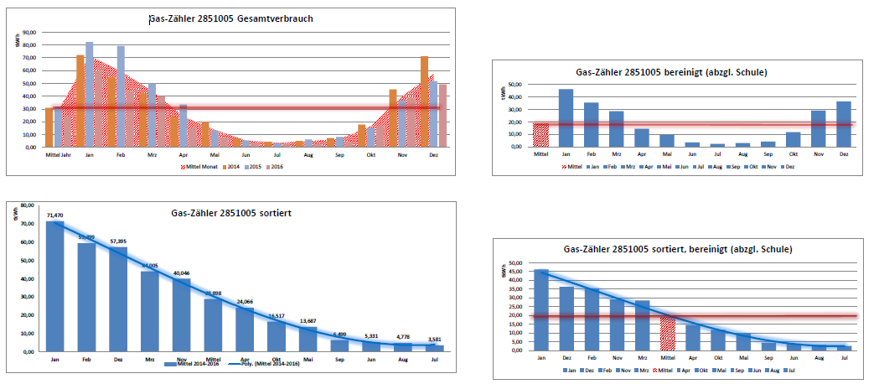
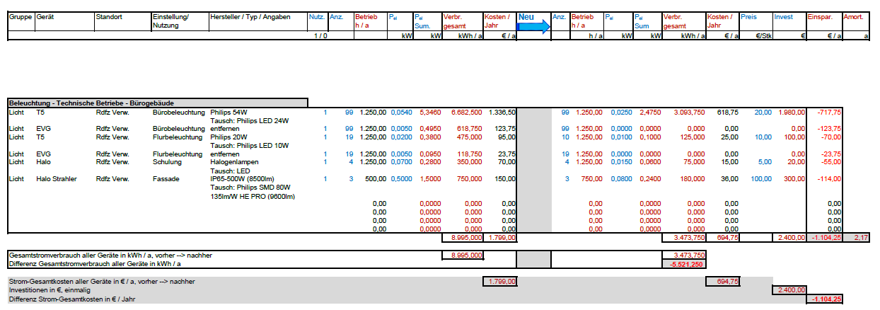
Energy Consumption Analyzing

Slide 4
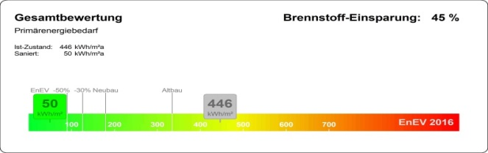

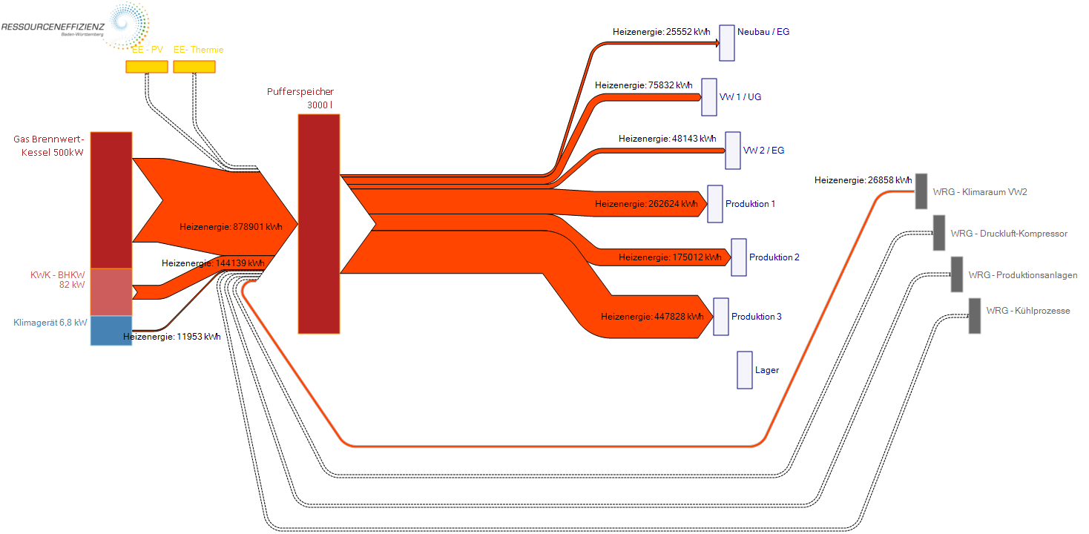
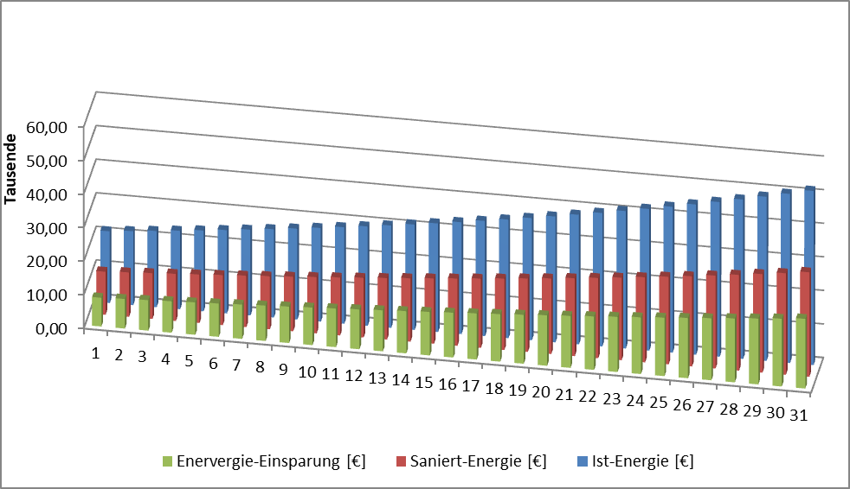
Energy Consumption Analyzing
Detailed analysis of total electricity savings per year | Electrical Costs in % | Power | Electrical Costs
 | % | kWh/a | €/a
Cooling Equipment | 24,82 | 2.737,14 | 574,80
Heat, Heat Pump | 30,71 | 3.387,20 | 711,31
IT | 31,44 | 3.467,50 | 728,18
Communication | 13,03 | 1.436,64 | 301,69
Total |  | 11.028,48 | 2.315,98

Slide 5
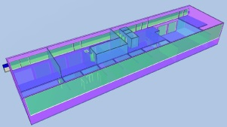
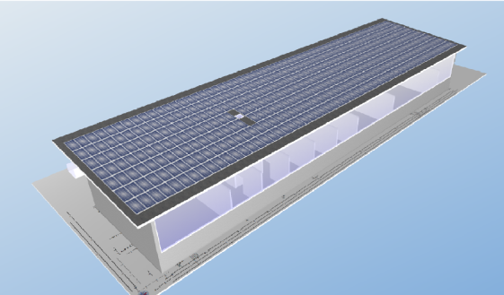
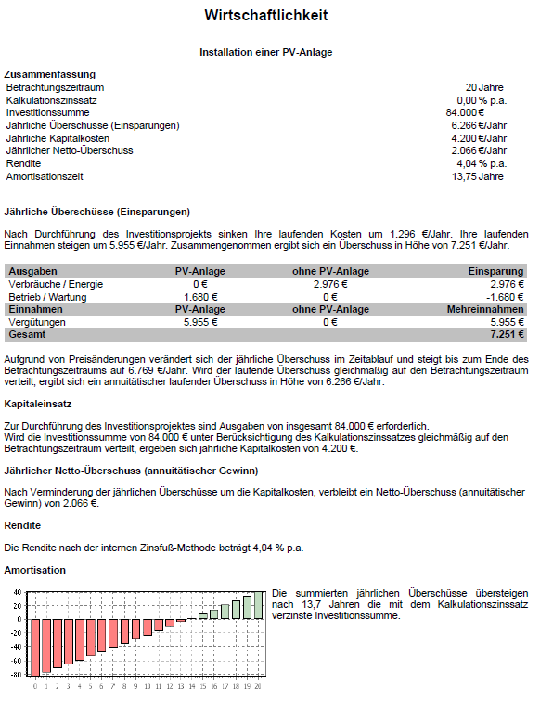
Profitability of Energy Saving Measures
Profitability analysis of efficiency investments

Slide 6
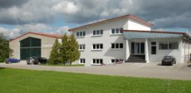
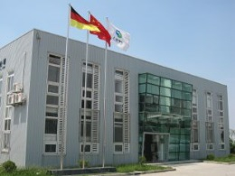
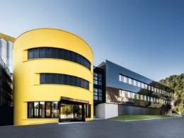
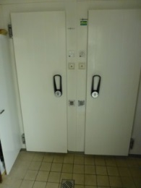
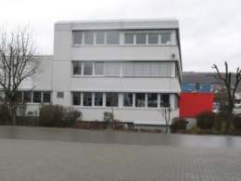
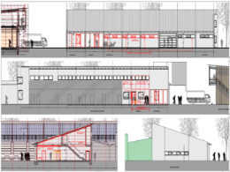
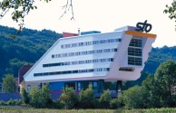
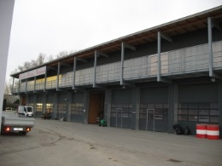
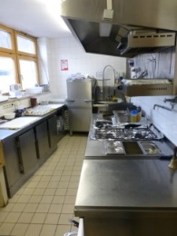
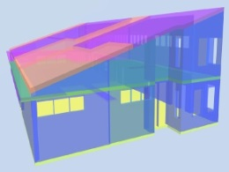
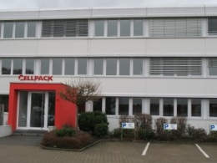
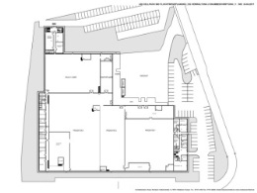
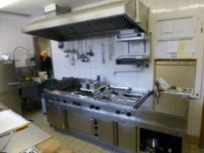
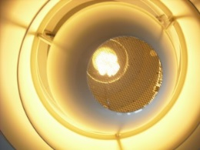
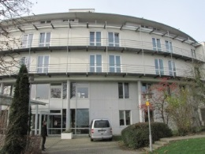
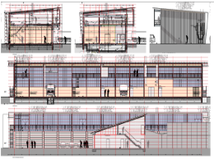
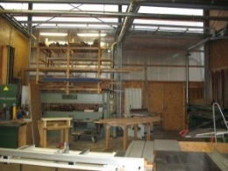
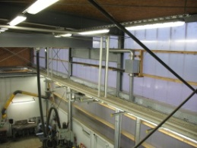
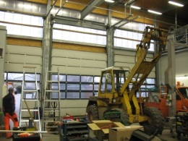
Office Buildings, Production Buildings, Craft Workshops and Hotels
Building envelope
Thermal insulation
Thermal windows
Summer thermal protection
Heating systems, CHP, trigeneration, heat pump
Air conditioning and ventilation systems
Renewable energies / PV / Thermal Solar
Lighting
Cold storage room, kitchenware
Multimedia applications
Building automation

Slide 7
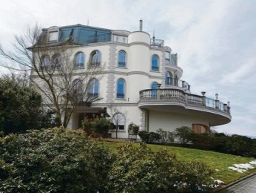
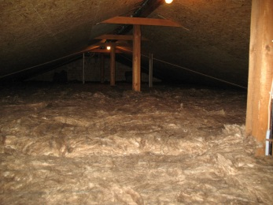

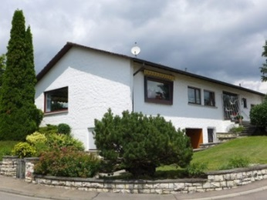
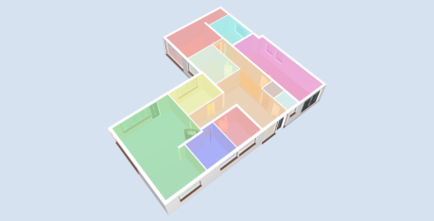
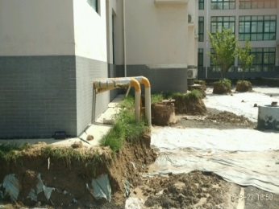
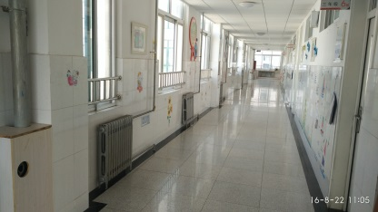
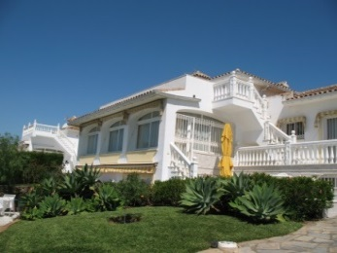
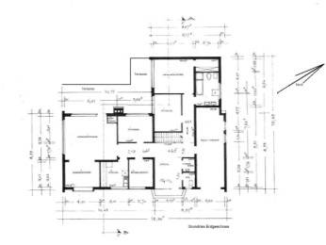
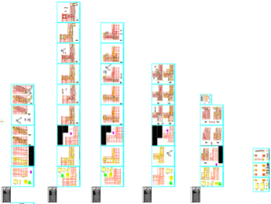
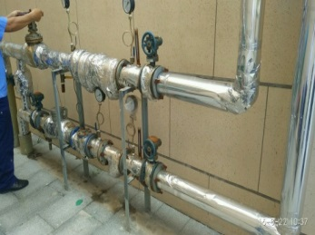
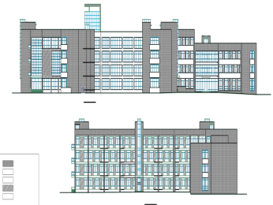
Residential Buildings and School Buildings
School building in Shandong province / China
Energetic building renovation
Insulation / Thermal insulation glazing
Air conditioning / ventilation system
Heating system
District heating / system insulation
Lighting
Building automation (KNX)
Thermal transmittance

Slide 8
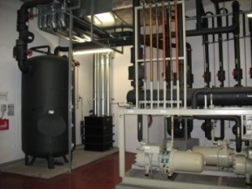
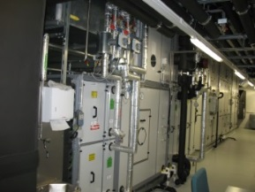
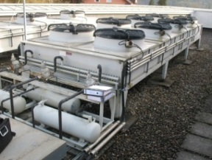

Energy Efficiency of Air Condition and Refrigeration Systems
Inefficient air condition / ventilation systems
25 % investment costs / 75 % operating costs
Obsolete equipment
Changed building structure
Lack of maintenanc
Heat and cold losses - no heat recovery
Lack of controls, incorrect settings
Inefficient drives, inefficient impellers
Airflow drag
Operating in complete recirculation mode
Conventional energy supply
Improving the energy efficiency
High-efficiency equipment - efficient components
Remodeling - change of use - partial load operation
Maintenance - defrosting - hydraulic balancing
Pipe insulation - sealing doors – user behavior
Controlled fans - set point settings
Axial fans instead of belt driven
Bionic blades - improve air passage
Free cooling options – building automation
Renewable energies - energy management
Mandatory Energetic Inspection of Air Condition Systems (EU Directive)
Room air conditioning / cooling systems - from 12 kW / 70 kW nominal cooling capacity
(DIN EN 15240 / DIN V 18599) - every 10 years - country specific
Directive 2010/31/EU of the European Parliament and of the Council of 19 May 2010 on the energy performance of buildings (recast): 02010L0031 – EN - 01.01.2021 - 003.001, Article 15
Inspection of air-conditioning systems
https://eur-lex.europa.eu/legal-content/EN/TXT/?uri=CELEX%3A02010L0031-20210101

Slide 9
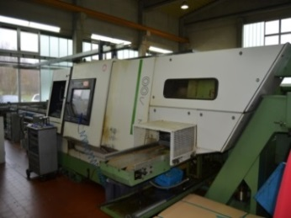

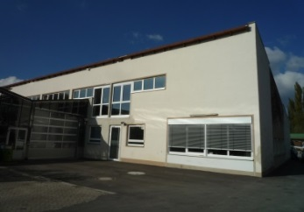
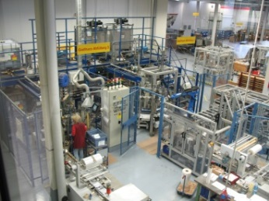




Energy Efficiency in Production Processes
Energy Efficiency Analysis / Energy Audit / Energy Management
Cross section technologies
  Electrical drives / frequency converter
  Measurement and control technology
  Energetic plant optimization
  Pumps
  Ventilators
  Compressed air systems
  Heat recovery
  Plant insulation
Steam / heat / cold generation and networks
Electrical lighting / building automation
Renewable energies
Energetic inspection - air conditioning system
IT / communication systems
Material flow cost accounting (MFCA)

Slide 10

Energy Efficiency in Production – Compressed Air Systems
  Compressed Air Efficiency potentials
  High-efficiency pumps
  Drying process
  Sealing the leakages
  Line optimization
  Pressure reduction
  Demand analysis
  Secondary networks
  Application duration
  Compressed air alternatives
  Heat recovery
  Hydraulic balancing

