Slide 1
SMART HEATING SOLUTIONS FOR ELECTRIFIED HEAT SUPPLY
D.En.S. Deutsche Energiesysteme GmbH
www.aelectra.de

Slide 2
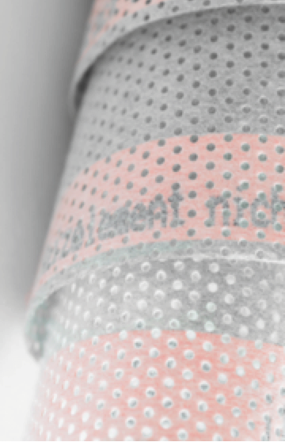
MISSION
Integration of the heating & renewable electricity sectors
Decarbonisation of heat generation
Technical added value for the energy transition
Economic benefits for the real estate market

Slide 3
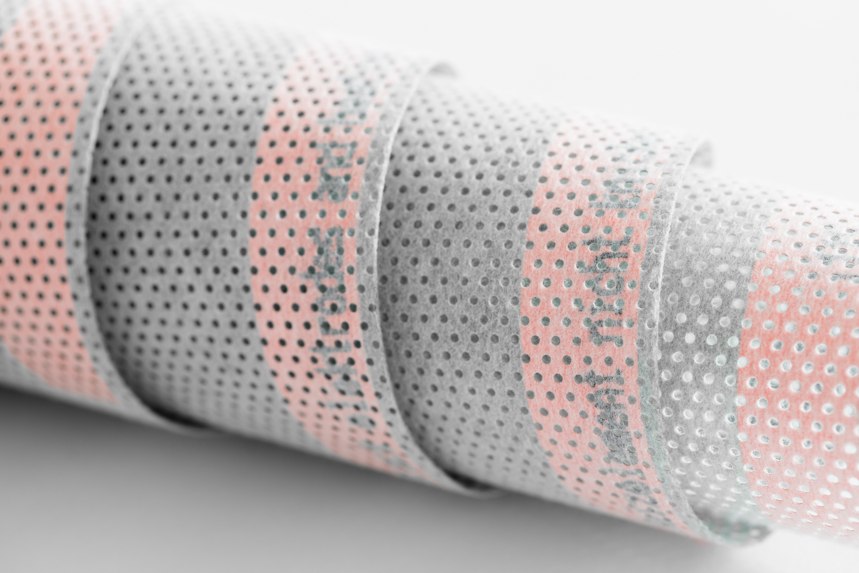

SYSTEM COMPONENTS
+
+
Open Interface
for control engineering
Carbon + PET Membrane
Power Supply 36 V
Problem-free integration of the ælectra system into a technical environment

Slide 4

ælectra AT A GLANCE
Carbon + PET = electrical resistance
Conversion of electrical energy into 100% heat
100% adaptable to the property through different performance variants
  Radiant heat for the best feel-good climate
Long service life + maintenance-free

Slide 5
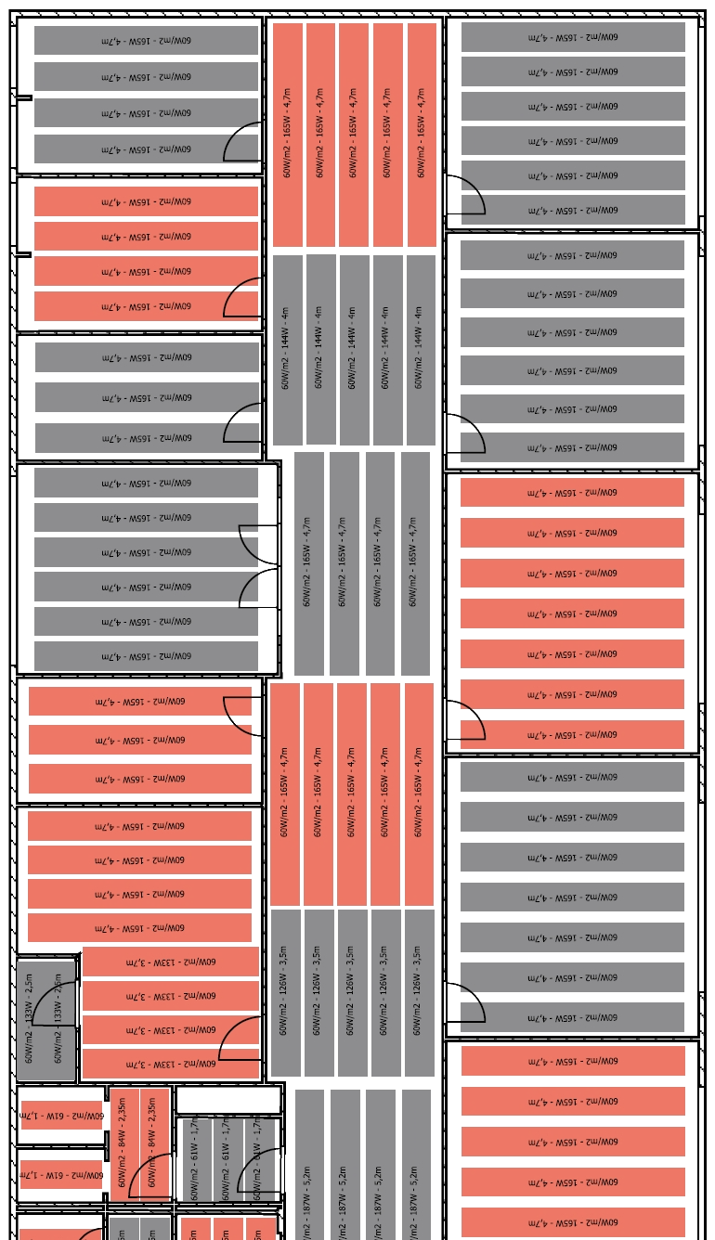
ADAPTABLE
Modular & precise control for heating-on-demand
Maximum accuracy of fit between heat demand and installed power
Thin and flexible structure for easy installation on walls, ceilings and under the floor
ælectra adapts to requirements - not the other way around

Slide 6

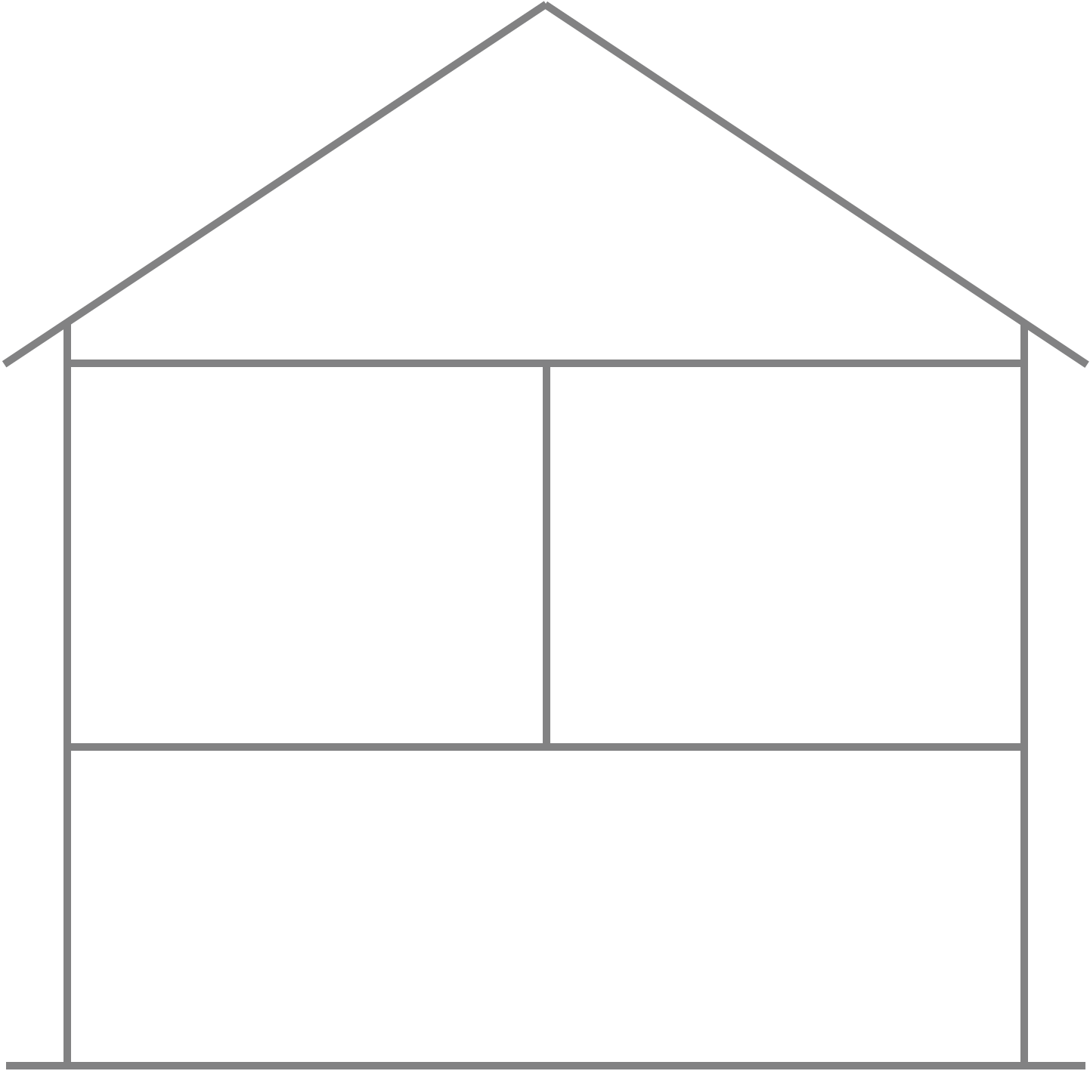
COMPATIBLE
Photovoltaic
100% compatible with all stakeholders in the energy transition
100% open to all future developments
100 % digital and Smart-Home-Ready
100% emission-free in operation with renewable energies
ælectra® Membrane
ælectra® Membrane
Electricity from
Renewables
Battery
Inverter
Smart Meter
Power Supply
ælectra is the technical answer to the challenge of sector coupling

Slide 7
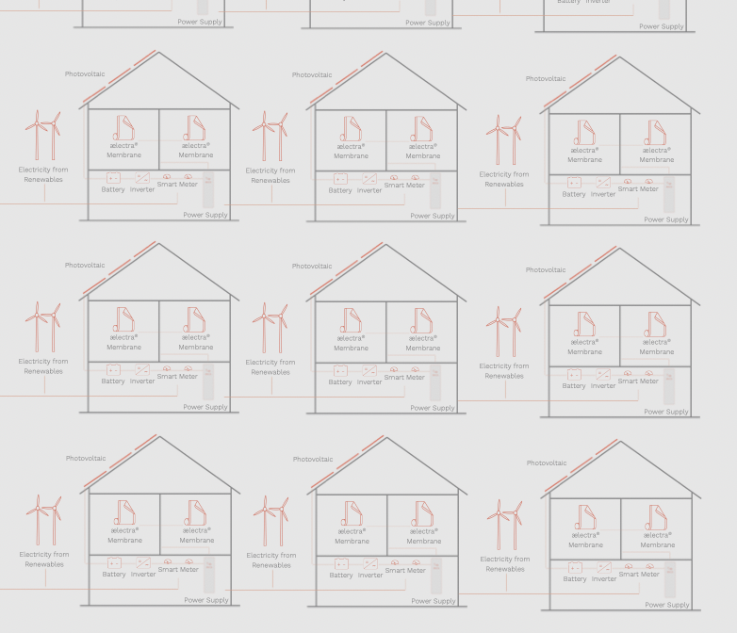
SCALABLE
Demand-Side-Management
Contribution to grid stabilization
New, CO2-free district heating
Smart Neighbourhood / Smart City
ælectra enables sustainable solutions for neighbourhoods and power grids

Slide 8
ENTITLED FOR FUNDING
Conformity with Directive 2010/31/EU on the energy performance of buildings
German efficiency standards (GEG) are achieved
Funding is possible by German development bank KfW
STANDARD BUILDING INSULATION | STANDARD BUILDING TECHNOLOGY | ALTERNATIVES HOT WATER SYSTEM | ACHIEVABLE EFFICIENCY STANDARD
KFW 55 | ælectra heating photovoltaic heat recovery | hot water heat pump | KFW 55
 |  | heating rod | GEG
 |  | continuous-flow water heater | GEG
KFW 40 | ælectra heating photovoltaic heat recovery | hot water heat pump | KFW 40
 |  | heating rod | KFW 55
 |  | continuous-flow water heater | KFW 55
KFW 40plus | ælectra heating photovoltaic heat recovery battery | hot water heat pump | KFW 40plus
 |  | heating rod | KFW 55
 |  | continuous-flow water heater | KFW 55
ælectra fits into EU/German efficiency standards and funding programmes

Slide 9
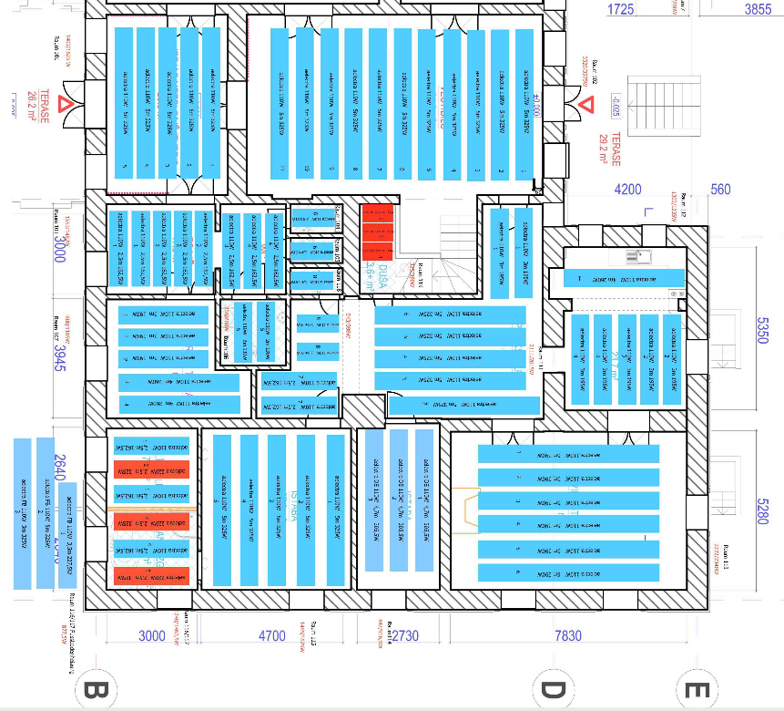
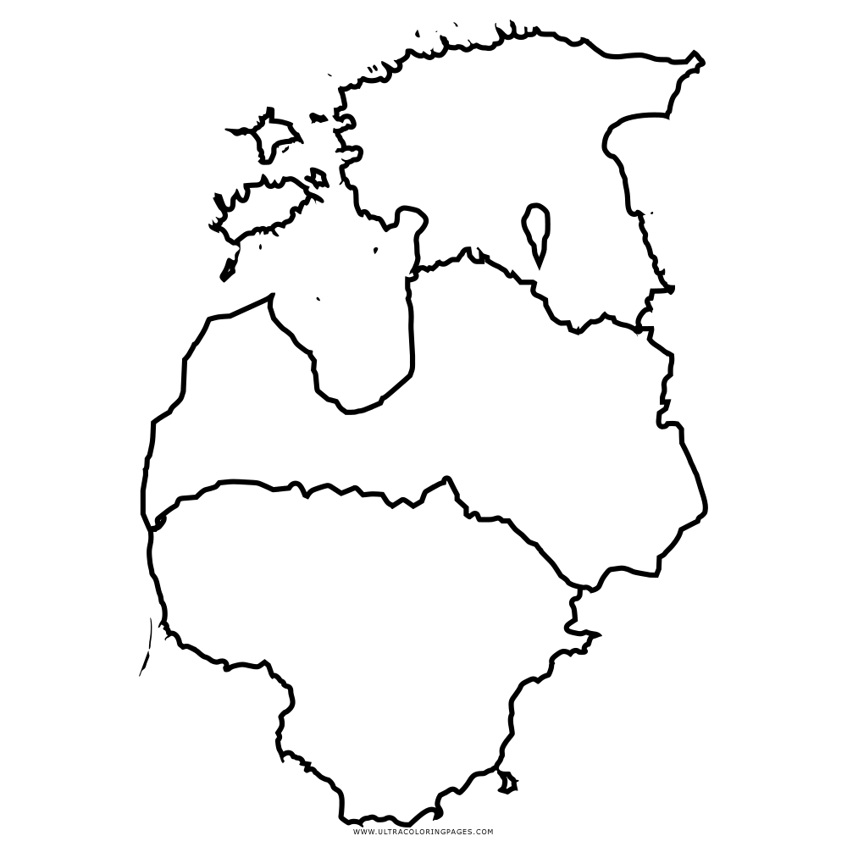
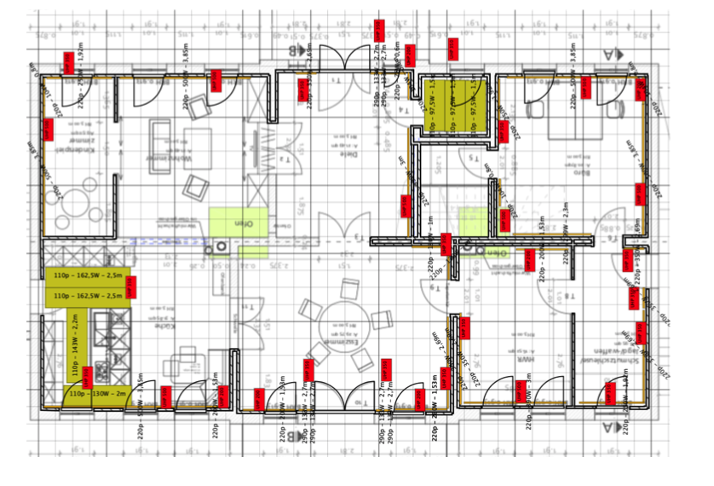
REFERENCES IN BALTIC REGION
Installation in existing building
B2C project
Ceiling heating
2018
Pūre, Tukums, Latvia
Installation in new building
B2C project
Floor/Wall heating
2021
Ventspils, Latvia

Slide 10
FUTURE IN BALTIC REGION
Replacement of oil and gas heating in existing buildings
CO2-free heating by usage of wind energy
Heating of new, low-energy buildings with low technical impact
Heating-on-demand in public buildings and for commercial use

Slide 11
CONTACT
D.En.S. Deutsche Energiesysteme GmbH
info@aelectra.de
www.aelectra.de
Matthias Zeller, Head of Sales
matthias.zeller@aelectra.de

