Slide 1
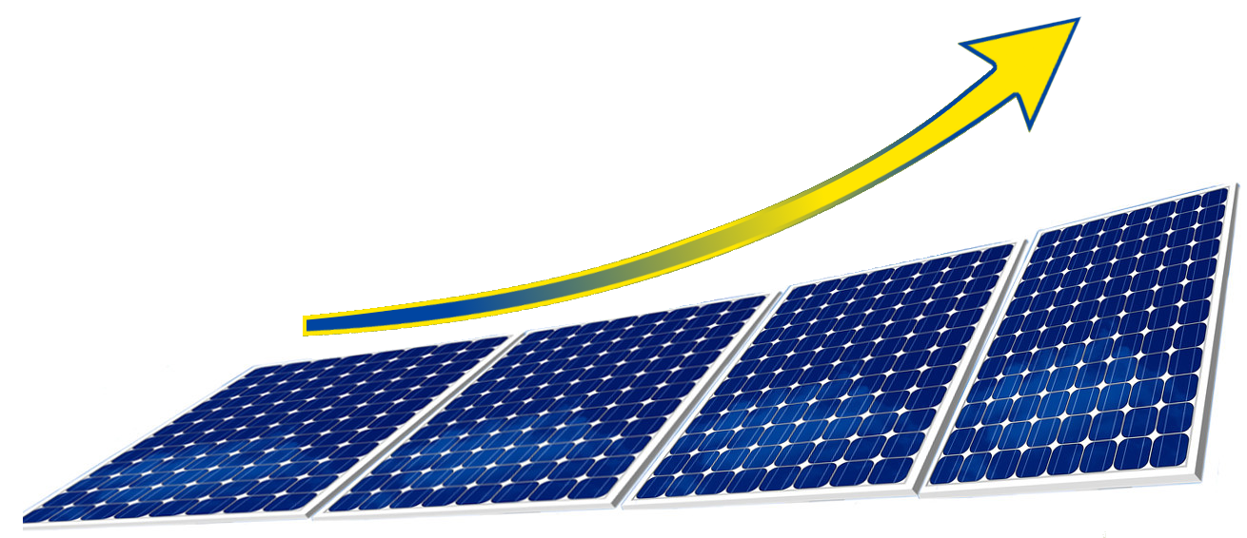
Got the best benefit from the sun
Hưởng ứng hiệu quả nhất từ ánh nắng mặt trời
Everywhere were energy is needed!
Ở mọi nơi khi người ta cần đến năng lượng!
Notes:
Begrüssung

Slide 2
Fact/ sự thực tế
Only two minutes of insulation is equivalent
to the hole annual usage of energy on earth!
Với chỉ 2 phút ánh nắng mặt trời toả xuống
trái đất đã đủ đáp ứng sự tiêu dùng về năng
lượng trong 1 năm!
Notes:
We all have to change our consumption of energy from fossile to solar energy and there is quite enough.

Slide 3
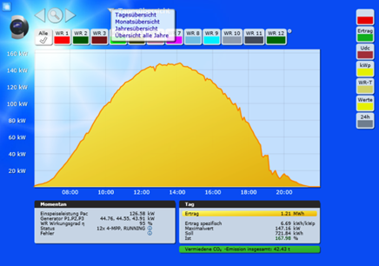
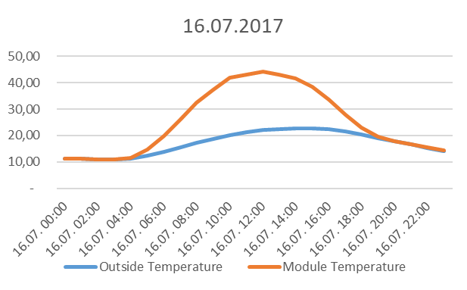
Our studies/Nghiên cứu của chúng tôi
solar power during
a day in summer
điện năng trong
một ngày mùa hè
heat – outside & module
nhiệt - ngoài trời & module
Notes:
Starting our development 7 years ago we made different studies. One of our studies was to meisure the temperature on the front and backside of photovoltaik modules. With higher outside temperature and increasing sun irradiation the production of power production decreases – with 1°C nearly 1% less power production. So we had the idea to use the heat from the photovoltaik-panel and cool down the panel using the heat for other things.

Slide 4
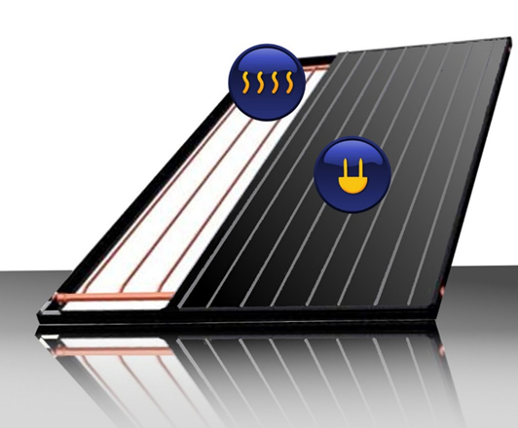
Solution/ giải pháp
2012 Experiments/ thí nghiệm
Photovoltaic panels and water-pipes in 1 module
mảng pin(PV) và đường nước gộp lại thành 1 module
Measurement/ đo lường
>25°C higher than the surrounding temperature
>25°C cao hơn so sánh với nhiệt độ ngoài trời
Notes:
At the end of our studies and developement we had a module with two components in one frame – the Photovoltaik-panel and a so called „thermal element“ on the backside.

Slide 5
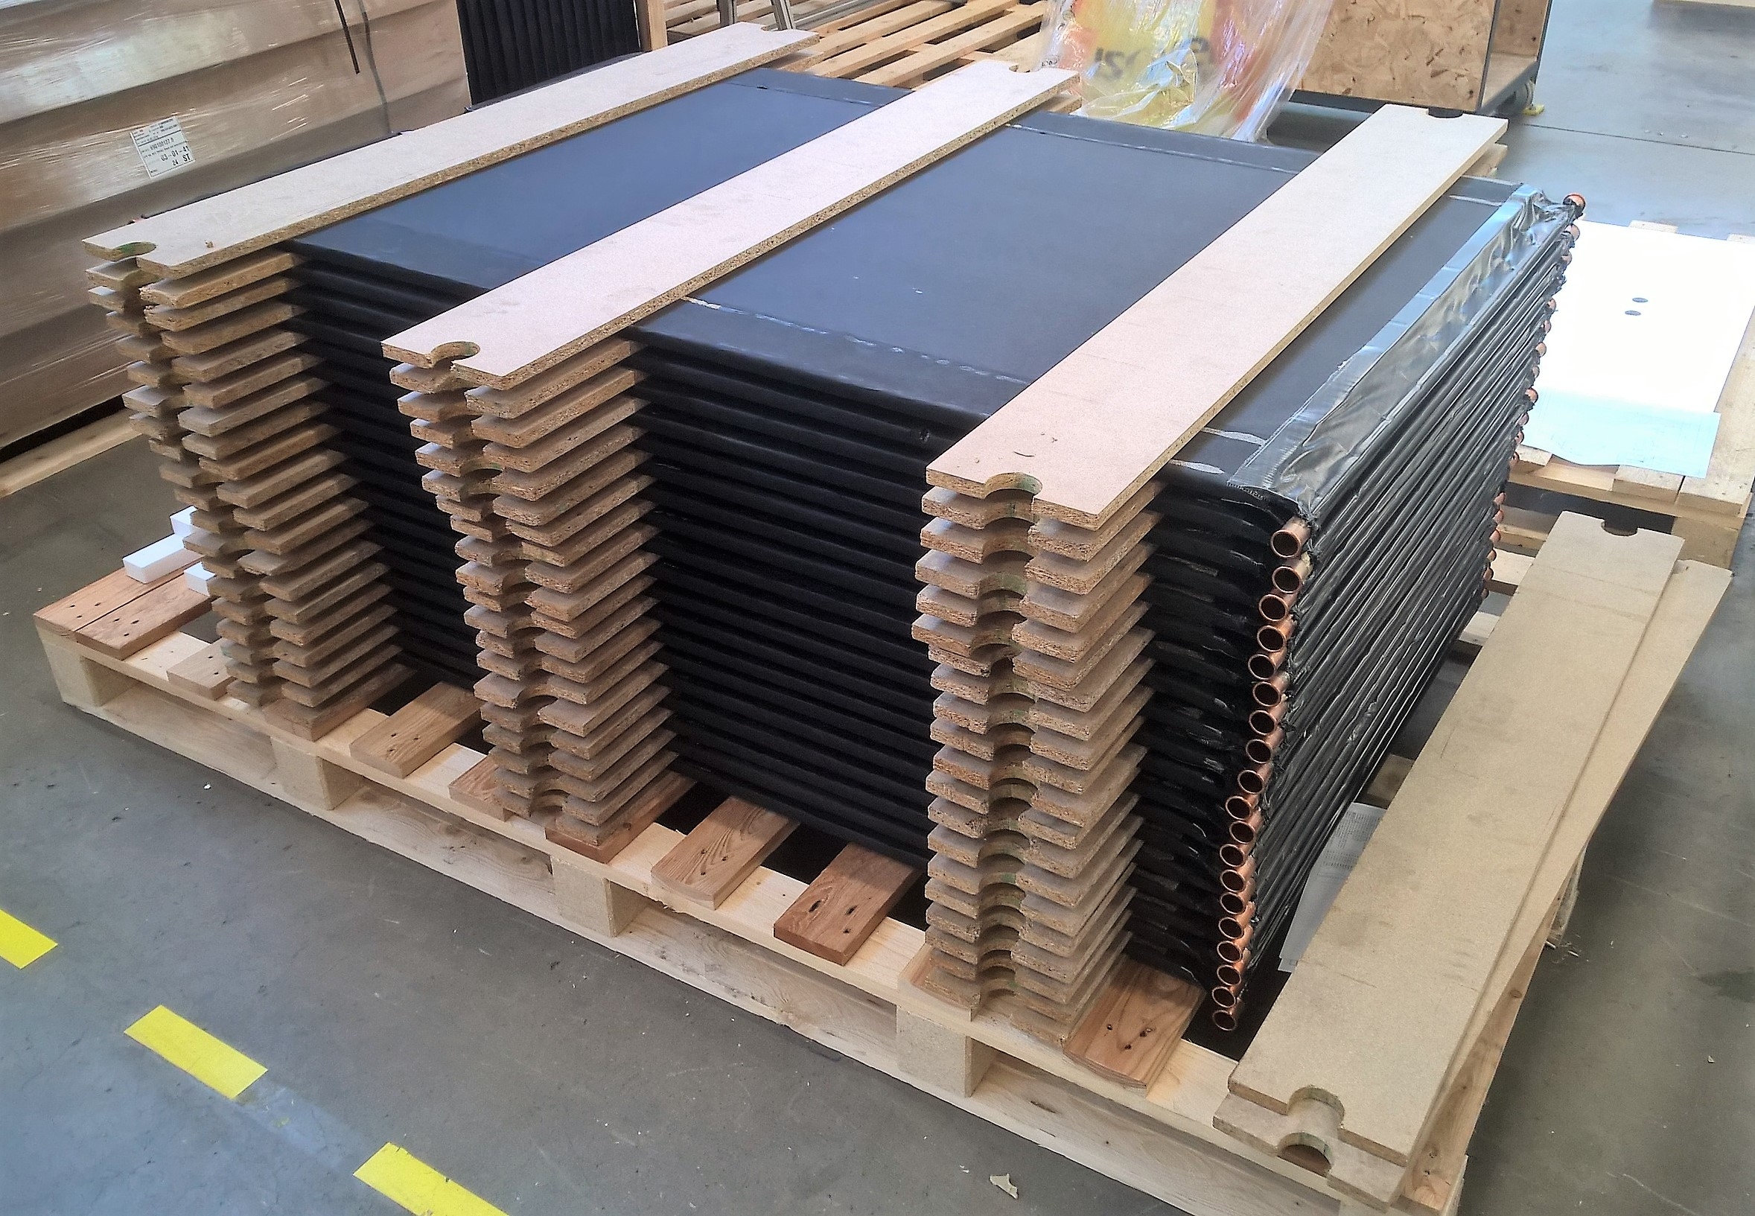
Solution/ giải pháp
Conclusion/ đáp án
Power and heat in one module!
điện và nhiệt có được từ một module!
USP(unique selling proposition)/ tính năng đặc biệt
energy autonomy, cost stability and no emission
tính tự lập về tiêu dùng năng lượng,
sự ổn định về giá tiền và không có khí thải
Notes:
At the end of our studies and developement we had a module with two components in one frame – the Photovoltaik-panel and a so called „thermal element“ on the backside.

Slide 6
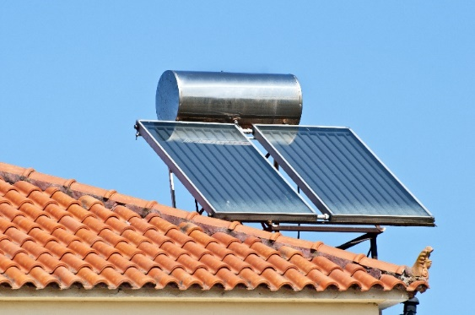
Nano
upgrade solar thermal plant
nâng cấp hệ thống làm nước nóng đã có
USP
power & heat replacing the thermal systems
điện & nhiệt thay thế hệ thống làm nước nóng cũ
Notes:
Our first solution was to make an offer to upgrade the normal solarthermal plants we have in Germany and Mediterranean area. Only in Germany have more than 2,5 mio. installations of these so called flat-collectors and more than 50 mio in the mediterranean.

Slide 7
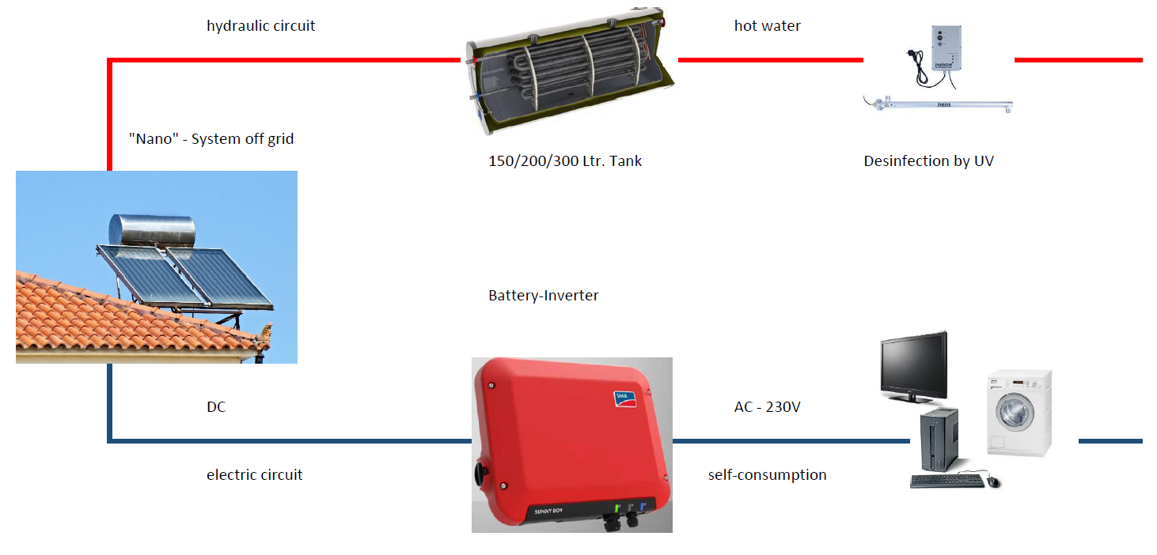
Nano – off-grid
“Nano off-grid“ for rural areas with UV-purifier
“Nano không hoà mạng lưới điện“ với UV- purifier
dành cho những nông thôn hoặc hòn đảo
USP
Power, heat and sterile water
điện, nhiệt và nước không nhiễm khuẩn
Notes:
In some areas in the mediterranean we had some small villages, which are not connected with the public power grid, e.g. small islands. Today in most cases the electric power ist produced by diesel gen-sets.
We want to offer a „renewable“ solution and developed an application with two up to six of our hybrid collectors with a battery inverter were radio, tv, cooking machines, light and others can by directly pluged in.
And in most of these areas we have a have a problem with clean and sterile water. So we integrated a purifier, which is operating with ultra-violet light in the system and with a small consumption of solar power, which is produced by the same system.
Last week we installed our first of these systems in Haiphong and you have a look on the purifier during our breaks.

Slide 8
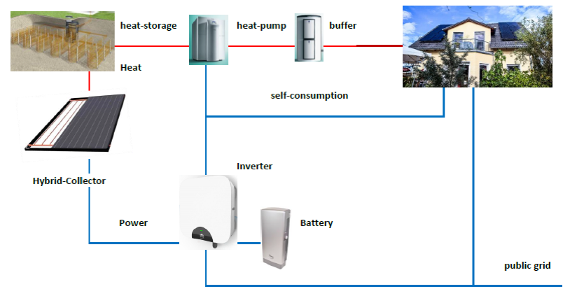
Notes:
Our next goal was to offer a solution for single homes to heat them, producing hot water and min. 80% of the annual electric consumption to our clients from the increasing energy costs, give them more stability in the cost-calculation of their housholds and give them more and more energy autonomy.
So we had to develope a heat-storage to store the heat from the hot periods of the year to charge a heat-pump in the cooler periods.
And after this - and our first demonstrtion-project we launch at the end of the year we level up this solution for the installation in apartment houses.

Slide 9
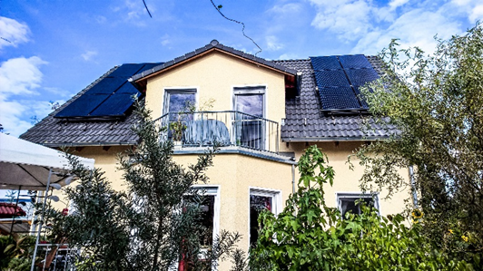
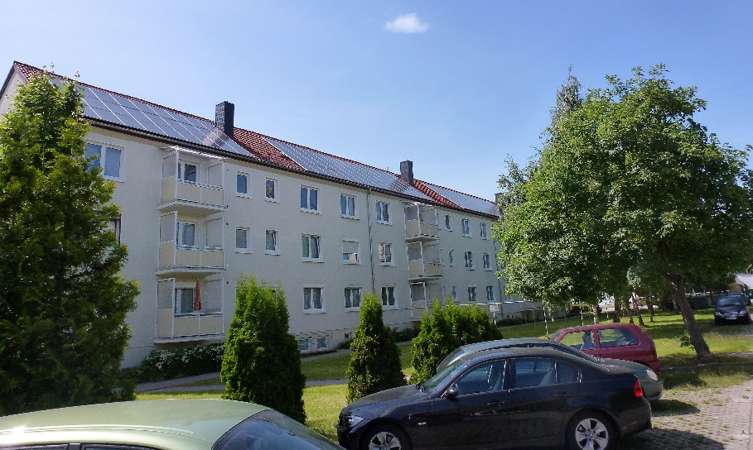
Home and Residential/ nhà ở
12 - 20 modules perhouse/apartment / 12 - 20 modules một nhà/ căn hộ
-heatpump / máy bơm nhiệt
-thermal storage / hệ thống lưu trữ nhiệt
USP
>80% energy autonomy/tính độc lập về năng lượng,
cost stability/sự ổn định về giá tiền
100% free of CO2! / 100% không có CO2!
Notes:
Here you can see the hybrid energy plant on the roof of a single house – which was our first installation in 2015.
An on the right you see a apartment house in eastern Germany with a pv-plant on the roof of 30 kWp and we can split these into 10 small hybrid plants of 3 kWp for each apartment and upgrade them with our hybrid collectors to heat the apartments.
And all this is 100% free of emission.

Slide 10
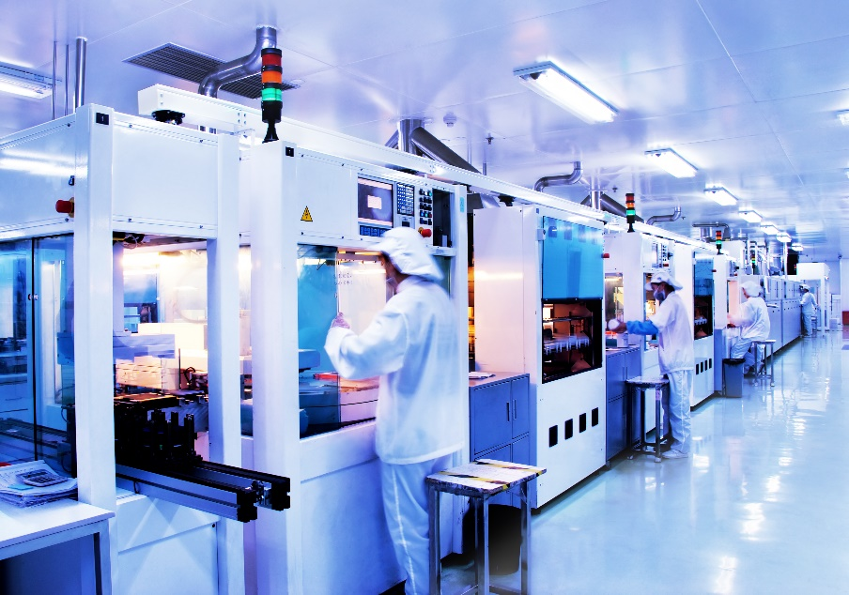
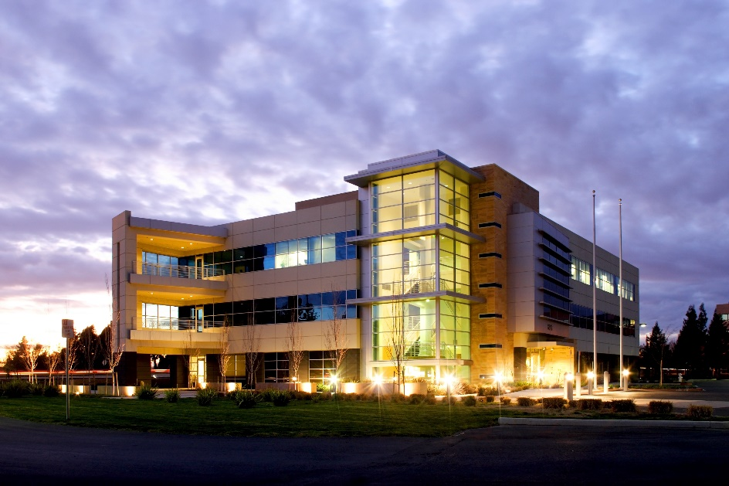
Industry and Tourism/ Công nghiệp và du lịch
power, heating and solar cooling / điện, nhiệt và làm mát bằng năng lượng mặt trời
USP
peak-shaving of electric consumption/giải quyết mật độ tiêu thụ điện
constant cost reduction/giảm chi phí lâu dài
significant environment protection/bảo vệ môi trường
Notes:
And actually we take part in a research-project with Fraunhofer Institute – the biggest research institute in the field of renewables, which is granted by the german ministry of energy to evluate the efficiency hybrid collectors in different applications – not only single homes.
Hybrid collectors can be integrated in solutions for the industry to produce power and heat for the production process, in hotels to produce hot water for the guests and for cooling the rooms and for example the lobby and reastaurants.
In the case of solar cooling we have a very significant effect of peak shaving and providing black-outs – when the cooling load reaches a peak, the production of solar energy is on top.

Slide 11
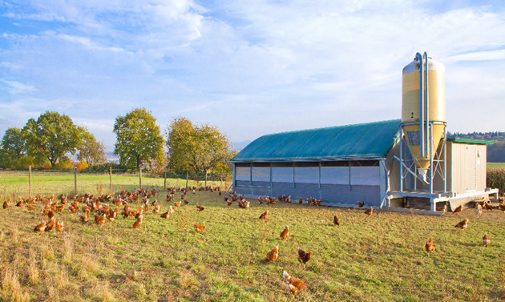
Farm/nông trại
problem/nang đề:
overheating- casualties of animals
quá nóng- thương vong của động vật
USP:
sustainable profit by providing losses
lợi nhuận bền vững vì tránh được sự thương vong
cost reduction/giảm chi phí
Notes:
On one of my trips to asea I had a deep impressive moment, when I visited a poultry-farm: a worker carried dead poultries out of the stable caused by overheating. And this is done every day – nearly 10% of the animals died by overheating during their growing period.
Now we are planing a demonstration-project here in asia to provide such losses and reach a higher level of sustainable profit for the farmers.

Slide 12
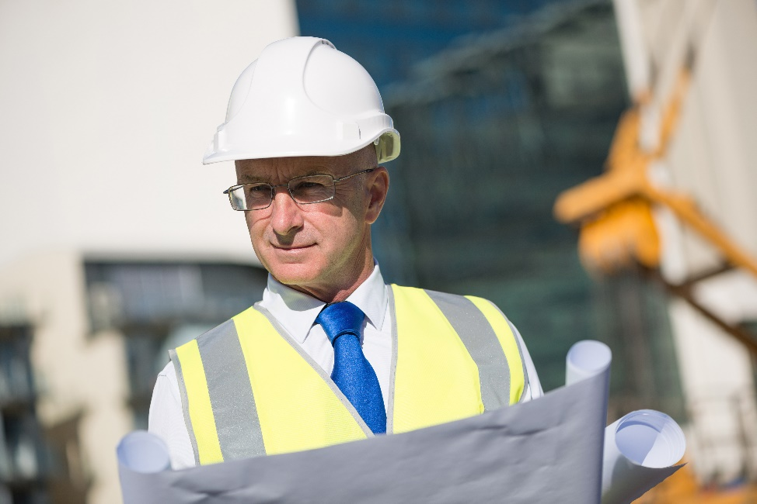
We are here in Vietnam/ chúng tôi đã có mặt tại Viêt Nam
A joint-venture in Vietnam/ Một công ty liên doanh tại Việt Nam
to step into the asian market/bước vào thị trường châu Á
to produce our hybrid-collectors in Vietnam
sản xuất “hybrid- collectors“ của chúng tôi tại Vietnam
Notes:
In the last years we looked for asian partners to step into this market. In my home-town Berlin lives many vietnamese people and with the help of my sister, who has vietnamese clients in Berlin we got contact to new partners.
Now Mr. Froehlich and his family are partners in our german company is sales director for Asia and also managing director here in Haiphong.

Slide 13
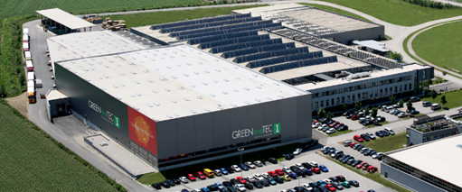
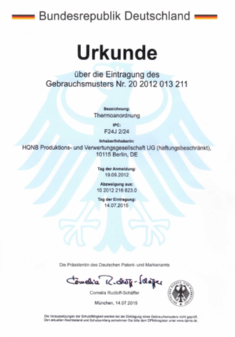
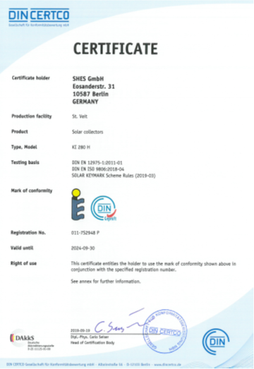
Contact & Joint-Venture in Vietnam
Our plan - a production company in Vietnam
Kế hoạch của chúng tôi - một công ty sản xuất tại Việt Nam
Many thanks for your attention !
For further information: info@shessolar.de
Công ty cổ phần SHES Việt Nam
CEO Mr. Phạm Thành Vân
Số 59 Cụm 1 Đông Khê
Quận Ngô Quyền
Hải Phòng /Viet Nam
Tel: +84 936833269

