Slide 1
energy solutions – made in Germany
Janine Fleischhacker
Consultant for the German Energy Solutions Initiative on behalf of the Federal Ministry for Economic Affairs and Energy
eclareon GmbH
2021 Berlin, Germany

Slide 2
The German Energy Solutions Initiative
Coordinated and financed by the German Federal Ministry for Economic Affairs and Energy
Facilitates business partnerships in the field of renewables, energy efficiency technologies, smart grids and storage technologies
Based on a parliament decision 2002 with the aims
- to support SMEs
- to distribute smart and sustainable energy solutions
- to contribute to international climate protection

Slide 3
We offer
Information about German energy solutions
Networking and business opportunities
Know-how exchange
Showcases of flagship projects around the world

Slide 4
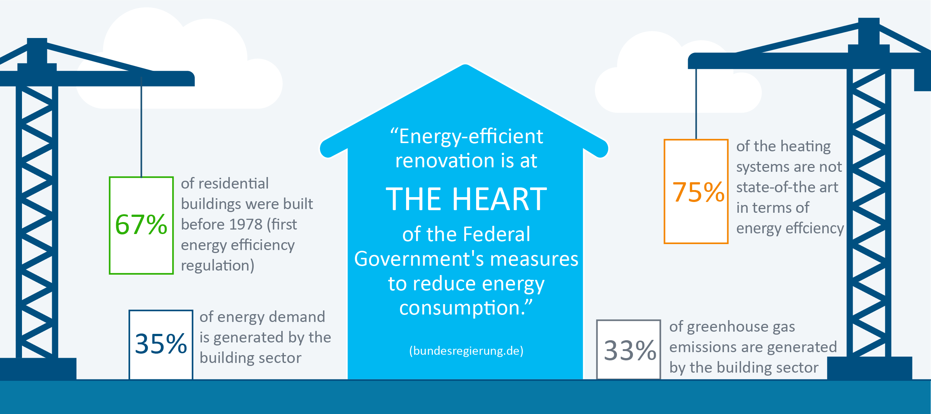
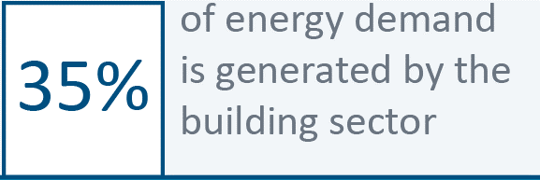
Energy-efficient renovation of buildings holds great potential
70%
68%
1977
of final energy consumption is generated by the building sector
~31%
*
* includes direct and indirect emissions
Source: Edelman.ergo, Navigant 2019

Slide 5
Participating German Companies
Alfred Pracht Lichttechnik GmbH
EcoSyst GmbH
Fech Fenstertechnik GmbH & Co. KG
Janitza electronics GmbH
LED Light Germany GmbH
mfh systems GmbH
Steinel Vertrieb GmbH
synavision GmbH

Slide 6
Contact us
Coordination Office of the German Energy Solutions Initiative
office@german-energy-solutions.de
www.german-energy-solutions.de/en
twitter: @export_EE
eclareon GmbH
Janine Fleischhacker
jf@eclareon.com
www.eclareon.com

