Slide 1
Company
Martin Feller
Product Management E-NERGY Solutions

Slide 2
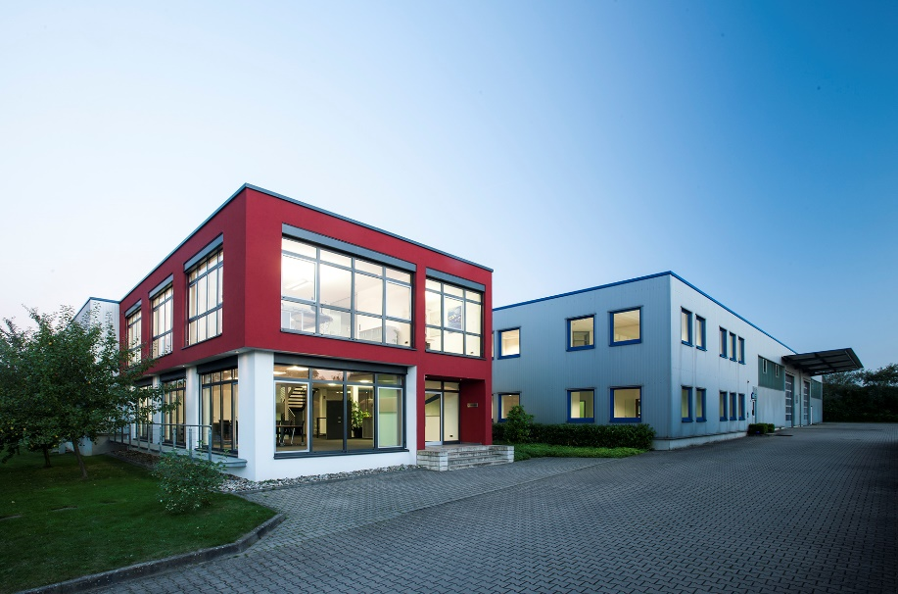
25 years of experience – History mfh systems GmbH
1995 JUPITER heating systems GmbH
System provider for sanitary connections and surface heating
Technological market leader in the field of dry underfloor heating systems
2-stage direct sales to craft enterprises
2007 Acquisition by Danfoss
European sales
„Heating Solution“comprising heat pump, panel heating, ventilation and control
3-stage wholesale distribution
2012 Foundation of mfh systems GmbH
Management buyout
Product range: dry wall panel heating systems, electric panel heating systems and decentralised domestic ventilation
OEM and Distributors Sales

Slide 3
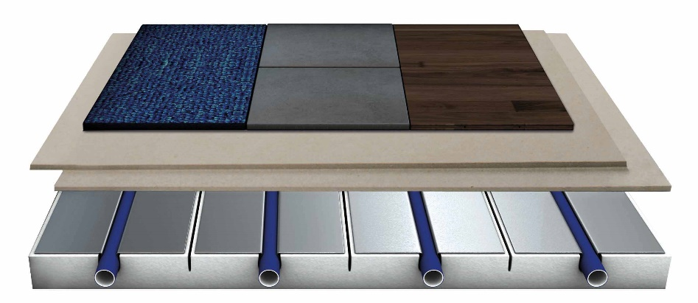
mfh systems GmbH – system overview
IDEAL Comfortable warmth and comfort at the touch of a button Fast reacting drywall surface heating / cooling
Floor
Wall
Ceiling

Slide 4
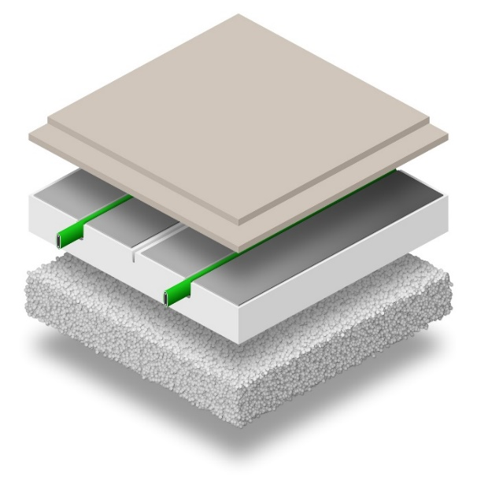
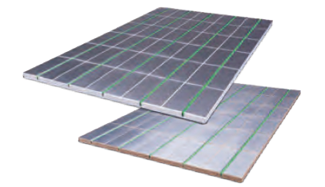
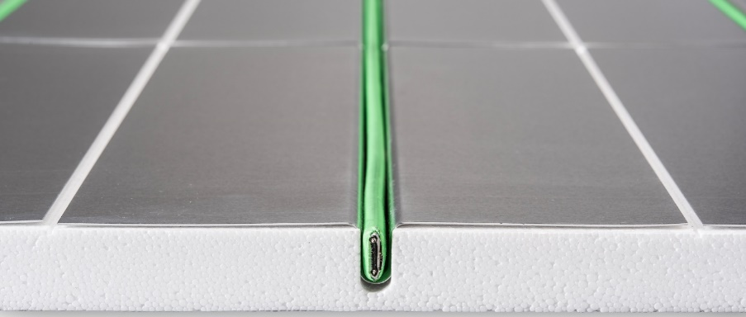
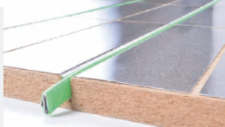
mfh systems GmbH – system overview
E-NERGY IQ Self-regulating floor heating system
for new building and renovation

Slide 5
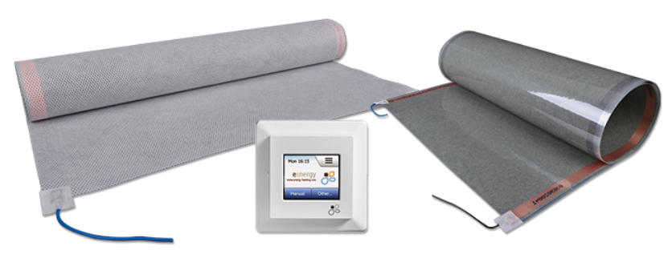
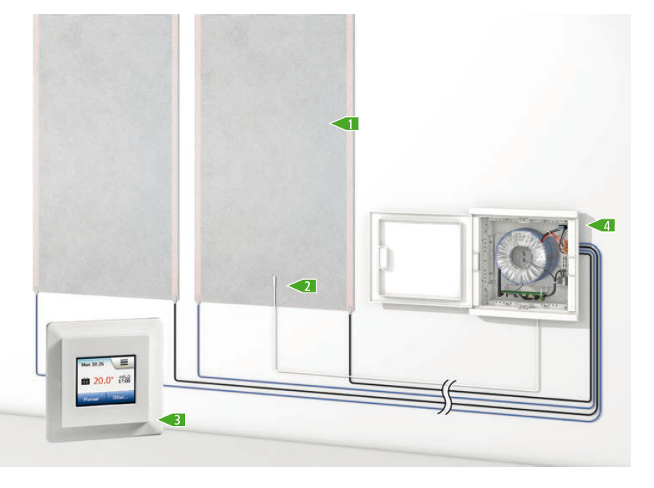
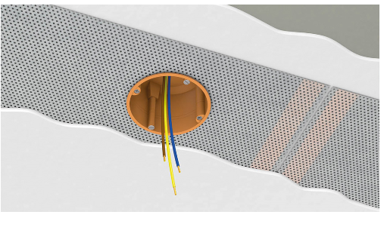
mfh systems GmbH – system overview
E-NERGY CARBON Comfortable warmth and comfort at the touch of a button Innovative heating foils for ceiling, wall & floor

Slide 6
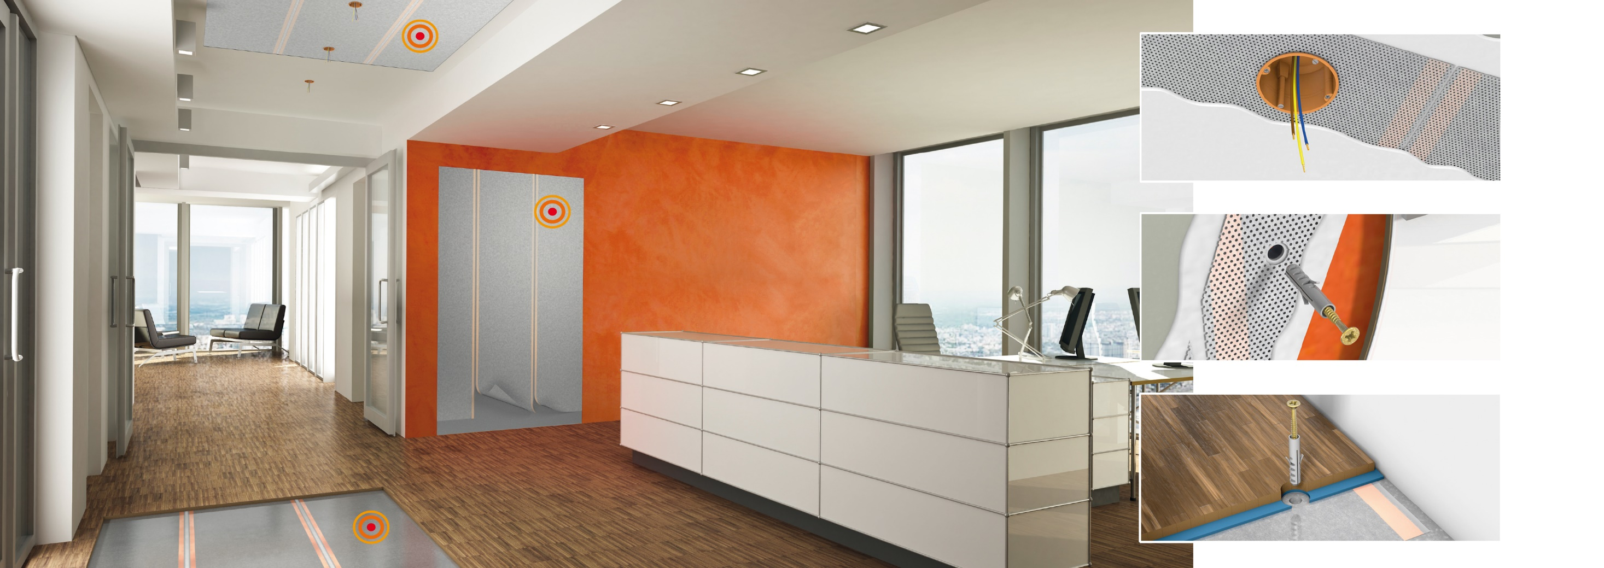
E-NERGY CARBON
Installation on ceiling, wall and floor

Slide 7
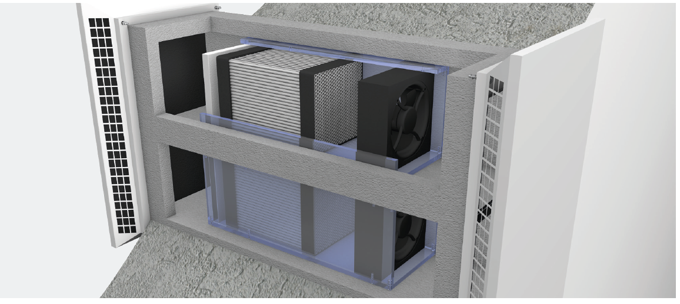
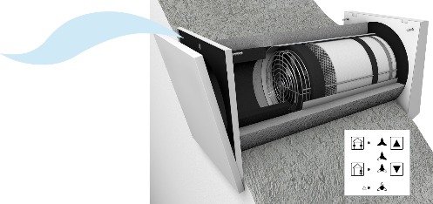
mfh systems GmbH – system overview
AIRUNIT Fresh and healthy air in the house
Decentralised domestic ventilation with high heat recovery
AIRUNIT GEMINI
AIRUNIT SOLUS

Slide 8
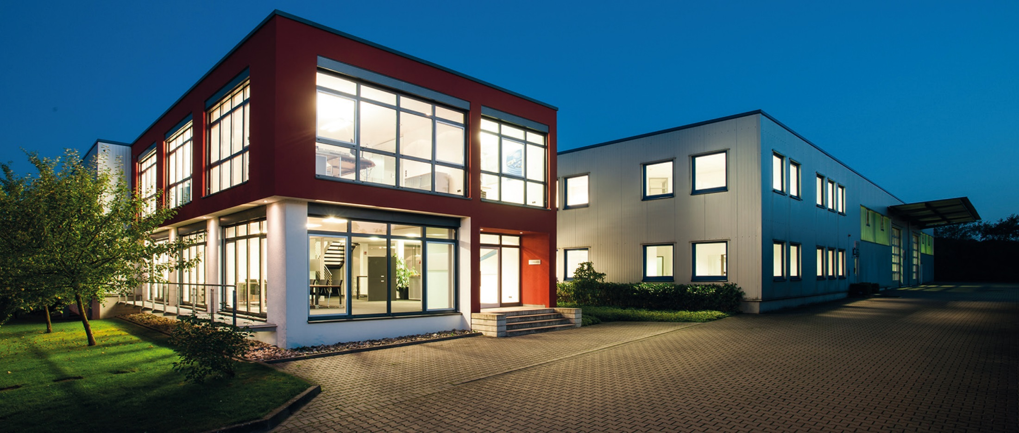
mfh systems GmbH · Hager Feld 8 · 49191 Belm Fon +49 (0) 54 06 | 6 99 95-10 · Fax +49 (0) 54 06 | 6 99 95-90 mail@mfh-systems.com · www.mfh-systems.com

