Slide 1
Sun creates New Energy
Self-sufficiency of buildings with solar energy Karlheinz Blau, CVO of Team Blau GmbH

Slide 2
About Team Blau GmbH
Team Blau is a group of experts, working together in different projects with different customers
Types of customer:
Commercial and industrial enterprises
Public institutions
Private persons
Types of projects:
Planning and installation of IT infrastructure
Planning and re-organization of IT infrastructure
Re-organization of companies
Planning and installation of units
Planning and installation of production plants
Planning and installation of power supply

Slide 3
How we work
Our business is based on :
A Wide range of expertise
Highly efficient problem-solving skills
Use of knowledge transfer
Sustainability in planning and thinking
Swift and efficient reaction
Excellent contacts to German suppliers
30 years experience in energy supply and units
Realization of high level automation
Networking/Membership in important Bavarian business associations (BayME, VBM, VBW)

Slide 4
Past Projects in Energy Supply
Projects with Liebert Hiross (Vertiv), Europe
Energy supply for private homes independent from public sources with high level of automation (in Munich)
Energy consulting based on BAFA and the European guidelines for Energy efficiency
Consulting for energy management and – supply, Hamburg
Early project: biogas plant for the Philippines

Slide 5
Our Products
Our current portfolio is based on inverters, energy storage and computer (PV and IT)
We have established partnerships with innovative European producers of PV inverters and storage units
Based on these products we provide
Distribution in Asia
Solution design
Training
Maintenance and replacement parts

Slide 6
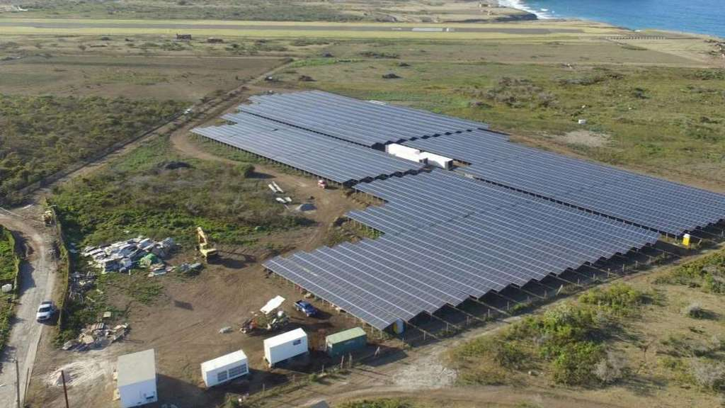
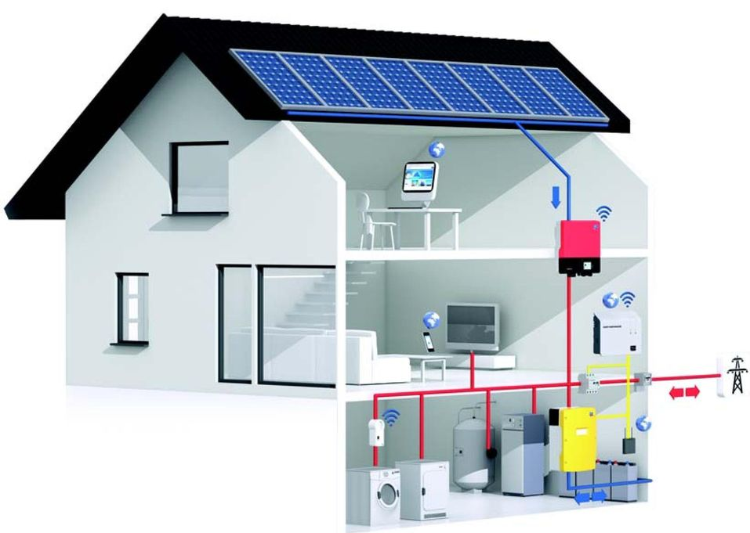
SMA Products
SMA is the leading manufacturer of PV inverters
Team Blau is the official distributor for SMA products in Sri Lanka
Solar-Hybrid-System auf St. Eustatius is a brilliant example of the potential of SMA-based solutions. https://youtu.be/0GlIRl8BHXo

Slide 7
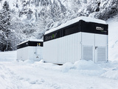
ADS-TEC Products
ADS-TEC is a German manufacturer of lithium ion battery & storage systems
Battery-Storage for net-stabilization – even in snow

Slide 8
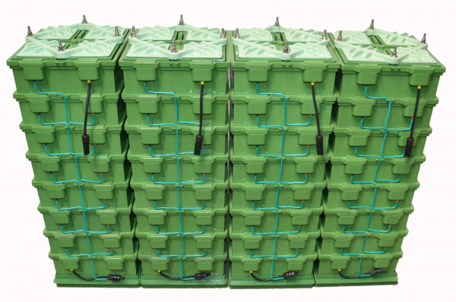
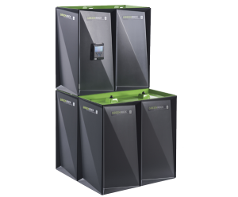
BlueSky Energy Products
GREENROCK builds very boring batteries
They do not burn
They do not explode
They do not leak toxic fluids
Team Blau plans to produce saltwater-batteries in Sri Lanka https://www.youtube.com/watch?v=HXmZW8Wnvko

Slide 9
Current status
At the moment we found the Team Blau Group Ceylon (Pvt. Ltd.)
On 5st November we are celebrating the opening of our Sri Lanka office with integrated training center in 41 B, Thalapathpitiya Road, Embuldeniya, Nugegoda (Colombo)
Our on-site manager is Siegfried Schosser
We already found many interested companies and partners
Together with our partners in Sri Lanka and Europe we aim to set up a medium sized company within the next three years
Our goal is to set up production in Sri Lanka and create new jobs

Slide 10
Team Blau is looking for partners
Legal services
Project Acquisition
Funding
Logistics providers
General contractors
Contractors for electric installation (PV)

Slide 11
Goals in Vietnam
In October we are starting business in Vietnam (and region)
We will enter the market for solar and environmental business in the region with our Vietnamese partners
We will found a company in Vietnam
There are already interested companies as potential partners
We want to team up with local companies and experts

Slide 12
Thank you for listening
Karlheinz Blau, CVO
Team Blau GmbH
Hans Boecklerstrasse 99
D-80995 Muenchen
eMail: kb@team-blau.net
Mobile: +49 170 3861708
WhatsApp: +49 170 3861708
Website: https://team-blau.net

