Slide 1
Wind Energy Sector Development GIZ Activities
MOIT/ GIZ Energy Support Programme

Slide 2
Content
MOIT/GIZ Energy Support Programme (ESP)
Support to the Up-scaling of Wind Power (Wind DKTI)
Project Development Programme (PDP)

Slide 3
MOIT/GIZ Energy Support Programme
Context
2009
Start of the German development cooperation with a focus on wind energy
Now
Mutually agreed strategic areas of cooperation: Renewable Energy and Energy Efficiency
July 2013
(G2G consultations)
Energy becomes one of three priority areas of Vietnamese-German cooperation

Slide 4
MOIT/GIZ Energy Support Programme
How do we work?
Energy Support Program
Action Areas
Research
Higher Education
Private Sector
Capacity Development
Technology Cooperation
Legal and Regulatory Framework Conditions
Government Institutions
Project Developers and Investors
Financial Institutions
Policies/ Strategies
Support Mechanisms
Regulations and Guidelines
Institution Building
Knowledge Sharing; Thematic Studies; Pilot Projects

Slide 5
MOIT/GIZ Energy Support Programme
Project & Pipeline
(BMUB)
Bioenergy in Viet Nam
(BMZ)
Smart Grids f. RE & EE (DKTI)
(BMZ/EU)
Co-Fi of RE & EE (4E)
(BMZ)
RE & EE (4E_I)
RE & EE (4E_II)
RE & EE (4E_III)
BMZ / USAID
Clim. Fin. Ready VN
(BMZ)
Up-scaling of Wind Power (DKTI)
(BMWi)
PDP business partnerships btw
German & Vietnamese companies
2013
2014
2015
2016
2017
2018
2019
2020
2021
2022
Legend:
Preparation
Implementation
Extension
Global Program
Project Idea

Slide 6
Support to the Up-scaling of Wind Power (Wind DKTI)
€
Partners
Line Agency: MOIT
Responsible Department: EREA
Funding Agency
German Federal Ministry for Economic Cooperation and Development (BMZ); German Climate Technology Initiative (DKTI)
EUR 6.9mio
Time Frame
January 2014 – December 2018
Objectives
The preconditions for the preparation and operation of wind energy projects have been improved

Slide 7
Hurdles- from many aspects
Technical
Limited data and low reliability
Adminis-trative
Complex, unclear investment procedure
Human resource
Limited human resource of authorities
Financial
Not bankable PPA
Limited access to finance
Lack of national law for RE
Loose communication and follow-ups between authorities
Low electricity price
Lack of qualified local service providers
Difficult access to information

Slide 8
Support to the Up-scaling of Wind Power (Wind DKTI)
FIT revision
Investment guidelines
CBA
NWP Planning
Forecasting
Guidelines on ESIA process
Legal and regulatory framework
Wind measurement campaign
Trainings on cash flow modelling for wind projects have been organized
Regular technical and economical trainings
Project clinic
Capacity development
Technology cooperation
Two-week Wind Power Summer School in summer 2016
Co-Funding of Vietnam-Germany Research Cooperation to increase the deployment of wind power technologies

Slide 9
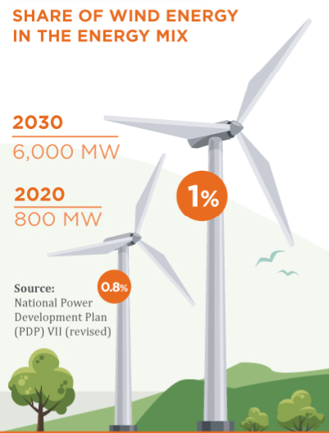
Vietnam‘s wind targets and regulatory framework
Decision 37
(2011)
FIT: 7.8 USct/ kWh
6 projects ≈ 200 MW in operation by Mid 2018
Decision 39
(2018)
FIT for onshore projects: 8.5 USct/kWh
FIT for nearshore projects: 9.8 USct/kWh
Other incentives for wind power projects:
Import tax exemption
CIT: exempted the first 4 years, 50% reduction the next 9 years
Source: GIZ

Slide 10
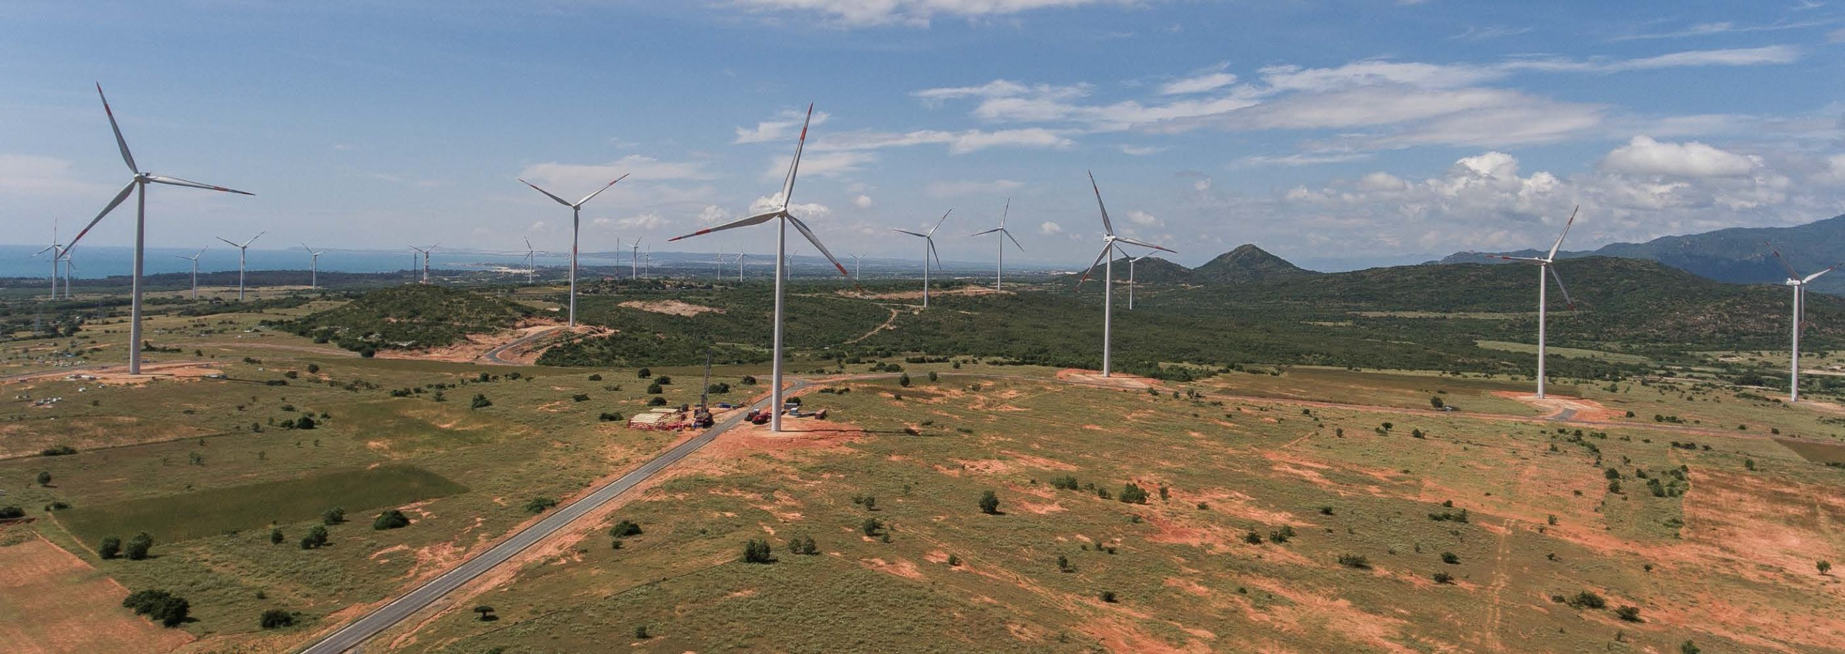
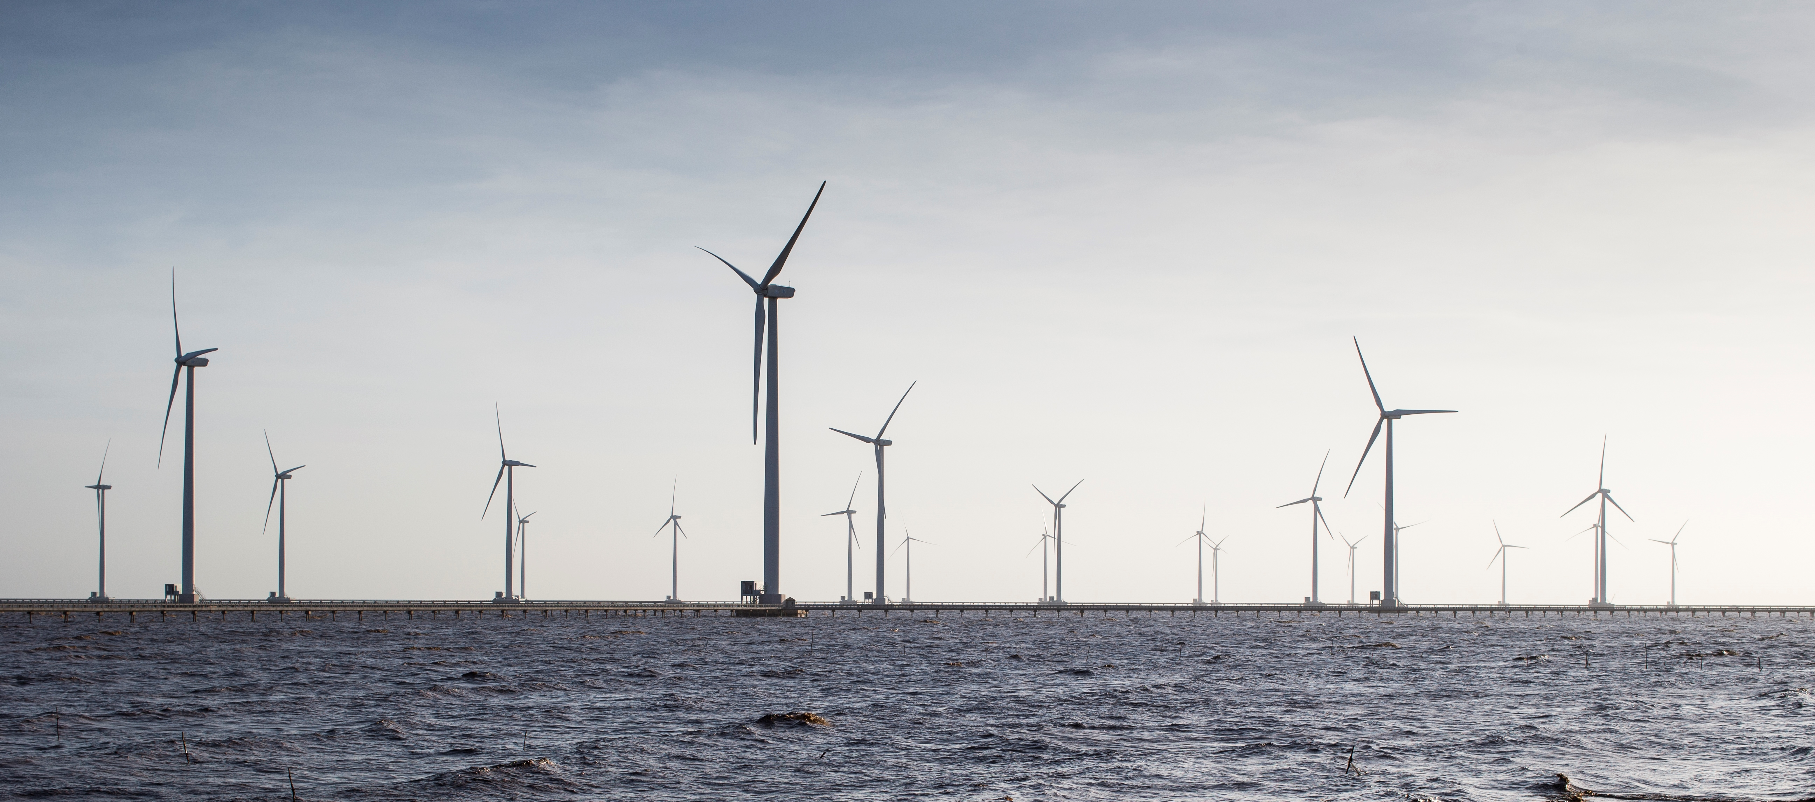
LCOE study for new FIT proposal
Performance data
Tuy Phong REVN (30MW)
LCOE assessment
Financial parameters:
Proposed revised FiT
Phu Lac (24 MW)
Cong Ly (99.2 MW)
Investment cost
O&M costs
Energy production
Phu Lac wind farm 24 MW, Binh Thuan province, FiT = 7.8 USct/kWh
Source: CTV Wind
Prime Minister Decision
8.5 USct/kWh
9.8 USct/kWh
Bac Lieu wind farm 1&2, 99.2 MW, Bac Lieu province, FiT = 9.8 USct/kWh
Source: GIZ

Slide 11
Wind power investment guidelines
→ Enhance transparency: Development steps and timeline. Legal requirements. Required documents.
Source: GIZ

Slide 12
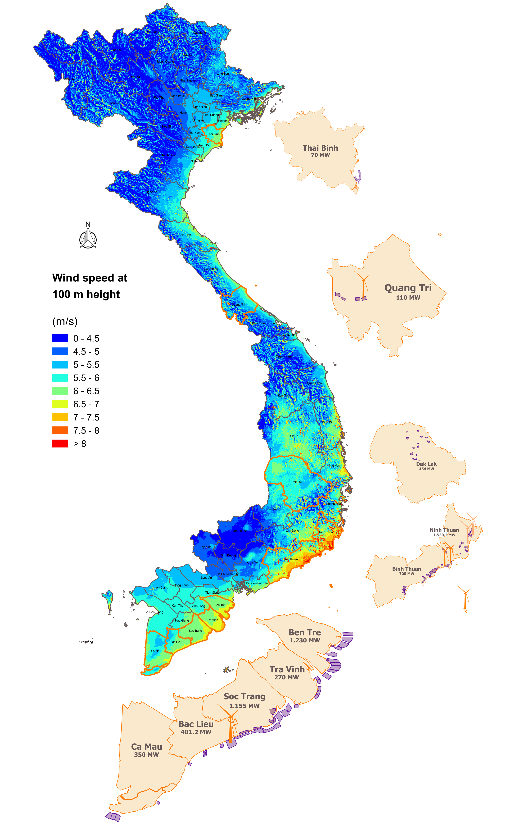
National wind power development plan
Combining:
10 existing provincial WPDPs
Data of terrain & land use
Wind resource data
Existing grid infrastructure
Current wind project pipeline
On shore planning
GIS analysis
National Wind Power Development Plan
Near-shore planning
Source: GIZ

Slide 13
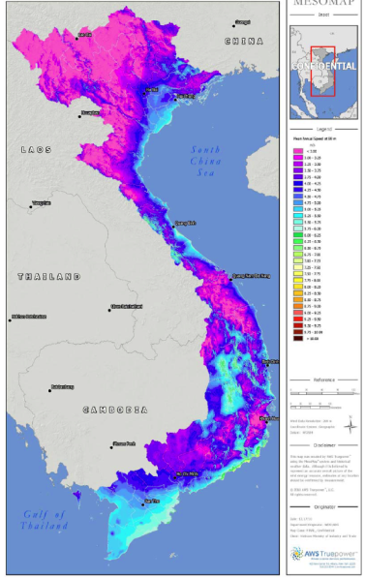
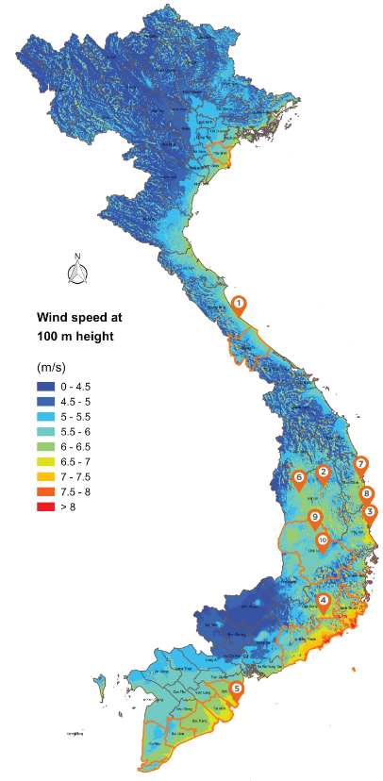
GIZ wind measurement campaign 2012-2017
Improved reliability of Vietnamese wind atlas
Vietnam wind speed map at 80m height, 2011
GIZ wind measurement campaign
Source: GIZ
Source: AWS TruePower LLC, 2011

Slide 14
ESIA Process
Project Preparation Phase
Project Development Phase
Project Implement
tion Phase
Project Operation Phase
Project Decommissioning Phase
Scoping the ESIA
Disclosure information and consultation
Initial Screening
Stakeholder Engagement Plan
Request for verification of land use demand
Prepare ESIA
ESIA Report *
Verification letter of land use demand
E&S Monitoring and Management Plan
Monitoring the Environmental and Social Impact
Request for Inclusion of the project into district annual land use plan
Appraisal of ESIA report and ESMMP
Stakeholder engagement activities
Approval of ESIA report and ESMMP
* land acquisition, compensation & resettlement plan
Acceptance inclusion of the project into annual land
Land Clearance
land acquisition and compensation & resettlement decision
Land use registration
Land use Certificate

Slide 15
Project Development Programme
Federal Ministry for Economic Affairs and Energy (BMWi)
PDP Team Berlin
PDP-colleagues in GIZ-country offices
Page 15
Notes:
Hintergrund
2005 forderte der Bundestag eine stärkere Berücksichtigung von Schwellen- und Entwicklungsländern im Rahmen der Exportinitiative Energie
Seit 2007 PEP Teil der Exportinitiative Energie der Bundesregierung.
Organisationsstruktur
Auftraggeber BMWi: Gesamtsteuerung
Für Entwicklungs- und Schwellenländer: Zusammenarbeit mit GIZ als Durchführer.
PEP: Inhaltliche Steuerung und regionale Koordination
PEP-Kollegen vor Ort: lokale Implementierung
Dabei: enge Zusammenarbeit mit den Durchführern der Exportinitiative Energie, insbesondere der AHK u. DIHK,
sowie mit den deutschen Energie-Verbänden
Unique Selling Point PEP
Fachliches Know-How: Team mit technischer und betriebswirtschaftlicher Expertise
Länder- und Sektorkenntnisse: Sektorale Kenntnisse der GIZ + auf Nachhaltigkeit ausgerichteten privatwirtschaftlichen Ansatz PEP

Slide 16
Services by PDP
Analyses of countries, sectors and key accounts
Identification of commercially viable and scalable projects
Lead of project opportunities forwarded to German SME
Project
Development
Page 16

Slide 17
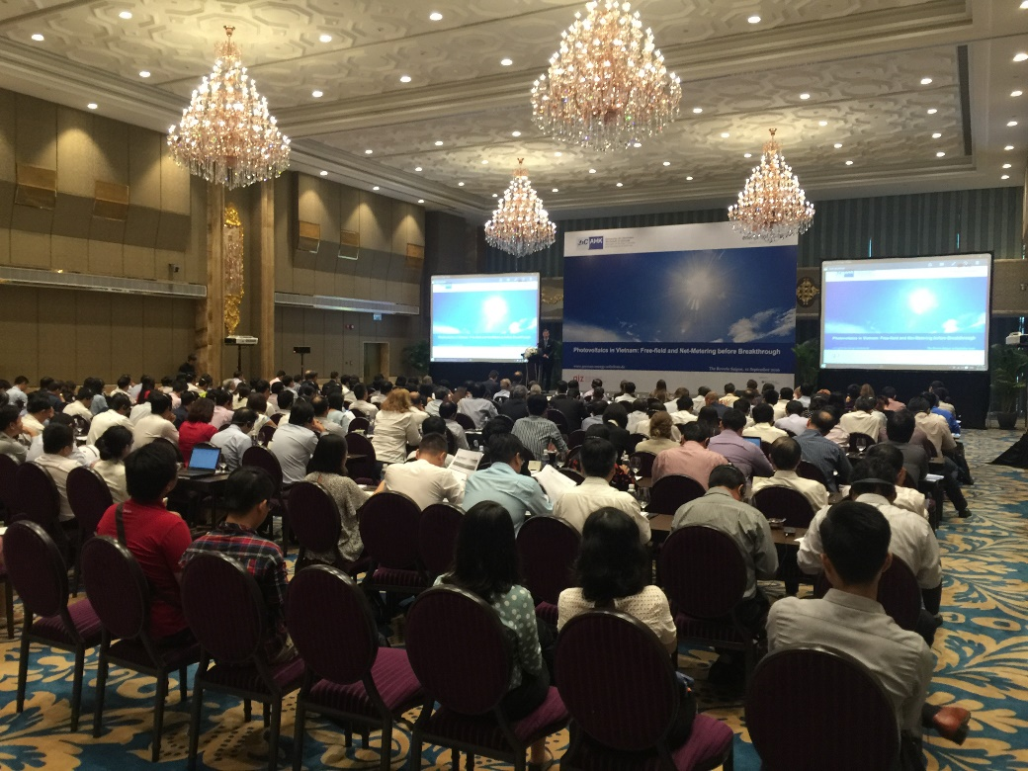
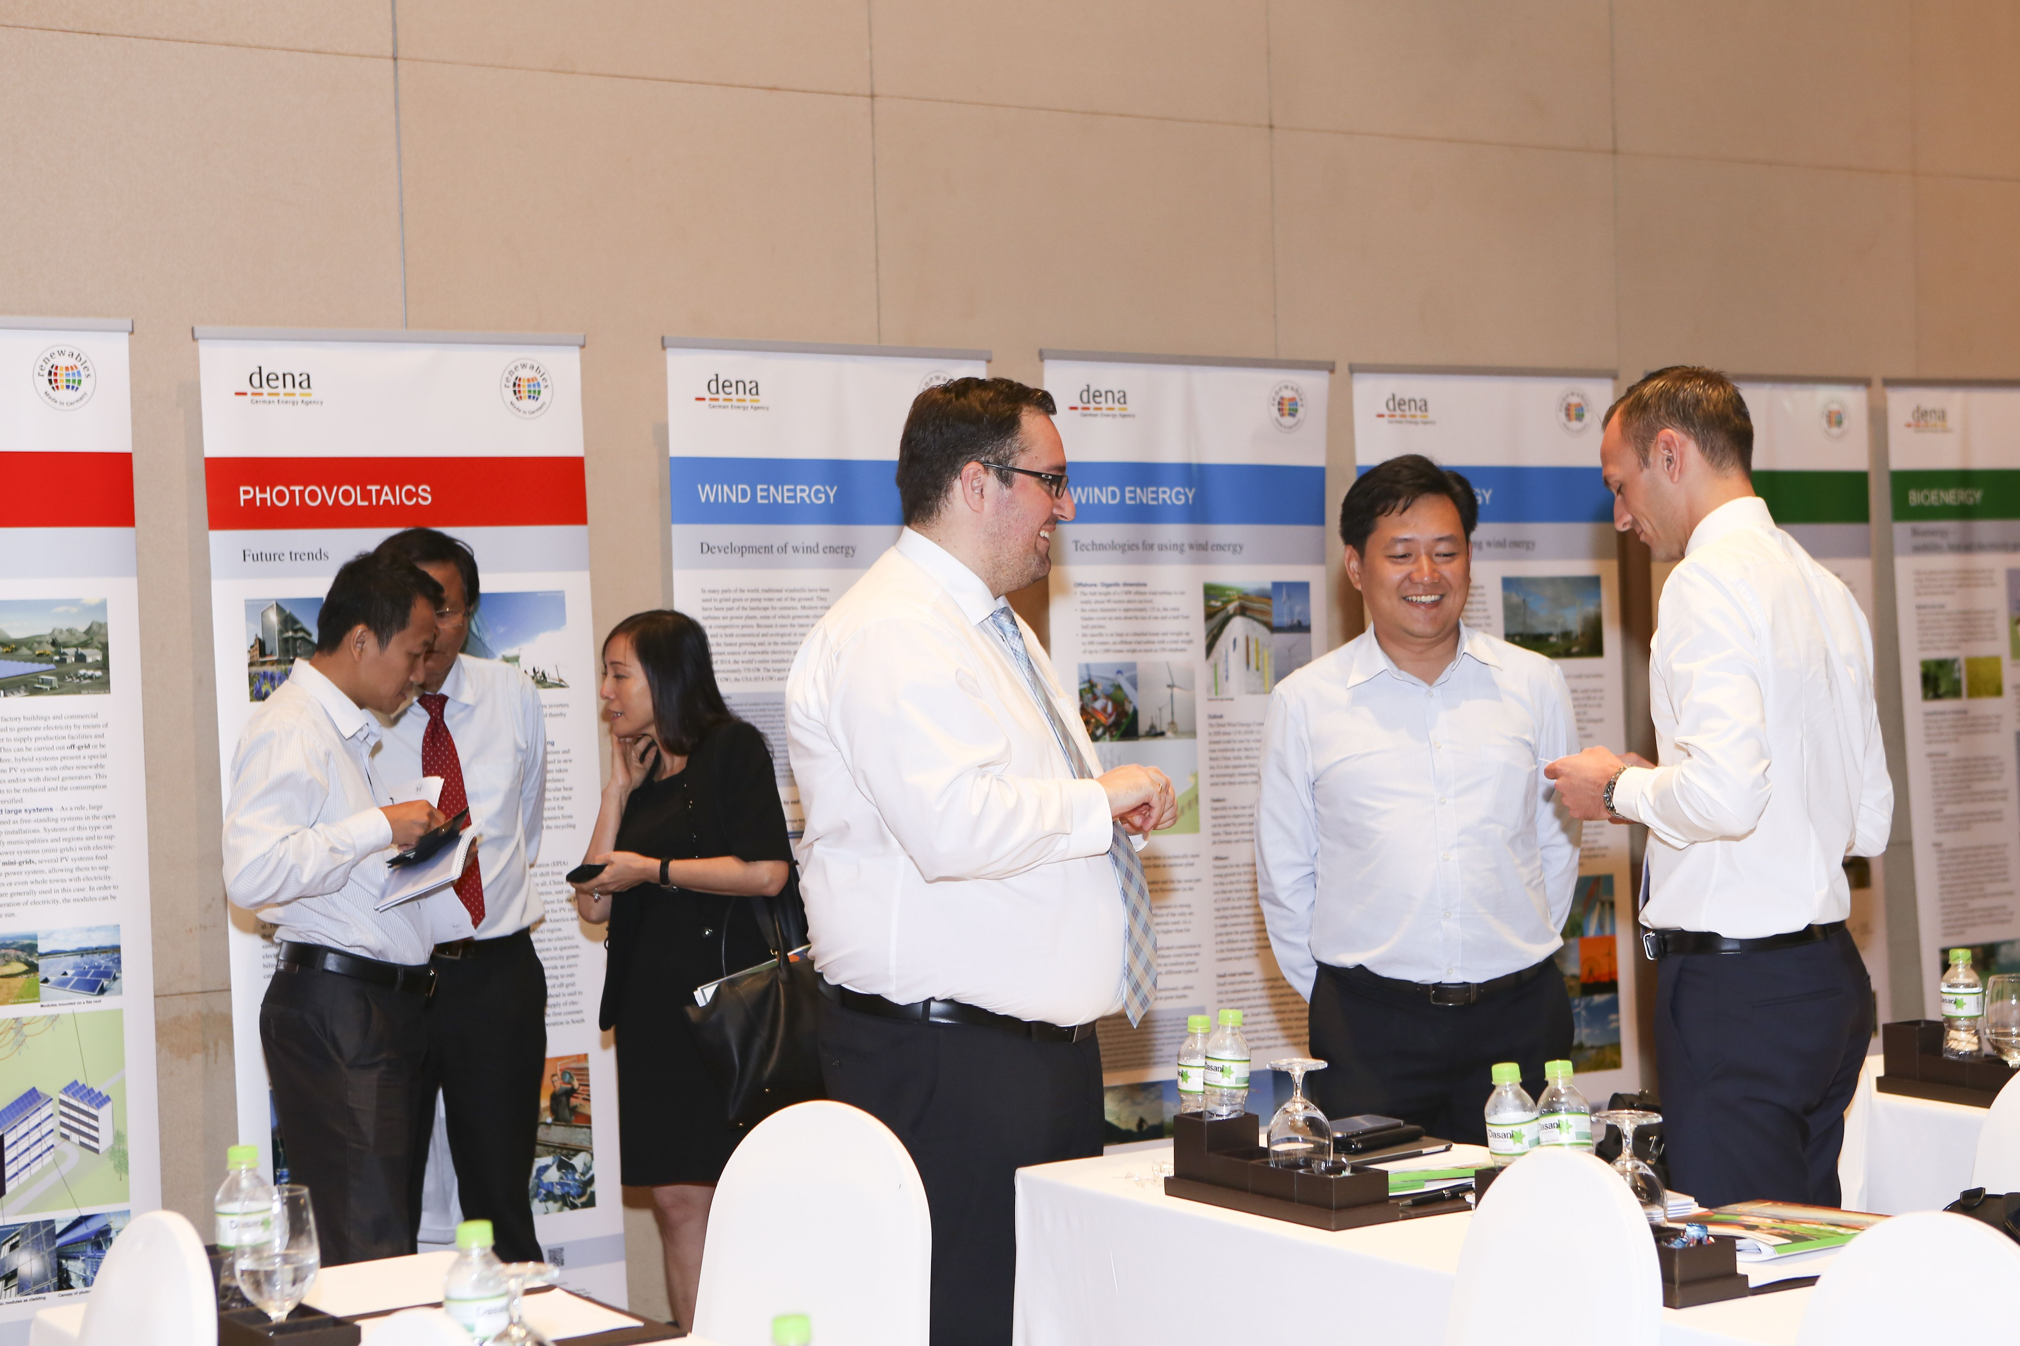
Services by PDP
Evaluation and compilation of market information
AHK-business trips
Delegation trips to Germany
Match-making local and German partners
Business
Development
Page 17
Notes:
Bereitstellung praxisorientierter Marktinformationen
→ Entscheidungshilfe für KMU für oder gegen Markteintritt
Kontaktanbahnung und Anbahnung von Geschäftspartnerschaften zwischen deutschen und lokalen Unternehmen
Instrumente:
Informationsveranstaltungen
AHK-Geschäftsreisen
Informationsreisen nach Deutschland

Slide 18
Services by PDP
Political consultancy
Collaboration with business associations
Participation in conferences and trade fairs
Capacity development
(technical and project development trainings)
Market
Development
Page 18
Notes:
Instrumente
Beratung lokaler Entscheidungsträger zu pol. Rahmenbedingungen:
Regulierung zur technischen Netzintegration
Technische Beratung von Kommunen, Energieversorgern und Ministerien zu Grid-Codes u. Net Metering
Beratung zu Abbau von administrativen Hürden in Genehmigungsprozessen
Kooperation mit Verbänden aus Energiesektor
Öffentlichkeitsarbeit/ Messebeteiligungen
Förderung des Bewusstseins für EE und Wettbewerbsvorteil deutscher Produkte
Fortbildung von stakeholdern zu Ausschreibungen
Erstellung von Studien
Kompetenzaufbau: GSTW

Slide 19
Thank you!
MOIT/GIZ Energy Support Programme

