Slide 2
The intelligent building
Best cases of sensor technology and sensor light
Speaker:
Cristiano Fossati, MD Steinel Italia

Slide 3
Founded in 1959.
From pioneer to market leader.
170 million
sales
2,000
products
1,620
employees
1959
2020

Slide 4
The inventors’ company
Development centre and production facilities in Europe.
Herzebrock-Clarholz, D
Leipzig-Mölkau, D
Liberec, CZ
Einsiedeln, CH
Chisinau, MV
Curtea de Arges, RO

Slide 5
Light & Sensors
Sensor-switched lights & high-tech sensors 2,600,000 products sold per year
passive infrared
since 1987
ultrasonic
since 2014
high frequency
since 1999
optical sensor system
since 2016
true presence
since 2018

Slide 6
Our role.
We are the sensory organs to enable building intelligence
eyes
lighting
heating
ears
nose
shadowing
ventilation
Data Analytics
security

Slide 7
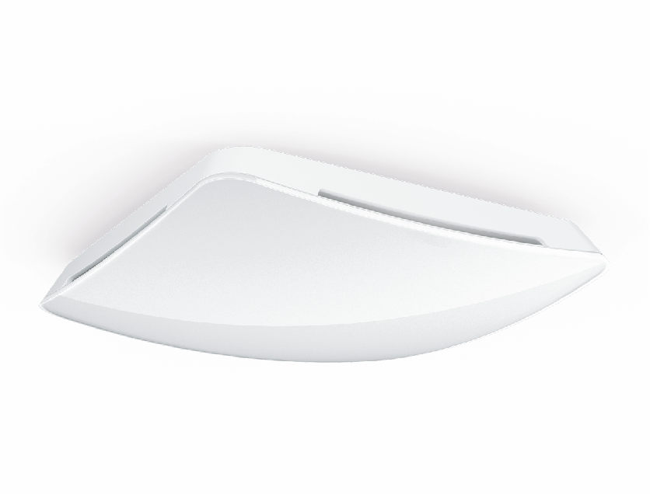
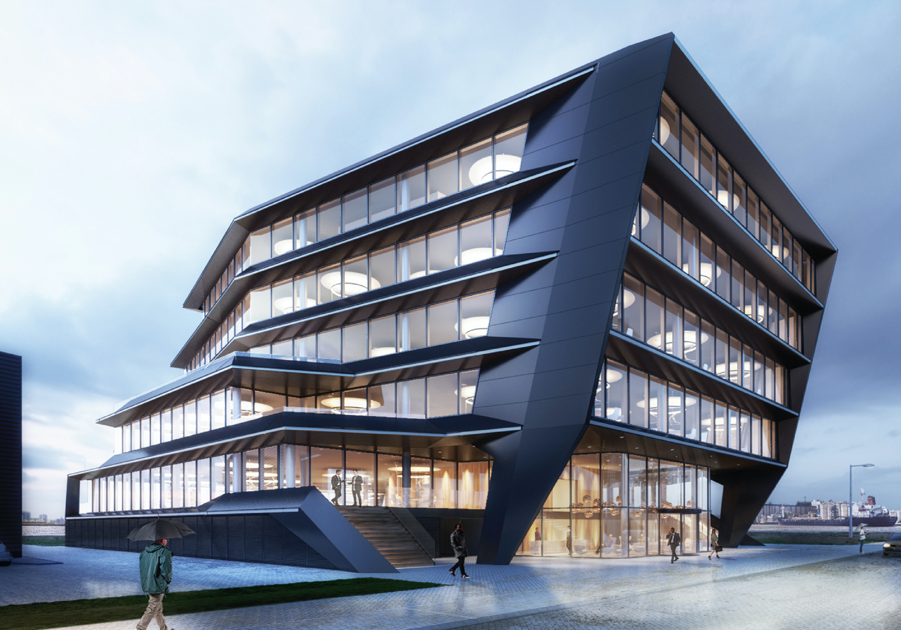
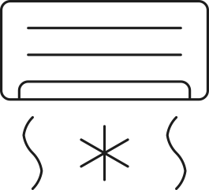
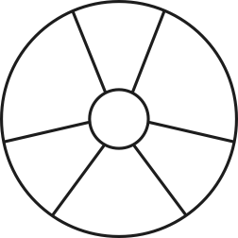
Presence control and air quality
The Flow, Amsterdam
True Presence®
Multisensor KNX
true presence
brightness
temperature
humidity
air pressure
CO2
VOC
Automation Software
lighting
heating
ventilation

Slide 8
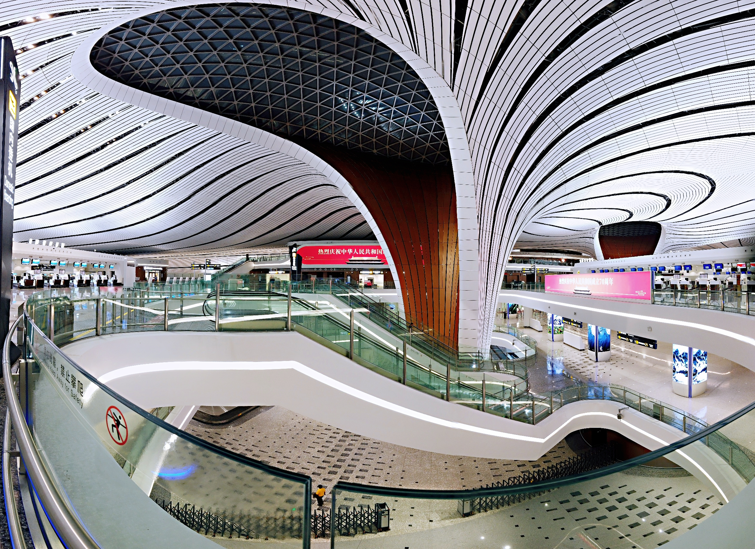
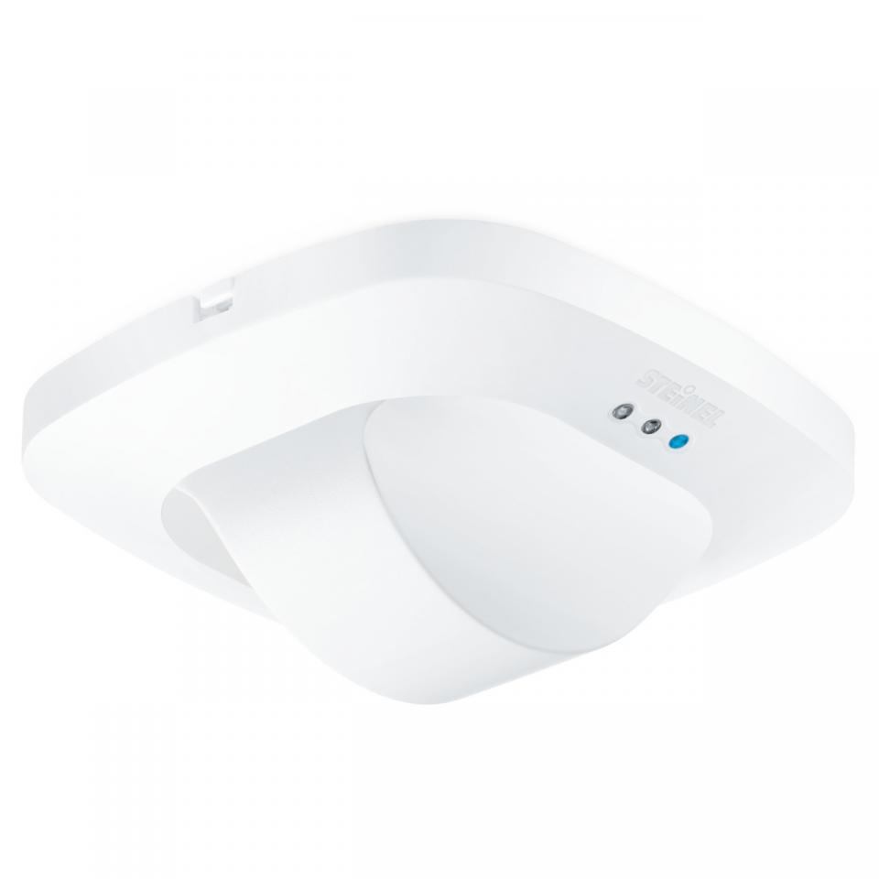
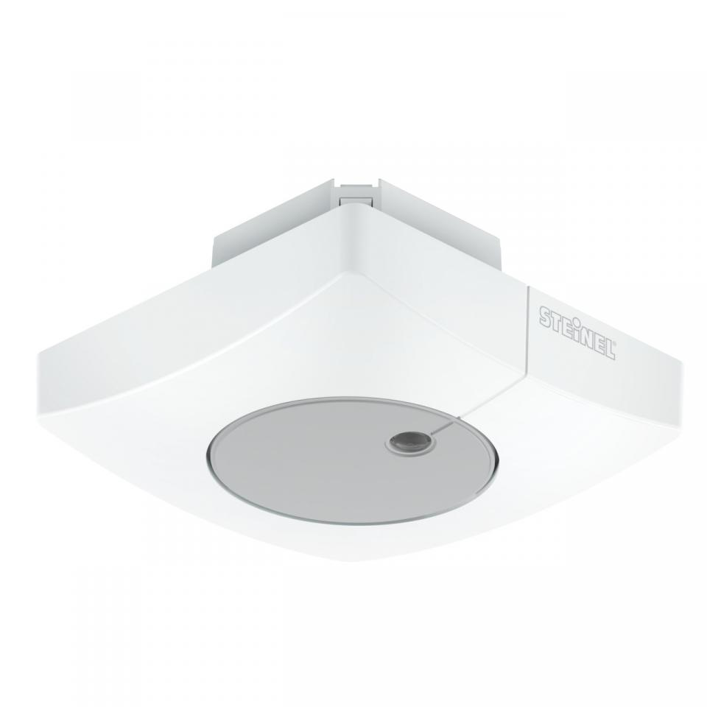
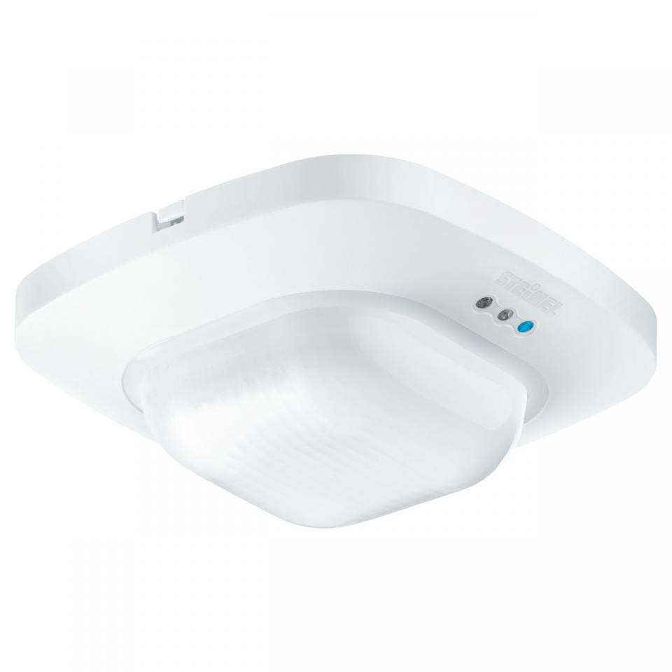
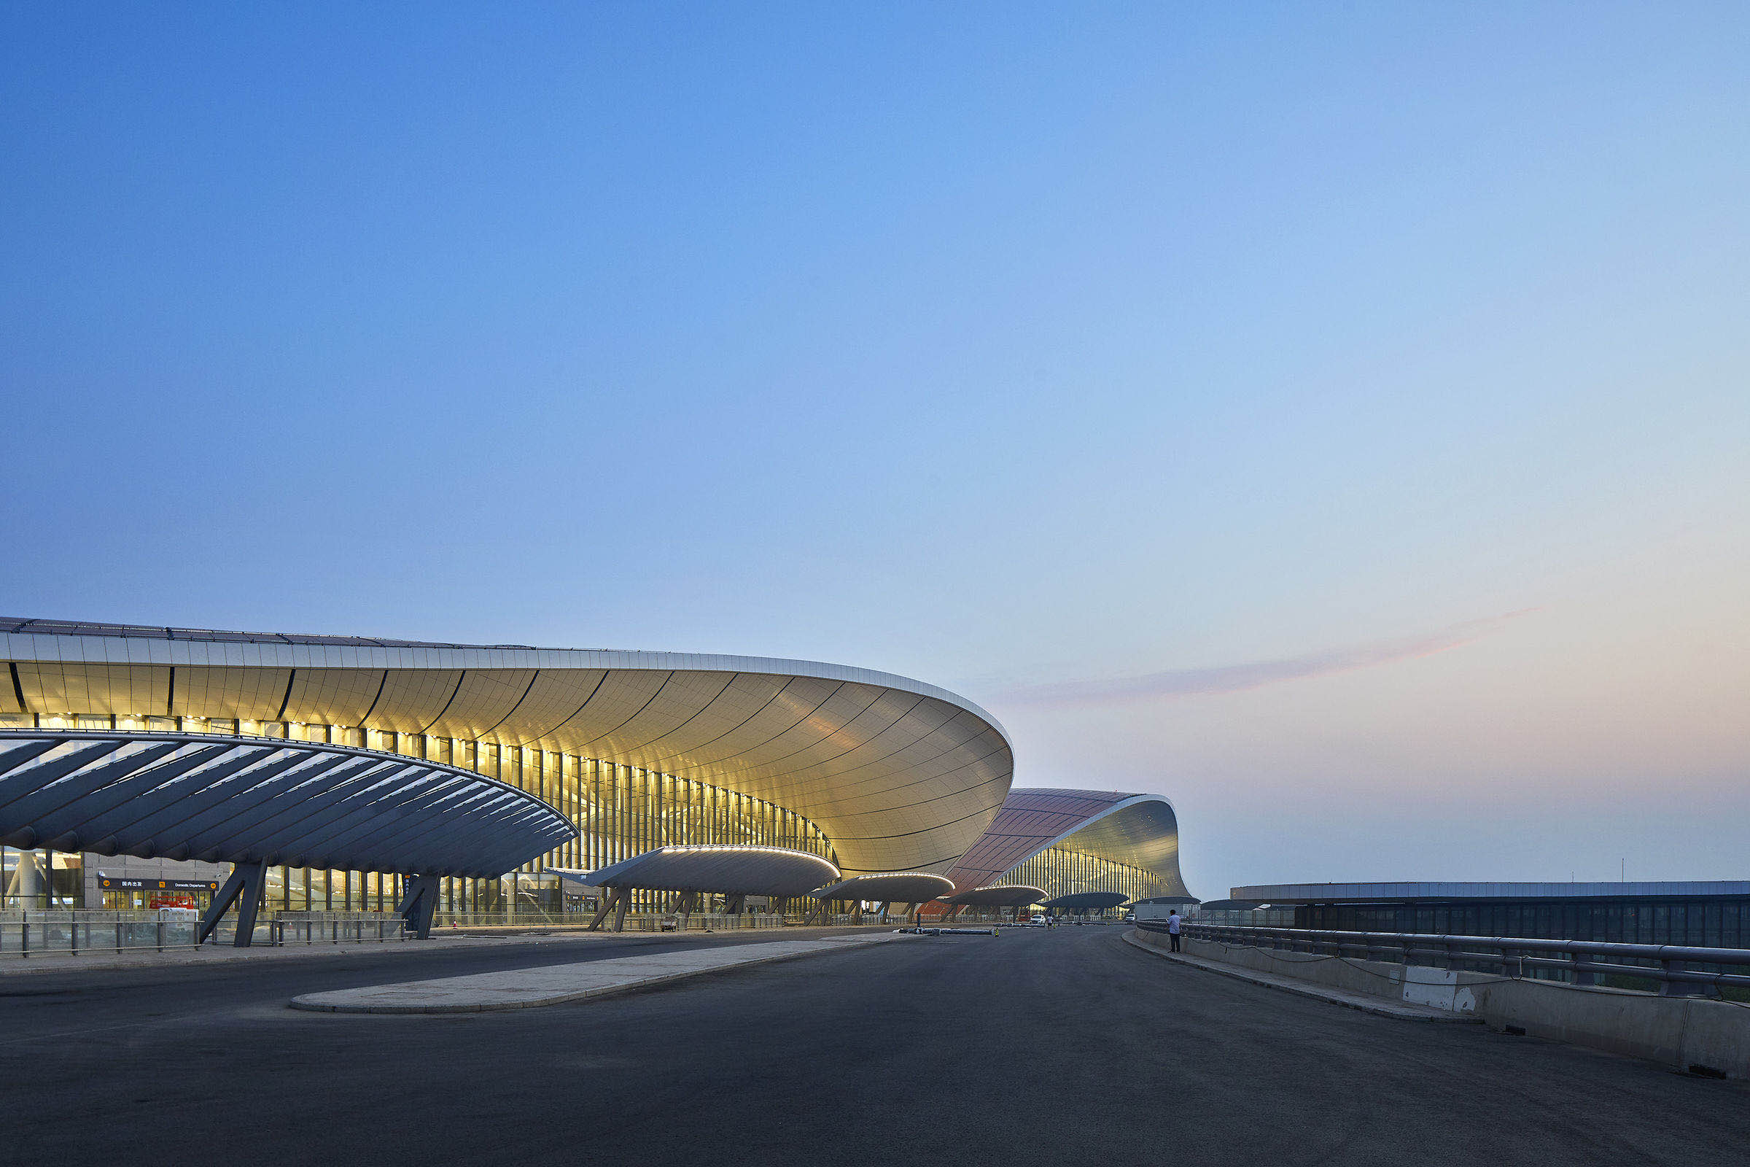
Lighting managment via KNX sensors
Beijing International Airport – World larges Airport
92% energy saving
different KNX sensor for several application
Settings with Smart Device

Slide 9
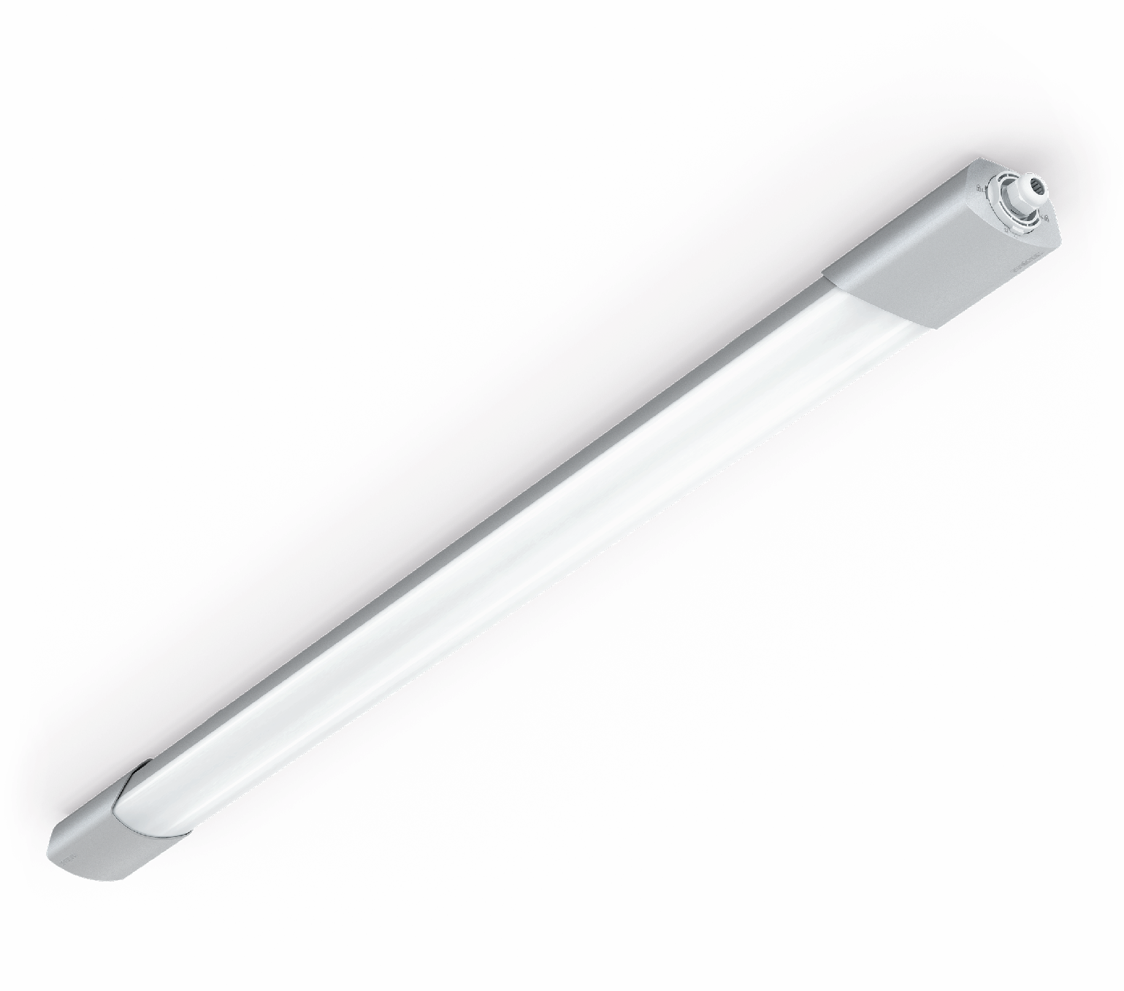
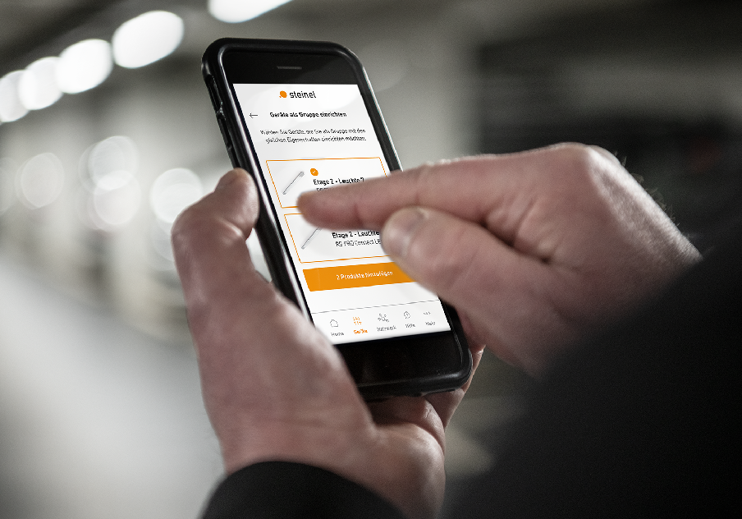
Intelligent light management
Car Park Heuried, Zurich
92% energy saving
RS PRO Connect 5100 LED
basic light
shock proof
IP66
360° sensor
Ø 1 -10 m
2 - 2000 Lux
Settings with Smart Device
Bluetooth Mesh Network

Slide 10
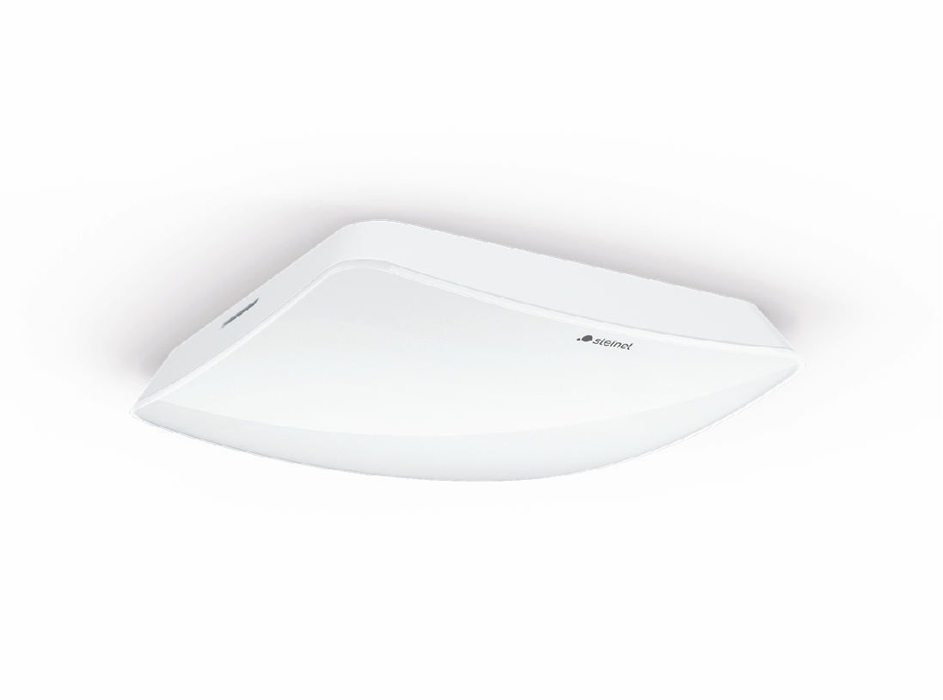
Hospitality room management
Park Inn by Radisson, Wismar
True Presence®
true presence
brightness
temperature
humidity
Check-in
HVAC Control
Energy saving
Room service

Slide 11
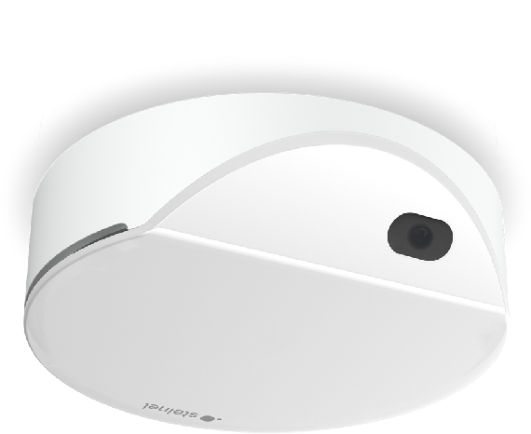
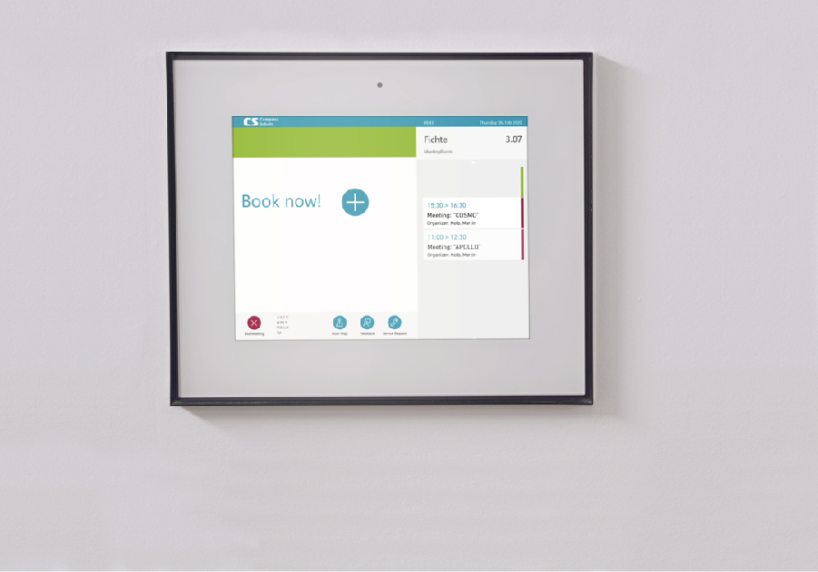
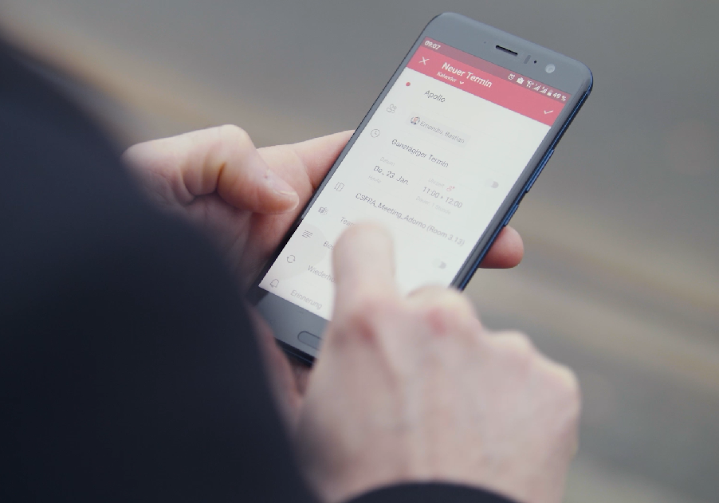
Meeting room management
C+S, Frankfurt
HPD 3
counting people
10 zones
temperature
humidity
Booking system
Chat bot

Slide 12
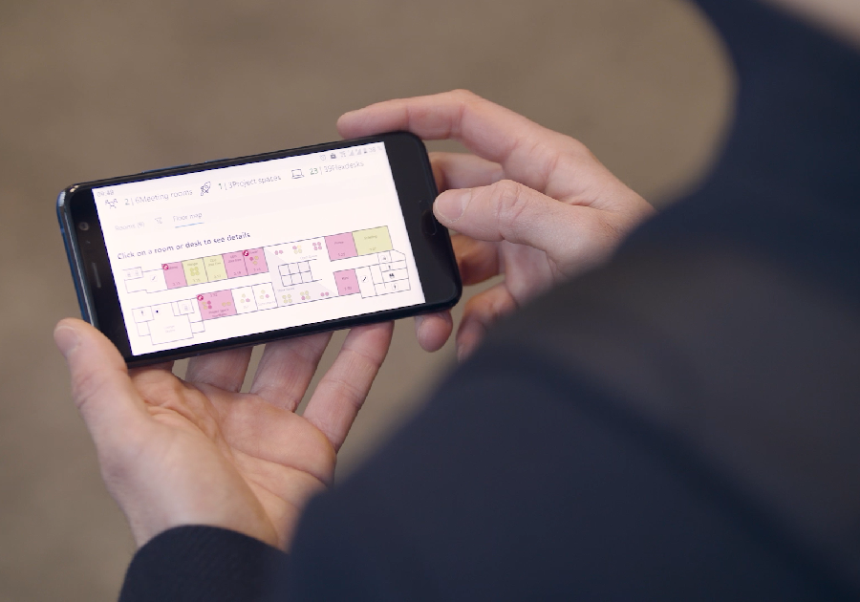
Flex Desk management
C+S, Frankfurt
HPD 3
counting people
10 zones
temperature
humidity
Booking system
Analytics

Slide 13
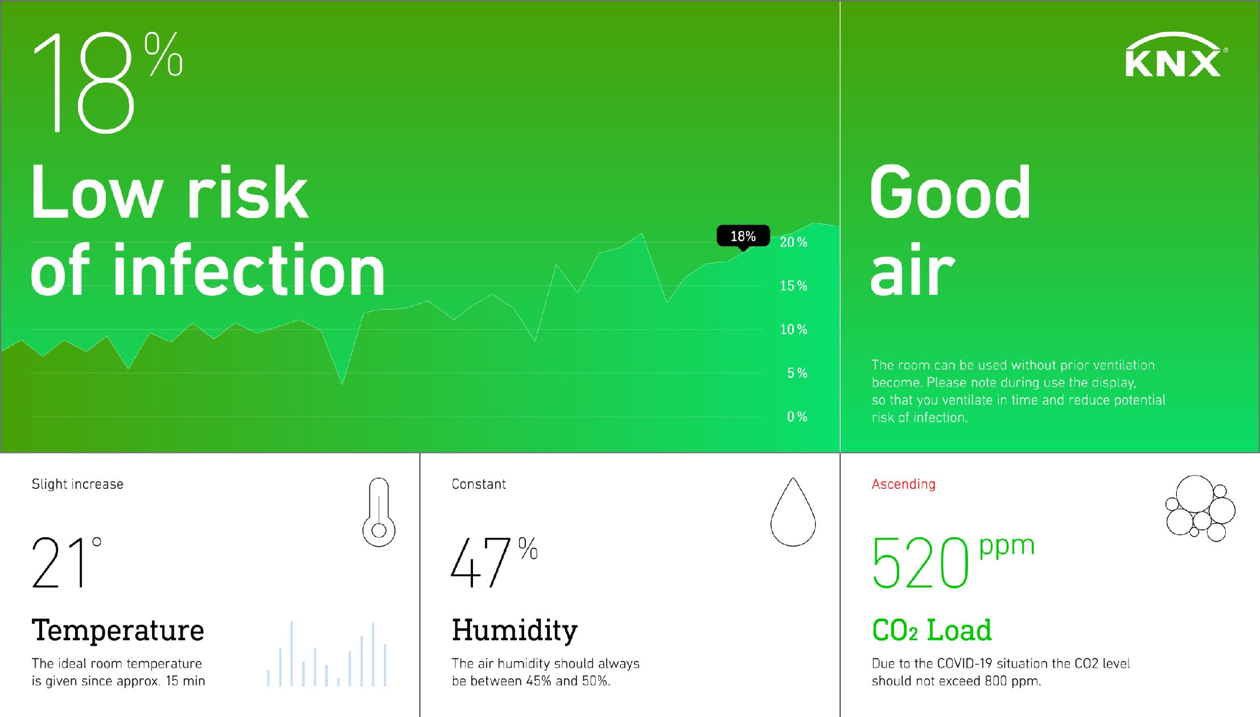
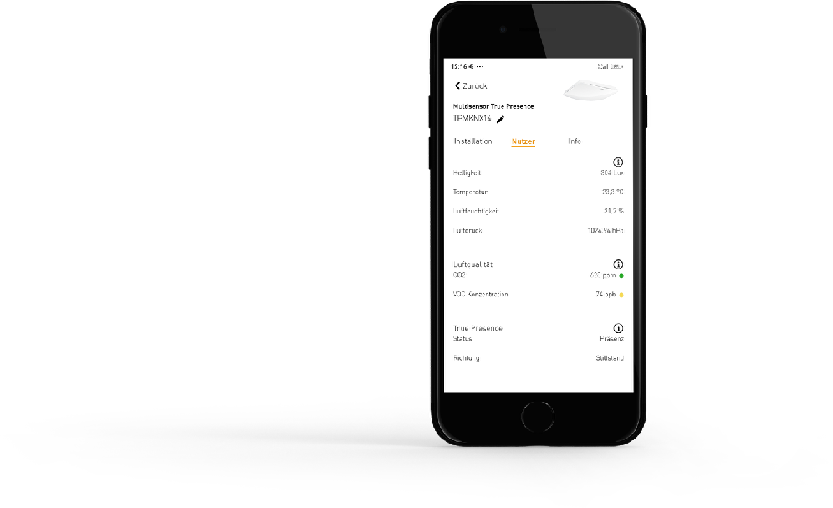
Air quality management
New possibilities in building automation
Live-Demo
Multisensor AIR Aerosol
= Risk of infection
temperature
humidity
CO2

Slide 14
Thank you very much !
Feel free to contact me:
Cristiano Fossati MD Steinel Italia cristiano.fossati@steinel.it

