Slide 1
Grid-connected PV in Germany
Mathias Böswetter, BSW-Solar

Slide 2
Agenda
BSW-Solar
The global picture
Why Germany?
Latest trends in Germany‘s PV market
C&I segment as market driver
Digitizing grid-connected PV
Outlook

Slide 3
German Solar Association
TASK To represent the solar industry in Germany in the thermal and photovoltaic and storage sector
VISION A sustainable global energy supply provided by solar (renewable) energy
ACTIVITIES Lobbying, political advice, public relations, market observation, standardization
EXPERIENCE Active in the solar energy sector for 40 years
REPRESENTS More than 800 solar producers, suppliers, wholesalers, installers and other companies active in the solar business from all over the world
HEADQUARTERS Berlin
Materials
System components
Wholesale & Distri-bution
Project Develop-ment
Con-struction
O&M
Equipment

Slide 4
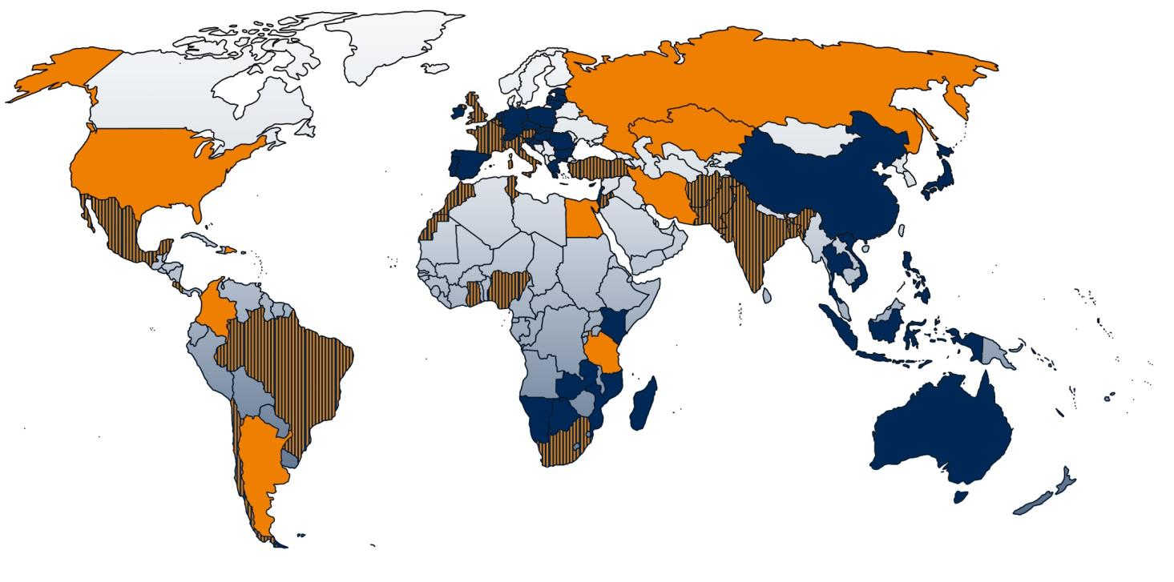
With our partners, we work together to improve framework-conditions for solar energy world wide!
Partnerships, business networks
Projects, Market reports, esp. “Enabling PV”
both
© BSW-Solar

Slide 5
Agenda
BSW-Solar
Latest trends in Germany‘s PV market
C&I segment as market driver
Digitizing grid-connected PV
Outlook

Slide 6
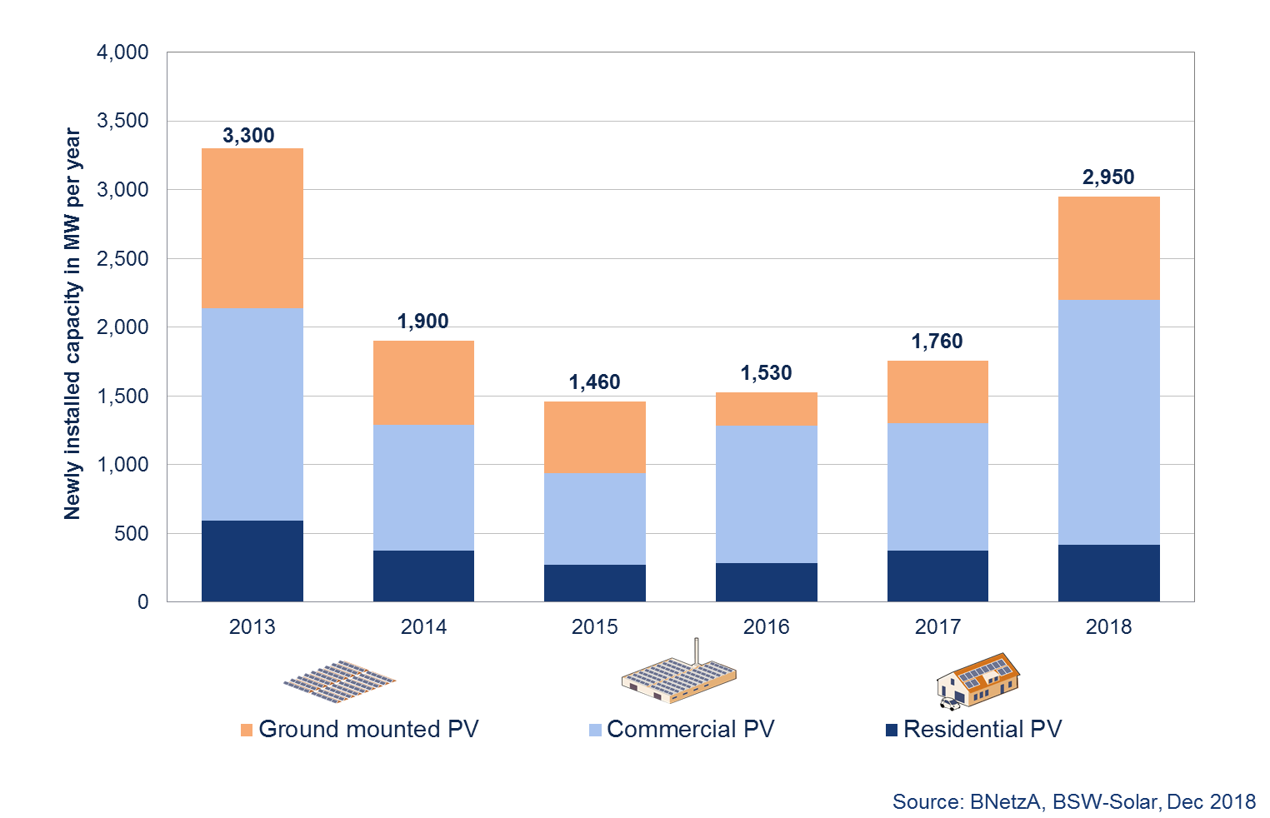
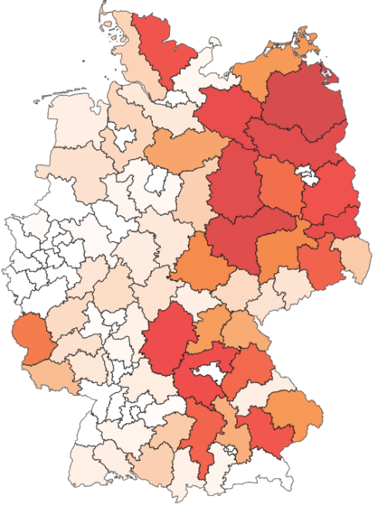
Recent Market Development (I) – the overall picture
In 2018 German PV market grew for the third year in a row
Commercial segment is the main market driver
Installation of ground mounted PV is concentrated in eastern Germany
PV Market Segment Development in Germany
Regional spread of ground mounted PV projects since 2015
( 1.7 GW in total)
160 MW

Slide 7
1. legal and fiscal framework conditions
Important to know: Security for investors is the key!
(Renewable Energy Sources Act)
Statutory regulations for the operation of renewable energy systems:
Connection and purchase obligations of grid operators to take up electricity from renewable energies
Feed-in tariffs in the form of moving market premiums, the amount of which depends on the current electricity price on the exchange, and fixed feed-in tariffs for smaller PV systems.
Feed priority for renewable energy systems
7
Notes:
EU Winter Package - Three legal principles continue to exist

Slide 8
1. legal and fiscal framework conditions
Important features of the EEG
Definition of plant and development corridor:
Plant term for solar energy: PV module = renewable energy system (§§ 3 No. 1, 100 Para. 1 S. 1 No. 1 EEG 2017)
Plant operator = "whoever uses the plant for the production of electricity from renewable energies or from mine gas independently of the property" (§ 3 No. 2 EEG 2017)
Expansion path: 2,500 MW gross (§ 4 no. 3). Adjustment of the breathing cap/degression:
Reduction of the observation period from twelve to six months (§ 49 para. 1 sentence 3)
Degression drops below 2,000 MW faster (300 MW - undershot - degression 0.25%, 700 MW - undershot - degression 0 %, 1,100 MW - undershot - increase 1.5 %, 1,500 MW - undershot - increase 3 % § 49 Abs. 3)
8
Notes:
Expansion path = desirable target quantity PV - energy policy target triangle

Slide 9
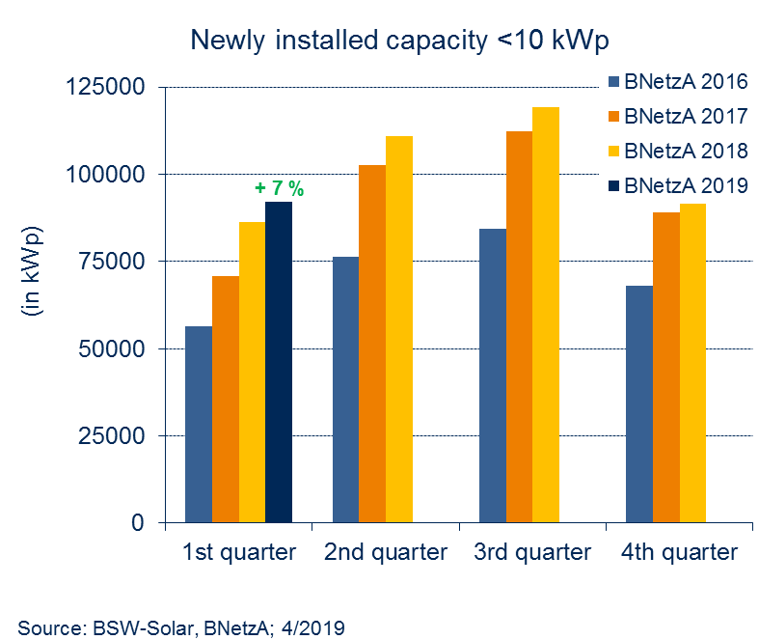
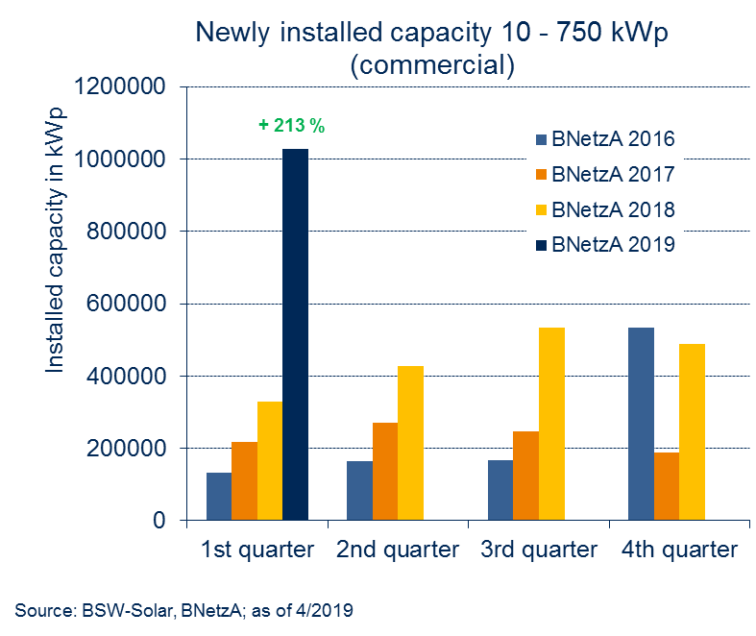
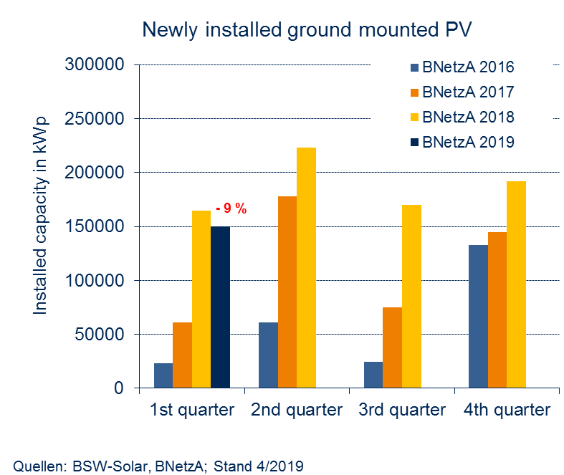
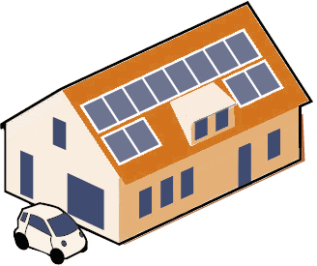
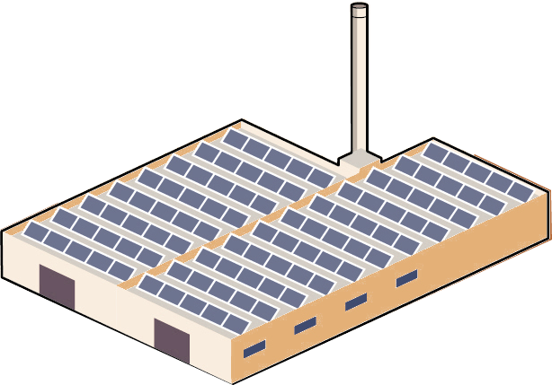
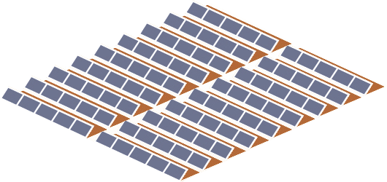
Recent Market Development (II) – Market Segments
Market Share 2018: 14 %
Growth rate 2018: +12 %
Market Share 2018: 60 %
Growth rate 2018: +92 %
Market Share 2018: 26 %
Growth rate 2018: +63 %

Slide 10
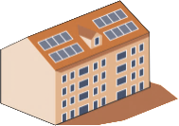
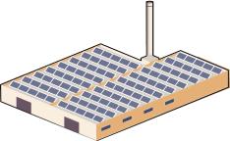
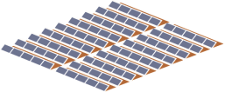
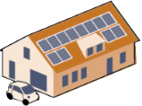
Basic photovoltaic structure - Typical building and area scenery (2017 figures)
1. legal and fiscal framework conditions
Building and area scenery
up to 10kW
> 10kW to 100kW
> 100kW up to 750kW
> 750kW up to 10MW
> 10MW
Market share PV extension
2017
1.700MW
22,0%
21,3%
30,3%
26,4%
de minimis limit 0% (§61a EEG)
3x a 200MW p.a.
(§28 EEG)
tenant flow
(Section 21 (3) EEG)
open space
Buildings / Area scenery
One and two-family houses
Small commercial roofs
MFH,
Barns/stables,
commercial operations
trade
administration
schools
Large agricultural holdings
Large supermarkets
factory buildings
open space
structural facilities
open space
Conversion areas
structural facilities
large roofs
Building site
Notes:
Structural facilities:
landfills, sewage treatment plants, waste dumps

Slide 11
1. legal and fiscal framework conditions
Basic photovoltaic structure - Typical plant operators (2017 figures)
Actor structure
up to 10kW
> 10kW to 100kW
> 100kW up to 750kW
> 750kW up to 10MW
> 10MW
Market share PV extension
2017
22,0%
21,3%
30,3%
26,4%
de minimis limit 0% (§61a EEG)
3x a 200MW p.a.
(§28 EEG)
tenant solar
(Section 21 (3) EEG)
open space
private individuals
building owner)
small trade
private individuals
farmers
small businesses, public sector
Farmers Farms
open. hand
fund
Project companies
ENERGY SUPPLY COMPANY
fund
Project and civil societies
ENERGY SUPPLY COMPANY
ENERGY SUPPLY COMPANY
Capital-gsl.
Plant operator

Slide 12
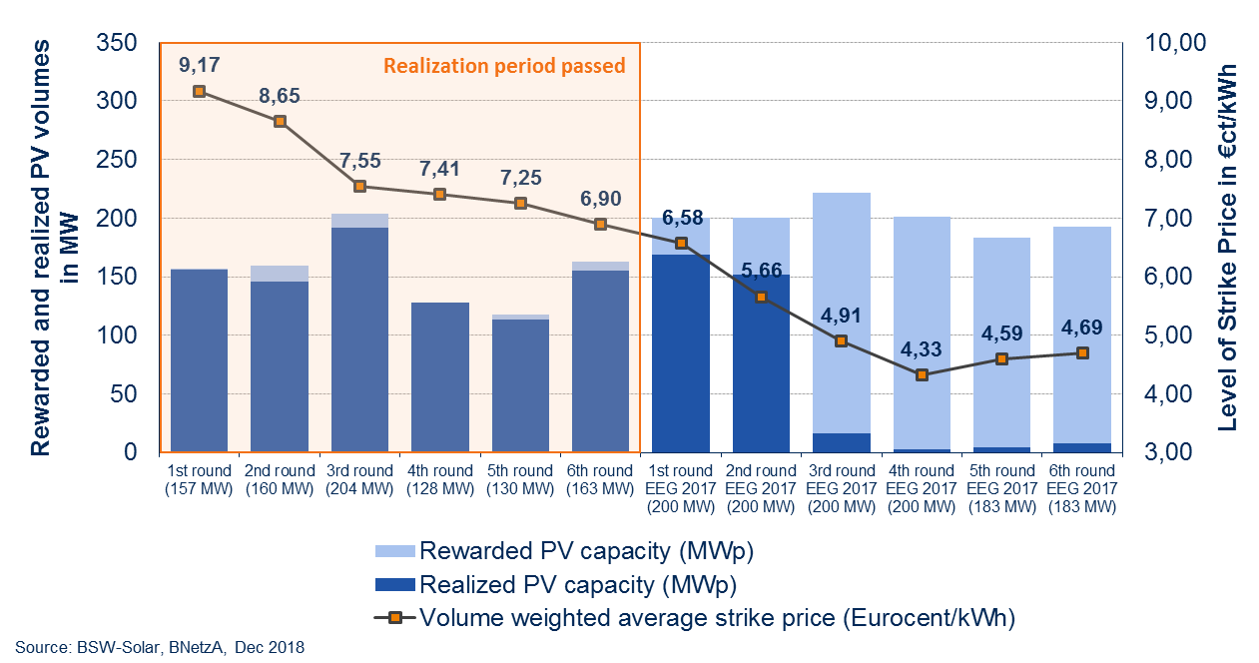
Recent Market Development (II) - Tenders
Since first round in April 2015 average prices nearly cut in half
Intensity of competition has been constantly high
So far more than 90% of rewarded projects were realized in time
PV tender results and level of strike prices since April 2015

Slide 13
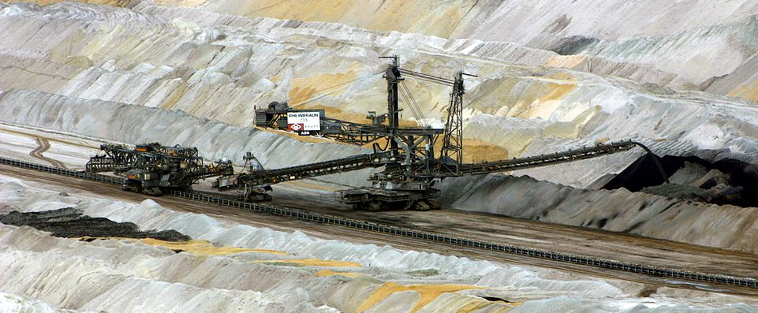
Political Background – Extra Tenders
The recent governments coalition agreement demanded 4 GW extra capacity for each PV and Wind until 2020
A Coal Commission was tasked with preparing a roadmap for phasing out coal. It has concluded its work, and according to the consensus found, Germany should complete its exit from coal no later than 2038
The agreement also required that the grid has to be prepared for more RES
A revision of the German renewable energy act (EEG) was adopted in late 2018
The compromise included the agreed volumes of extra tenders for both PV and wind installations until 2021, also measures to improve grid stability and system integration and so called “innovation tenders” were introduced
Dates and volumes of extra tenders:
Foto: Elsdorf-blog.de
Notes:
Power generation accounts for a significant share – 37% – of Germany’s greenhouse gas emissions. Lignite and coal-fired power plants account for around 80% of this sector’s emissions, yet they produced only 35% of Germany’s electricity in 2017. Shutting down these power plants therefore holds the key to protecting the climate.
The electricity mix has a considerable impact on the climate footprint of the transport and buildings sectors as well: the amount of green energy in the grid determines the environmental performance of electric cars and heat pumps.
Germany is still operating many coal-fired power plants that date back to the 1960s, 1970s and 1980s. Besides being extremely inefficient and releasing carbon dioxide into the atmosphere, they emit fine particulate matter and other substances which are harmful to the health of local communities. Even so, in lignite regions in particular, communities feel a strong connection to the familiar structures and fears of job losses run high.
In June 2018, the German government established the Commission on Growth, Structural Change and Employment (also known as the Coal Commission), tasked with preparing a roadmap for phasing out coal. The Commission concluded its work in late January 2019. Its 28 voting members from politics, academia, industry, trade unions and environmental groups included an Oeko-Institut expert, Dr Felix Matthes. The Commission was mandated to look at all the environmental, economic and social implications of the exit from coal and, as far as possible, facilitate a consensus.
According to the Commission, Germany should complete its exit from coal no later than 2038 and allocate 40 billion euros in structural support to mitigate the social impacts of the transition in mining regions. From a climate perspective, the priority is to make fast progress with the exit early on and thus avoid substantial carbon emissions: Germany should therefore shut down 12.5 gigawatts of coal-fired power plant capacity by 2022.
In addition, installed capacity at coal-fired power plants should be cut by 60% to 2030 against the 2017 baseline. As far as possible, emissions should be steadily reduced from 2023 to 2030. A review should be conducted in 2032 to assess whether the phase-out of coal-fired electricity generation could be completed as early as 2035, with Germany’s last coal-fired power plant going offline no later than 2038.

Slide 14
Political Background – Recent Developments
Energy Collective Law passed at the end of 2018:
Reductions in remuneration for PV systems 40-750 kWp and adjustment of calculation of tenant electricity surcharge
Special tenders for PV systems >750kWp
Innovation tenders (regulation expected shortly)
Changes to the degression mechanism according to § 49 EEG (2019 52 GW calculated without open field installation tenders)
47.2 GW installed so far - only 5 GW “to go”, Final spurt possible BSW-Solar lobbying hard to remove the cap
Picture: BSW-Solar
Notes:
Energy Collective Law passed at the end of 2018:Reductions in remuneration for PV systems 40-750 kWp and adjustment of calculation of tenant electricity surchargeSpecial tenders for PV systems >750kWpInnovation tenders (Regulation expected shortly)Changes to the degression mechanism according to § 49 EEG (2019 52 GW calculated without FF tenders)52 GW coverExpected end of 2020; 47.2 GW installed so far 5 GW open, final spurt possibleCurrently political negotiation

Slide 15
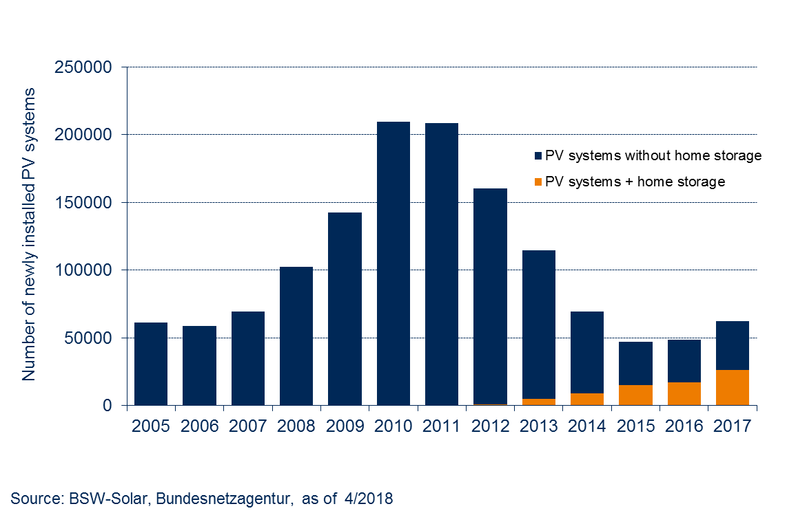
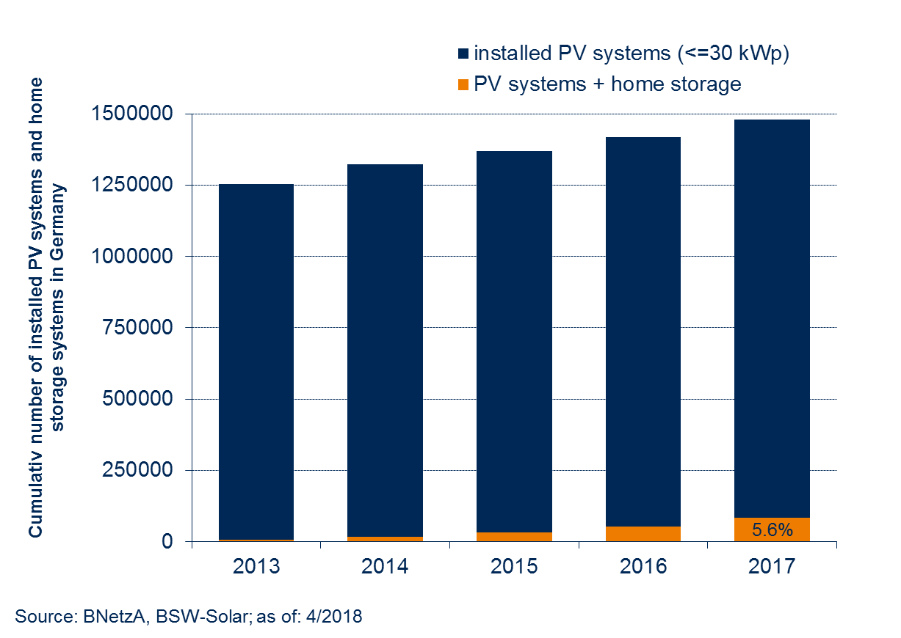
Trend (I) Storage
…a huge potential for further growth
More than 1.4 m rooftop PV systems without home storage systems
Retrofit potential is growing by declining storage prices
Expected storage parity in 2019
Combination with EV expected to drive the market further
~ 40,000 new stationary battery storage systems in 2017 (~125,000 batteries installed at the end of 2018)
Average annual growth rate: around 50 % since 2013
More than 50% of the newly installed PV plants (up to 30 kWp) are installed in combination with a storage system
AND…

Slide 16
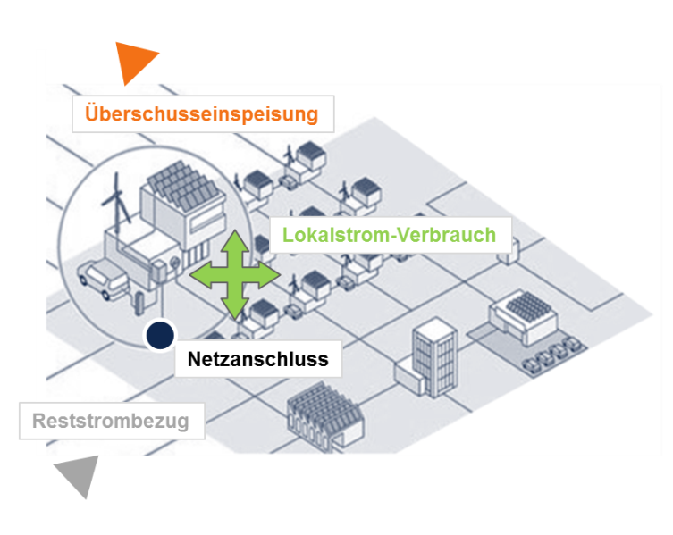
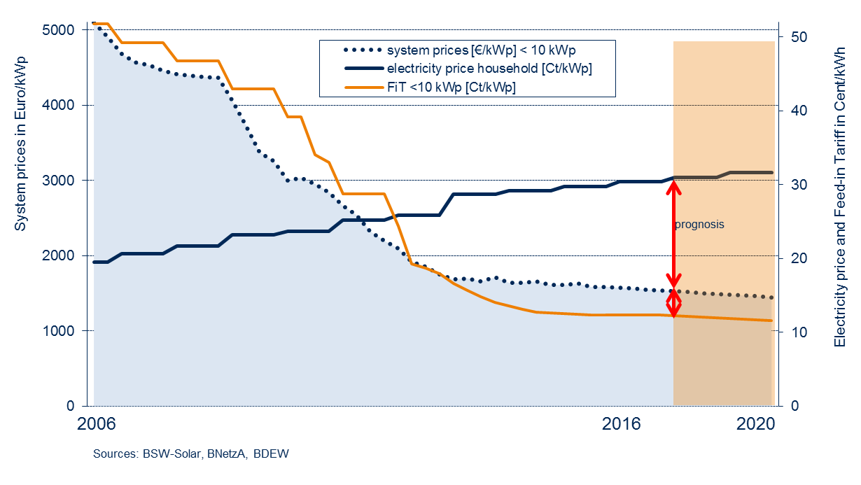
Trend (II) Self-consumption / Prosuming?
Decreasing PV system prices reduce electricity cost; as a driver of the majority of PV installations
In many cases solar energy is cheaper than electricity from the utility
Particularly attractive in the commercial / industrial sector

Slide 17
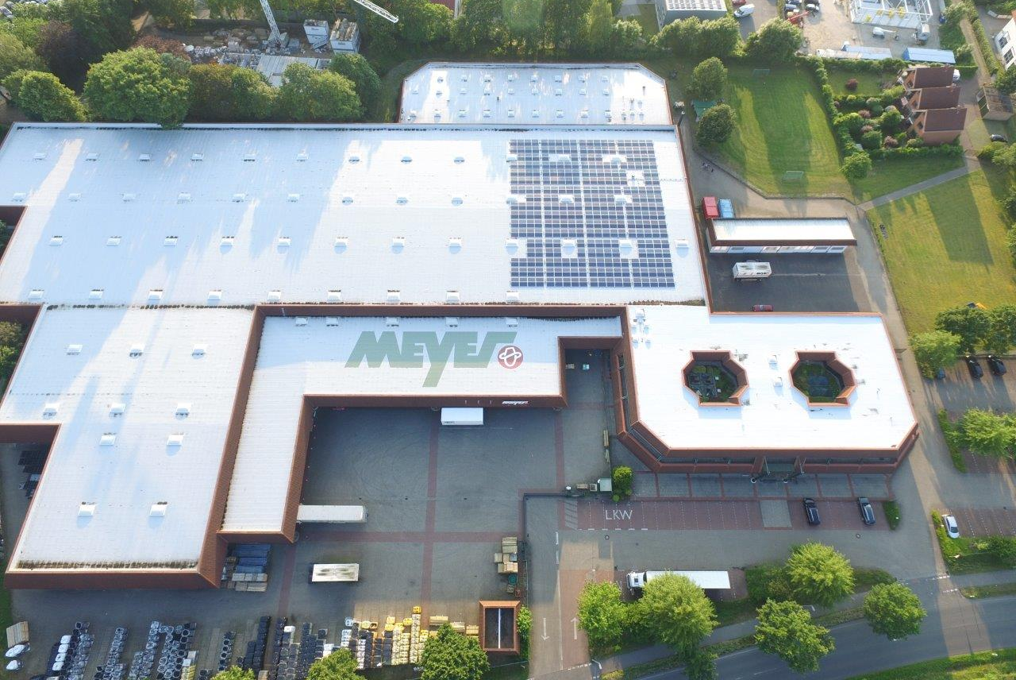
Trend (III) Growing commercial and industrial segment
Rooftop systems up to 750kWp; no special building permit required
Best with east / west orientation to produce more electricity throughout the day - increases self-consumption!
Self-consumption possible, but there is a EEG surcharge of approx. 2.7 €ct / kWh
PV electricity production costs (all in) <10 € ct / kWh
Feed-in-Tariff up to 100kWp: currently ~ 8 €ct/kWh (20 years)
> 100kWp: mandatory direct marketing (Compensation = Feed-in-Tariff minus market price)
Foto © Christian Meyer, Hermann Meyer, Germany

Slide 18
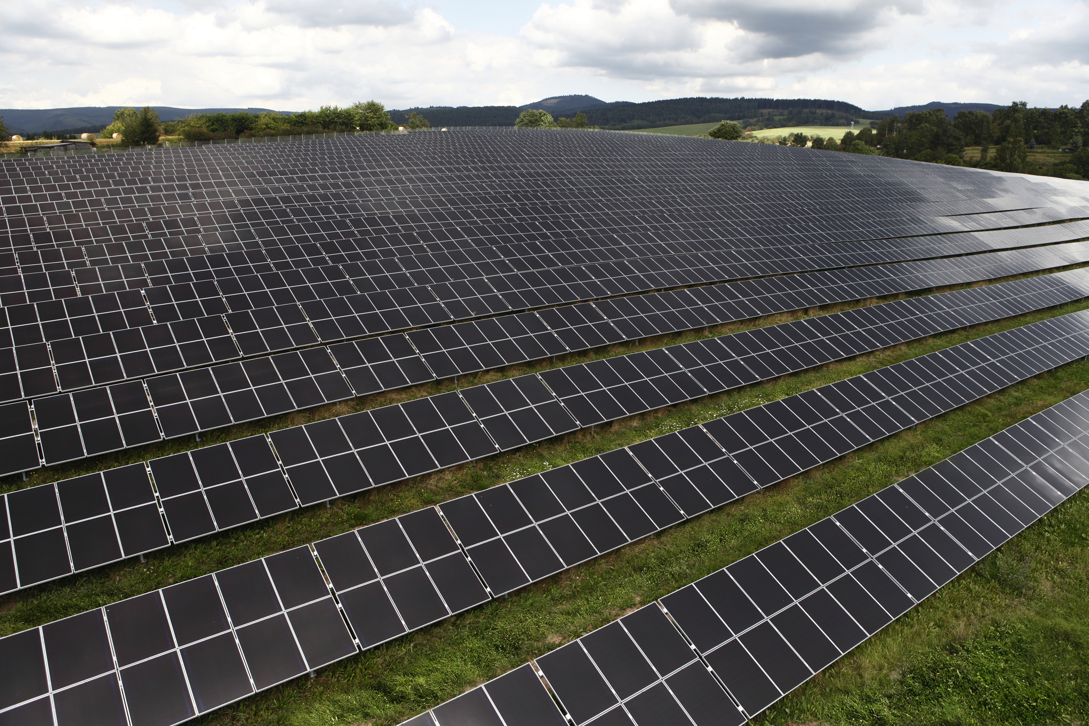
Trend (IV) Power Purchase Agreements (PPAs)
Trends
First projects in Germany are being realized after lengthy discussion
Customers are often utilities
Problems: lack of practical experience, models partly unknown
BSW Survey: Potential of 1 GW per year
Investors Perspective
PV systems >20 years (post EEG) of greater interest
Tender (sometime) unattractive because of penalties, restrictions regarding the location → PPAs: free choice of locations, no limitation regarding plant size (>10 MW) hence lower installation costs and falling LCOEs
Customers Perspective
Stable power prices (customers)
Marketing tool → regional focus; clean power from RES

Slide 19
Agenda
BSW-Solar
Latest trends in Germany‘s PV market
C&I segment as market driver
Digitizing grid-connected PV
Outlook

Slide 20
20
Self-consumption model – what makes PV so attractive Reduction of electricity price components possible (industrial plant)
Price components electricity bill*
0 or 40% of the total
The EEG levy
The electricity tax
concession fees
network charges
The CHP levy
§19 Allocation
The offshore liability allocation
The switchable load allocation
*Average electricity prices for industry in ct/kWh (incl. electricity tax)
Annual consumption 160,000 to 20 million kWh (medium-voltage supply; 100kW/1,600h to 4,000kW/5,000h consumption)
20

Slide 21
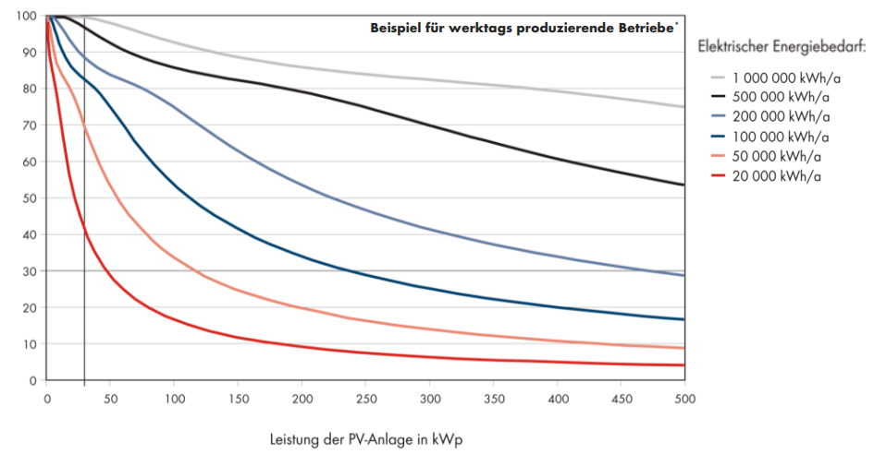
Basic information - Own consumption rate: Percentage of self-consumed PV electricity
self-consumption rate
SC-quota up to approx. 85% with a system size of 200kWp
Power requirement and system size determine SC rate
Source: SMA

Slide 22
Basic information - Degree of self-sufficiency: Percentage of electricity demand covered by PV electricity
The level of the self-sufficiency rate results from the load profile of the industry
Source: SMA, DGS

Slide 23
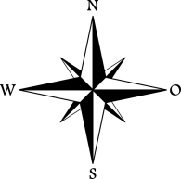
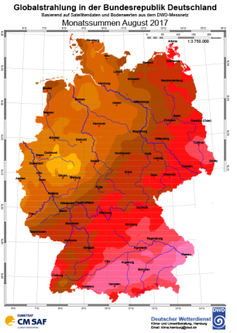
Set up of a system - Yield factors during the operation of a PV system
solar radiation
roof pitch
Max. Yield south provide roof areas with 30% inclination
Roof areas to the west with an inclination of less than 25% also achieve high yields
Ideal east/west orientation for own consumption
Regional yield data
Geographical location
Shading conditions
specific local conditions
(Max. radiation: 1367kWh/m2)
PV components
Service life of 25 - 30 years possible
High quality components

Slide 24
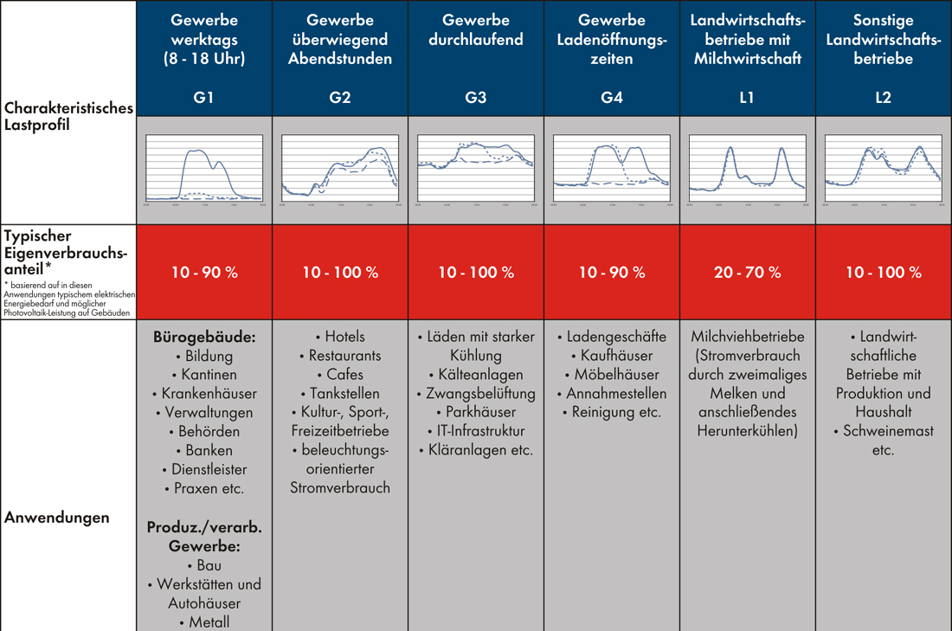
Typical consumers in C&I segement- SC rates as a function of the specific load profile of commercial enterprises
Commercial daytime
8-18 h
Commercial afternoon / evening
Commercial contious
Commercial shop hours
Agriculture – dairy production
Agriculture – others
Typical load profile
Self consumption ratio
Office buildings
Education
Canteens
Hospitals
Amdinistaration
Public Agencies
Banks
Service providers
Medical institutes
C & I
Construction
Crafts facilities, Auttomobile Sales offices
Hotels
Restaurants
Cafes
Service stations
Cultural, sports, leisure business
Lighting
Shops with cooling
Cooling / ventilation facilities
Parking buildings
IT-infracture
Sewage cleaning facilities
Shops
Department stores
Cleaning Services
Dairy process plants
(milking (2 day) & cooling
Agricultural companies with production and linving area
Animal raising
Use case
examples
etc.
Source: SMA

Slide 25
Agenda
BSW-Solar
Latest trends in Germany‘s PV market
C&I segment as market driver
Digitizing grid-connected PV
Outlook

Slide 26
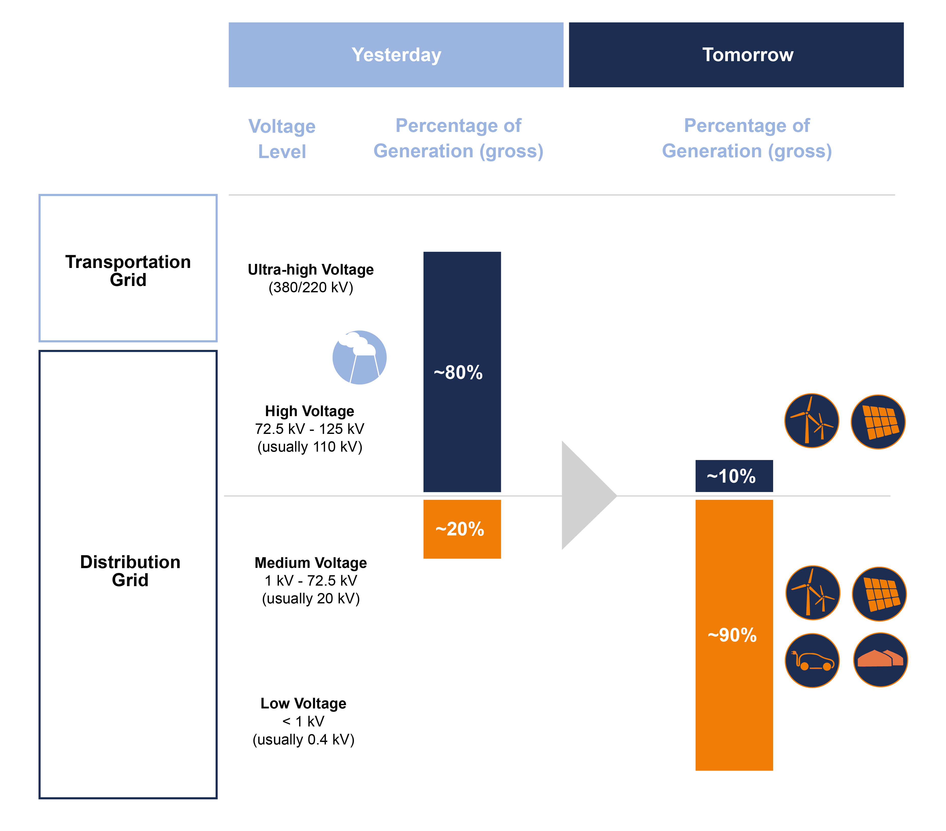
Renewables A shift towards distribution grids

Slide 27
Renewables A shift towards distribution grids – consequences
A shift towards distribution grids equals a growing complexity.
Growing complexity demands a higher grade of coordination.
A higher grade of coordination demands a higher level of situation awareness.

Slide 28
Solution: the digitalization of the energy transition
How can we coordinate the growing complexity of the energy system due to the integration of renewables?

Slide 29
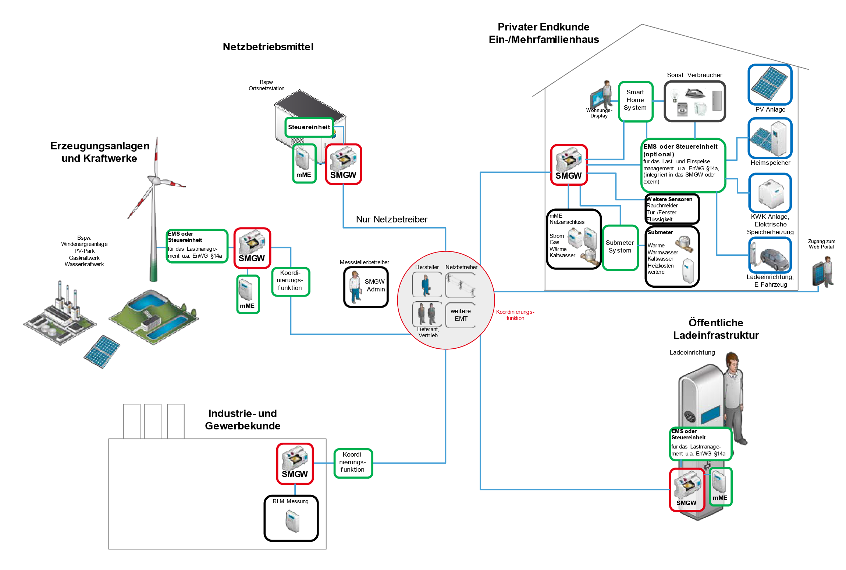
The current solution: the smart meter gateway

Slide 30
Agenda
BSW-Solar
Latest trends in Germany‘s PV market
C&I segment as market driver
Digitizing grid-connected PV
Outlook

Slide 31
Outlook & Summary
After a few years of relatively weak market development, we now see increasing installation rates as the simultaneous nuclear and coal phase-out drives demand.
For Germany in 2019, we expect
Residential PV: 450 – 500 MW in 2019 (2018: 420 MW)
Commercial PV: 2,100 – 2,400 MW in 2019 (2018: 1,780 MW)
Ground mounted PV: 900 – 1,100 MW in 2019 (2018: 750 MW)
Total market (expected): 3,500 – 4,000 GW in 2019 (2018: 2,950 MW)
Market drivers Tender; Regular-, Extra-, Joint- and Innovation-Tenders; Tender-Volume: 2019 ~ 2.0 GW; 2020 ~ 2.5 GW; 2021 ~ 2.8 GW
Main business models / without tenders: Commercial/Industrial PV, Prosuming, PPAs, Storage - All segments hedge electricity costs!
Estimations show an additional investment volume of about 3.5 to 4.5 billion Euros in the German PV market due to the extra tenders
We also expect a rising PV share in German gross power consumption; In 2018 about 8 percent; 2020 up to 10 percent feasible

Slide 32
Thank you very much
for your attention!
Mathias Böswetter
Head of Digital
German Solar Association
boeswetter@bsw-solar.de
Source: Solarmarkt

