Slide 17
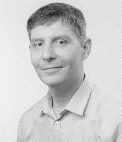
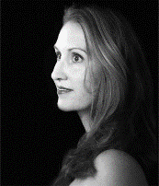
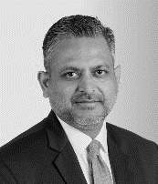
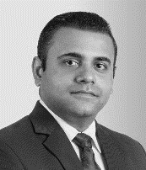
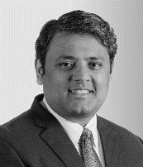
Contact Us
Khaitan & Co events@khaitanco.com | Indo-German Chamber of Commerce (IGCC) bombay@indo-german.com
Boris Alex Director South Asia Germany Trade and Invest
Anja Klos Consul Consulate General of the Federal Republic of Germany
Rabindra Jhunjhunwala Partner M&A and Corporate Practice, Khaitan & Co
Anshul Prakash Partner Employment, Labour and Benefits Practice, Khaitan & Co
Sameer Sah Partner Corporate and Commercial Practice, Khaitan & Co

