Slide 1
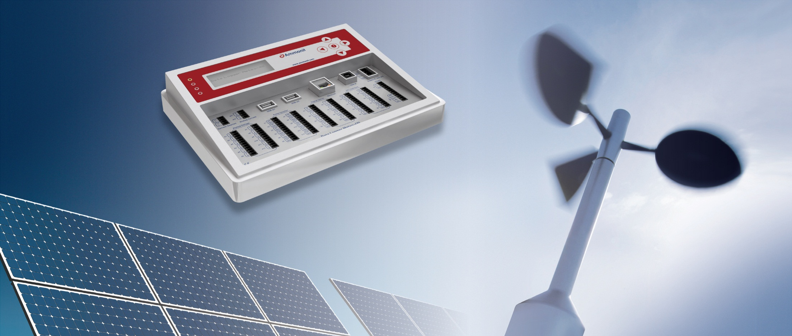
Site-specific Wind Resource Assessment for Accurate Wind Energy Yield Calculations
Hoang Thi Giang, Vietnam Partner of Ammonit Measurement GmbH

Slide 2
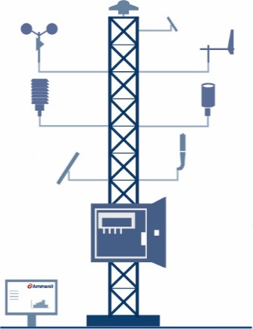
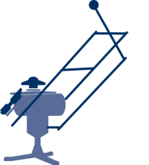
Ammonit Company Profile
German company, based in Berlin
+25 years of know-how (founded in 1989)
Projects in more than 100 countries
Measurement equipment for the following activities: Before the construction of a wind or solar power plant
- Wind Resource Assessment Measurements
- Solar Resource Assessment Measurements
- Soiling Measurement
After the construction of a power plant
- Wind Monitoring Systems (SCADA)
- Solar Monitoring Systems
- Power Curve Measurements
- Soiling Measurement
Solar Measurement
Wind Measurement
Notes:
13.05.09
2

Slide 3
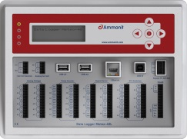
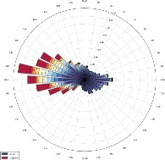
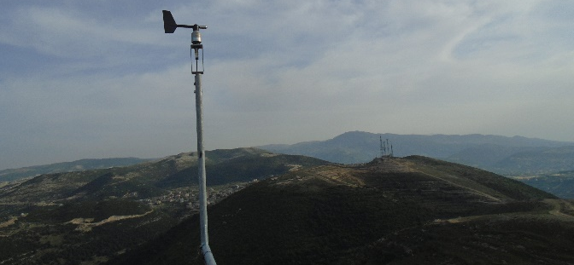
Ammonit Company Profile
Own products with own development
Data loggers → Meteo-40
Online Software for campaign monitoring → AmmonitOR
Complete first class measurement systems Wind sensors from the German company Thies
Solar sensors from the Japanese company EKO
SoDAR devices from Swedish company AQ System
LiDAR devices from UK company ZephIR Lidar
Configuration of cables, cabinets, … → designed and assembled by Ammonit
Notes:
13.05.09
3

Slide 4
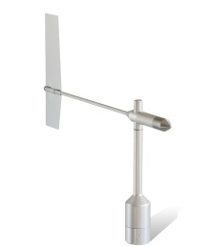
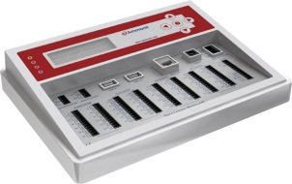
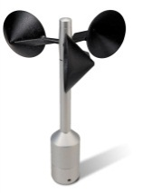
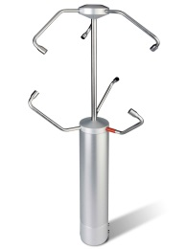
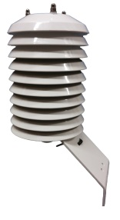
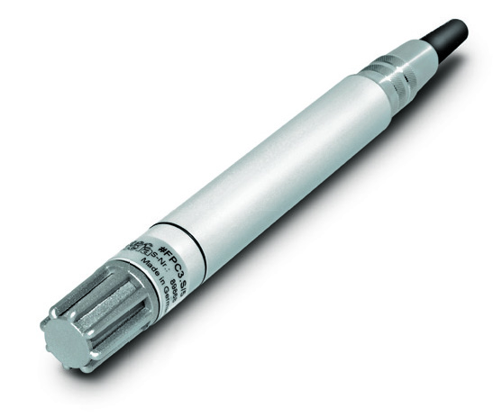
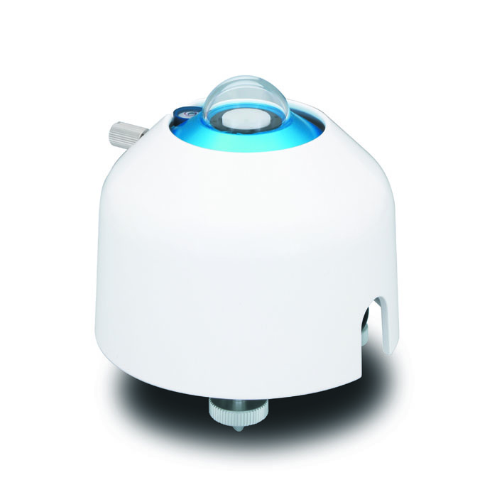
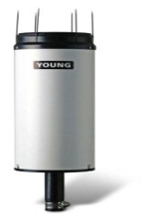
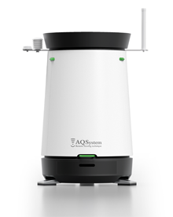
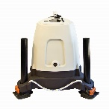
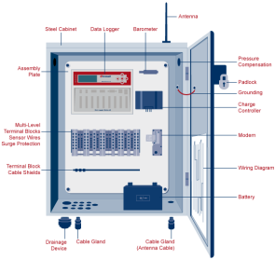
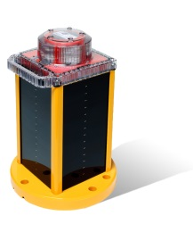
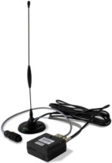
Ammonit Product Portfolio
Data Loggers |  | Anemometers |  | Wind vanes
Ultrasonic Anemometers |  | Barometers |  | Temperature & Humidity Sensors
Pyranometers Pyrheliometers Sun Trackers / RSI |  | Precipitation |  | Remote Sensing Systems
Steel Cabinets |  | Communication & Power Supply Systems |  | Obstacle Lights

Slide 5
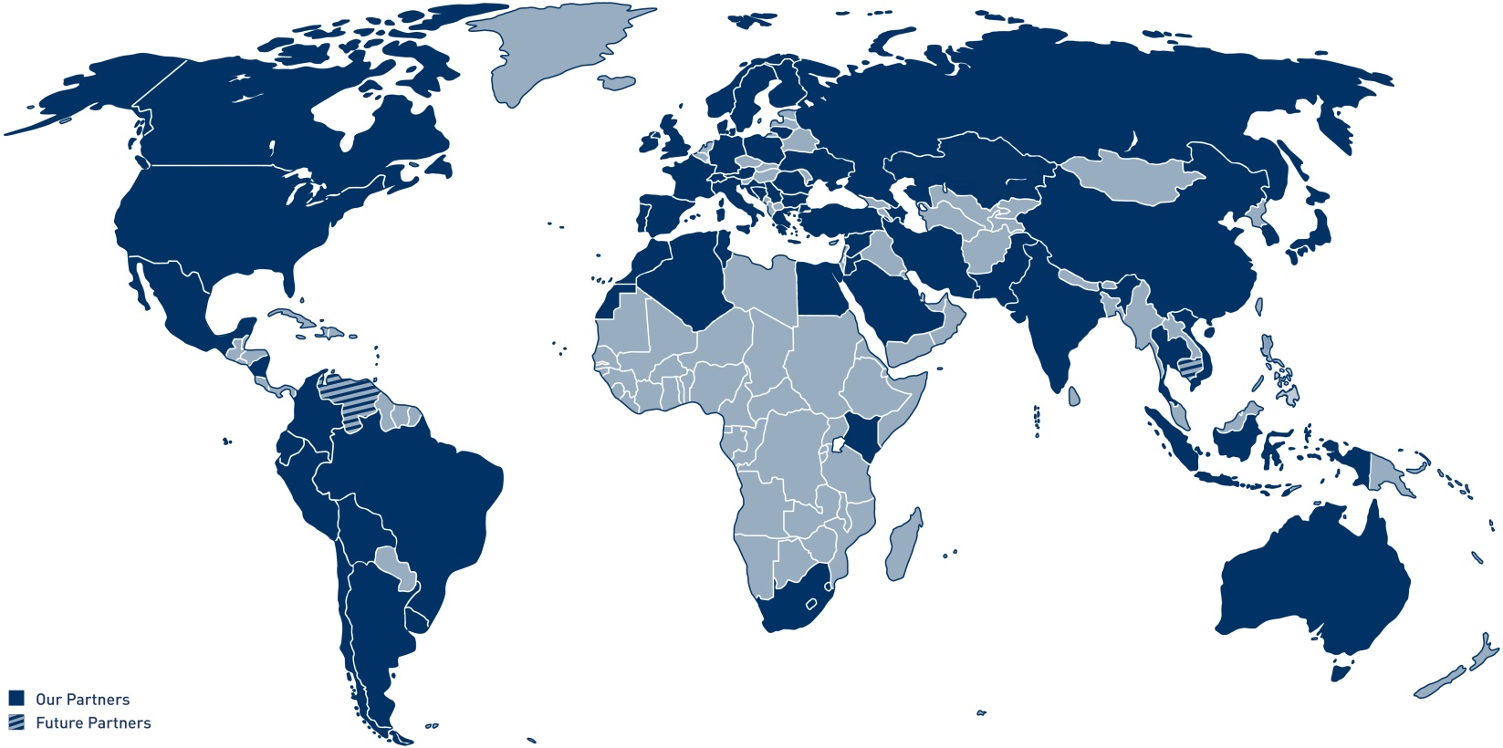
Ammonit Global Partner Network
Ammonit cooperates with local partners for:
Assembly of systems (cables, solar supply, ...)
Mast and system installation
Maintenance of the system
Ammonit Partner in Vietnam
Thinh Phong Ltd. E-mail: thinhphongndv@gmail.com

Slide 6
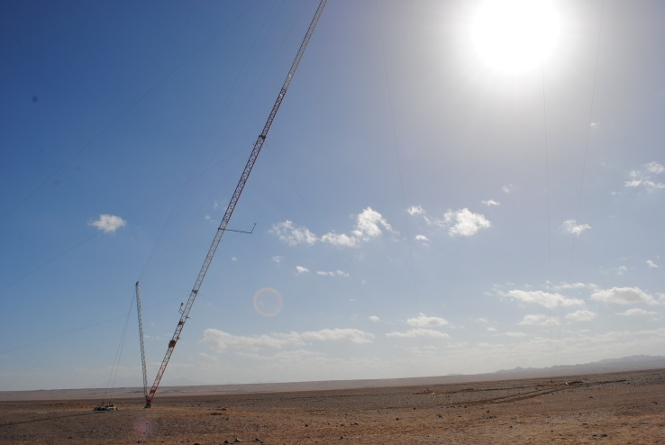
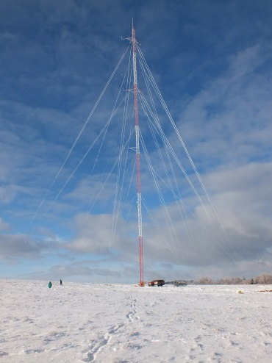
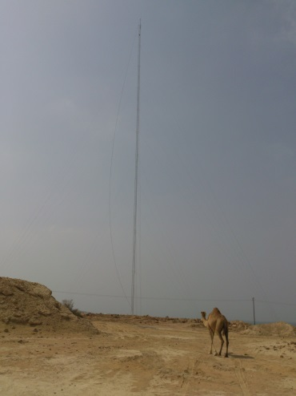
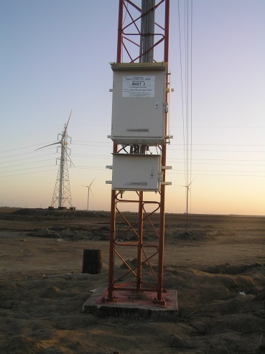
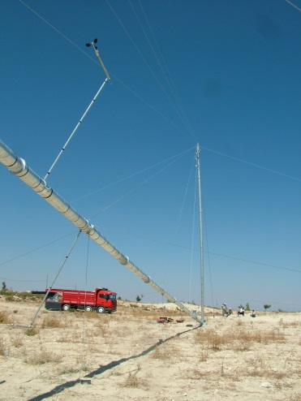
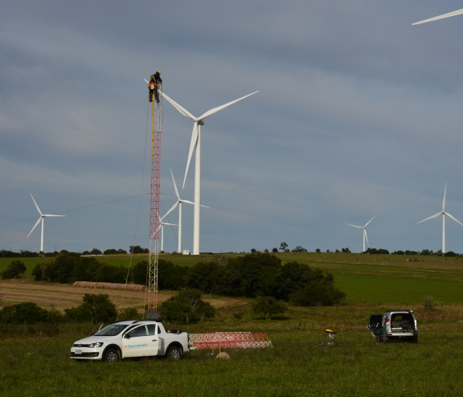
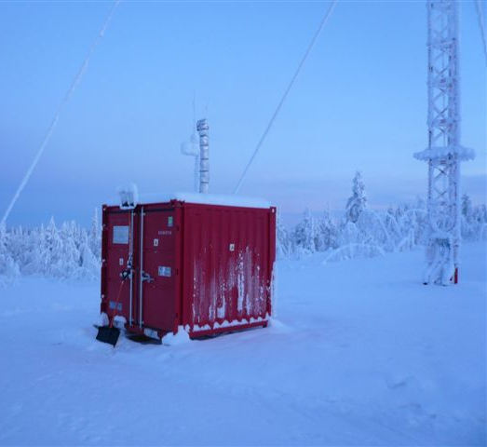
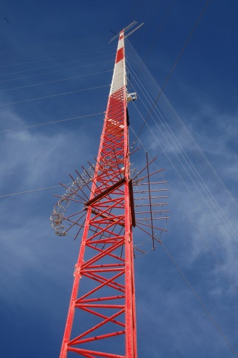
Ammonit References for Wind Resource Assessment (I)
Egypt
Bulgaria
Iran
Pakistan
USA
Turkey
Uruguay
Finland

Slide 7
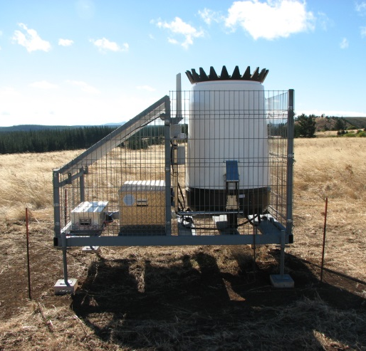
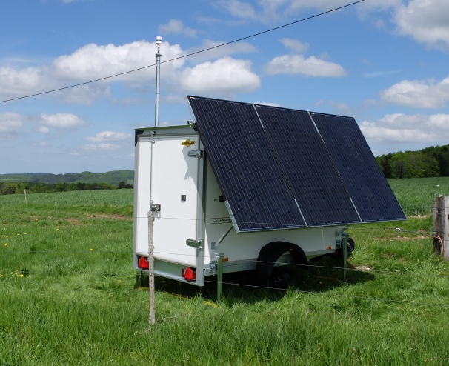
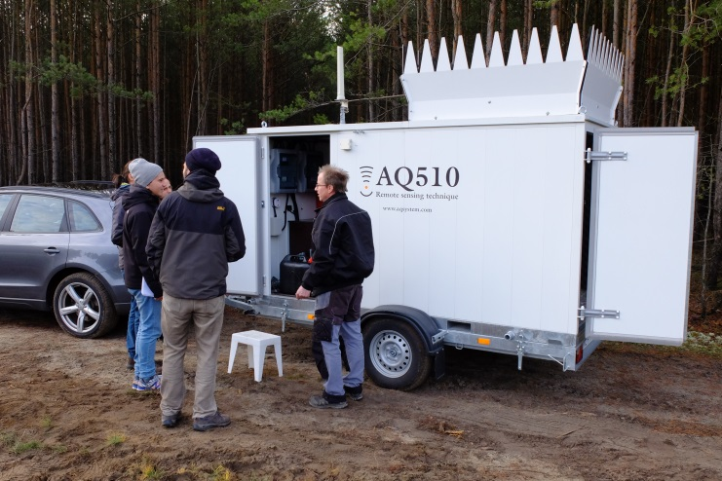
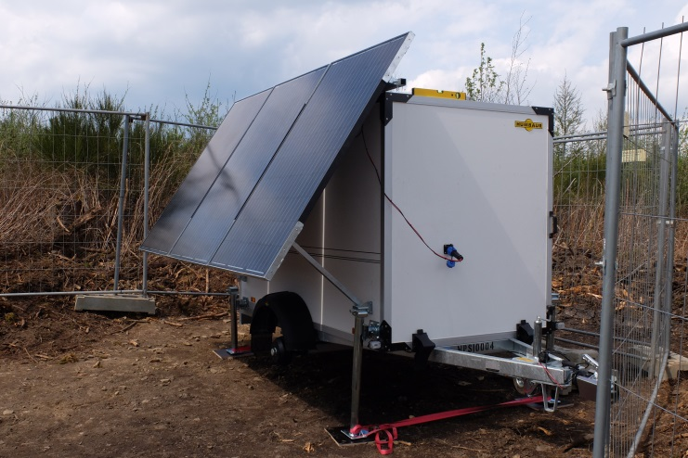
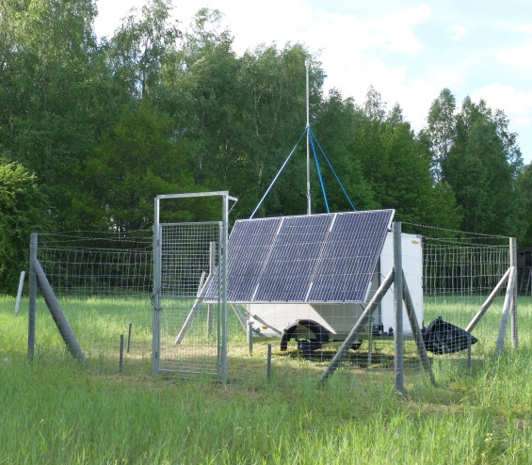
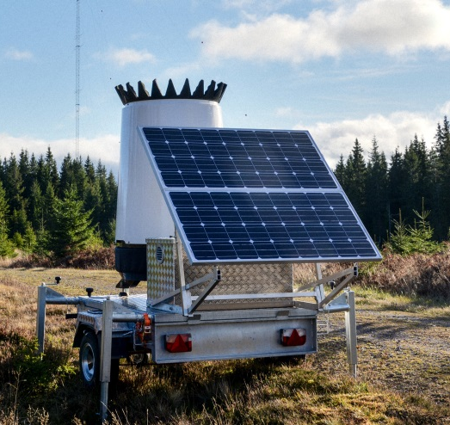
Ammonit References for Wind Resource Assessment (II)
SoDAR in Chile
LiDAR in Switzerland
SoDAR in Germany
LiDAR in Germany
LiDAR in Germany
SoDAR in Sweden

Slide 8
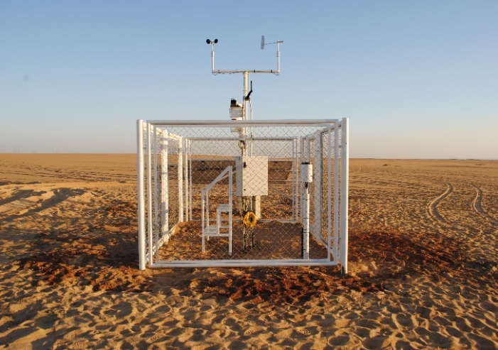
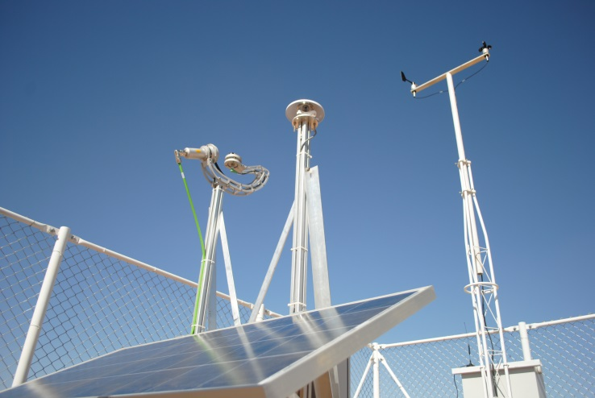
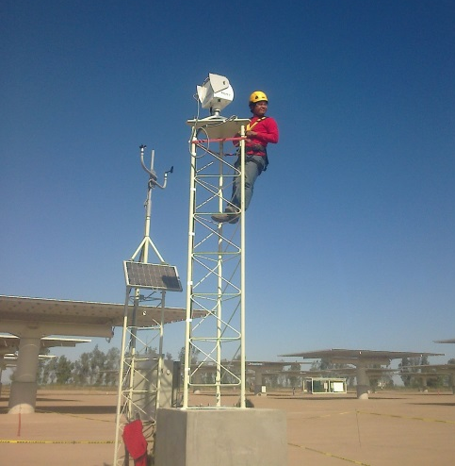
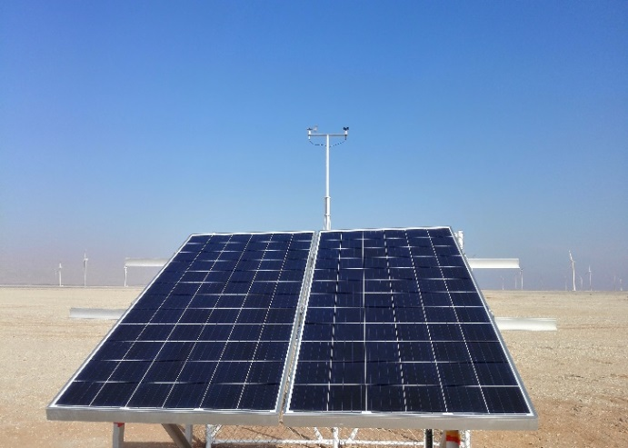
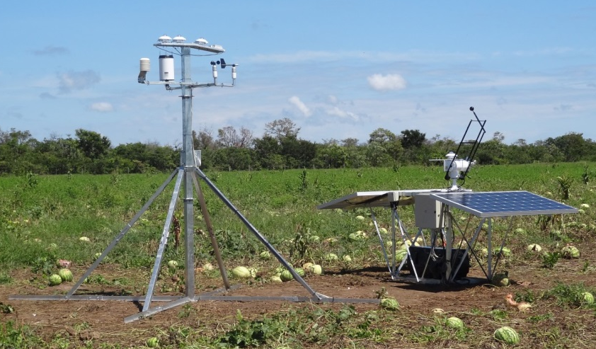
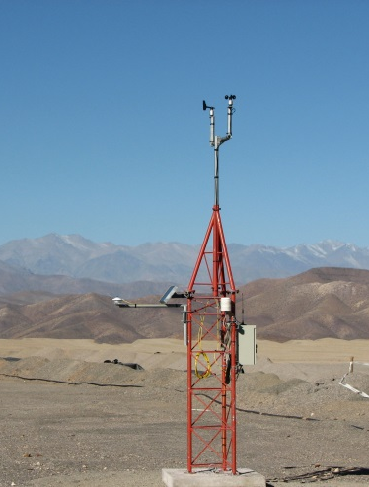
Ammonit References for Solar Resource Assessment
Egypt
Egypt
Mexico
Egypt
Brazil
Chile

Slide 9
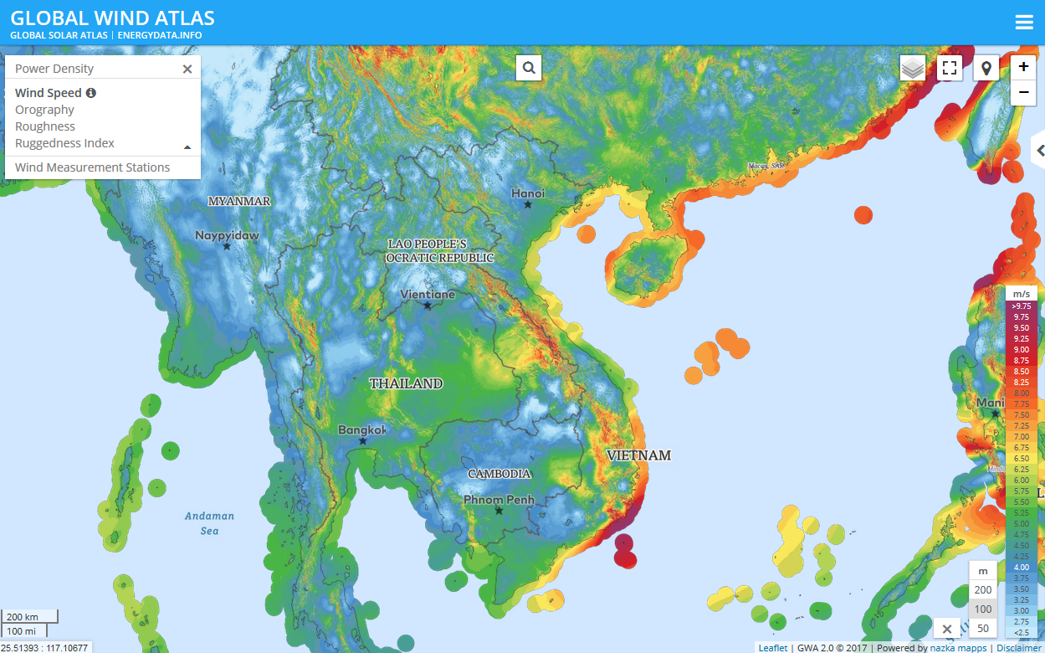
Wind Power Potential in Vietnam
Good and great potential for wind energy generation with approx. 3,000 km coastal line
Existing wind atlas whereas the data quality is insufficient for energy yield calculations → Site-specific measurements for accurate bankable energy yield calculations necessary

Slide 10
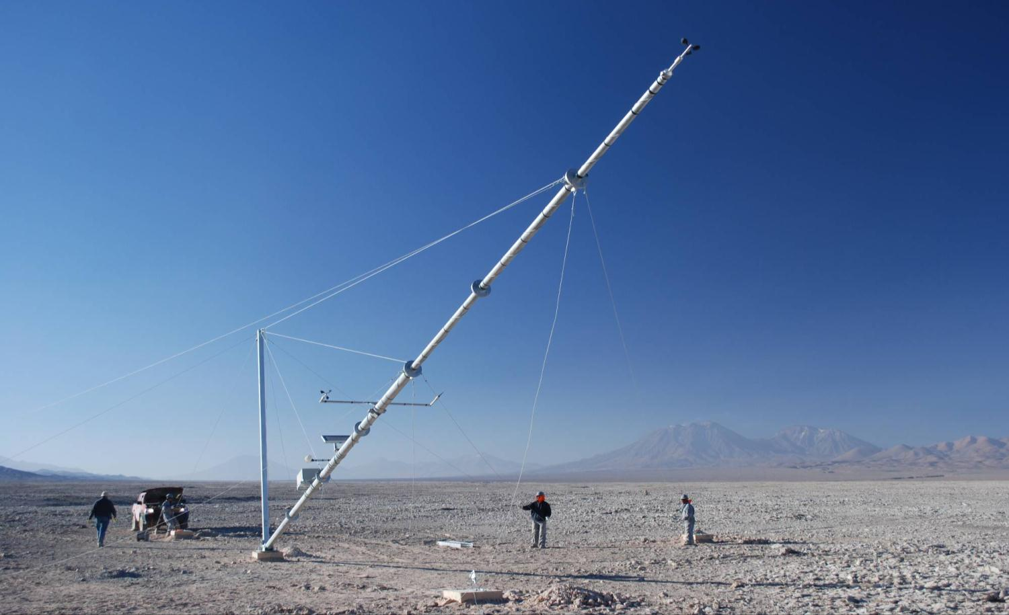
Wind measurement – Why?
Wind Resource Assessment Wind Farm Monitoring
Climate Research
Photo by GIZ: Wind site assessment in Northern Chile

Slide 11
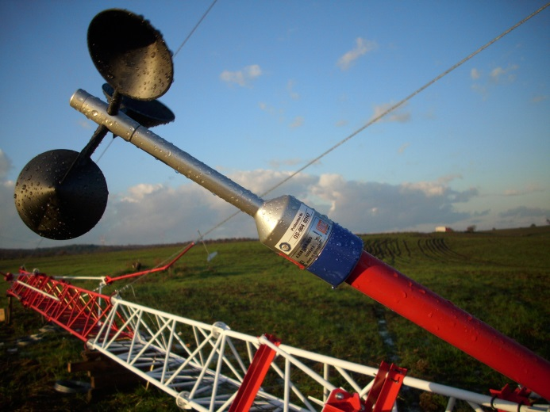
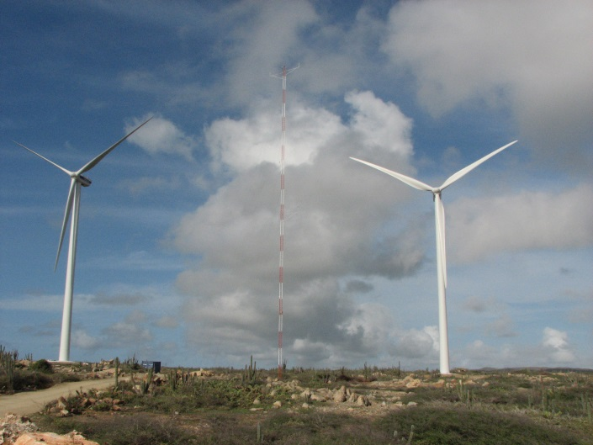
Why Wind Measurement is important?
Commercial view
Wind resource assessment to design profitable wind farms
Wind farm monitoring to ensure high productivity
Site monitoring to organize efficient maintenance schedules
Meteorological and governmental view
Wind maps
Climate research

Slide 12
International Standard for Wind Power Performance Measurement
Standards + Guidelines
IEC 61400-12-1 (2017) „Power Performance Testing”
Set-up of a met mast including installation of sensors, sensor quality regarding accuracy and reliability
MEASNET (2016) „Evaluation of site specific winds”
Process of site assessment incl. data collection, evaluation and interpretation
Criteria for data quantity and quality, as well as reporting
Focus on data quality, plausibility and integrity incl. data filtering and reporting
→ Fulfilled with Ammonit Measurement Systems
Quality criteria for SoDAR / LiDAR devices and ultrasonic anemometer for wind assessment / traceability of measurement data
→ Fulfilled with Ammonit Measurement Systems
Notes:
18.09.09
12

Slide 13
Betz Law
Wind speed
Wind energy is proportional to the cube of the wind speed according to Betz’ law: Wind power is P = 1/2 • ρ • A • v³ Δ1% wind speed ≈ Δ 3% wind energy
Measure the wind conditions to calculate the wind energy
A is the area;
ρ is the air density, ρ = p / (R • T), being p the air pressure, T the air temperature and R the gas constant;
v is the wind speed
Notes:
18.09.09
13

Slide 14
Why high quality measurement equipment?
Leverage Effect: Impact of measurement error on profitability
A small error in the energy assessment has a huge impact in the profitability of a project.
P = 1/2 • ρ • A • v³
v
P
P
$$$$$
wind
measurement
(error)
energy
assessment
(error)
profitability
calculation
(error)
1st leverage effect
2nd leverage effect
1% wind speed error => 3% wind energy error

Slide 15
Impact of Measurement Errors on Estimated Annual Energy Production (AEP)
Comparison of the Impact of Different Wind Sensors on the Assessment
Reduce measurement errors by installing high quality sensors
Even small discrepancies in the evaluation of wind speed data lead to significant deviations in the assessment calculations
 | Generated Energy Error by 1% Measurement Error | Notes
Anemometer | Δ1% wind speed → Δ3% energy | Most important measurement
Wind vane | No direct relation, but eventually wrong wind farm design | Important measurement for wake effect
Barometric pressure sensor | Δ1% pressure → Δ1% energy | Extrapolation of pressure possible once site is known
Temperature sensor | 1°C → 0.35%
Humidity sensor | with 40°C; 1% → 0.05%
Notes:
18.09.09
15

Slide 16
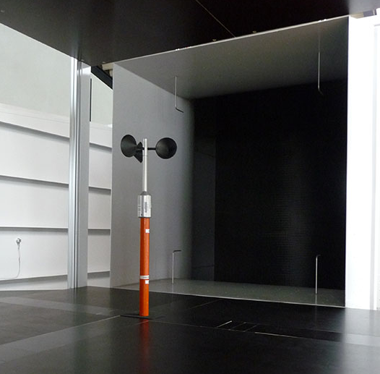
Calibration Service via Ammonit Wind Tunnel GmbH
New company founded by Ammonit Measurement GmbH and Wind-consult GmbH
Independent test laboratory according to DIN EN ISO / IEC 17025
Accredited by DAkkS and certified by MEASNET
Became a member of MEASNET Group in April 2017
Benefit from sensor calibration at Ammonit Windtunnel
Faster service
Better prices than other Germany calibration institutes
Calibration of cup anemometers, wind vanes and ultrasonic anemometers
Download of calibration certificates via website of Ammonit Windtunnel
Calibrated sensors available on stock

Slide 17
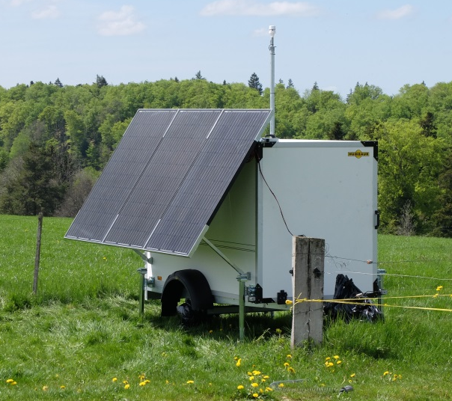
Remote Sensing Devices for Wind Resource Assessment and Monitoring
SoDAR AQ 510 Windfinder
SoDAR = Sound Detection And Ranging
Doppler effect → outgoing sound beams reflected by the aerosols in the wind flow
Fully classified acc. to IEC 61400-12-1:2017
Wind speed and direction measurement between 40 … 200 m
LiDAR ZephIR 300
LiDAR = Light Detection And Ranging
Doppler effect → outgoing laser beam reflected by the aerosols in the wind flow
Fully classified acc. to IEC 61400-12-1:2017 with finance-grade data accepted by DNV GL
Wind speed and direction measurement between 10 … 200 m
Notes:
18.09.09
17

Slide 18
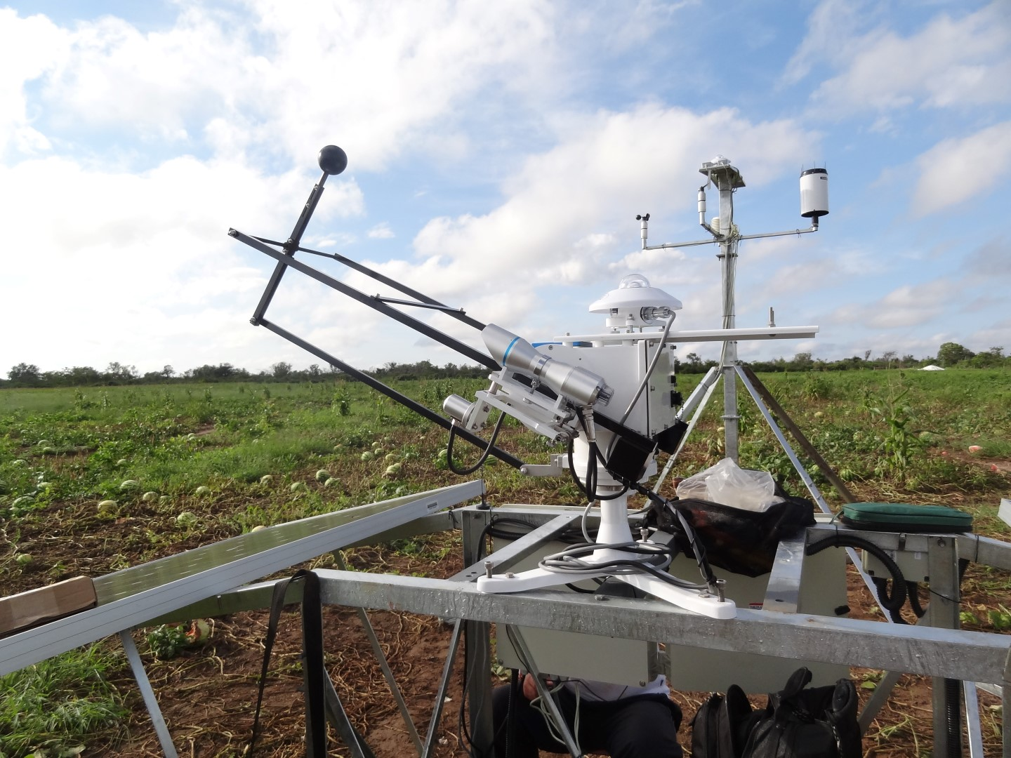
Solar measurement Why and how?
Notes:
18.09.09
18

Slide 19
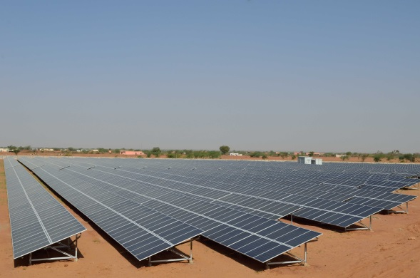
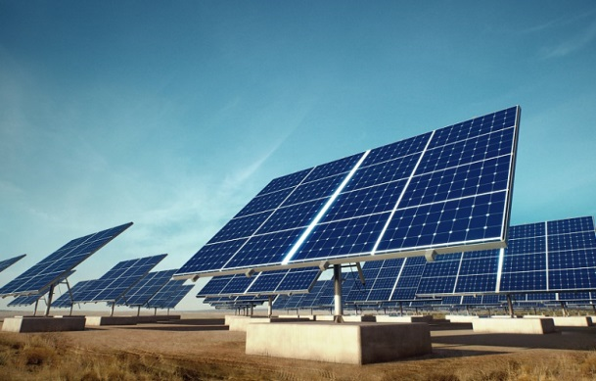
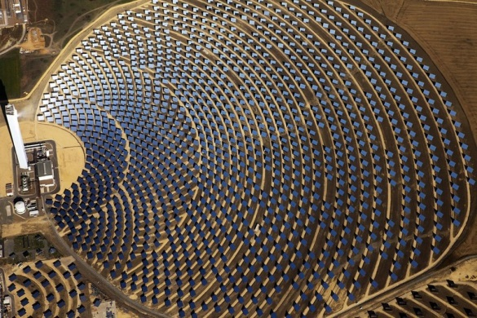
Solar Measurement
Commercial view
Solar resource / site assessment to design profitable PV / CPV / CSP power plants
Site monitoring to organize efficient maintenance schedules and to ensure high productivity
Meteorological and governmental view
Solar maps
Climate research
Solar power plants
PV = Photovoltaic
CPV = Concentrated Photovoltaic
CSP = Concentrated Solar Power

Slide 20
Solar Irradiation
Global Irradiation = Diffuse + Direct
GHI = DHI + DNI • cos(θ)
Where θ is the zenith angle (at vertical over the site 0˚, at horizon 90˚).
GHI = Global Horizontal Irradiation
DHI = Diffuse Horizontal Irradiation
DNI = Direct Normal Irradiation
GTI = Global Tilted Irradiation
DIRECT
(DNI)
DNI * COS (Ө)
DHI
DIFFUSE
Ө
Global (100%)
Direct (80%)
Diffuse (20%)
=
+
W/m²
Notes:
18.09.09
20

Slide 21
Ammonit Meteo-40 Data Logger – Different Applications
Wind Resource Assessment
Wind Farm Monitoring (SCADA)
Solar Resource Assessment
Site Assessment in Cold Climate
Solar Power Plant Monitoring
Wind and Solar Maps
Soiling Measurement
Climate Research

Slide 22
Ammonit Meteo-40 Data Logger
Storage of 1 sec. original measurement data (up to 2 GB)*
→ Turbulence analysis, wind gust and mechanical load calculations
Recording of electrical and physical data
→ Retrospectively correction of possible mistakes by applying slope and offset
Digitally signed and encrypted measurement data*
→ Prevent data manipulation and unauthorized data access
Flexible Communication: UMTS/GSM/CDMA/GPRS, RS485, WiFi, Ethernet, USB
→ Laboratory and on-site communication
Configurable data transfer via HTTPS, FTP/SCP, email to AmmonitOR or client server*
→ Security purposes
* according to MEASNET Site Assessment Norm

Slide 23
Meteo-40 Web Interface: Sensor Configuration
User-friendly web interface for sensor configuration
Detailed sensor library
Sensor helper (wizard) for convenient configuration

Slide 24
Meteo-40 Web Interface: Communication Configuration
Various methods to transfer and download measurement data:
File upload via FTP or SCP → upload to AmmonitOR for campaign monitoring
Send CSV files as email attachment
Download CSV files via web interface
Download CSV files on USB memory drive on-site
Schedule to configure file uploads and online periods
Convenient modem configuration via provider helper (wizard)

Slide 25
Ammonit Meteo-40 Data Loggers: Remote Access
Ammonit Tunnel Server
Ammonit Tunnel Server provides IP address, at which Meteo-40 can be reached on the Internet (e.g., https://subdomain.tunnel.ammonit.com)
Ammonit
Tunnel Server
Internet
Communication via Ammonit Tunnel
Data transfer via HTTPS connection

Slide 26
Ammonit Meteo-40 Data Logger for SCADA Operation
SCADA = Supervisory Control and Data Acquisition
Monitoring the performance of a wind and solar farms
Verification of the predicted annual energy production
Communication via Ethernet (TCP/IP) or RS485
Data transmission via standard protocols Modbus TCP/IP and Modbus RTU
Comparison of meteorological data gathered by wind measurement systems and data from the wind turbine
Notes:
13.05.09
26

Slide 27
AmmonitOR: Managing & Monitoring Measurement Campaigns
Notes:
18.09.09
27

Slide 28
AmmonitOR: Managing & Monitoring Measurement Campaigns
Management and monitoring of measurement campaigns (solar, wind, power curve)
Data quality check according to MEASNET site assessment guideline
Filters to detect measurement errors or sensor defects
Calendar to monitor data integrity
Evaluation and reporting
Display data in customizable plots over certain periods
PDF reports on sensors and statistics
Data archiving
Notes:
18.09.09
28

Slide 29
Ammonit solutions for data security
Download
Current research project
E-mail
Server
OR

Slide 30
Contact
Please contact us for further information
Thank you!
Ammonit Measurement GmbH
Wrangelstrasse 100 • D-10997 Berlin (Germany)
T: +49 30 6003188-0
F: +49 30 6003188-10
info@ammonit.com
www.ammonit.com

