Slide 1
INTERDISCIPLINARY APPROACHES FOR INNOVATIVE SUSTAINABLE AND
ECONOMIC ENERGY CONCEPTS

Slide 2
AHK GESCHÄFTSREISE DER EXPORTINITIATIVE ENERGIE
„NIEDRIGENERGIEGEBÄUDE IN LITAUEN UND ESTLAND MIT FOKUS AUF SMART HOME PRODUKTE UND ENERGIE-SPARSYSTEME“

Slide 3
Introduction
Renewable energies
Intelligent energy concepts
Examples
Summary
IBK I Ingenieurbüro Köberlein · Griesäckerstr. 38 · 97078 Würzburg · Germany · jk@ingbuero-koeberlein.de · +0151-65013100 · Online - 13/10/2021
3

Slide 4
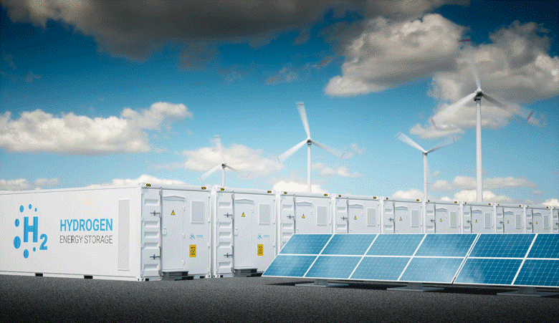
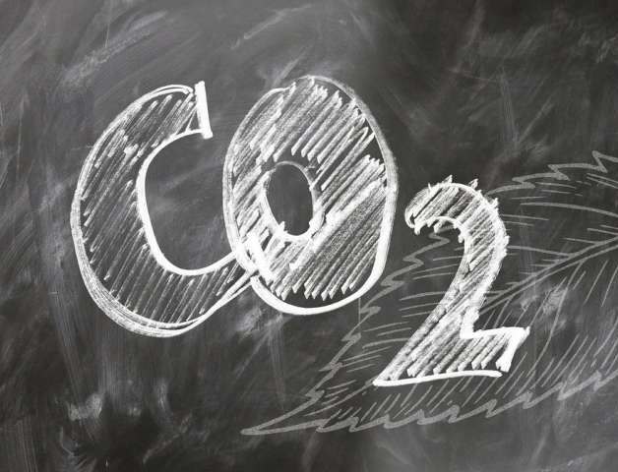
Introduction
Renewable energies
Intelligent energy concepts
Examples
Summary
INTRODUCTION
Founded in 1970 the IBK gained 50 years of experience in the field of building technologies such as heating, ventilation, sanitary, electrical engineering, smart home and district heating networks. Integrative and interdisciplinary construction and designs of new systems as well as the optimisation of existing facilities are our core competency. Innovative energy concepts allow us to combine both the improvement of economic aspects of urban development by lowering the investment costs and the aspect of sustainability by overachieving recent climate goals.
Source: meed.com
IBK I Ingenieurbüro Köberlein · Griesäckerstr. 38 · 97078 Würzburg · Germany · jk@ingbuero-koeberlein.de · +0151-65013100 · Online - 13/10/2021
4

Slide 5
Introduction
Renewable energies
Intelligent energy concepts
Examples
Summary
THINK INNOVATIVE
Чистейшая форма безумия - оставить все таким, какой он есть, и одновременно надеяться, что все изменится.
IBK I Ingenieurbüro Köberlein · Griesäckerstr. 38 · 97078 Würzburg · Germany · jk@ingbuero-koeberlein.de · +0151-65013100 · Online - 13/10/2021
5

Slide 6
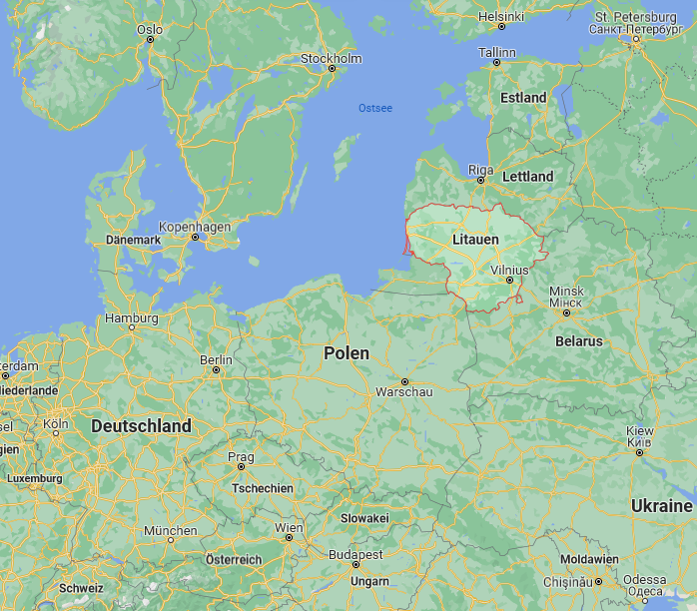
Introduction
Renewable energies
Intelligent energy concepts
Examples
Summary
DEVELOPMENT
Lithuania
Estonia
Energy must be regional and economical.
• a universal solution is non-existent
• every region provides different resources • sustainable solutions are unique solutions
Source: www.inforse.org
IBK I Ingenieurbüro Köberlein · Griesäckerstr. 38 · 97078 Würzburg · Germany · jk@ingbuero-koeberlein.de · +0151-65013100 · Online - 13/10/2021
6

Slide 7
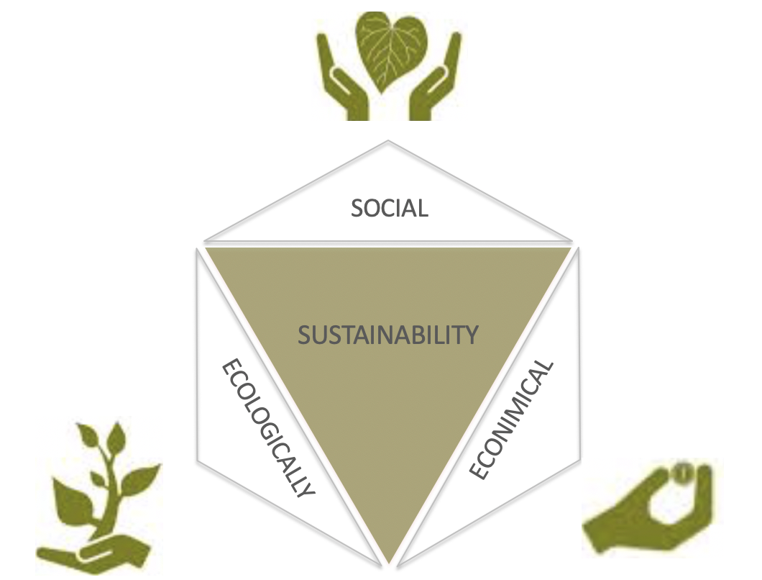
Introduction
Renewable energies
Intelligent energy concepts
Examples
Summary
SUSTAINABILITY
IBK I Ingenieurbüro Köberlein · Griesäckerstr. 38 · 97078 Würzburg · Germany · jk@ingbuero-koeberlein.de · +0151-65013100 · Online - 13/10/2021
7

Slide 8
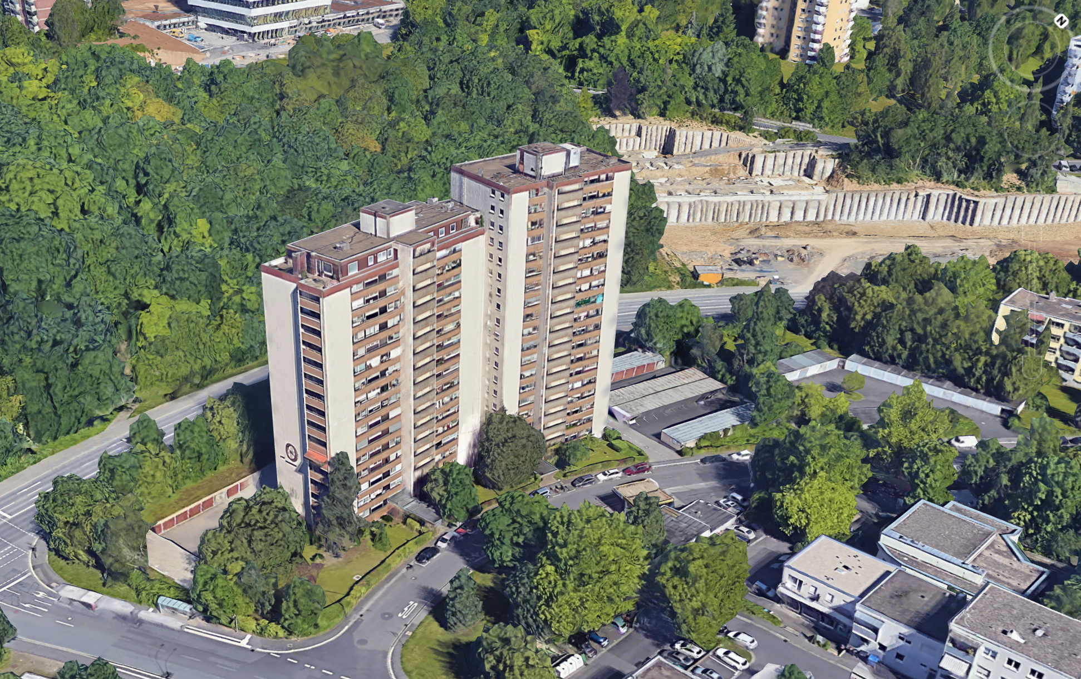
Introduction
Renewable energies
Intelligent energy concepts
Examples
Summary
PV-SOLAR building facade
IBK I Ingenieurbüro Köberlein · Griesäckerstr. 38 · 97078 Würzburg · Germany · jk@ingbuero-koeberlein.de · +0151-65013100 · Online - 13/10/2021
8

Slide 9
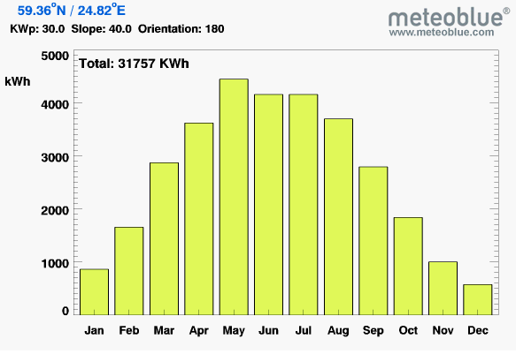
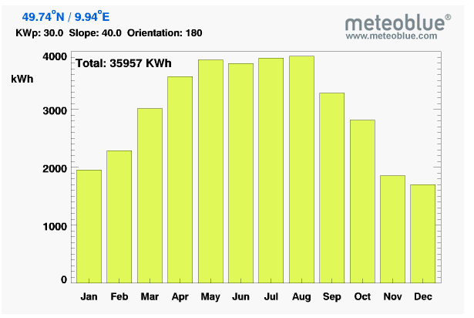
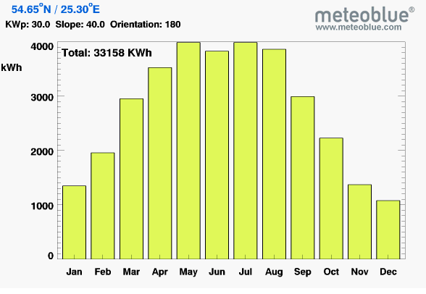
Introduction
Renewable energies
Intelligent energy concepts
Examples
Summary
SIMULATION
Tallinn / Estonia PV-Modul 40°
Wuerzburg / Germany PV-Module 40°
-11,68%
Vilnius / Lithuania PV-Modul 40°
-7,78%
IBK I Ingenieurbüro Köberlein · Griesäckerstr. 38 · 97078 Würzburg · Germany · jk@ingbuero-koeberlein.de · +0151-65013100 · Online - 13/10/2021
9

Slide 10
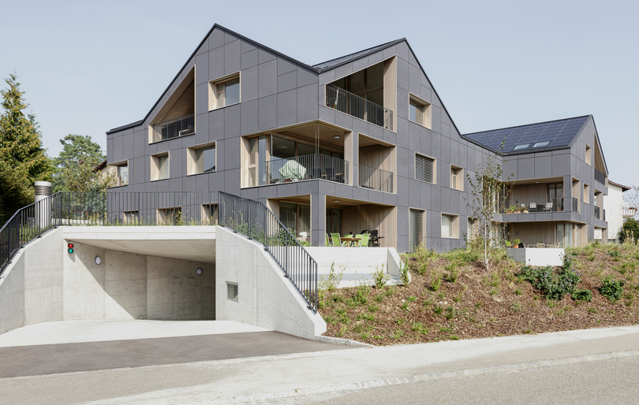
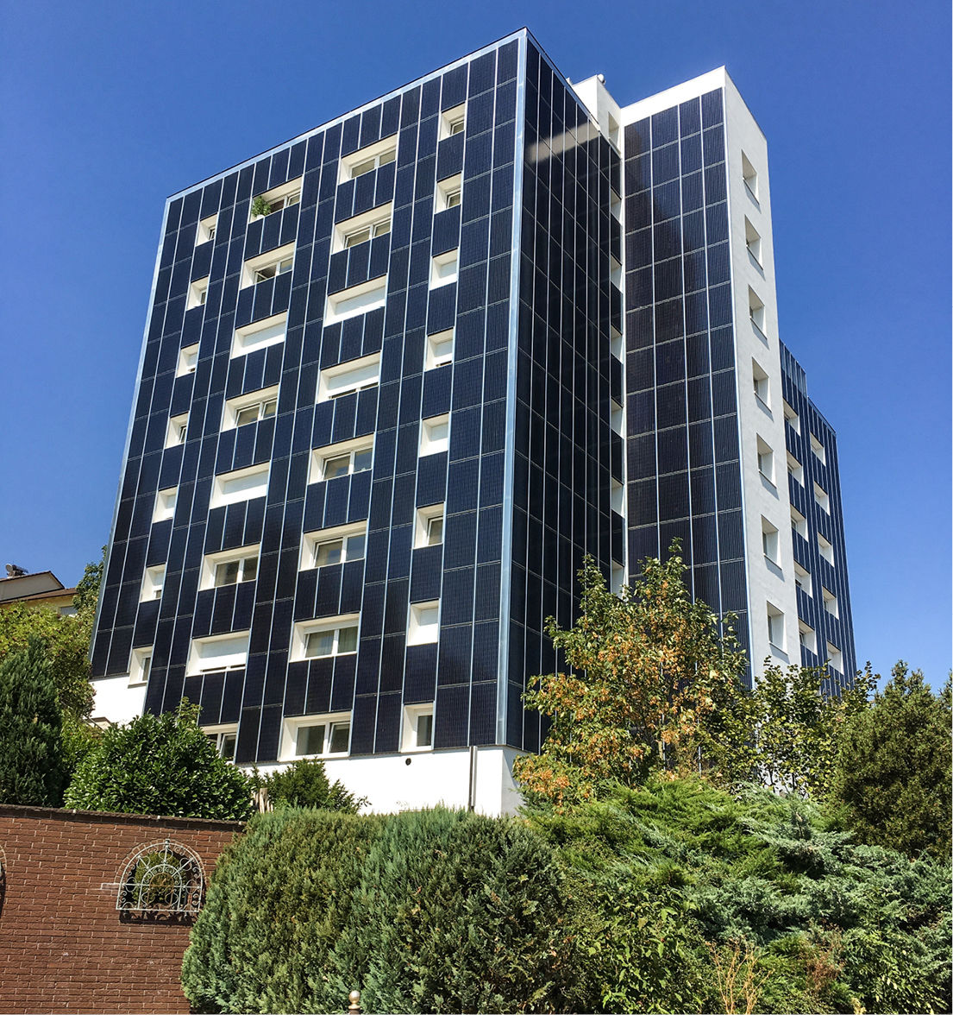
Introduction
Renewable energies
Intelligent energy concepts
Examples
Summary
PV-SOLAR building facade
Source: Umwelt Arena Schweiz/René Schmid Architekten
• good yield when the sun is low in winter
• ratio of facade areas to roof areas
approx. 2/3 to 1/3 (Analysis - Projekt Standard-BIPV / Fraunhofer ISE)
• easy to integrate optically
Source: © Foto: Galaxy Energy
IBK I Ingenieurbüro Köberlein · Griesäckerstr. 38 · 97078 Würzburg · Germany · jk@ingbuero-koeberlein.de · +0151-65013100 · Online - 13/10/2021
10

Slide 11
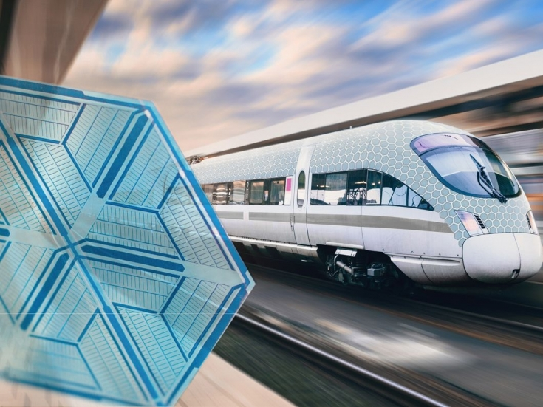
Introduction
Renewable energies
Intelligent energy concepts
Examples
Summary
ORGANIC PV
What kind of integrated technology do we need to power everything? The symbiosis of energy and design.
Opvius OPV: self-adhesive OPV solar modules in carrier materials
The potential of the organic photovoltaics is enormous and shows the range of new opportunities. OPVIUS organic PV technology is characterized by freedom of design, shape and material.
IBK I Ingenieurbüro Köberlein · Griesäckerstr. 38 · 97078 Würzburg · Germany · jk@ingbuero-koeberlein.de · +0151-65013100 · Online - 13/10/2021
11

Slide 12
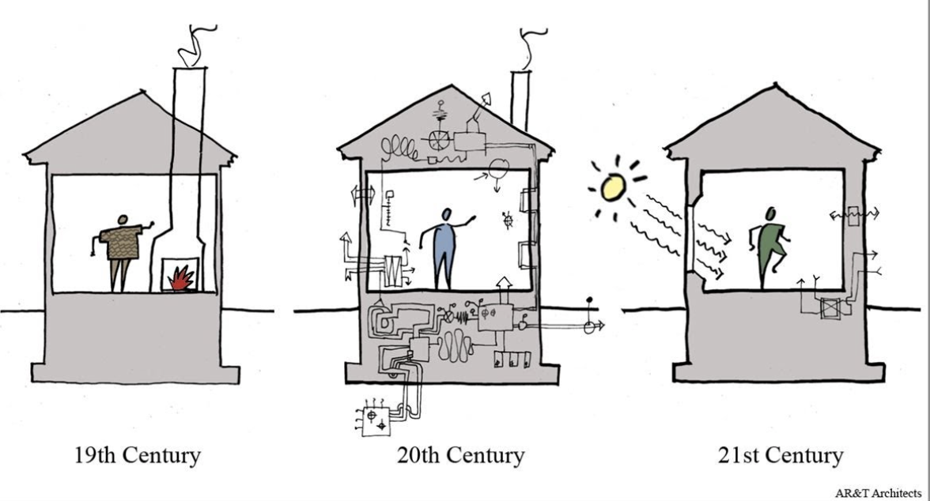
Introduction
Renewable energies
Intelligent energy concepts
Examples
Summary
LESS IS MORE
Quelle: AR&T Architects
IBK I Ingenieurbüro Köberlein · Griesäckerstr. 38 · 97078 Würzburg · Germany · jk@ingbuero-koeberlein.de · +0151-65013100 · Online - 13/10/2021
12

Slide 13
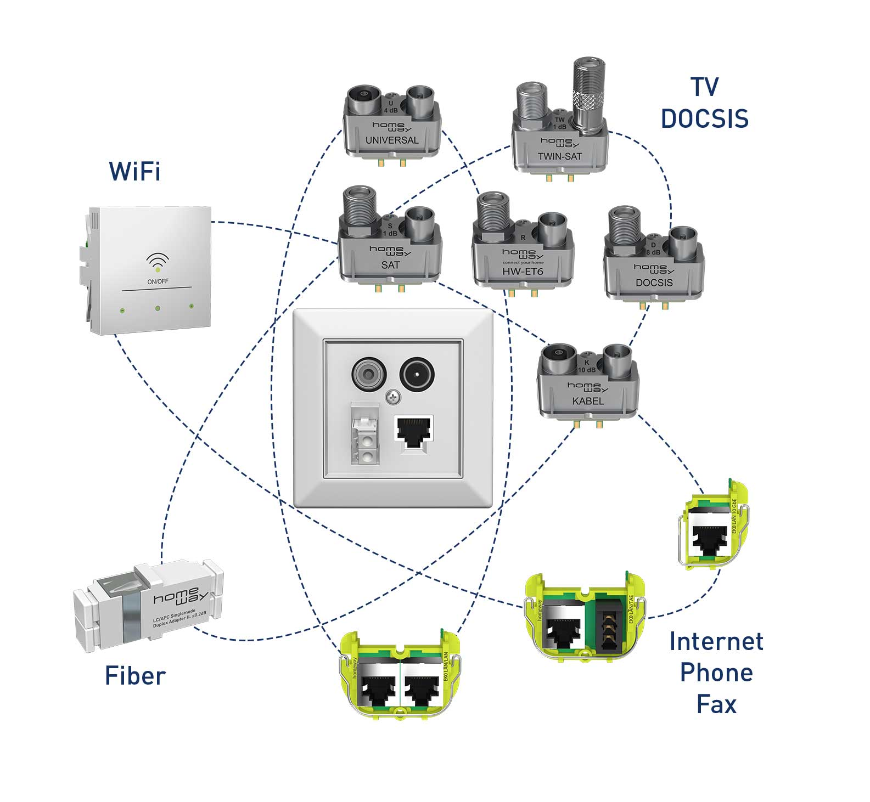
Introduction
Renewable energies
Intelligent energy concepts
Examples
Summary
HOMEWAY
Flexibility: Simply select the right plug-in modules for television, WiFi, telephone and network and plug them into the homeway socket.
Quelle: homeway.de
IBK I Ingenieurbüro Köberlein · Griesäckerstr. 38 · 97078 Würzburg · Germany · jk@ingbuero-koeberlein.de · +0151-65013100 · Online - 13/10/2021
13

Slide 14
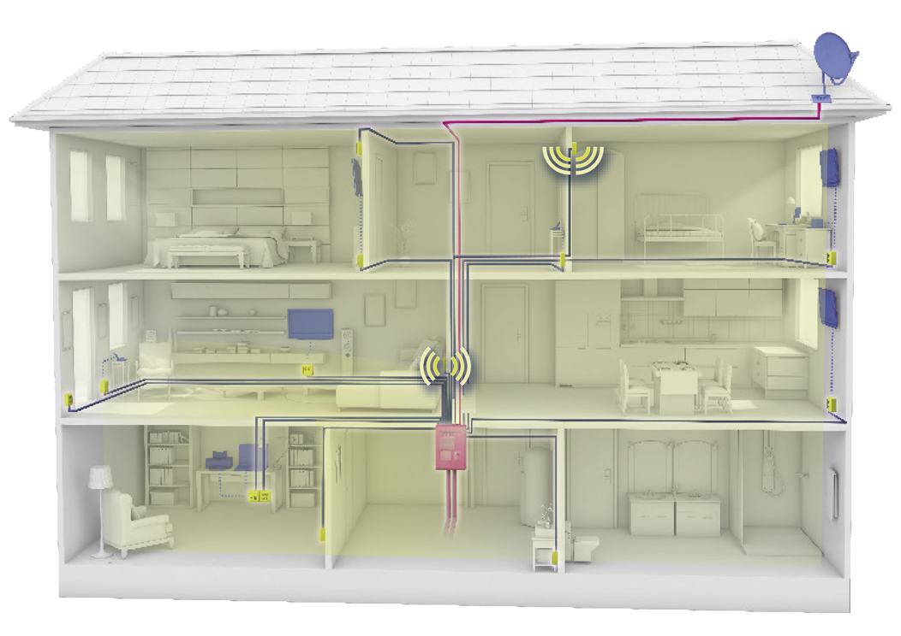
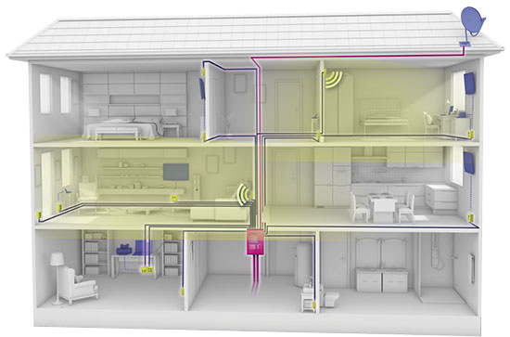
Introduction
Renewable energies
Intelligent energy concepts
Examples
Summary
HOMEWAY
Range extension
With the homeway access points, you can supplement your WiFi where your central WiFi router does not provide sufficient coverage, because floors and ceilings are often impenetrable.
Room concept – increased security
With the help of the homeway access points, you can only create WiFi where you want it. The transmission power can be reduced to a minimum, and the other rooms remain largely radiation-free. This increases security against possible external access or attacks.
Quelle: homeway.de
IBK I Ingenieurbüro Köberlein · Griesäckerstr. 38 · 97078 Würzburg · Germany · jk@ingbuero-koeberlein.de · +0151-65013100 · Online - 13/10/2021
14

Slide 15
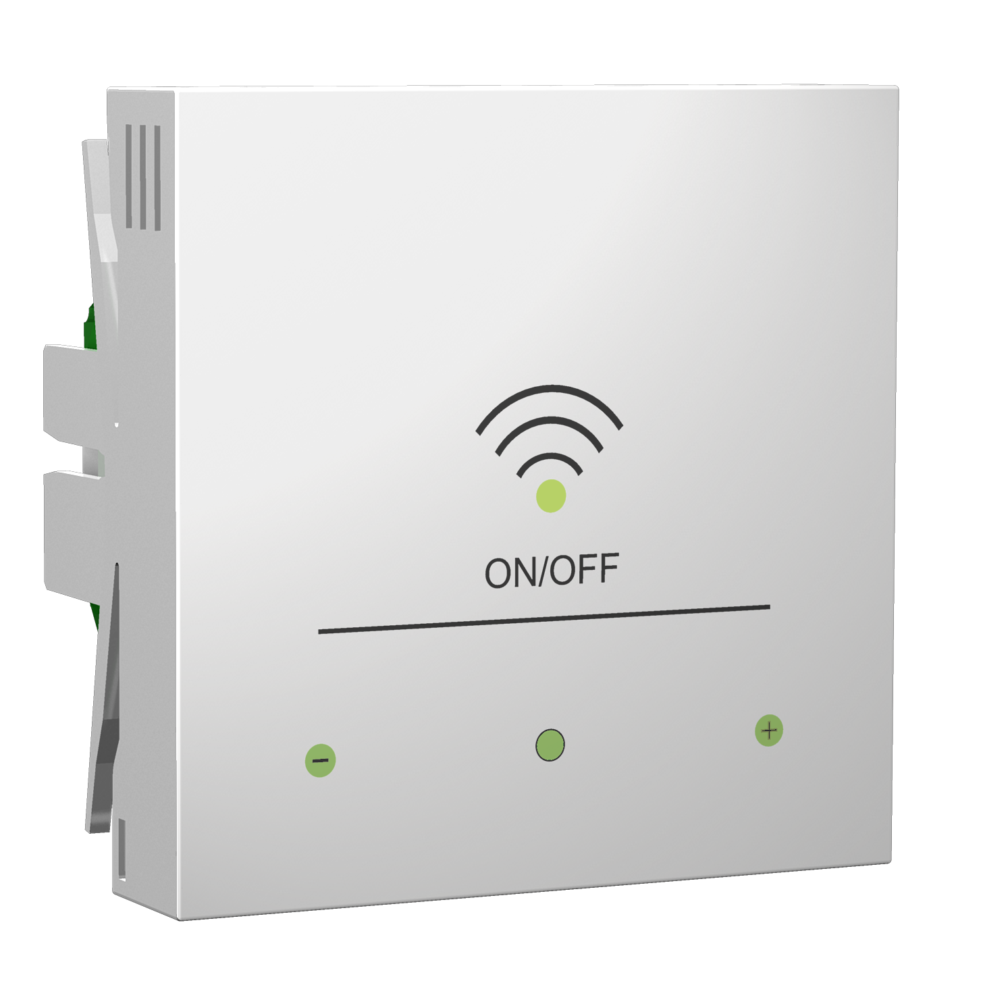
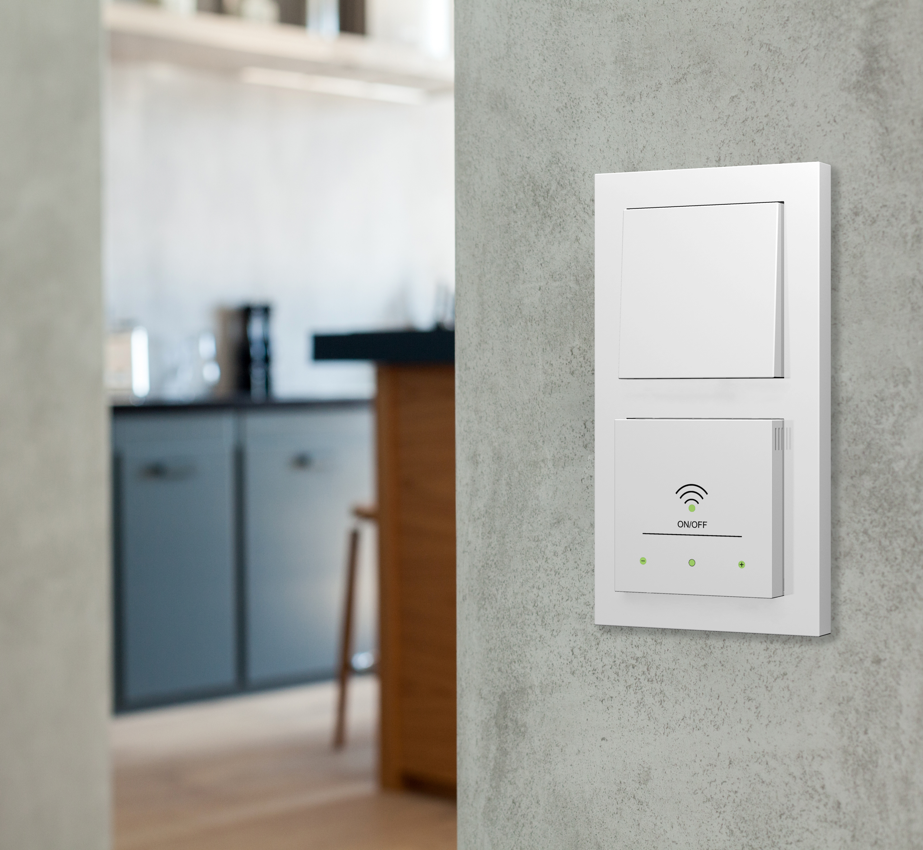
Introduction
Renewable energies
Intelligent energy concepts
Examples
Summary
HOMEWAY
"Dimmable" WiFi - The WLAN Touch ac Access Point
With touch function
Transmission power "dimmable"
Use WIFi in a radiation-reduced and controlled manner
Smart integration into the homeway cabling system
Simultaneous Dual Band 5GHz and 2.4GHz
WiFi ac & n
Guest WiFi for Smart home Systems like KNX or Loxxone
Quelle: homeway.de
IBK I Ingenieurbüro Köberlein · Griesäckerstr. 38 · 97078 Würzburg · Germany · jk@ingbuero-koeberlein.de · +0151-65013100 · Online - 13/10/2021
15

Slide 16
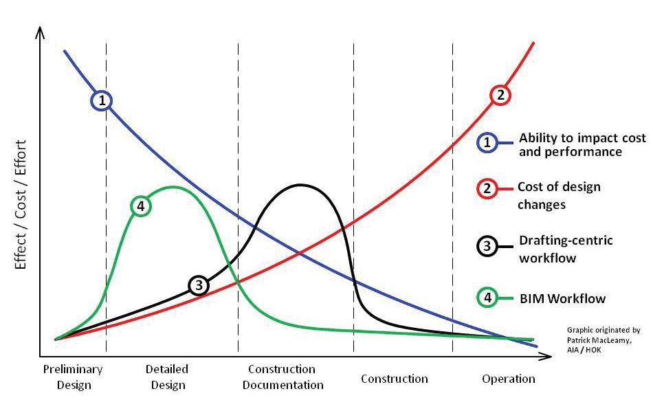
Introduction
Renewable energies
Intelligent energy concepts
Examples
Summary
PROCESS IMPACT
Vorteil
Source: .pinterest.ru
IBK I Ingenieurbüro Köberlein · Griesäckerstr. 38 · 97078 Würzburg · Germany · jk@ingbuero-koeberlein.de · +0151-65013100 · Online - 13/10/2021
16

Slide 17
Introduction
Renewable energies
Intelligent energy concepts
Examples
Summary
WHY IBK?
IBK
INNOVATIVE CONCEPTS
COOPERATION WITH COMPANIES
IBK
• many years of experience with innovative
technology and renewable energies
• goal-oriented project processing through
iterative planning processes
• simulations of the targets already in the design phase
• cloud solutions as a common workplace
• a lot of jobs and business
opportunities in the energy-market
• Investors at private and municipal levels
• optimization of existing plants -> high savings potential
• training and know-how transfer at Universities
MAX. ECONOMICS
LOW INVESTMENT
IBK I Ingenieurbüro Köberlein · Griesäckerstr. 38 · 97078 Würzburg · Germany · jk@ingbuero-koeberlein.de · +0151-65013100 · Online - 13/10/2021
17

Slide 18
Introduction
Renewable energies
Intelligent energy concepts
Examples
Summary
ENDING
• renewable energies are a great and benificial
challenge
• high CO2 savings possible with less investment
• know-how transfer for more efficiency and economy
• keep on the good work!
Thank you for your attention!
Questions? jk@ingbuero-koeberlein.de Tel./Whatsapp +49 (151) 650 13 100
Adress cv
IBK I Ingenieurbüro Köberlein · Griesäckerstr. 38 · 97078 Würzburg · Germany · jk@ingbuero-koeberlein.de · +0151-65013100 · Online - 13/10/2021
18

