Slide 1
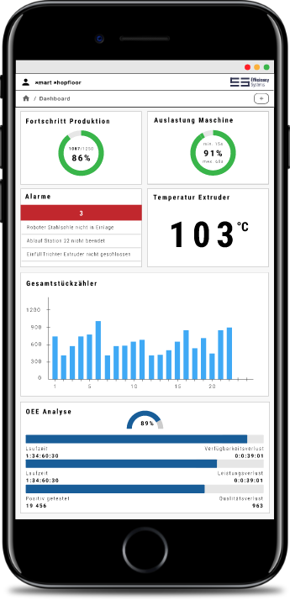
Stop Flying Blind
DAPONA: the IoT Platform for
Digital Asset Management
Real time Data visualization and Alerting
Forecasting, machine learning (coming soon) Simply connect and get started

Slide 2
Once a standstill has occurred, it can never be made up again.
The only possibility is prevention.
Thilo Heffner, Efficiency Systems

Slide 3
DAPONA
Reduce costs, act before it is too late:
DAPONA digitally depicts your reality, generates tasks and forecasts. All you have to do is connect your physical Assets (such as machines, analogues, sensors, systems, etc.) and you can immediately see digitally, anytime and anywhere, what is happening, what the utilisation rate is and where faults are reported. On tablets, your PC, or on the road on your smartphone: A web browser is all you need.

Slide 4
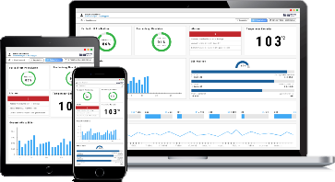
DAPONA: The digital image of reality
Free configurable realtime web-dashboards, tasks, alerts
Digital World
Open secure platform DAPONA
…
Real
Local Assets, Integration

Slide 5
DAPONA: usecase Saving Energy
Free configurable realtime web-dashboards, tasks, alerts
Thresholds, alerting, actions
Energy saving dashboards
Digital World
Open secure platform DAPONA
…
Energy sensors
Real
Local Assets, Integration

Slide 6
DAPONA: usecase disaster prevention
Free configurable realtime web-dashboards, tasks, alerts
Thresholds, alerting, warning, actions
Desaster risk-level dashboards
Digital World
Open secure platform DAPONA
…
Sensors @ potential desaster sources
Real
Local Assets, Integration

Slide 7
DAPONA: usecase Environment
Free configurable realtime web-dashboards, tasks, alerts
Thresholds, alerting, actions
Environmental dashboards
Digital World
Open secure platform DAPONA
…
Air, water, temp, weather sensors
Real
Local Assets, Integration

Slide 8
all industries, all usecases
Industries
….
Branch specific Solutions
Branch specific Solutions
Branch specific Solutions
Branch specific Solutions
Branch specific Solutions
Branch specific Solutions
Branch specific Solutions
Branch specific Solutions
Branch specific Solutions
Requirements
Smart Shopfloor
generic
Virtual Reality
specific
Artificial Intelligence, Machine Learning, Forecasting
Reporting, Business Analytics, Data Mining
Automatic Organisation Maintenance
Alerting, Task´s
Visualization, Monitoring
Data Collection

Slide 9
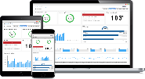
Platform Smart Shopfloor
Free configurable real-time dashboards
3
Dashboards
Alerting, Maintenance
OEE ….
roles and access rights
2
Storage
Open platform Smart Shopfloor
Shopfloor, Machines,
Sensors
Workplaces,
Services, etc…
1
Local data acquisition
….
Data Sources

Slide 10
Platform Smart Shopfloor
Free configurable realtime dashboards
Dashboards
Alerting, Maintenance
OEE ….
User/Manufacturer
Supplier
3
Stakeholder
2
Storage
Open platform Smart Shopfloor
Shopfloor, Machines,
Sensors
Workplaces,
Services, etc…
1
data acquisition
….
Data Sources

Slide 11
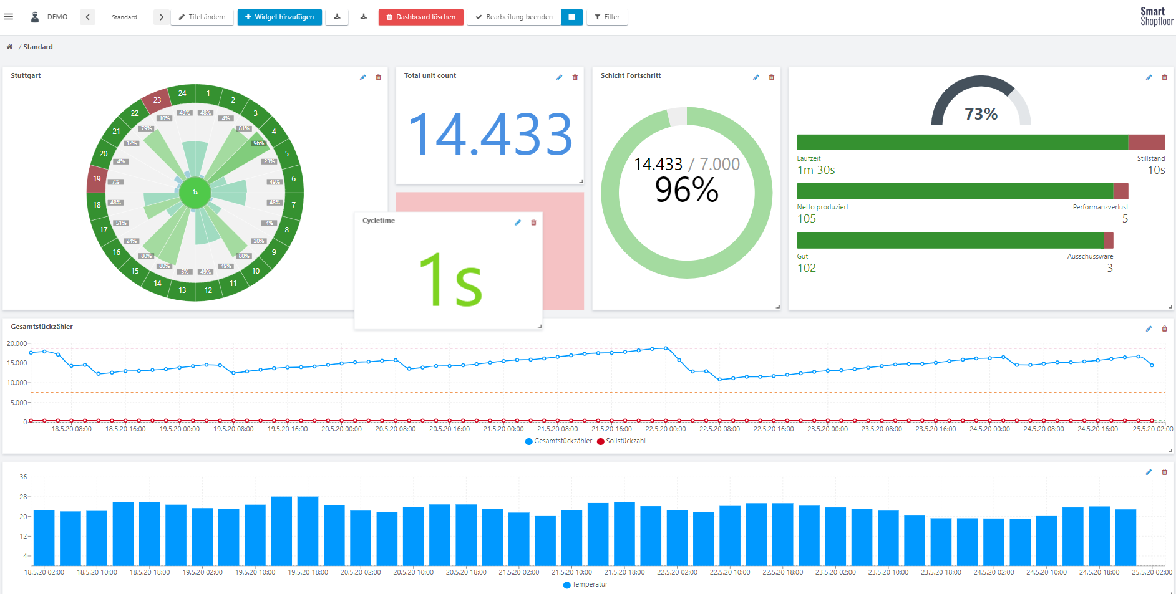
Dashboard drag&drop configuration on the fly

Slide 12
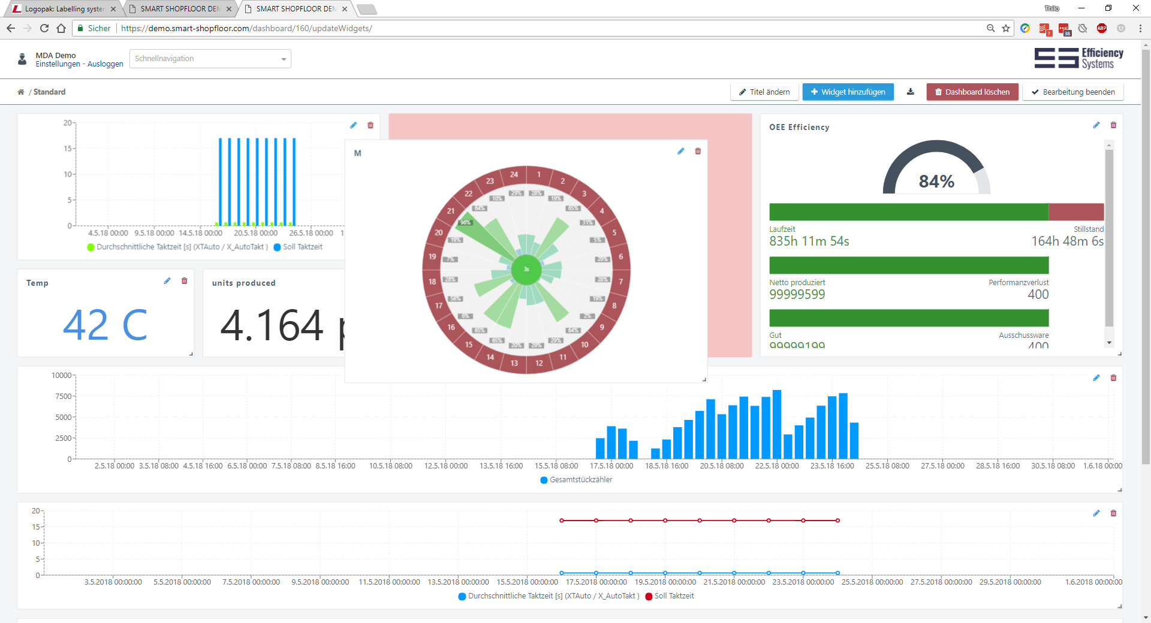

Slide 13
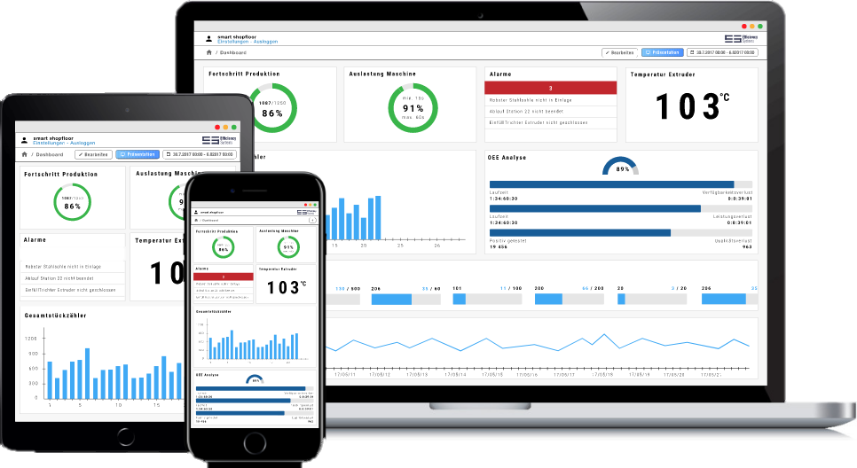
Supplier
Non binding Illustration
Notes:
Why a customer byes a DESMA machine?

Slide 14
clients (Extract)
Notes:
Why a customer byes a DESMA machine?

Slide 15
Clients

Slide 16
www.smart-shopfloor.com

Slide 17
The efficiency team
We are 4 creative people, with
strong know how in state of the art software technology
understanding of business requirements
strong demand, to solve them with an standard plug&play web- platform
Alexander Fritz (CTO, Software Development) Daniel Heffner (Software Development) Sebastian Gerock (Software Development) Thilo Heffner (CEO, business development, founder)

Slide 18
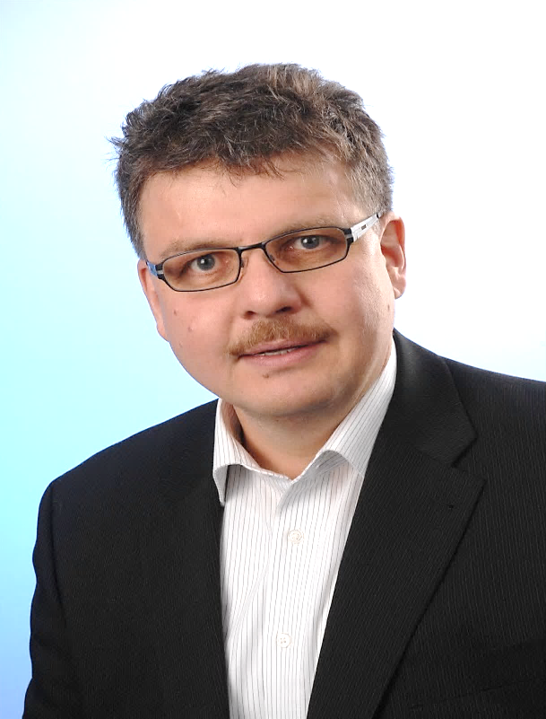
Thilo Heffner
CEO
Efficiency Systems
Zum Zander 8
DE-88662 Überlingen
phone: +49 160 767 88 11
E-Mail: mail@efficiency-systems.com
efficiency-systems.com

