Slide 1
Market Development of On- and Offshore Wind Energy – Success Factors and Lessons Learned from Germany
Sabine Schmedding, 11/06/18, Ho Chi Minh City

Slide 2
Agenda
BWE at a glance
Wind Energy and Industry in Germany
Status and Development
RES Act – A Success Factor
Employment, Investments, Costs
Outlook

Slide 3
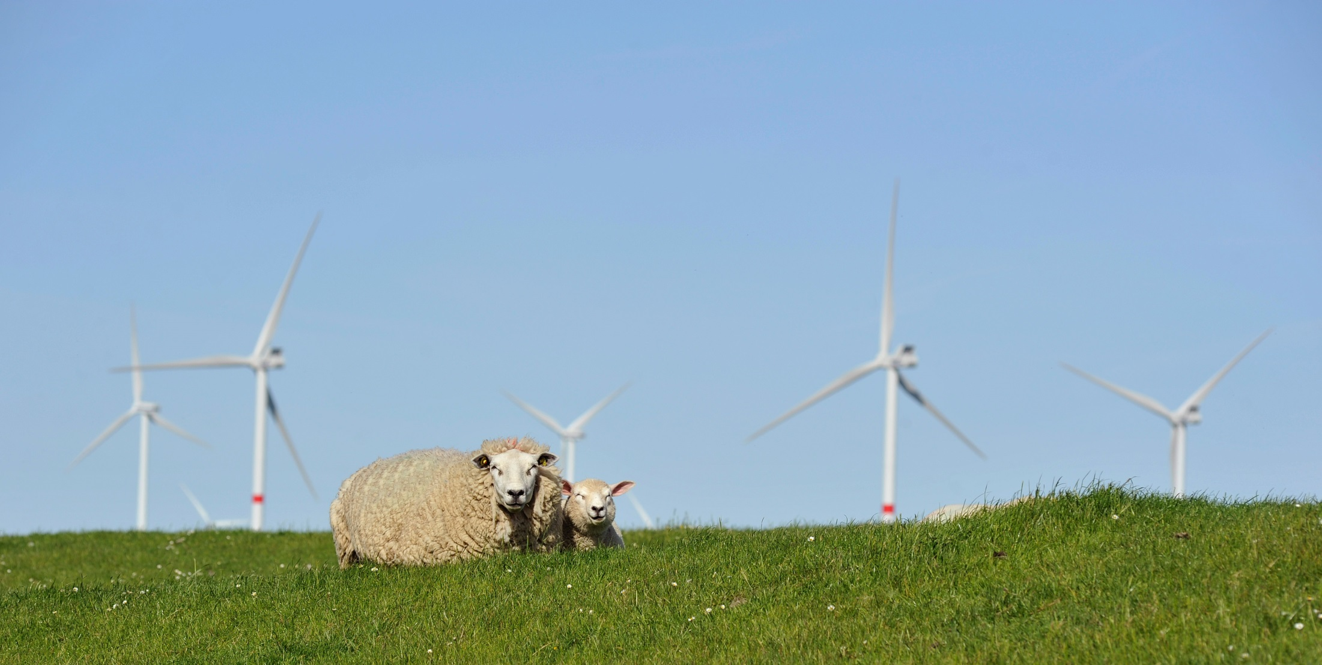
German Wind Energy Association (BWE) at a Glance
©BWE/J. Meier

Slide 4
About the German Wind Energy Association
One of the largest associations in the field of renewable energies (more than 20,000 members)
Political work at national/federal and regional level
Partner of 1,100 companies (manufacturers, suppliers, project planners and experts) and of 2,200 operating companies
Member of other associations and committees at an international level (WindEurope, EREF, GWEC and WWEA)

Slide 5
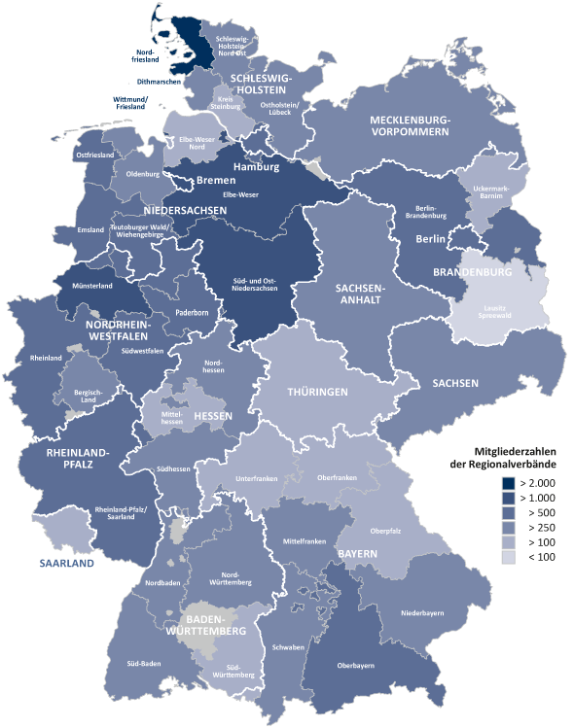
Regional Associations
13 federal state associations and 42 regional associations
Intensive networking, consultancy and local support
Regional exchange between economy and politics
Parliamentary events

Slide 6
Committees and Working Groups
Committees
Experience and know how
Working Group
Special issues
Aviation obstruction markers
Forum of Operators
Exchange
Enercon
Investment
Plant management
Operators and operator forums
Financing
Manufacturer and supplier
Legal
Planning
Experts
Science and research
Foundations
Radar
Nature conservation & wind energy
Grids
Rotor blade
Continued operation of WTG's
Marketing
Forum independent maintenance
NEG-Micon
Nordex
Senvion
Siemens Wind Power
Vestas
Communication
Energy Policies

Slide 7
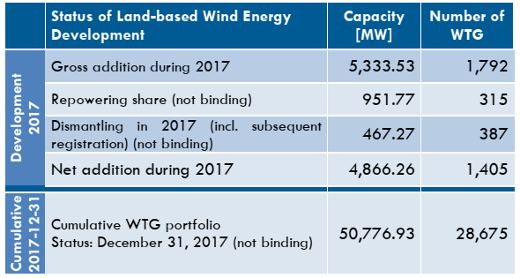
Status of Land-based Wind Energy Development (2017-12-31)
Source: DWG, 2017

Slide 8
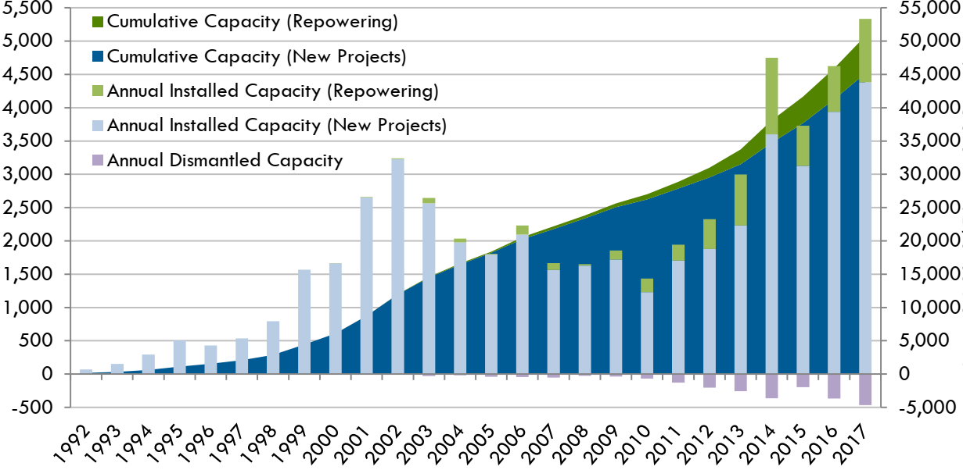
Development Annual Installed and Cumulative Capacity in Germany
Annual Added / Dismantled Capacity (MW)
Cumulative Capacity (MW)

Slide 9
Average Capacity Development of Onshore Turbine Technology

Slide 10
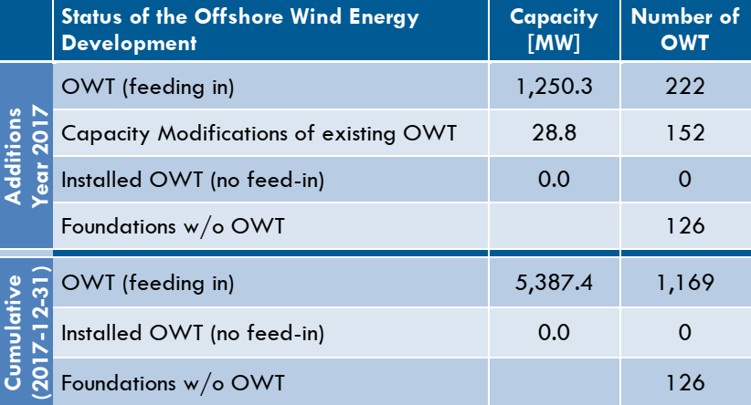
Status of Offshore Wind Energy Development (2017-12-31)
Source: DWG, 2017

Slide 11
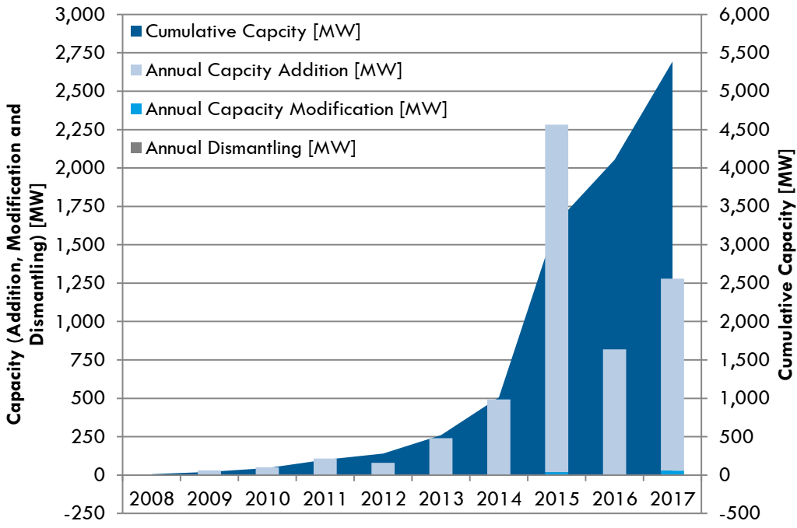
Development of Offshore Wind Energy in Germany
Source: DWG, 2017

Slide 12
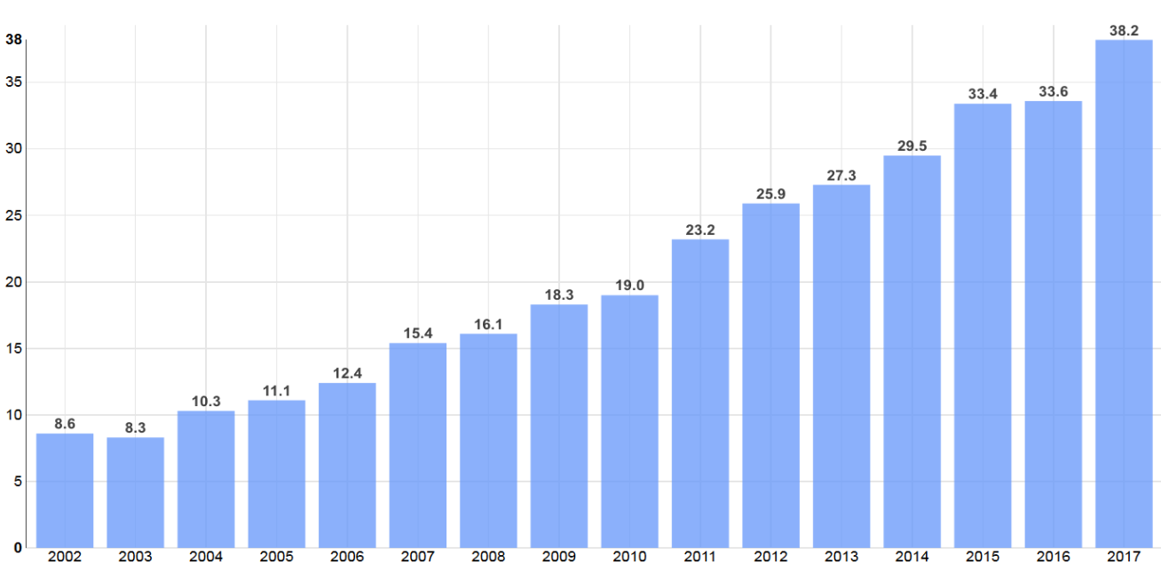
Renewables share in Net Power Generation (2002 – 2017)
Wind energy contributes nearly 19 percent to German energy generation
Share of renewable energies %
year
Burger, Fraunhofer ISE, 2018

Slide 13
Success by Reliability Renewable Energy Sources Act (EEG)

Slide 14
Renewable Energy Sources Act (EEG) Key Success Factors
Purpose of the law:
Sustainable development of energy supply
protection of climate and environment
reduction of energy supply costs
promotion of renewable energy technology
Reliable regulatory framework:
Fixed remuneration for fed-in electricity for 20 years
guaranteed grid access / priority feed-in
decentralization and accessibility for citizens

Slide 15
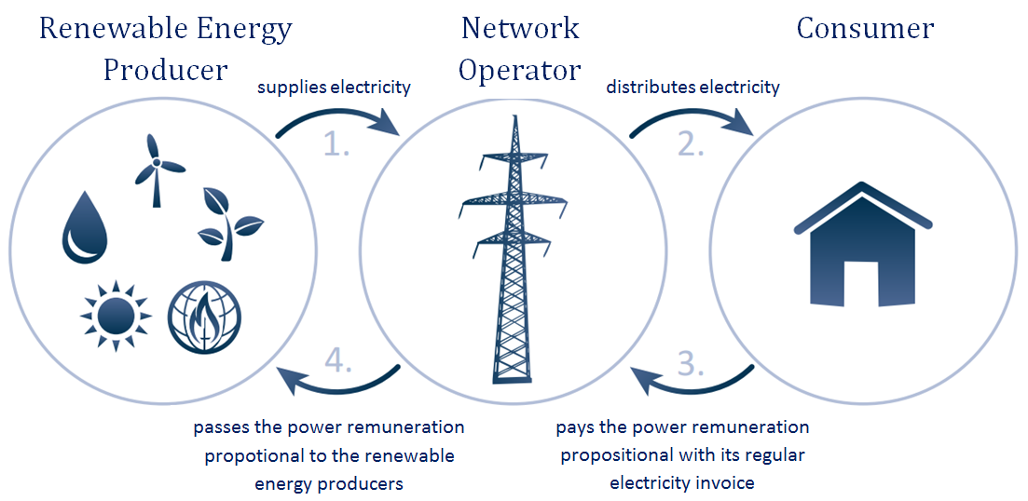
Renewable Energy Sources Act (EEG) EEG links four phases to one scheme

Slide 16
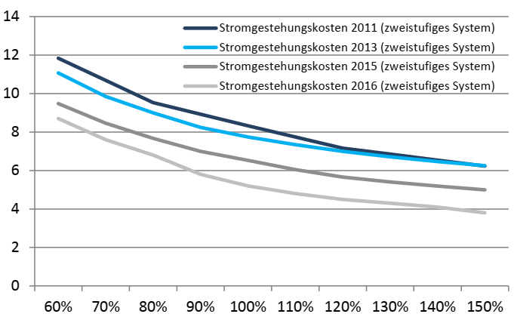
Generation Costs
electricity generation costs 2011 (two step system)
electricity generation costs 2013 (two step system)
electricity generation costs 2015 (two step system)
electricity generation costs 2016 (two step system)
generation costs ct / kWh
Site Quality
Source: DWG 2018

Slide 17
I Key elements of EEG 2017 - Auctions instead of fixed funding rates
Prices fixed by government competitive auctions for onshore and offshore, photovoltaics and biomass from 2017 on
Cost-efficiency
Stakeholder diversity Guiding principles of EEG 2017
Deployment corridor for RES
Auctions will cover 80% of newbuild
Restriction of onshore wind newbuild in areas with grid bottlenecks to 58 % of the average newbuild

Slide 18
II Key elements of EEG 2017
Deployment corridor for onshore wind energy :
Annual 2,800 MW gross from 2017 to 2019
and 2,900 MW gross from 2020 on
Rounds of auction:
3 x 2017, 4 x 2018, 3 x from 2020 on
Participation requirements:
Approval under the Federal Immission Control Act, ("BImSchG") and security-deposit „Bid Bond“ of 30 EUR/kW

Slide 19
III Key elements of EEG 2017
Bids will be placed on the floating market premium
Acceptance of a bid: "pay as bid“, starting with the lowest
Timeframe: Two years, contractual penalties in case of non-completion
Maximum level for bids in 2018: 6.3 ct / kWh for the 100-percent reference site, over 20 years

Slide 20
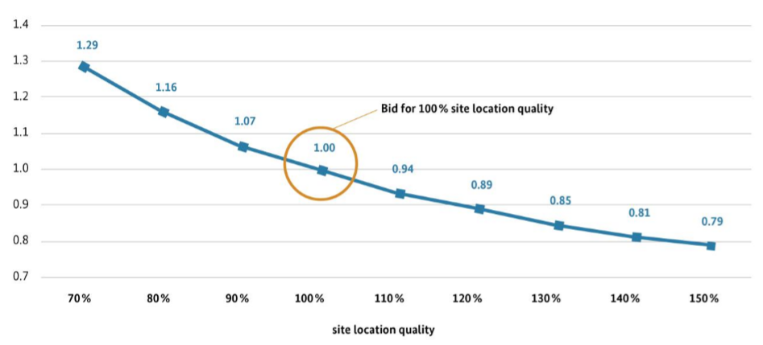
IV Key elements of EEG 2017 Reference Revenue Model
A single-tier reference revenue model is introduced for onshore wind energy
The target is to build efficient installations at windier sites will be provided:
Relative value
Site Quality
Source: „2017 revision of the Renewable Energy Sources Act”, BMWi, 2016

Slide 21
Auctions - Bids and awarded bids 2017/2018

Slide 22
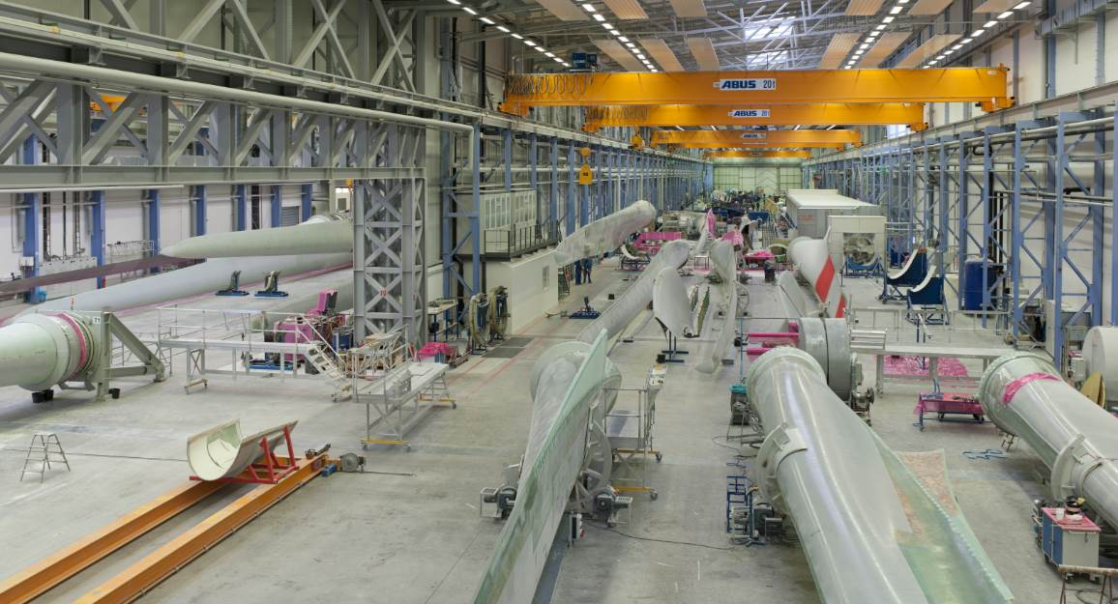
Wind Industry in Germany Employment and Investments

Slide 23
Employment in Renewables Energies
SourceGWS on behalf on BMWi, 2018

Slide 24
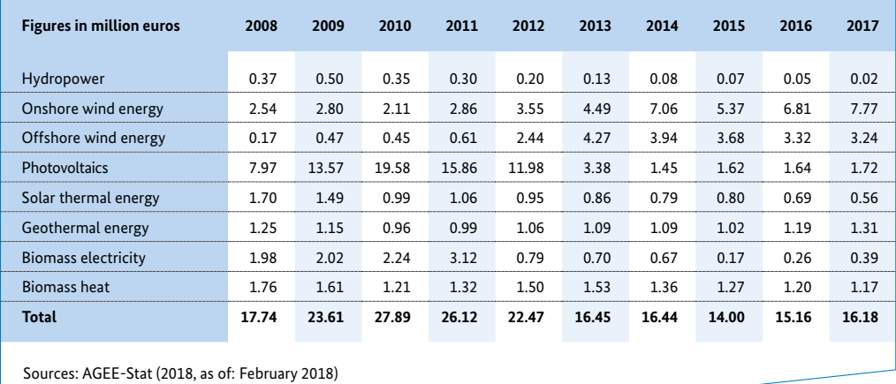
Selected investments in renewable energy sources nationwide

Slide 25
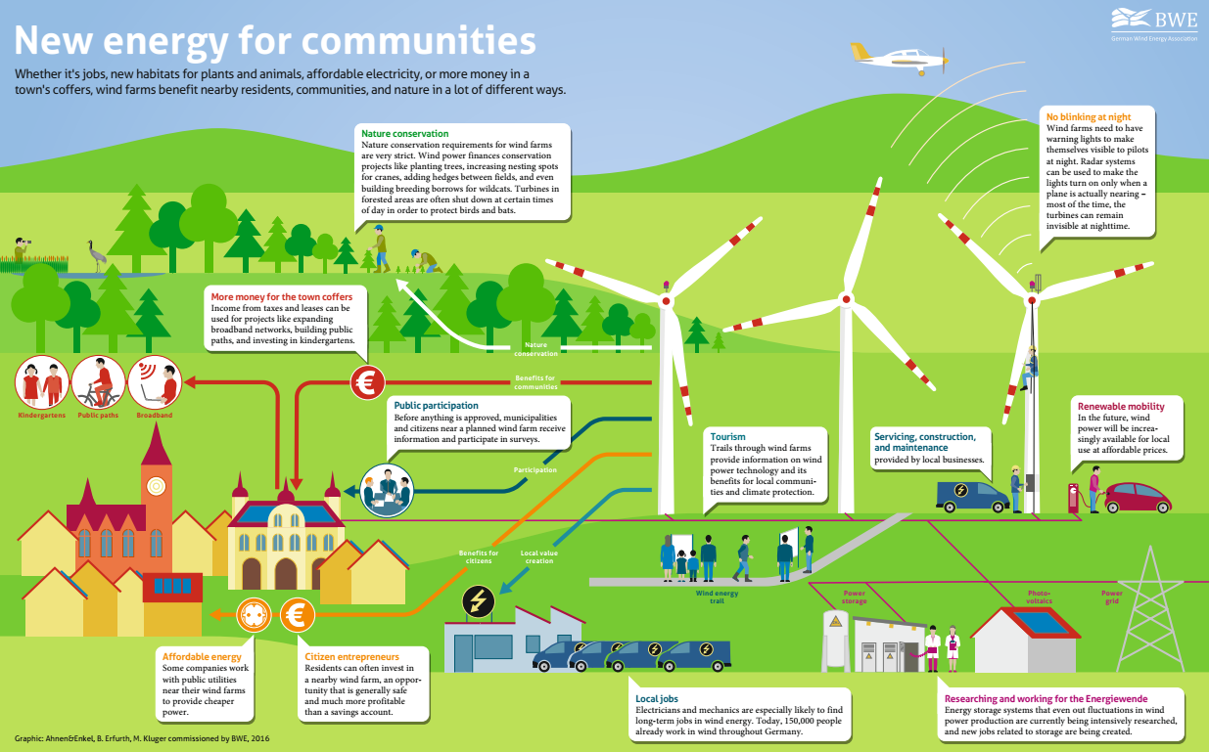

Slide 26
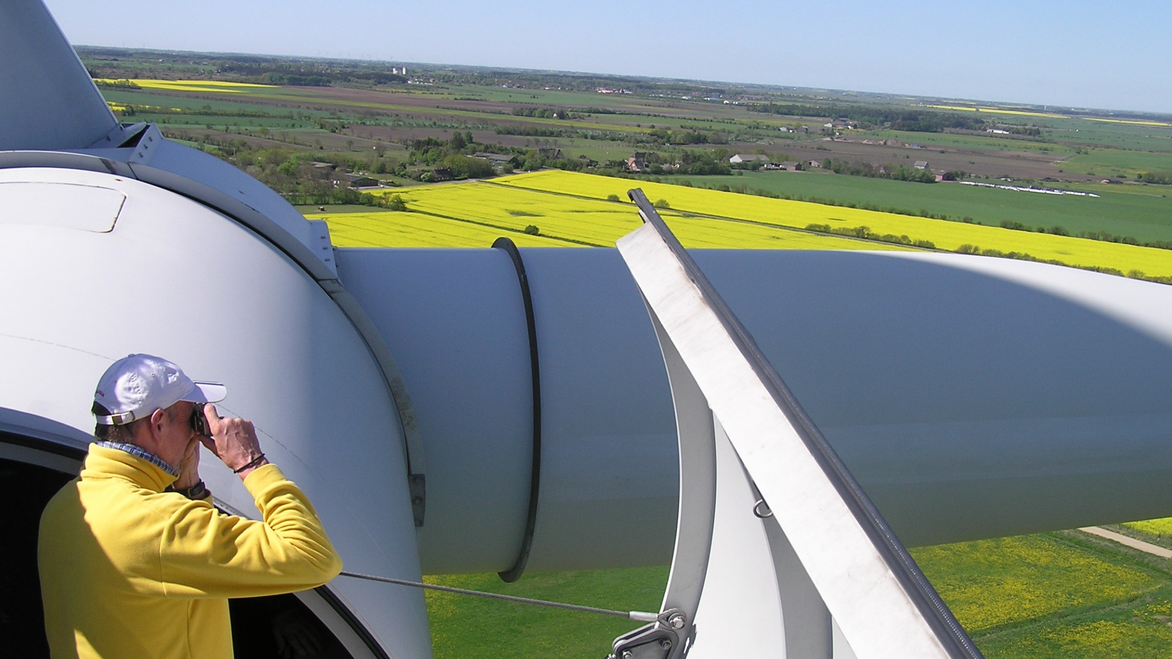
Outlook

Slide 27
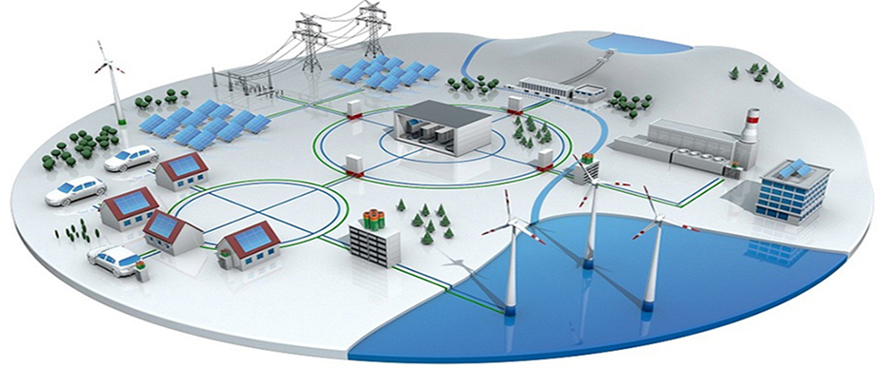
Sector Coupling and Digitalization

Slide 28
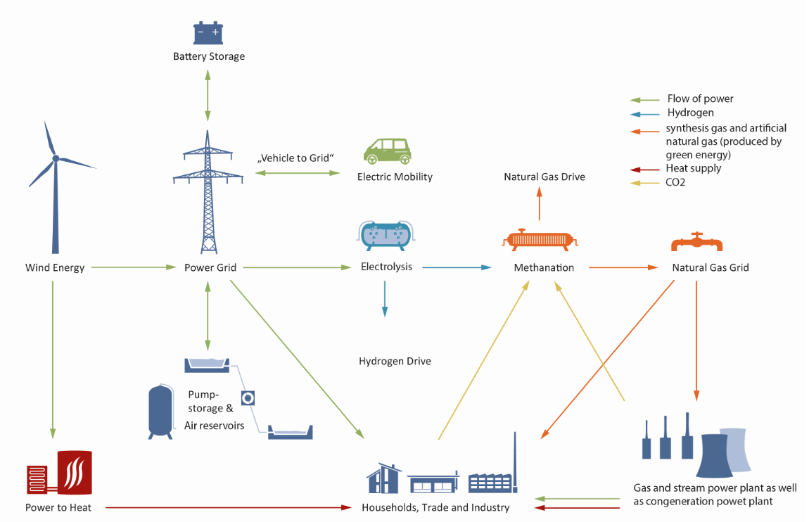
Sector Coupling and Digitalization

Slide 29
Sector Coupling and Digitalization
More than electricity
The switch to renewable energies does not stop at the electricity sector. The future energy will include the sectors heath, industry and mobility.
Unlocking the full potential
Converting renewable electricity into heat/cooling, mobility or gas (power-to-gas) is the most important project of the EU energy market.

Slide 30
Thank you for your attention!
Contact
Sabine Schmedding, Policy Department
German Wind Energy Association
Neustädtische Kirchstraße 6
10117 Berlin
Germany
T +49 30 / 212341 – 252
F +49 30 / 212341 – 410
s.schmedding@wind-energie.de
www.wind-energie.de

