Slide 1
Hee Jin Eun
Hybrid Technology (Smart Grid)
Wind Turbine
+ Photovoltaic Power
+ Bio Gas
+ Energy Storage System
Photovoltaik & Smart Grids
Hanoi, 22nd of October 2019

Slide 2
Organizational Structure in Germany
Ingenieurbüro Hofmann
engineering office, founded 1974
ownership
ownership
QREON Gmbh (Ltd.)
development, production and delivery of modern hybrid power plants, founded 2012
supplier
EZB - Energiezentrum Brandenburg GmbH (Ltd.)
construction and operation of solar energy plants, founded 2012

Slide 3
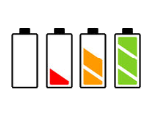
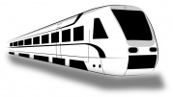
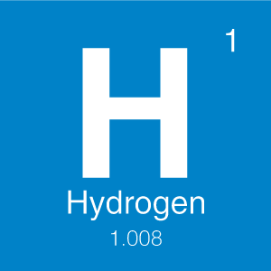
Our vision of sustainable energy solutions
short term Li-ion buffering
100% green energy from wind + PV
long term Hydrogen buffering

Slide 4
Products
A reliable Wind Turbine with an integrated Battery System
Highest efficient Photovoltaic Power Plant
Compatibility with different tower types
Integrated energy storage system from 0.2 to 5 MWh with focus on standardized 2 MWh solutions

Slide 5
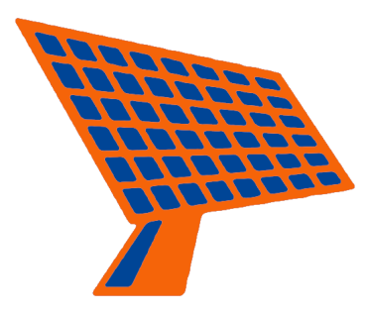
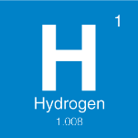
Products - Island Solutions
Smart energetic support for the highest independency from the grid operator

Slide 6
Products
Optional integration of additional power producers, e.g. Diesel generators
Reliable mechanical and electrical components with a simple and common technical maintenance
Several Gigawatt of operational experience
Constant power supply
Made in Germany

Slide 7
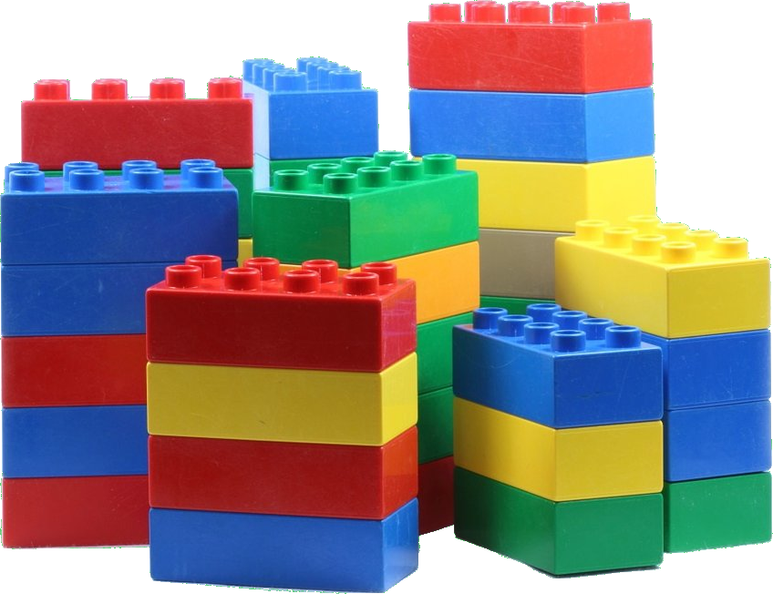
Products – Modular Design
Easy and fast assembly for the most divers construction site situations due to Modular Design

Slide 8
Services
Certifications for worldwide installations
QREON support for the national business cooperations or licensees
Support service for partner
purchase
financing
assembly
maintenance

Slide 9
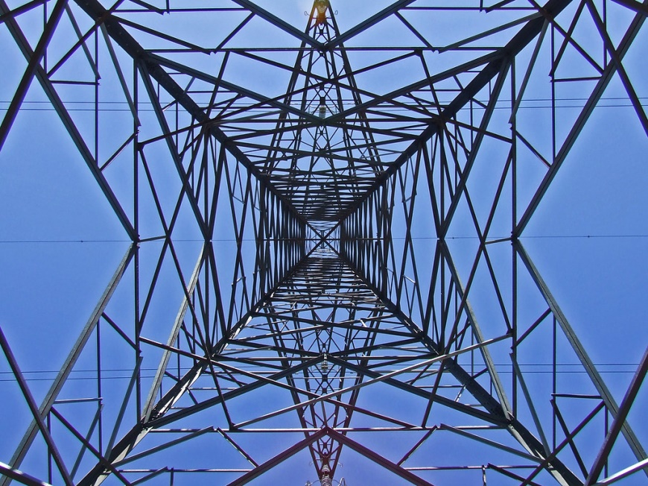
Applied Technology – Wind Turbine
Unique 130m lattice tower wind turbine design
more building height for lower wind speeds possible
less weight than tubular design
transportation of small pieces
easy assembly at plant
high resilience
high durability

Slide 10
Applied Technology – Wind Turbine Details
Optional Tubular steel tower 60m – 80m - 101m
Pitch system
integrated power supply
adaptive charging super caps
high dynamic single blade pitch control
Generator
synchronous generator
electrical excitation, auxiliary field generated
Rotor Blades
40m
hybrid build GRP (CRP)

Slide 11
Applied Technology – Wind Turbine Details
Gear
planetary- and spur gearing
gear ratio: approx. 1:96
Converter
only one converter for the complete turbine and the battery system
rated apparent power: Sn = 2,300 kVA
active power range: 0.88 inductive – 0.88 capacitive

Slide 12
Applied Technology – Solar Energy
Highest efficiency, active single/double axis, intelligent tracking system
Enables the optimal utilization of all the irradiation energy
Yield increases of approx. 30% compared to standard applications
Robust durable technology
Monitoring and real tracking with maximum light detection technology
Snow and storm sensors for cleaning and security

Slide 13
Applied Technology – Solar Energy
Lowest service expenditure and maintenance free rotary drive
Hot-dip galvanized steel/alloy structure, 20 years warranty against corrosion
Complex Condition Monitoring and SCADA System
Power Control Unit
Photovoltaic modules glass-glass monocrystalline with 30 years linear power warranty (87% of peak power)
Made in Germany with global references

Slide 14
Applied Technology – Energy Storage
2014 price only wind turbine system with battery buffering
Lithium-Ion battery technology with cells from the industry leader
Modular technology, maintenance free
Warranty > 8,000 cycles
Island grid operation (with grid supporting features) and Uninterruptable Power Supply UPS functions
Proven technology > 2 GWh installed

Slide 15
Applied Technology – Energy Storage
Battery Management System and turnkey Solution designed and produced in Germany
The highest energy density on the market with the fastest system respond time
Different operation modes with intelligent Energy Management (Industry electricity bill saving, self-consumption, emergency power back-up, peak-shifting, frequency regulation, renewable integration)
Integration (in the bottom of the tower or separated operation building)
Alternative energy storage solutions (e.g. Redox-Flow-Battery)

Slide 16
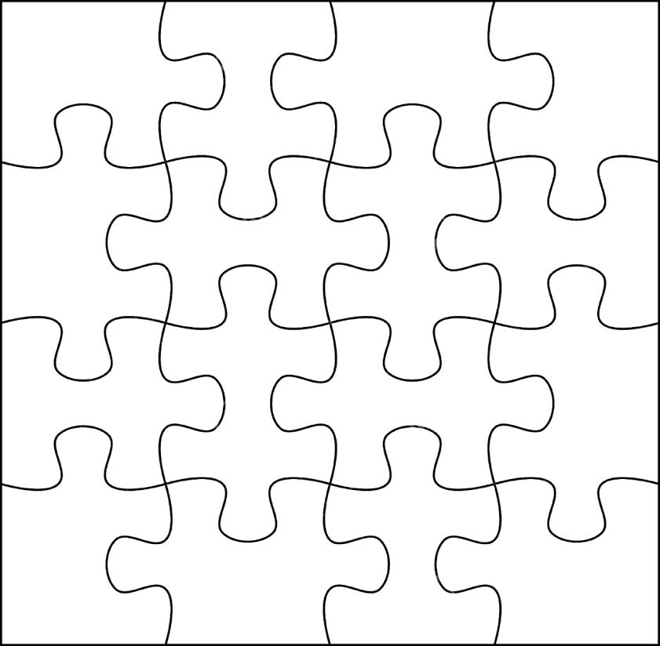
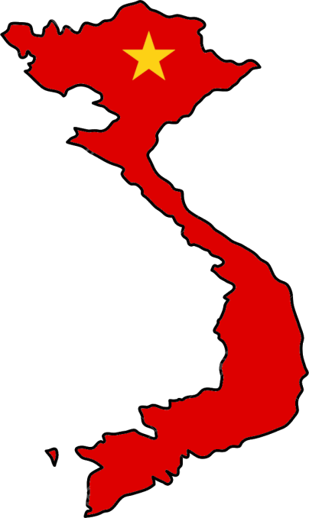
Motivation for activities in Vietnam
Large potential to develop intelligent sustainable energy solutions
Wonderful location to join local craftsmanship with proven specialized german experience
Our goal: Assembling the puzzle

Slide 17
Desired partnerships in Vietnam / requirements
National business cooperations or licensees
Joint Ventures or economically independent suppliers
Companies with obtained permission to produce, install and run a windpark = companies that already realized their first steps to realize sustainable energy solutions

Slide 18
Thank you very much for your attention!
Hee Jin Eun
QREON GmbH Großer Kamp 5, D-22885 Barsbüttel, Germany Tel.: +49 (0)40 25 4994 400
mobile +49 (0)1512 0734717
Email: heejinek@qreon.de
Website: www.qreon.de

