Slide 1
Photovoltaic & Smart Grids in Vietnam
COMPANY PROFILE
21st Century Clean Energy GmbH & Co KG
Germany
Hanoi, Oct. 22nd 2019

Slide 2
WELCOME MESSAGE
Bernd Malorny
21CCE Founder & Global business development
Specialized in oversea Asia Business - 20 years !
Have lived in Asia - 8 Years
Have lived in Vietnam - 2 years
Passionate in renewable energy and international businesses

Slide 3
ABOUT US
We connect
ASIA PACIFIC - European technology
in the “Renewables “!

Slide 4
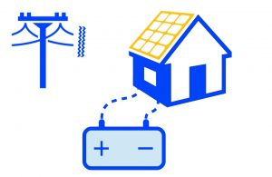
OUR KEY MARKET
95%
Customer area:
ASEAN
Greater India
Oceania
100%
Target customer:
B2B only !
PV system integrators – EPC’s
95% Commercial applications
65% off-grid /45% on-grid
Projects materialized for Factories, Hotels, Offices , Warehouses , Schools etc.
.
Specialized in off-grid applications with storage

Slide 5
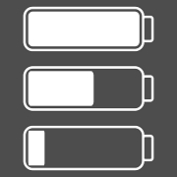
OUR HISTORY
Young - Passionate - Highly motivated – Service Oriented
Energy Storage
Start to enter energy storage business
First VN project
1 MWp served in Vietnam
5 MWp today
Founding
21CCE established
New Office in Lübeck
Base to growth
Wide penetration
24 Energy storage systems
almost every Asian country
2014
2017
2019
2019/ Q2
2019

Slide 6
WHAT WE DO !
Project Development
Distribution
Service & Support
Energy Storage
Trade
Support
I
II
III
Safe, reliable and modern Lithium Energy Storage !
PV- & Battery Inverter
Industry leading
European Manufacturers !
Aftersales Service !
Project Finance !
Certificates & Reports !

Slide 7
I
PROJECT DEVELOPMENT & SOLUTIONS
Energy Storage Systems
PRODUCT FEATURES
CUSTOMER BENEFITS
Up to 30 years life span
100% DoD, up to 8000 full cycles , 1C Rate ,
-10°C to +50°C operating temperature
unlimited KWh ,
stand by power 1W -5 W
Low voltage / high voltage 98% efficiency
10 years performance guarantee
Safe & Reliably ➔ Bankable
Long lasting
Expandable at any time
Highly efficient
Lowest cost of energy from storage ( LCOS )

Slide 8
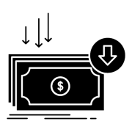
II
INTERNATIONAL & Trade & Distribution
Cost leadership
Fast delivery
After Sales Excellence
Direct authorization
Sourcing partners
Regional demand .
Stock in Germany
Stock in Region
Stock in Vietnam
Close to market /
Close to manufacturers
Service Provider
PV Inverter
Battery inverter
PV Accessories
European Manufactures / Industry leaders
.
Officual Int. Distributor &
Service Provider

Slide 9
III
OUR SERVICE
ADVANCED ENGINEERING
AFTER SALES SERVICE
Design &Simulation
Verification
Made in Germany
On Side
Escalating at hq.
Regional partners
SUPPORT
Project finance
Transport & Logistics
Crowd funding
Made in Germany
We move your products from Europe to Asia
Consulting
Document management!
Support on project development
CO
CQQ
Test reports !
WE AIM TO MOVE BARRIERS AWAY,
SHARE BEST PRACTISE AND TO TRANSFER KNOWLDEGE

Slide 10
OUR Motivation
We search for !
High quality PV projects !
Energy Storage
Save – Reliable- Long lasting = Low cost!
From projects
to full
solutions
Fully financed !
PV Inverter!
Test us !
You one stop sourcing point!
Energy Storage
Pilot Projects
Early birds of the industry wanted !
Project Finance
Made in Germany
Become a qualified partner !

Slide 11
CONTACT : info@21cce.com
WWW. : https://www.21cce.com/
PHONE NUMBER : +49 162 9028868
THANK YOU

