Slide 1
energy solutions – made in Germany
Vietnamese-German Conference on Wind Energy
Berthold Breid CEO Renewables Academy (RENAC) AG
Consultant on behalf of the German Energy Solutions Initiative
November 06th, 2018 in Ho-Chi-Minh

Slide 2
Content
The German Energy Solutions Initiative
The Energy Transition in Germany

Slide 3
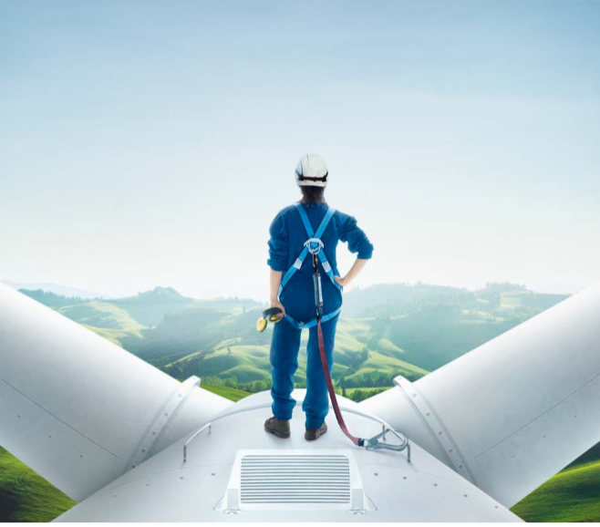
Our Aims
Promotion of renewable energy and energy efficient technologies
Showcase sustainable energy solutions
Implementation of projects
Know-how transfer
Contribution to international climate protection
Notes:
The promotion of renewable energies and energy efficiency in Germany has started already in the early 90’s of last century. This are almost 30 years, which have resulted in the establishment of a strong industry, encompassing several 100 small and medium-sized enterprises specialized in research and development, design and production of sustainable energy solutions.
Today 4 of those companies from Germany have travelled Thailand to present you their concept and solutions for energy efficiency in the industry. They will present themselves in a panel later on.
Before that, let me tell you in which way you can participate an profit from our Energy Solutions Initiative:
The aims of German Energy Solutions Initiative are:
Promotion of renewable energy and energy efficient technologies
By Show casing sustainable energy solutions :
The implementation of projects using German technologies and expertise
Further, to transfer know-how into the hands of political decision-makers, key opinion leaders and market participants all over the globe
As well as contributing to international climate protection
The key word interlinking all these issues is “German Energiewende” which I will present a little bit later

Slide 4
How can you participate and meet German enterprises?
Foreign trade fairs
Networking opportunities
Know-how transfer
Information
Capacity building
Trade missions
Fact finding missions
Project development & flagship projects
Notes:
In order to achieve those aims the initiative offers a wide range of instruments. Here you can see a brief overview of those instruments:
Foreign trade fair participation:
Networking opportunities
Know-how transfer
Information about the German renewable energy sector
Trade missions for German companies to go abroad
Fact finding missions for foreign companies to come to Germany
Project development assistance and the implementation of flagship projects

Slide 5
Know-how transfer
Fact finding missions
Missions to Germany for foreign companies & decision-makers
Visit of best practices and applied solutions
Project development & flagship projects
Facilitating business partnerships and know-how transfer
Capacity building
© endostock/Fotolia
© GIZ
Notes:
You as a foreign company or decision-maker can take part in fact finding missions to Germany, where you will visit best practices renewable energy installations and companies who have successfully implemented energy efficiency measures. You will also have the opportunity to get insights into the German energy technology sector as well as to establish valuable business contacts with German companies.
The initiative offers various instruments for the realization of sustainable energy projects worldwide:
The Project Development Program (PDP) is implemented by the Deutsche Gesellschaft für Internationale Zusammenarbeit (GIZ). It focuses on developing and emerging economies.
Renewable-Energy-Solution-Program (RES-Program) is implemented by dena, the German Energy Agency. Through this program flagship projects showcasing all technologies are realized worldwide.
Both programs aim at facilitating business partnerships as well as the transfer of know-how. They also include capacity building measures.
Another instrument for learning about best-practice projects in your country are Technology Showcases. These showcases present implemented projects in your country that use energy-efficient technologies and expertise “made in Germany”. During these events you can meet all the companies involved in the implementation of the projects. The showcase also comprises a workshop where you will have the opportunity to discuss technical aspects with experts.
Besides those programs there are also more capacity building activities in which representatives from renewable energy and energy efficiency companies can take part as well as foreign decision-makers.
European Energy Manager (EUREM) – Training programme offered by selected German chambers of commerce abroad. Corporate decisions-makers get the opportunity to acquire and extend their knowledge and expertise about energy efficiency.
Manager Training Programme – „Fit for Partnership with Germany“ – The programme is implemented by the GIZ. Participating managers get the opportunity to establish contact with potential business partners in Germany while acquiring management skills and useful skills for international cooperation.

Slide 6
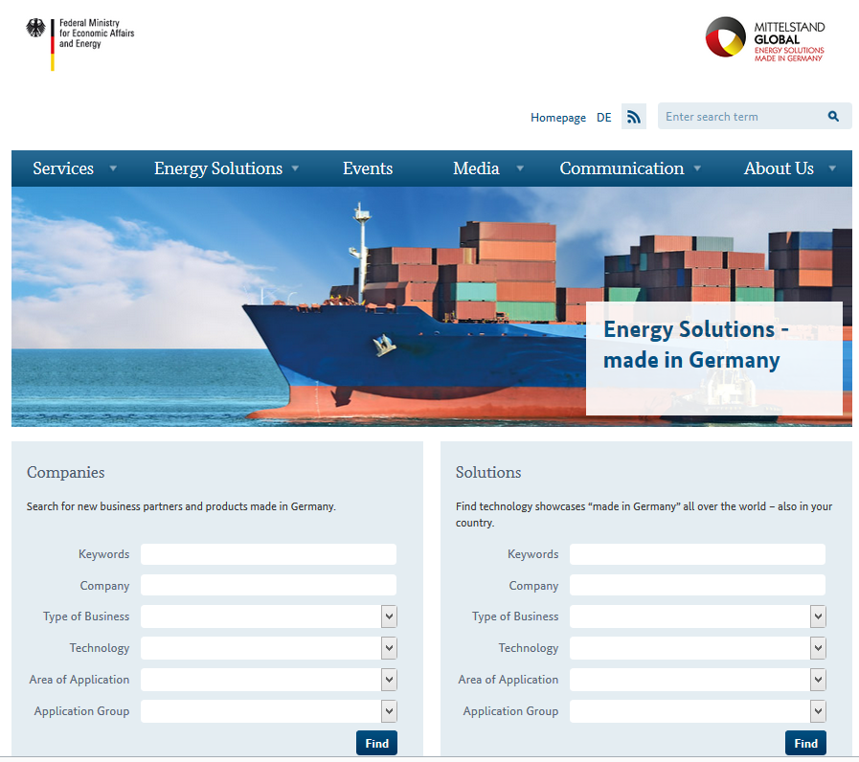
Information about Events and German companies
On our website you can find:
Information about technologies made in Germany on a Database
Current news and upcoming events
www.german-energy-solutions.de
You may also always contact us!
Notes:
On the website of the Germany Energy Solutions Initiative you find a wide range of information. When browsing the company directory, you can also find suitable business partners. A contact adress when you want to figure out more about activities concerning your region

Slide 7
Upcoming Events for Vietnam in 2019
AHK-Business Trip to Vietnam on Industrial Energy Efficiency from January 14th-18th, 2019
Information Session Vietnam on Smart Grids on July 11th, 2019 in Berlin
AHK-Business Trip to Vietnam on Smart Grids from October 21st-25th, 2019

Slide 8
The German Energiewende

Slide 9
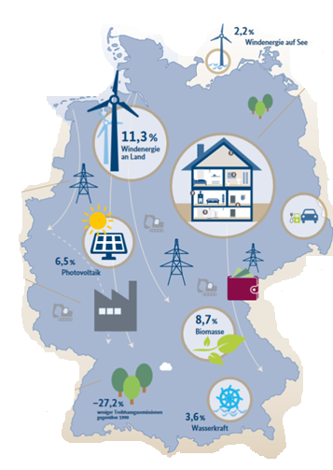
Reasons for the Energy Transition in Germany
Phase-out nuclear power generation
Reduce dependency on energy imports
Reduce carbon emissions and reach climate protection targets
Development of new technologies as new sources of growth and employment
Energy policy can be both sustainable and economically successful (combined with measures for energy efficiency)
Notes:
So I told you I wanted to give a small introduction on what is „Energiewende“ What do we mean by saying „Energy transition“?
On this slide you can see a map of Germany and a mix of aspects energy transition encompasses: - We want to become more indepent from oil and gas imports – and therefore using more renewable energy sources. Currently each third kilowatthour comes from renewables, the biggest share from wind power. - We want to reduce the output of greenhouse gases. We could reduce emissions since 1990 about 27%. - We are working on energy efficiency measures, both in the building and in the industrial sector. - We are working on the topic of e-mobility: in 2015 we had about 42.000 vehicles running on batteries on the road, double as much as in the year before. - We are extending our electricity grid, electricity has to be transported from North to South. - And we want this development in the energy sector to be also a source of growth for our economy, for example by creating new employment opportunities or by producing more efficiently in the industry.

Slide 10
Policy and guiding principles of the Energiewende
Secure and reliable energy supply
Affordable and cost effective energy supply
Environmentally sound energy supply
Affordability, reliability and environmental protection are interlinked and the ultimate objectives of the Energiewende and German energy policy.
Source: BMWi 2017, RENAC
Notes:
Energy security reflects the availability of affordable energy. Because germany imports so much of its energy, it is especially vulnerable to unexpected price hikes. - Sometimes energy imports can dry up for political reasons overnight.
The burning of coal, oil and gas is causing our climate to overheat. Our current energy supply is not sustainable. One major aim of the Energiewende is to decarbonize energy suuplied by switching to renewable resources.

Slide 11
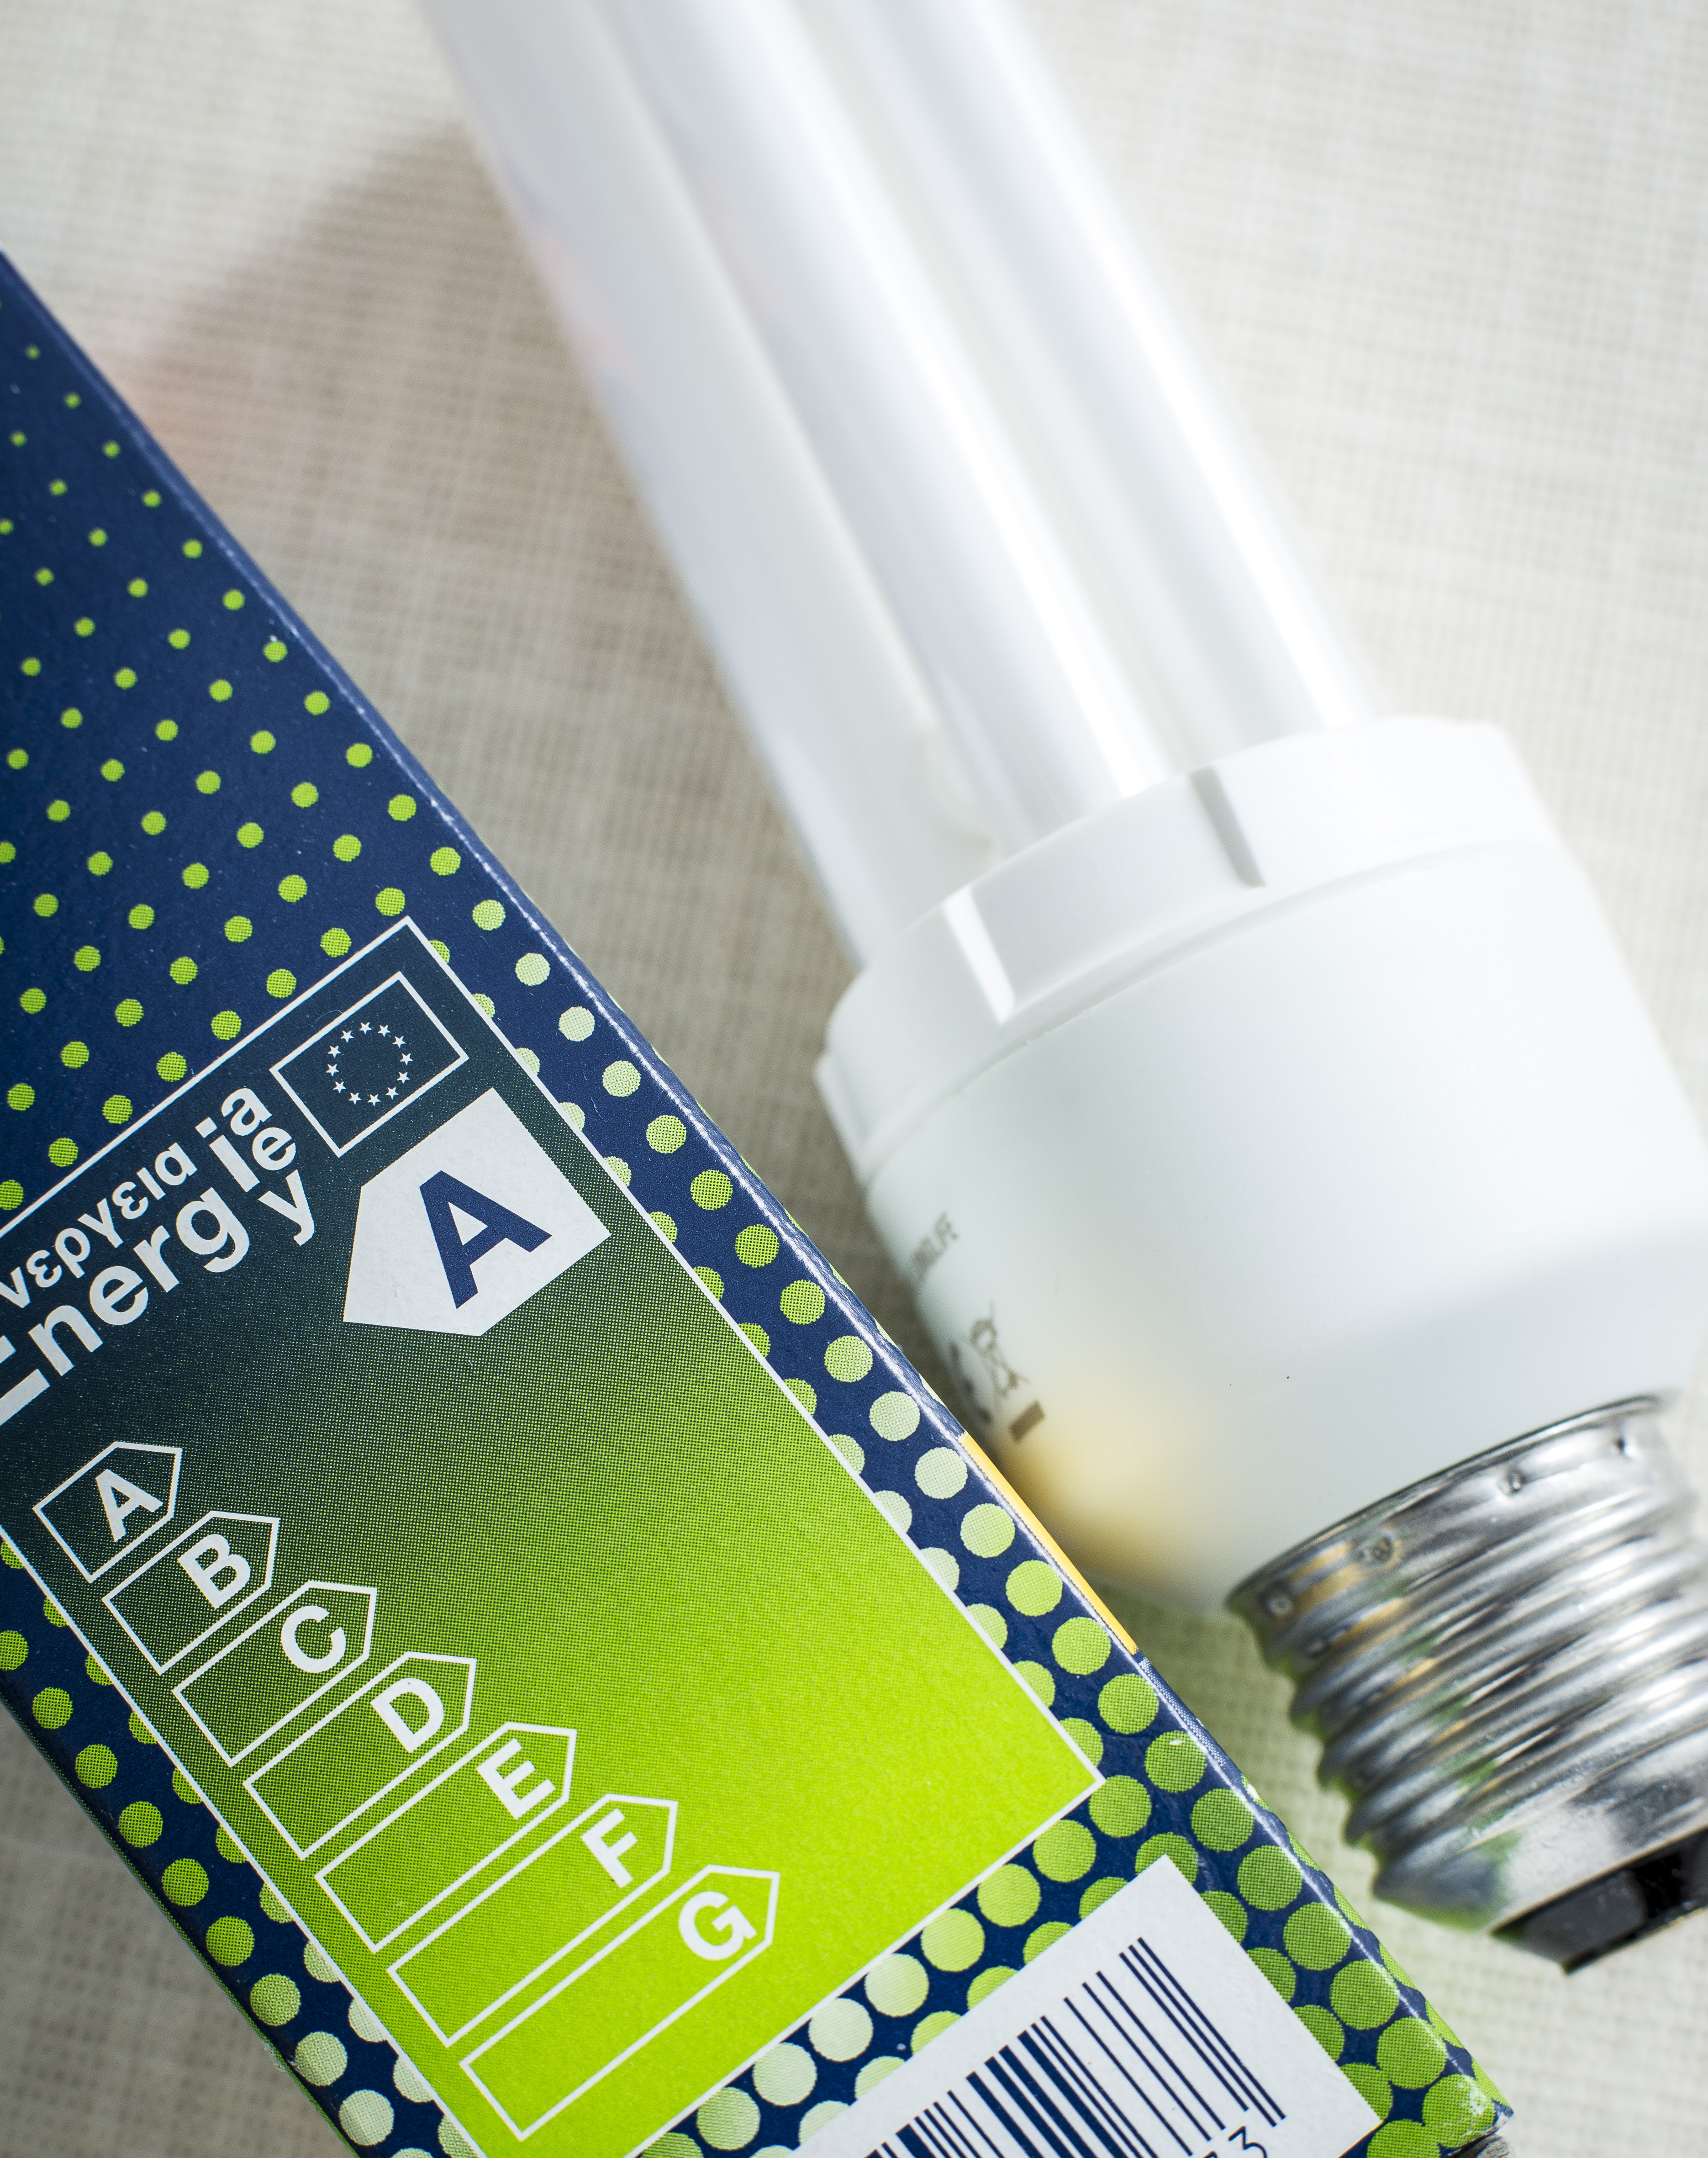
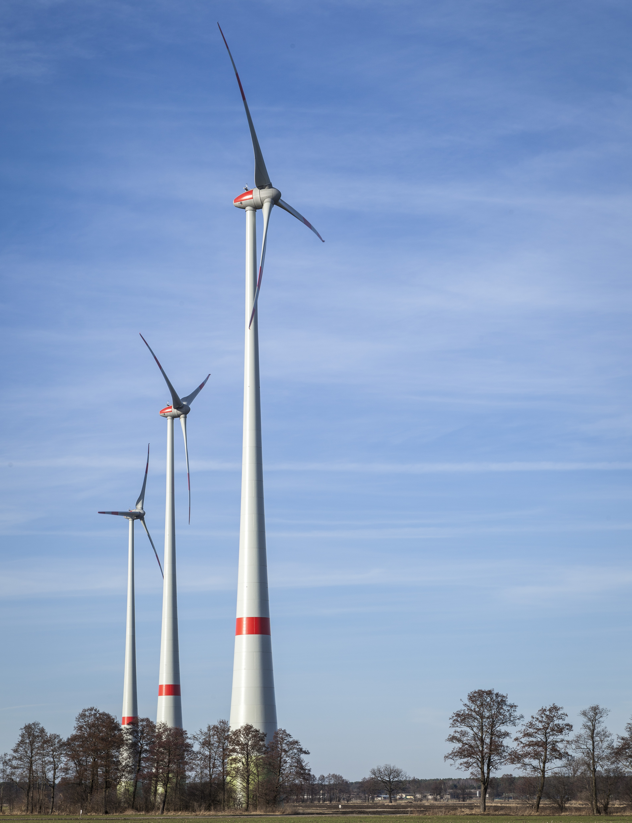
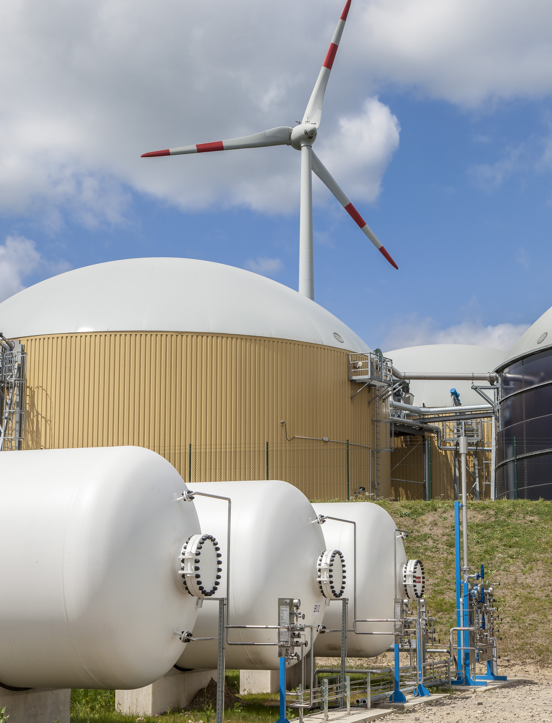
Pillars of the Energiewende
Efficiency first
Direct use of renewables
Sector coupling
The energy transition triad combines efficiency, direct use of renewables and sector coupling
Source: BMWi 2017
Notes:
Efficiency first means: prioritizing energy efficiency – measures to raise energy efficiency are always cheaper than providing energy
The greatest share of the remaining energy demand (what is not covered by improving energy efficiency) is to be covered by the direct use of renewables.
Sector coupling means using electricity from renewables to bring the energy transition to other sectors (heating&cooling, transport) and so reduce the amount of fossil energy energy required
Background information
European energy and climate policy The EU's 2030 framework for climate and energy policies is a decisive factor in the future direction of national energy policy, and the successful delivery of the energy transition
Current wording speaks of Energy Efficiency and Renewables as “fundamental strategies” and “core objectives”. Past documents mentioned them as “key pillars” (e.g. the coalition agreement, KoaV 2013), and the “cornerstones” of the Energiewende (Eckpunkte 1.7.2015). “Key pillars” is outdated

Slide 12
RE development in Germany since 1990
218
1990: PV programme “1.000 Roofs”
2011: Energiewende package, nuclear phase out
2014+2016:
EEG Amendment
2017: Auctions
2010: Energy Concept
1991:
Electricity Feed-In Law
2000:
First EEG
Source: AGEB 2017, AGEE-Stat 2018
The Energy transition started decades ago. Continuously developed policy support has triggered the steady growth of RE in Germany.
Notes:
This is what we reached so far regarding the different renewable energy technologies. In the early 90’s, renewable were limited to hydro power. By continuously implementing and adapting a package of support mechanisms, we are now at: - 28.000 wind energy power plants with a capacity of 50 GW (on-shore) and 4000 MW off-shore - 1,5 Million PV power plants with a capacity of 41 GW - 8000 biogas plants with a capacity of 4000 MW = about 50% of installed capacity for power generation comes from renewables
Für Fragen zu den Daten = main laws promoting RES:
In order to support Solar PV pioneers, the „1000 Roofs Programme (1000 Dächer Programm) was established, which supported the installation of roughly 2000 PV installations between 1990 and 1992.
In 1991 the „Electricity Feed-In Law“ obliged power corporations to buy renewable electricity for predefined price. (16.61 Pfennige/kWh for Wind and Solar). This was a milestone for RES support policies in Germany.
In 2000 the electricity feed-in law was replaced by the first „Renewable Energy Sources Act“ (EEG)
2010: The Integrated Energy and Climate Programme (IEKP) translates the corresponding EU policies into German law and tackles all areas of sustainable energy supply, not only renewables, but also efficiency in the various sectors.
The 2011 nuclear disaster in Fukushima, Japan, led the German government to re-think their nuclear power strategy. A phase-out of all nuclear power generation by 2022 was agreed and a corresponding ramp up of renewables (Energiewende package).
The EEG was amended several time. Major changes occurred in 2014 when feed-in traiffs were substantially lowered. In 2016 a major novelty was the introduction of tenders for PV, Wind and Biomass, representing a shift away from the well-established feed-in tariff system.
After initial tenders in PV in 2016, the new auctioning/tender support instrumnets will be in place from 2017 onwards. Smaller RE systems (PV below 100 kW) are not affected.
Background info
The Electricity Feed-In Law entered into force on 1.1.1991 and required power companies to buy electricity from renewable energy sources and to remunerate for a fixed price. This was based on the average returns of the power company in the penultimate calendar year; when introducing the price was 13,84 Pfennig per kilowatt-hour (kWh), and 16.61 cent / kWh for electricity from wind and solar energy.
In 1999 the 100,000 Roofs Program (based on the 1000 roofs program) was supposed to expand the role of photovoltaics and offered interest-reduced loans.
The first Renewable Energies Act (EEG) came into force in 2000 and defined feed-in tariffs for the different renewable energy technologies.
2007 the IEKP was adopted.

Slide 13
Targets of the Energiewende until 2050
 |  | 2016 | 2020 | 2030 | 2040 | 2050
Climate | % greenhouse gas reduction (vs. 1990) | -27.3 % | -40 % | -55% | -70% | -80-95%
Renewable energy | % gross final energy consumption | 14.8 % | 18% | 30% | 45% | 60%
 | % gross electricity consumption | 36.2 %* 31.6 % | Min 35% | Min 50% | Min. 65% | Min 80%
 | Share in heat consumption | 13.2 % | 14%
 | Share in Transport sector | 5.2 % | 10% (EU)
Energy efficiency | % primary energy consumption (vs. 2008) | -6.5 % | -20% |  |  | -50%
 | Final energy productivity (2008-2016) | 1.1% p.a. | 2,1% per year (2008-2050)
 | Gross electricity consumption (vs. 2008) | -3.6 % | -10% |  |  | -25%
 | Primary energy demand (buildings) (2008) | -18.3 % |  |  |  | - 80 %
 | Heat demand (buildings) (vs. 2008) | -6.3% | -20%
Transport | Final energy consumption in transport (vs. 2005) | +4.2% | -10% |  |  | -40%
 | Number of Electric vehicles (1/2018) (hybrid cars) | 53.861* (236.710) | (1 million) | (6 million)
Sources: BMWi 2018, BMUB 2016, AGEE-Stat 2016, UBA 2017, BMWi 2016
The energy transition follows a transparent long-term strategy with specific targets.
* = 2017
Notes:
So energy transition in Germany touches all sectors, it is like an “integrated concept” and it is a long-term strategy along the pathway until 2050.
Specific targets have been set in the extension of renewable energy capacities as well as in the field of energy efficiency. While where is a good progress in the
Sources:
BMWi 2018: Sechster Monitoring-Bericht zur Energiewende. Berichtsjahr 2016, Juni 2018, https://www.bmwi.de/Redaktion/DE/Publikationen/Energie/sechster-monitoring-bericht-zur-energiewende.pdf?__blob=publicationFile&v=16, page 10.
BMWi 2016: Fünfter Monitoring Bericht zur Energiewende Berichtsjahr 2015., Dezember 2016, https://www.bmwi.de/Redaktion/DE/Publikationen/Energie/fuenfter-monitoring-bericht-energie-der-zukunft.pdf;jsessionid=243FCA6521D2909EEF8AE6AD3840E98E?__blob=publicationFile&v=24, Seite 3.
BMWi 2016: Erneuerbare Energien in Deutschland: Daten zur Entwicklung im Jahr 2015, http://www.erneuerbare-energien.de/EE/Redaktion/DE/Downloads/erneuerbare-energien-in-zahlen-2015.pdf?__blob=publicationFile&v=3, as of February 2016, last accessed July 2016.
Treibhausgasemissionen: UBA (2015): http://www.umweltbundesamt.de/daten/klimawandel/treibhausgas-emissionen-in-deutschland
Ziele: BMWi/BMU (2010): Energy Concept. for an Environmentally Sound, Reliable and Affordable Energy Supply. 28. September 2010: field of renewable energy, we have to extend our efforts in the field of energy efficiency

Slide 14
Gross electricity production in Germany 2017
Renewables have become the biggest source of power generation.
Source: BMWi 2018 – Energiedaten, AGEB 2018, UBA/AGEE-Stat 2018
Notes:
Notes
The slides illustrates the structure of gross electricity production (Bruttostromerzeugung) in Germany in 2017.
Since 2014, Renewables (25.8%) are the biggest source of electricity followed lignite, and hard coal.
Hard coal and brown coal and natural gas still constitute the back bone of German electricity production.
Among renewables, wind onshore (88 TWh), solar PV (40 TWh) and biomass (solid biomass and biogas: 45 TWh) were the most important sources of renewable electricity.
The share of nuclear in German electricity production decreased significantly (from 27.1% in 2004 to 11.7% in 2017 (15.9% in 2014 / 15.4% in 2013), due to the federal government‘s decision to phase-out nuclear. Over the coming years the remaining nuclear plants will be shut down, so the share will decline to zero by 2022.
TOTAL 2017: 654,8 TWh
Lignite: 22,5% = 147,5 TWh
Oil and other 3,9% = 25,7 TWh
Hard coal 14,1% = 92,6 TWh
Natural gas 13,2% = 86,5 TWh
Nuclear 11,7% = 76,3 TWh
Renewables 34,5% = 217,9 TWh
TOTAL 2016: 648,4 TWh
Lignite 23,1% = 150,0 TWh
Oil and other 5,2% = 33,4 TWh
Hard coal 17,2% = 111,5 TWh
Natural gas 12,4% = 80,5 TWh
Nuclear 13,1% = 84,6 TWh
Renewables 29,0% = 188,3 TWh
Sources
BMWi 2018: Energiedaten, Gesamtausgabe der Energiedaten, Datensammlung des BMWi, https://www.bmwi.de/Redaktion/DE/Artikel/Energie/energiedaten-gesamtausgabe.html, August 2018.
BMWi 2018: Sechster Monitoring-Bericht zur Energiewende. Berichtsjahr 2016, Juni 2018, https://www.bmwi.de/Redaktion/DE/Publikationen/Energie/sechster-monitoring-bericht-zur-energiewende.pdf?__blob=publicationFile&v=16, page
UBA/AGEE-Stat 2018: Erneuerbare Energien in Deutschland, Daten zur Entwicklung im Jahr 2017, https://www.umweltbundesamt.de/sites/default/files/medien/376/publikationen/180315_uba_hg_eeinzahlen_2018_bf.pdf, page 11.
AGEB 2018: Bruttostromerzeugung in Deutschland nach Energieträgern 1990 - 2017 (Stand Februar 2018), https://ag-energiebilanzen.de/index.php?article_id=29&fileName=20171221_brd_stromerzeugung1990-2017.pdf, February 2018.

Slide 15
Renewable electricity production in Germany 2017 (TWh)
Wind, biomass and PV are the most important sources of renewable electricity generation in Germany.
Source: UBA/AGEE-Stat 2018
Notes:
Notes
The slides illustrates the structure of gross electricity production (Bruttostromerzeugung) in Germany in 2017.
Since 2014, Renewables (25.8%) are the biggest source of electricity followed lignite, and hard coal.
Hard coal and brown coal and natural gas still constitute the back bone of German electricity production.
Among renewables, wind onshore (88 TWh), solar PV (40 TWh) and biomass (solid biomass and biogas: 45 TWh) were the most important sources of renewable electricity.
The share of nuclear in German electricity production decreased significantly (from 27.1% in 2004 to 11.7% in 2017 (15.9% in 2014 / 15.4% in 2013), due to the federal government‘s decision to phase-out nuclear. Over the coming years the remaining nuclear plants will be shut down, so the share will decline to zero by 2022.
TOTAL 2017: 654,8 TWh
Lignite: 22,5% = 147,5 TWh
Oil and other 3,9% = 25,7 TWh
Hard coal 14,1% = 92,6 TWh
Natural gas 13,2% = 86,5 TWh
Nuclear 11,7% = 76,3 TWh
Renewables 34,5% = 217,9 TWh
TOTAL 2016: 648,4 TWh
Lignite 23,1% = 150,0 TWh
Oil and other 5,2% = 33,4 TWh
Hard coal 17,2% = 111,5 TWh
Natural gas 12,4% = 80,5 TWh
Nuclear 13,1% = 84,6 TWh
Renewables 29,0% = 188,3 TWh
Sources
BMWi 2018: Energiedaten, Gesamtausgabe der Energiedaten, Datensammlung des BMWi, https://www.bmwi.de/Redaktion/DE/Artikel/Energie/energiedaten-gesamtausgabe.html, August 2018.
BMWi 2018: Sechster Monitoring-Bericht zur Energiewende. Berichtsjahr 2016, Juni 2018, https://www.bmwi.de/Redaktion/DE/Publikationen/Energie/sechster-monitoring-bericht-zur-energiewende.pdf?__blob=publicationFile&v=16, page
UBA/AGEE-Stat 2018: Erneuerbare Energien in Deutschland, Daten zur Entwicklung im Jahr 2017, https://www.umweltbundesamt.de/sites/default/files/medien/376/publikationen/180315_uba_hg_eeinzahlen_2018_bf.pdf, page 11.
AGEB 2018: Bruttostromerzeugung in Deutschland nach Energieträgern 1990 - 2017 (Stand Februar 2018), https://ag-energiebilanzen.de/index.php?article_id=29&fileName=20171221_brd_stromerzeugung1990-2017.pdf, February 2018.

Slide 16
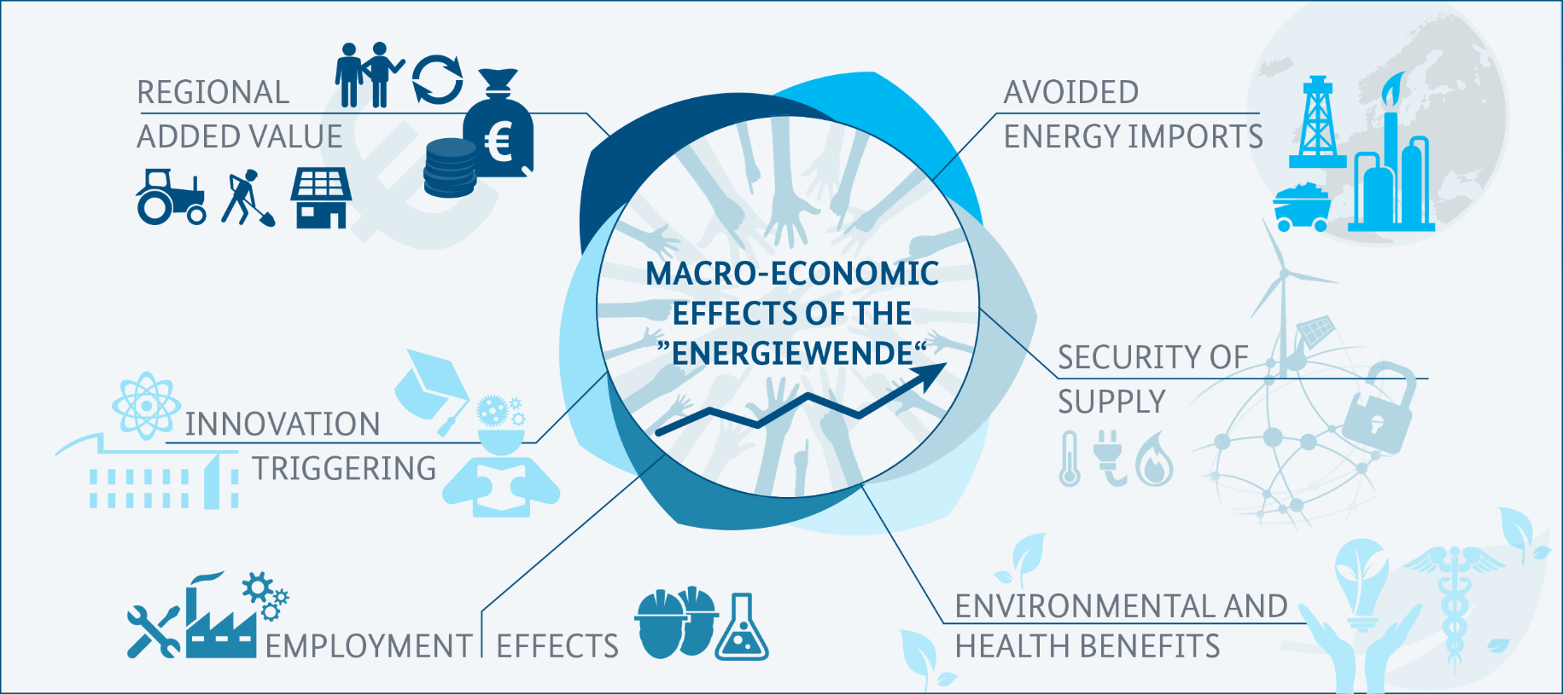
Benefits of the Energiewende
Source: BMWi 2014, ERGO Kommunikation
The energy transition has numerous positive effects on various levels.
Notes:
BASIC
The slide visualizes the diverse and multi-fold macroeconomic effects of energy transition (Energiewende) in Germany.
The development of renewable energy technologies, services and products such as renewable electricity as well as energy efficiency technologies, services and products used by end consumers have effects on several factors such as
Avoided energy imports: The substitution of fossil fuels imports (oil, gas, coal) to Germany by renewable energy use saves money. In 2013 renewables saved energy imports worth 9,1 billion euros.
Increased security of supply due to reduced exposure to volatile world prices and less dependence on non-democratic regimes (=reduced geopolitical hazard)
Environmental protection (lower emissions and less pollutants
positive employment effects in the renewables and energy efficiency sectors, which outweigh negative effects in the conventional energy sector.
Innovation triggering: Germany is establishing a green economy based on new products, services and new companies that lead to
an increase in regional added value via turnover and economic activities by and for local actors.
All these factors constitute the macro-economic effects presented here.
Reduced external costs/ higher external benefits (e.g. emission reductions) from renewables or energy efficiency are usually not accounted for by macro-economic models leading to a systemic bias in favour of traditional energies and their use.
Source
Visualisation: ergo-kommunikation based on IZES, Fraunhofer ISI, DIW Berlin and GWS 2010: „Einzel- und gesamtwirtschaftliche Analyse von Kosten- und Nutzenwirkungen des Ausbaus Erneuerbarer Energien im deutschen Strom- und Wärmemarkt“ http://www.erneuerbare-energien.de/fileadmin/eeimport/files/pdfs/allgemein/application/pdf/endbericht_ausbau_ee_2009.pdf, last accessed May 2015.

Slide 17
Wind energy – What is the global status?
Top countries (cumulative capacity, end 2017 in GW)
China 188.23 GW
USA 89.07 GW
Germany 56.13 GW
India 32.84 GW
Spain 23.17 GW
United Kingdom 18.87 GW
France 13.75 GW
Brazil 12.76 GW
Canada 12.24 GW
Italy 9.48 GW
Rest of the world 83.01 GW
There is a constant growth of global wind power generation capacity.
Sources: BMWi 2018, UBA/AGEE-Stat 2018
Notes:
Notes
The slides illustrates the structure of gross electricity production (Bruttostromerzeugung) in Germany in 2017.
Since 2014, Renewables (25.8%) are the biggest source of electricity followed lignite, and hard coal.
Hard coal and brown coal and natural gas still constitute the back bone of German electricity production.
Among renewables, wind onshore (88 TWh), solar PV (40 TWh) and biomass (solid biomass and biogas: 45 TWh) were the most important sources of renewable electricity.
The share of nuclear in German electricity production decreased significantly (from 27.1% in 2004 to 11.7% in 2017 (15.9% in 2014 / 15.4% in 2013), due to the federal government‘s decision to phase-out nuclear. Over the coming years the remaining nuclear plants will be shut down, so the share will decline to zero by 2022.
TOTAL 2017: 654,8 TWh
Lignite: 22,5% = 147,5 TWh
Oil and other 3,9% = 25,7 TWh
Hard coal 14,1% = 92,6 TWh
Natural gas 13,2% = 86,5 TWh
Nuclear 11,7% = 76,3 TWh
Renewables 34,5% = 217,9 TWh
TOTAL 2016: 648,4 TWh
Lignite 23,1% = 150,0 TWh
Oil and other 5,2% = 33,4 TWh
Hard coal 17,2% = 111,5 TWh
Natural gas 12,4% = 80,5 TWh
Nuclear 13,1% = 84,6 TWh
Renewables 29,0% = 188,3 TWh
Sources
BMWi 2018: Energiedaten, Gesamtausgabe der Energiedaten, Datensammlung des BMWi, https://www.bmwi.de/Redaktion/DE/Artikel/Energie/energiedaten-gesamtausgabe.html, August 2018.
BMWi 2018: Sechster Monitoring-Bericht zur Energiewende. Berichtsjahr 2016, Juni 2018, https://www.bmwi.de/Redaktion/DE/Publikationen/Energie/sechster-monitoring-bericht-zur-energiewende.pdf?__blob=publicationFile&v=16, page
UBA/AGEE-Stat 2018: Erneuerbare Energien in Deutschland, Daten zur Entwicklung im Jahr 2017, https://www.umweltbundesamt.de/sites/default/files/medien/376/publikationen/180315_uba_hg_eeinzahlen_2018_bf.pdf, page 11.
AGEB 2018: Bruttostromerzeugung in Deutschland nach Energieträgern 1990 - 2017 (Stand Februar 2018), https://ag-energiebilanzen.de/index.php?article_id=29&fileName=20171221_brd_stromerzeugung1990-2017.pdf, February 2018.

Slide 18
Next steps of the Energiewende
Coal phase-out (decarbonization of energy sector)
Energiewende in heat sector (buildings)
Energiewende in transport sector
Sector coupling (power, heat, transport)
Electric mobility and charging infrastructure
Grid integration of growing shares of renewables
Grid modernization / expansion
Cross-border interconnections
Notes:
The Energiewende is a long term process with some challenges ahead.
- Sector coupling: Energy is consumed in 3 end-use sectors (buildings / transportation/ industry). Connecting these will be crucial for the energy transition‘s success = sector coupling. Focus in Germany was for many years on the power sector, and little progress has been made on the transport sector or renewable heat sector. Excess amounts of green electricity when sun is shining, wind is blowing – can be used to generate heat - Transport sector: Transitioning German carmakers over to electric vehicles is a major challenge

Slide 19
German Delegation
Company | Name of Representative
Ammonit Measurement GmbH | Mr. Viet Ngo Duc
BayWa r.e. Wind GmbH | Mr. Brian Barry
Geo-Net Umweltconsulting GmbH | Mr. Andreas Hunold
VSB Holding GmbH | Mr. Johannes Rentzsch
zWe Projekt GmbH | Mr. André Winkler

Slide 20
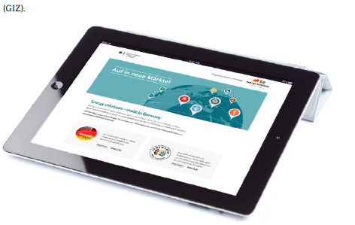
Contact
Coordination Office
German Energy Solutions Initiative
+49 (0)30 18 615- 6401/7386
office@german-energy-solutions.de
www.german-energy-solutions.de
Follow us: @export_EE
Facilitator
Renewables Academy AG
Berthold Breid
+49 (0)30 5268958-88
breid@renac.de
www.renac.de

