Slide 1
Innovative Cybersecurity | Monitoring | Management Platform
With the help of modern technologies in combination with statistical methods and intelligent algorithms we are revolutionizing the security monitoring of
IT systems.
MARIO JANDECK
CEO, Enginsight

Slide 2
Digitization - leads to increasing complexity
More and more activities are supported by software solutions.
On the customer side: apps, online banking, shops, online portals, workflows, IOT etc.
On the corporate side: Increasing complexity of the software and hardware landscape
It is hardly possible for humans anymore, to ensure safe and stable IT operation.

Slide 3
19 March 2019 - Norsk Hydro
Encryption through LockerGoga costs "in the millions".
Conversion of production to manual operation necessary
April 2019 - Authorities of Jackson County
Encryption by Ryuk
400,000 USD ransom paid
13 April 2019 - FBI
4000 records of investigators and law enforcement officers member area FBINAA published
Cause: outdated websites and plugins
23 October 2018 - Clinic in Lisbon
DSGVO: 400,000 Euro fine due to insufficient access to patient data
10 January 2019 - Airbus
Server hacked with employee data
March 20, 2019
On average, a cyber attack is only discovered after 200 days," said Hans-Wilhelm Dünn, Secretary General of the German Cyber Security Council.

Slide 4
PROBLEMS
IT monitoring and cyber security are indispensable for any company! BUT
Companies do not know how important which IT systems are and what consequences a failure has.
Companies do not have an overview of the actual threat situation.
90% of alerts generated by monitoring tools are false positives.
Administrators waste 30% of their time finding the cause of a problem.

Slide 5
MORE Operating-Problems
Scenario 1: Using of different special security tools
Extensive administration, training and administration of the various tools
No communication between the individual tools, which makes error analysis very difficult and time-consuming
Scenario 2: Using big player tools
Very high purchase and operating costs
Time- and cost-intensive consulting necessary
Each use case must be implemented individually

Slide 6
Conclusion:
It is very difficult
for medium-sized companies
to operate an economically viable
security solution.

Slide 7
A software platform that automatically monitors the entire IT landscape and that shows the really important problems and events.

Slide 8
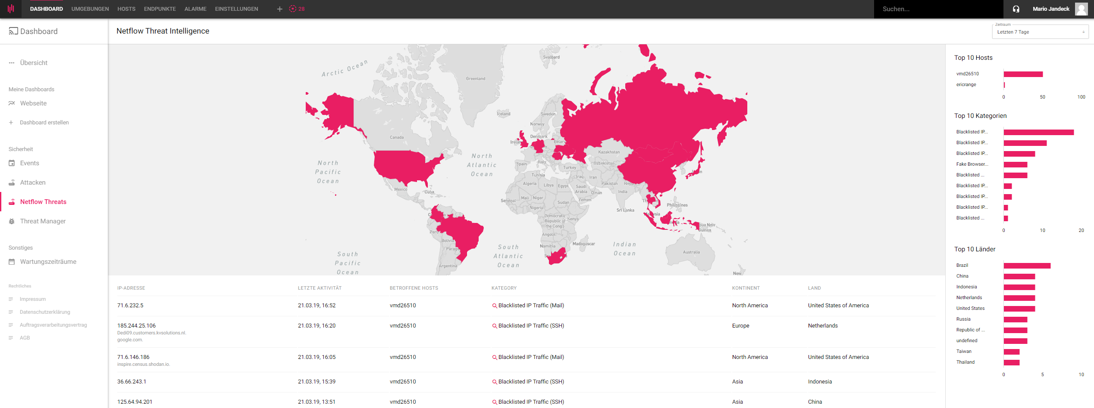
30%
TIME SAVING
compared to previous solutions
Low
"set-up costs"
out-of-the-box setup
Reduction of required tools
through comprehensive feature set

Slide 9
We reduce complexity and eliminate data silos.
SIEM (Security Information and Event Management)
DPI (Deep Packet Inspection)
Vulnerability Management
CVE scanner
Penetration tests
risk scores
website security
network monitoring
server monitoring
patch management
dependency monitoring
Platform independent
We automate repetitive tasks in IT.

Slide 10
USPs
ALL IN ONE SOLUTION
Cybersecurity, IT-Monitoring and Host-Management.
NEURONAL NETWORKS (AI)
No manual rule configuration necessary.
SECURITY SUITE
Locate security vulnerabilities, configuration flaws and attacks.
Enginsight offers a 360-degree view of a company's IT environment, is modular in design and runs "out of the box", so there are minimal setup costs on the customer side.
All functions are out of the box, directly usable without preconfiguration.
AUDIT REPORTS
Automated penetration testing and Riskscorring
AUTOMATION
Enginsight can perform actions independently.
MODERNE ARCHITEKTUR
Freely scalable through own API and individual plugins.

Slide 11
More than a tool.
Enginsight is a process.

Slide 12
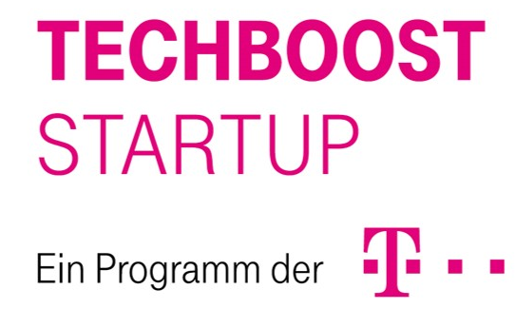
Customers and press
„One of the 30 Top AI-Startups of the DACH Region“
“In Enginsight we already see the best from the worlds of security and monitoring.”
"Swiss Army Knive for IT Security"

Slide 13
PRODUCTS and SERVICES - AVAILABLE
SaaS
Book plans online
On Premise
One Click installation
Hardware Appliances
Watchdog / Hacktor / Server
Support Packages
Trainings
Users
Sales
Admins

Slide 14
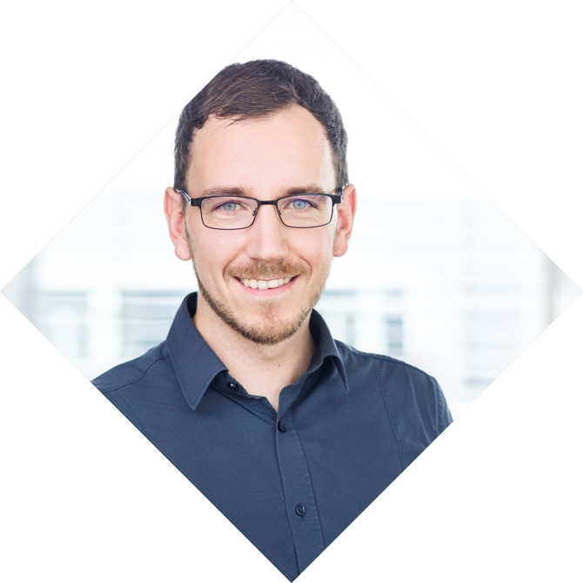
ENGINSIGHT GMBH
CEO: Mario Jandeck & Eric Range
Founded: 2017 growth to 7 employee; 2019 growth to 11 employees + external partner (IT service companies)
Headquarter: Jena, Germany Sales locations: Nuremberg, Munich, Berlin
Many years of experience in IT security, process management and business intelligence.
contact
Mario Jandeck
Hans-Knöll-Str. 6 07745 Jena
+49 (0)3641 2714966
mario.jandeck@enginsight.com

