Slide 1
Smart Grids for the German „Energiewende“
Prof. Dr.-Ing. Markus Zdrallek
Wuppertal University
22nd of October 2019
Hanoi, Vietnam

Slide 2
Main political framework
EU: Clean Energy for all Europeans Package (till 2030)
  Reducing CO₂-emissions by 40 %
  Increasing energy efficiency by 32,5 %
  Covering 30 % of the energy demand by renewable sources
Germany: Energy Concept 2050 of the German Government
  Covering 80 % of the electrical energy demand by renewable sources
Challenge for grids:
Connecting enormous numbers of renewable power plants to the grid while keeping the high quality-of-supply level with less cost for grid enhancement.

Slide 3
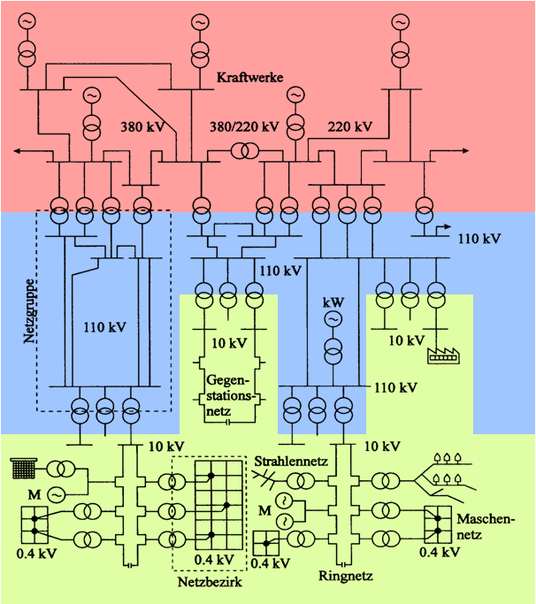

What happens to the German grid ?
Change in Generation
Wind Power
Photovoltaics
No Nuclear Power
Comb. Heat/Power plants
Biomass
New electrical loads
E-mobility
Air condition
Heat pumps
Storage units

Slide 4
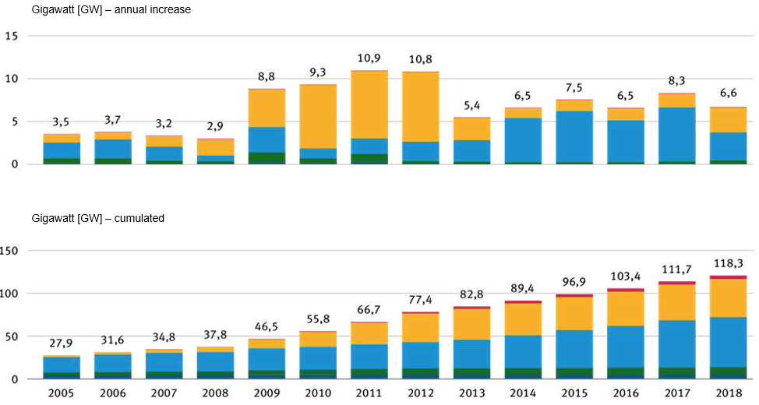
German „Energiewende“ – Development of the installed renewable energy
Prognosis
6,6
Peak load Germany: 82 GW !
197,5
…
2030
Source: Based on renewable energy statistics working group (AGEE-Stat)
Notes:
The figure visualizes the development of the installed capacity of renewable energies. In 2018, the installed capacity was 118.3 GW. As can be seen, the annual increase in capacity in recent years has fluctuated around the value of 6.6. There are various ramp-up scenarios for the further development of renewable energies. If we simply assume that the trend shown will continue over the next few years, we would end up with almost 200 GW by 2030.

Slide 5
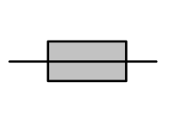
Challenges for the distribution grids
Strongly increasing distributed generation especially in rural Medium- and Low-Voltage-grids leads to:
  Power flow inversion: (Rural) grids are rather collection than distribution grids (“green grids”)
  Local violations of the permitted voltage rage
  Component overloads
Voltage
Cable overload!
U_{r} + 10%
Solution 1:
Expensive enhancement of grid capacity
187,6 A
Length of the line
129,8 A
72,1 A
NAYY 4x50 SE,
I_{r} = 142 A
10 kV / 0,4 kV
S_{t,r} = 100 kVA
Solution 2:
Intelligent control (Smart Grids)
U_{r} - 10%

Slide 6
Enhancement of Grid Capacity (Solution 1)
Concrete Measures:
Increase capacity of Medium Voltage Grid
as foreseenin scenario 2030
Adherence to today’s guidelines in 2030
30 Mio. € investments until 2030 in MV
Massive additional investments in LV- and HV-grids
  New 55 km cables (300 mm²)
  New 9 MV satellite grids (81 km, 800 mm²)
  New 2 HV/MV-substations

Slide 7

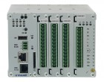
Smart Low-Voltage Grid Concept
smart RTU
– automation intelligence–
self-sustaining monitoring and control
of low voltage grids
system operation
technical data
topology
data
conditioning
grid monitoring
decentralized sensor/actuator
decentralized sensor
Low Voltage
Grid State Identification
grid control
electric powered vehicles,
decentralized power generation units, heat pumps, accumulators
determination of desired values for decentralized generation units and consumer loads
substation
output:
voltage control
power factor control
active power control
broadband powerline
communication

Slide 8
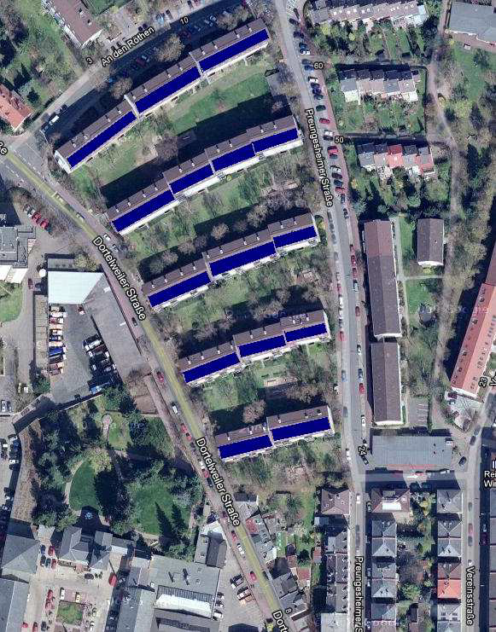
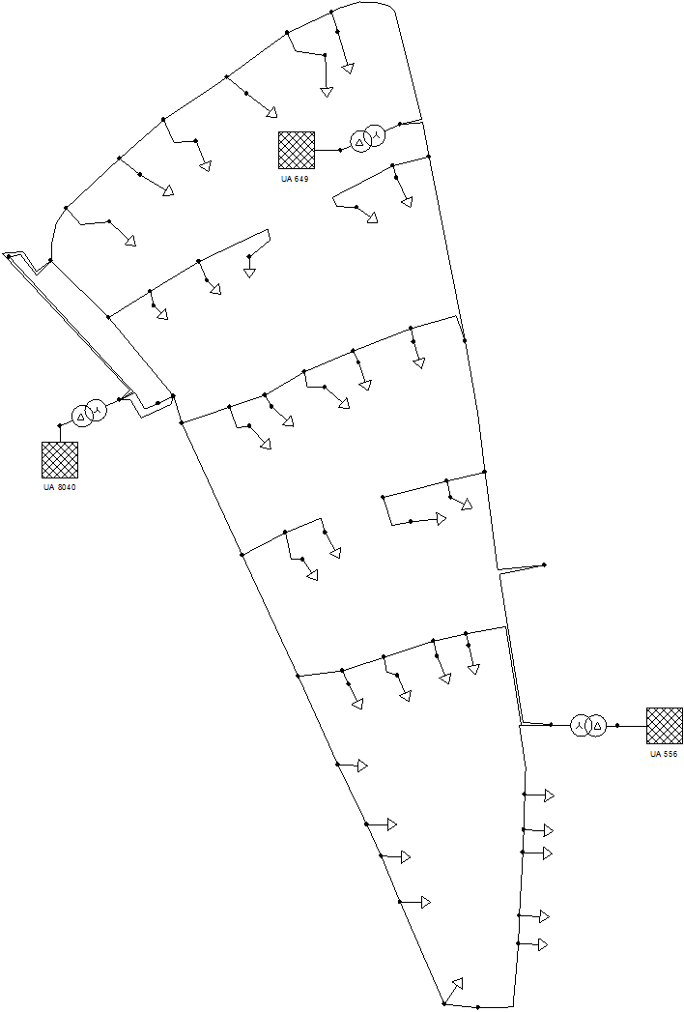

Smart Low-Voltage Grids (Solution 2)
Satellite-View
Grid-View
11kW_{p} up to 26kW_{p}

Slide 9
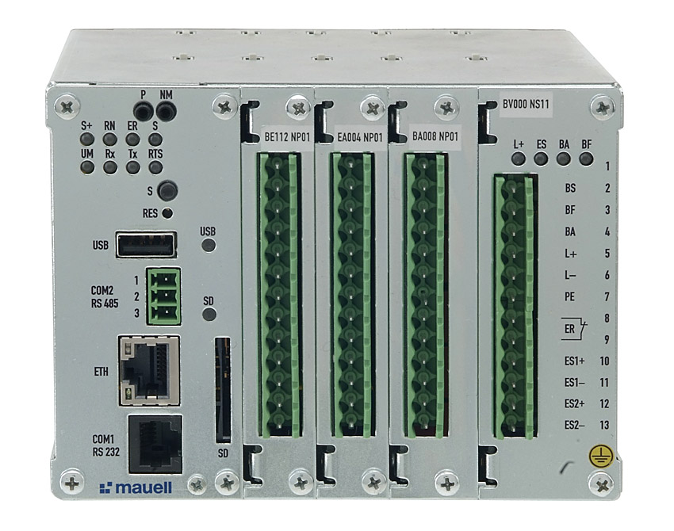
Smart LV-Grids (Solution 2)
Hardware:
3 SmartRTU in 3 MV/LV-substations with
8 points of current measurement
6 decentralized direct measurement units
Broadband powerline
communication infrastructure

Slide 10
Smart Medium-Voltage Grids
Transferring the Concept to Medium-Voltage level
Ensures cost-efficient integration of distributed generation on all distribution levels

Slide 11
Smart Meter Rollout in Germany
2014
2015
2016
2017
2018
2019
2020
2021
2022
2023
2024
2025
2026
2027
2028
2029
2030
2031
2032
Pilot phase
SM-Sys
Generating plants: Nominal power > 7 kW (§29 (1), no. 2)
Mandatory
Installation SM-Sys
Consumption > 20.000 kWh/a (§21 (1), no. 3)
Consumption 10.000 – 20.000 kWh/a
Consumption 6.000 – 10.000 kWh/a (§29 (1), 1)
Generating plants: Nominal power 1-7 kW (§29 (2), no. 2)
Optional Installation SM-Sys
Consumption < 6.000 kWh/a (§29 (2), Nr. 1)
Smart Meter, assuming no SM-Sys installed and economically justifiable (§29 (3))
Mandatory Installation Digital Meter
Rollout process: mandatory installation for digital meters and smart meter systems. Source: Own representation based on the metering point operating act.
Notes:
The legal basis for placing smart meters on the market in Germany is the Metering Point Operating Act (German: Messstellenbetriebsgesetz, abbreviated as MsbG). It sets technical specifications for smart meter systems and regulates the equipment of metering points. As can be seen, 3 different cases are classified ….

Slide 12

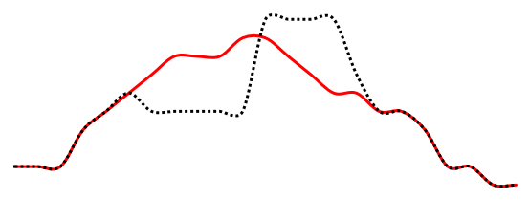

Smart Grids and Smart Meter enable Smart Markets – Happy Power Hour
original load profile
Dynamic Electricity Tariffs for Industry Companies
Reducing of the electricity costs
using flexibility
Fully automated marketing and
control of flexibility
Consumption side adapts itself by reacting on price signals to the feed-in of the renewable energies
€
€
€
€
€
optimized load profile
€
€
price-signal
increase power
€
€
€
reduce power
€
€
€
€
€
€
€
€
€
€
€
€
€
€
€
€

Slide 13
Conclusions
The German “Energiewende” changes the grid structures fundamentally – both in urban and rural areas!
The Smart Grid solutions:
  Are established
  Avoid expensive grid enhancement in many cases
  … but grid enhancement is necessary, too!
Smart Grids enable Smart Markets
A cost-optimized smart grid solution complemented by inevitable grid enhancement forms the basis for Germany’s “Energiewende”.

Slide 14

Contact
Wuppertal University
Institute of Power System Engineering
Univ.-Prof. Dr.-Ing. Markus Zdrallek
Rainer Gruenter-Str. 21
42119 Wuppertal, Germany
zdrallek@uni-wuppertel.de
http://www.evt.uni-wuppertal.de
Thank you for your attention!

