Slide 1
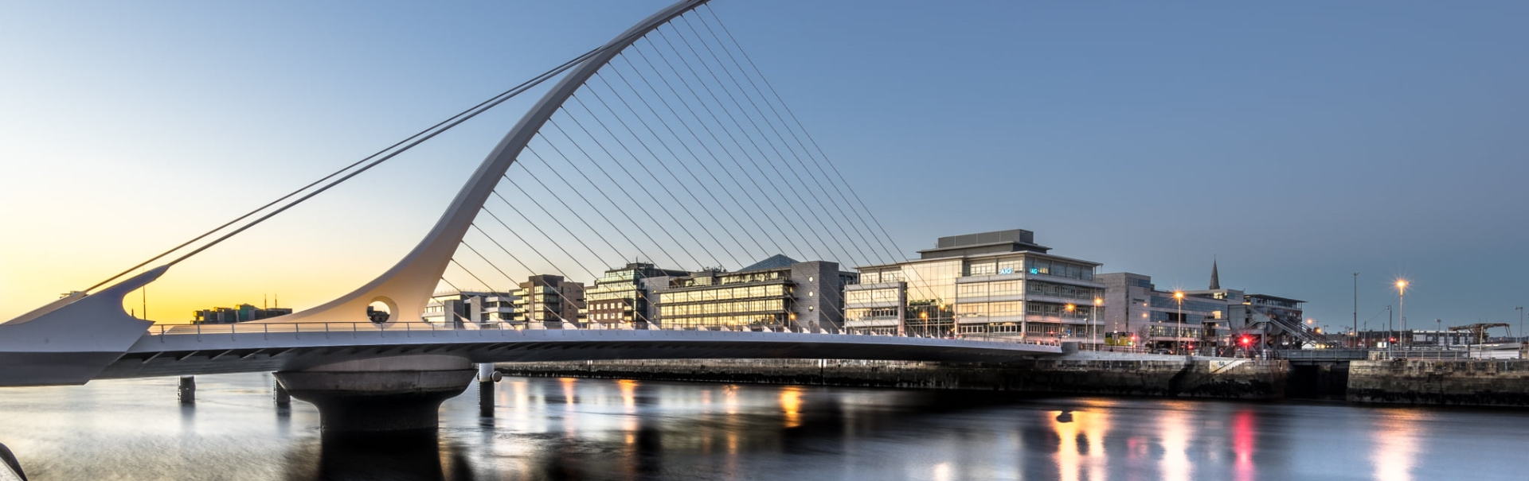
Ireland and Germany
German-Irish Chamber of Industry and Commerce

Slide 2
KEY FACTS GERMANY
Population: 83 million in 2019
Europe’s largest economy,
4th largest economy world-wide
Germany Leading industrial nation in automotive, life sciences, Agritech, software and engineering devices
1st in Europe in the semiconductor industry *5
The largest financial services sector in Eurozone *6
1st in Europe and 5th in the world for dairy production *2
Leads the way in renewable energy, with 45% of its energy consumption coming from renewable sources by 2035 *8
1st in Europe for construction investment, valued at over 200€ billion Euro annually *3
Notes:
Sources: GTAI – Wirtschaftsdaten Kompakt, Irland Mai 2019
N:\NEW TSM\4 Procedures & Projects\4.1 Services\4.1.37 Commercial Sales\02 Projects\1. Current\Presentation Content Folder

Slide 3
KEY FACTS GERMANY
A significant nationwide market in medical devices and pharmaceuticals and biologicals
An outsized market for datacentres, construction and material handling equipment
Largest electronics market in Europe
Credit rating stands at AAA
Leading industrial nation in automotive, life sciences, Agritech, IT-services and engineering
3rd largest importer of goods worldwide
3rd largest Medtech market in the world *4
3rd largest spender in the world on travel
Notes:
Sources: GTAI – Wirtschaftsdaten Kompakt, Irland Mai 2019
N:\NEW TSM\4 Procedures & Projects\4.1 Services\4.1.37 Commercial Sales\02 Projects\1. Current\Presentation Content Folder

Slide 4
INCENTIVES
Germany offers different financial support measures for investment. Incentive programs are available through different public funding instruments and for different funding purposes.
Measures include
supporting direct
investment costs
labor-related expenses
direct research and development project costs
Incentives instruments including grants, loans and guarantees can
ordinarily be combined; thus matching the different business activity
needs at different development stages of the company

Slide 5
KEY ECONOMIC FACTS COMPARED
Category | Year | Ireland | Germany
GDP | 2018 | 335.1 bn € | 3344.4 bn €
GDP per capita | 2018 | 68,440 € | 40,339 €
Gross Debt | 2018 | 65.2 % of GDP | 59.8 % of GDP
Inflation rate | September 2019 | + 0.9 % | + 1.2 %
Financial balance | 2018 | +/- 0 % of GDP | + 1.7 % of GDP
Foreign trade balance | 2018 | +54 bn € | +244 bn €
Notes:
Sources: GTAI – Wirtschaftsdaten Kompakt, Irland Mai 2019
N:\NEW TSM\4 Procedures & Projects\4.1 Services\4.1.37 Commercial Sales\02 Projects\1. Current\Presentation Content Folder

Slide 6
GDP COMPARISON GERMANY/IRELAND
Notes:
Sources: GTAI – Wirtschaftsdaten Kompakt, Irland Mai 2019
N:\NEW TSM\4 Procedures & Projects\4.1 Services\4.1.37 Commercial Sales\02 Projects\1. Current\Presentation Content Folder

Slide 7
GERMAN TRADE RELATIONS (2018)
Notes:
Sources: GTAI – Wirtschaftsdaten Kompakt, Irland Mai 2019
N:\NEW TSM\4 Procedures & Projects\4.1 Services\4.1.37 Commercial Sales\02 Projects\1. Current\Presentation Content Folder

Slide 8
GERMAN TRADE RELATIONS (2018)
Notes:
Sources: GTAI – Wirtschaftsdaten Kompakt, Irland Mai 2019
N:\NEW TSM\4 Procedures & Projects\4.1 Services\4.1.37 Commercial Sales\02 Projects\1. Current\Presentation Content Folder

Slide 9
IRISH TRADE RELATIONS (2018)
Notes:
Sources: GTAI – Wirtschaftsdaten Kompakt, Irland Mai 2019
N:\NEW TSM\4 Procedures & Projects\4.1 Services\4.1.37 Commercial Sales\02 Projects\1. Current\Presentation Content Folder

Slide 10
IRISH TRADE RELATIONS (2018)
Notes:
Sources: GTAI – Wirtschaftsdaten Kompakt, Irland Mai 2019
N:\NEW TSM\4 Procedures & Projects\4.1 Services\4.1.37 Commercial Sales\02 Projects\1. Current\Presentation Content Folder

Slide 11
GERMAN-IRISH TRADE RELATIONS
Ireland:
Main import goods from Germany
Motor vehicles
Chemicals
Electronics
Machinery
Germany:
Main import goods from Ireland
Pharmaceuticals
Industrial chemicals
Electronics
Food products
Notes:
Sources: GTAI – Wirtschaftsdaten Kompakt, Irland Mai 2019
N:\NEW TSM\4 Procedures & Projects\4.1 Services\4.1.37 Commercial Sales\02 Projects\1. Current\Presentation Content Folder

Slide 12
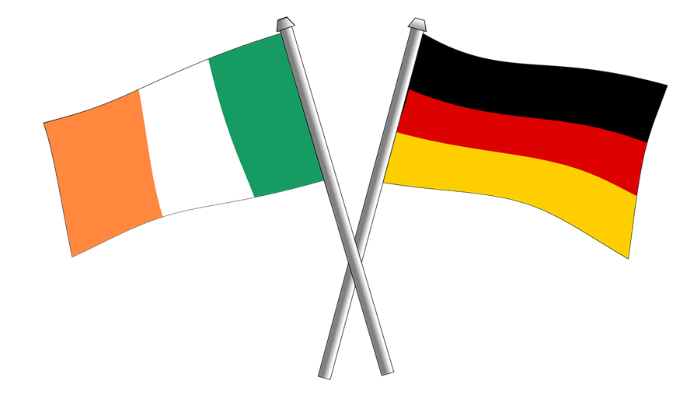
GERMAN-IRISH TRADE RELATIONS
€29 billion – German/Irish Bilateral trade (2017)
5th largest export market for Irish food and drink worth almost €730 million (2018)
4th largest market for indigenous Irish goods (2017)
3rd most important holiday market to Ireland
2nd largest source of foreign direct investment in Ireland
2nd largest source of Foreign Direct Investment in Ireland – SAP, Deutsche Bank, Allianz – (100 companies)
820,000 visitors from Germany to Ireland in 2017
Source: Enterprise Ireland 2018, OECD
Notes:
Sources: GTAI – Wirtschaftsdaten Kompakt, Irland Mai 2019
N:\NEW TSM\4 Procedures & Projects\4.1 Services\4.1.37 Commercial Sales\02 Projects\1. Current\Presentation Content Folder

Slide 13
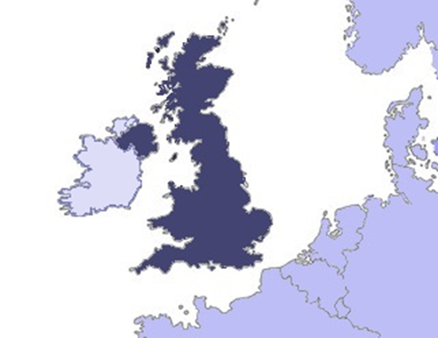
The 3 most important topics
Maintain trade with continental Europe via UK (landbridge)
Maintain UK as export market for food
Prevent border with Northern Ireland
Folkestone
Dublin
Holy Head
Duisburg
Calais
Cherbourg
Rotterdam
Roscoff
Notes:
Sources: GTAI – Wirtschaftsdaten Kompakt, Irland Mai 2019
N:\NEW TSM\4 Procedures & Projects\4.1 Services\4.1.37 Commercial Sales\02 Projects\1. Current\Presentation Content Folder

Slide 14
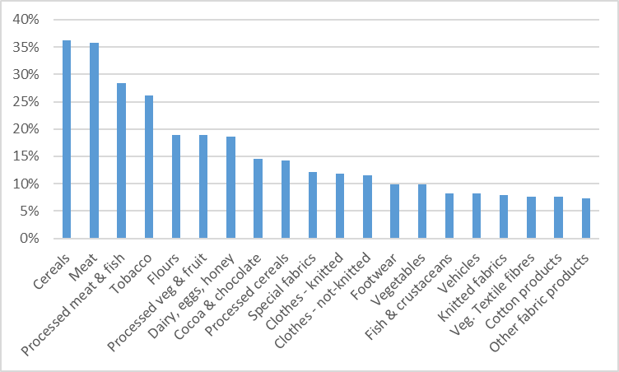
STUDY TO IMPACTS OF BREXIT BY
EDGAR MORGENROTH (DCU)
The graph only shows the average tariff for the product groups with the 20 highest average tariff (out of 96 groups).
Notes:
Sources: GTAI – Wirtschaftsdaten Kompakt, Irland Mai 2019
N:\NEW TSM\4 Procedures & Projects\4.1 Services\4.1.37 Commercial Sales\02 Projects\1. Current\Presentation Content Folder

Slide 15
STUDY TO IMPACTS OF BREXIT BY
EDGAR MORGENROTH (DCU)
Summary and Conclusions
Brexit poses significant challenges to exported but is also likely to impact on imports which will affect consumers and producers (see Lawless and Morgenroth, 2018).
The price increases due to tariffs in a hard Brexit scenario will make import substitution away from UK produced to EU produced goods.
The analysis here shows that there is significant scope for this covering almost two thirds of the products currently imported from the UK.
Notes:
Sources: GTAI – Wirtschaftsdaten Kompakt, Irland Mai 2019
N:\NEW TSM\4 Procedures & Projects\4.1 Services\4.1.37 Commercial Sales\02 Projects\1. Current\Presentation Content Folder

Slide 16
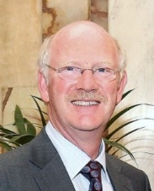
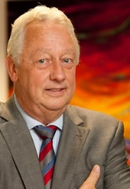
German Desk – The Expert Team
OUR SERVICES:
establishing an export presence in the German market;
using the German market as part of your supply chain;
logistics & transport challenges;
marketing services such as market analysis & market entry services;
tax & legal;
payroll;
accounting;
company formation;
Germany as export and import market.
Ralf Lissek Expert for bilateral connections
Florian König M.L.E. Attorney at law
Markus Ludwig, Solicitor MHL-Law
Lukas Kortenhaus Marketing Services/ Market Entry
Dr Jack Golden International Business Development
Werner Schwanberg
SFGS – Schwanberg Financial Governance Services
Patrick Bamming, AITI Chartered Tax Adviser (CTA)/TMITI with Irish Tax Institute
Shaun Ryann,
Commercial Manager Quality Freight and Safmarine Ireland

Slide 17
Ralf Lissek, CEO German-Irish Chamber of Commerce Tel: 00353 1 6424 300 Mobile: 087 2311 142 ralf.lissek@german-irish.ie www.german-irish.ie
Thank you!

