Slide 1
New Zealand „Intelligent and energy efficient Technologies for Buildings implementing renewable energies“ 27.10.2020 Mr. Christian Martiny, Sales Engineer „Energy efficient and sustainable room conditioning – with EcoSyst.”
Just feel good!

Slide 2
EcoSyst – topics today
company
market trends air conditioning
product
energy efficiency
looking for..
summary
contact

Slide 3
EcoSyst - the Company
EcoSyst GmbH was founded in 2017, based on a unique know-how in the fields of healthy buildings and mechanical engineering. CEO is Mr. Dipl.-Ing. Oec. Jörg Viertel. His entrepreneurial experience goes back to 1997.
The company is based in Chemnitz, Saxonia.
EcoSyst is winner of the IQ Innovation Price Central Germany 2019,
Cluster Energy.Environment.Solar.
To found successful partnerships in New Zealand, we are here today.

Slide 4
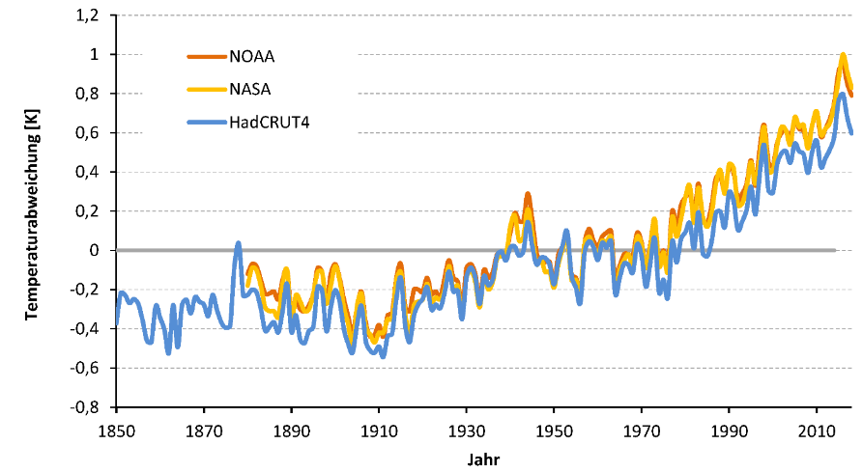
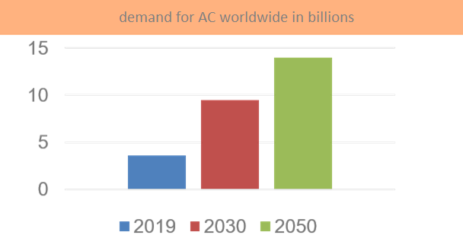
Market trends for air conditioning
Temperature deviation (from mean)
Long term temperature rising
Rising average temperatures worldwide
DNV GL Group expect a 2,4 degree rising of the global average temperature by the end of the century
Life conditions for mankind will fundamentally change
Demand for air conditioning will significantly rise worldwide
- the rising of temperatures cause an increasing
demand for cooling
- currently the estimated global demand for AC is
3,6 billion,
expected to increase to 14 billion by 2050
- problem: also the energy demand for cooling
will increase significantly!

Slide 5
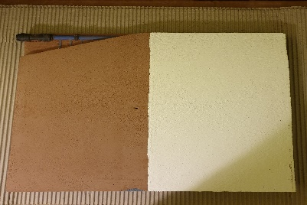
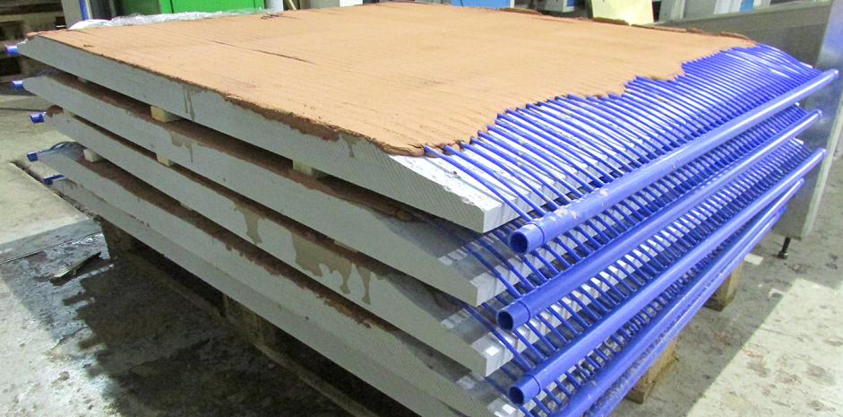
EcoSyst – the product
EcoSyst climate elements are the basis for a highly efficient system of energy distribution and release. The system provides an optimal dew point management. The climate elements are installed on the ceiling. Through the capillary tubes runs water, temperature-managed by a heat pump. The panels absorb possibly occurring condensation water.

Slide 6
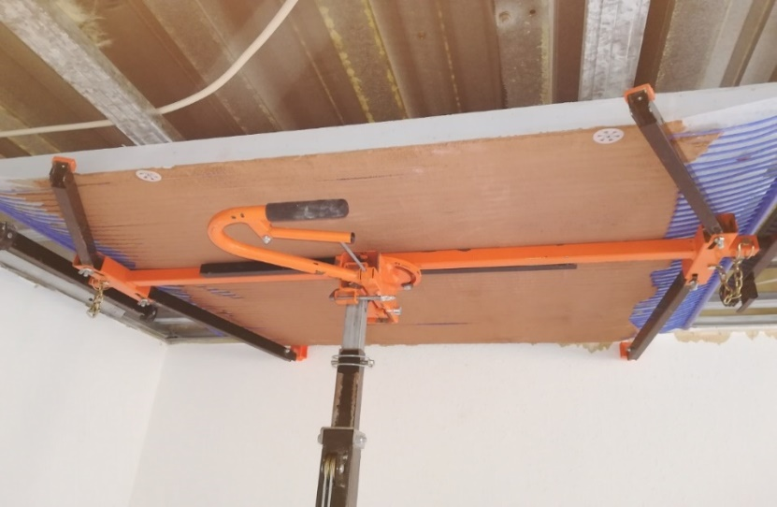
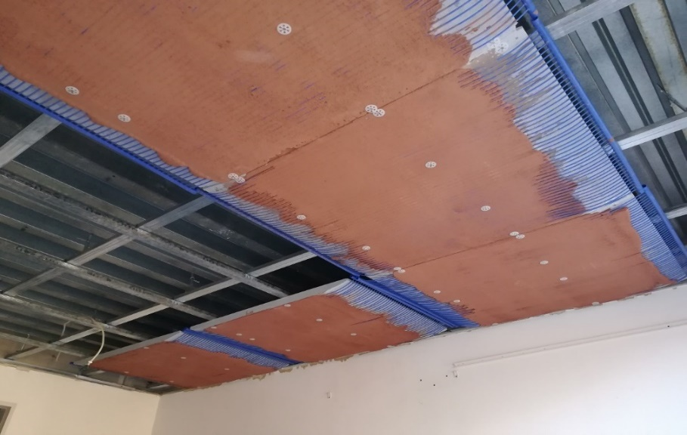
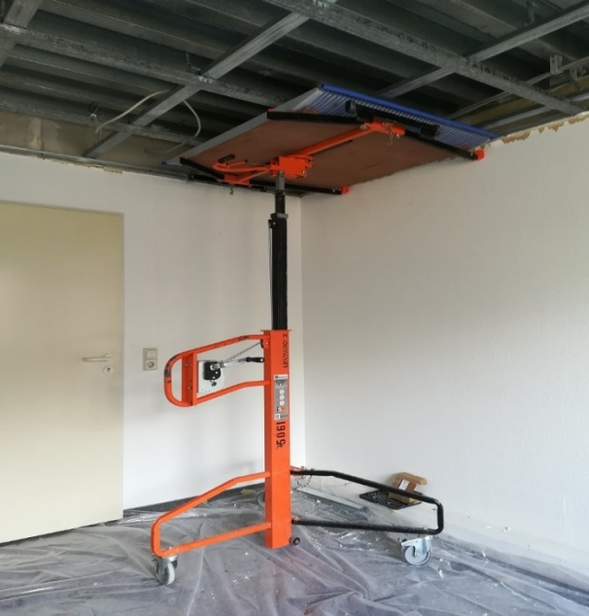
EcoSyst – reference object… …in the making at SLG Ingenieurtechnik GmbH
From Start ……

Slide 7
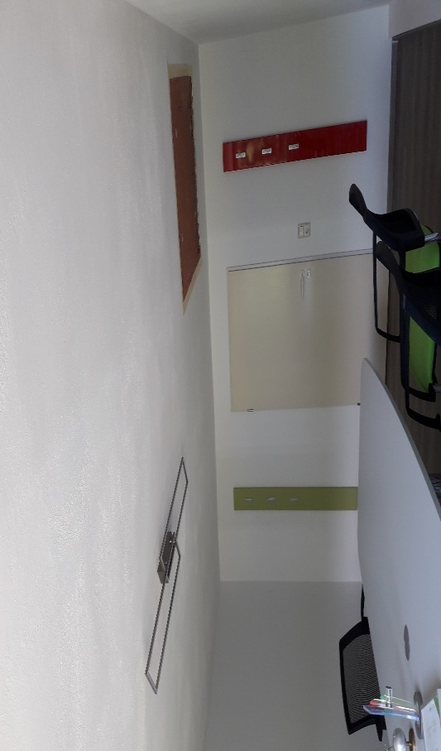
…… to Finish
Radiant heating and cooling in one water based System
Healthy environment
Calciumsilicate
(prevents moist in walls)
Capillary tubes
(water based)
Clay plaster
(binds bacteria from air)

Slide 8
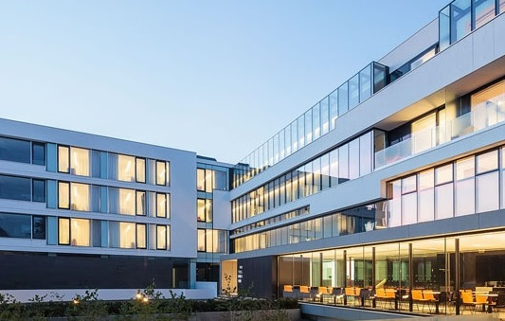
Looking for customers
EcoSyst is applicable for refurbishment and new build developments.
We are looking for property owners who are interested in an EcoSyst installation for a small reference object, for which we will deliver our
climate elements for free.
Interesting long term partnerships
could also be established
with architects and
project planners within
the field of
Green Buildings.

Slide 9
Looking for partners
EcoSyst GmbH aims to acquire system partners:
manufacturers and merchants of building materials
machine building companies
project planners/ installers of air conditioning and building automation.
The concept is to enable partners to manufacture the EcoSyst Climate Elements locally by providing the EcoSyst Systems Engineering.

Slide 10
EcoSyst – advantages at a glance
1 Applicable for refurbishment and new buildings
2 Heating & cooling with one water based system
3 No dew point-surface condensation, no mildew
4 Benefits from a good indoor climate
5 Reduced reverberation effect
6 Low-maintenance and durable/ user friendly
7 Considerable reduction in energy usage, Substantial cost savings
8 CO2-emissions close to zero
9 Decentralized fabrication, using semi-automatic systems engineering.
10 Recyclable, sustainable & climate friendly.
EcoSyst – think global, act local!

Slide 11
EcoSyst GmbH
www.ecosyst.de
Jörg Viertel - CEO
Christian Martiny – Sales Engineer
+49 371 3673 305 info@ecosyst.de

