Slide 1
Virtual Business Trip
Salzkotten, Germany
09-27-21 until 01-10-2021
Presenter: CEO Concrete Ing. Wolfgang Bonder

Slide 2
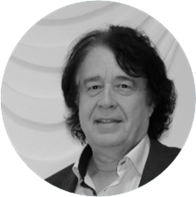
About MIG mbH
Founded in 2001 by
Dipl.-Chem.Ing. Burkhard Brandt and
Concrete Ing. Wolfgang Bonder
Joint Venture in China 2016 – MIGinno
Based in Salzkotten, Germany
Product types: - Chromate reducer
- Innovative building materials
Focus: Innovative products with sustainable use
Member of the Coating Standards Committee in the Chinese government
MIG is the “ key innovator „ of active facade systems insulation
Declared by the European Commission 2020

Slide 3
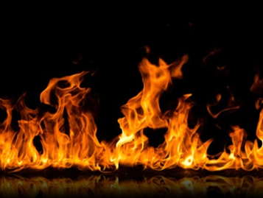
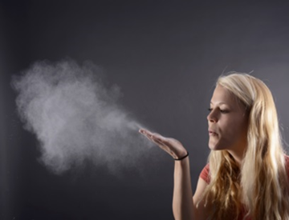
Innovative Building Solutions
Water
Heat/Fire
Dust
Sound
Light
Odor

Slide 4
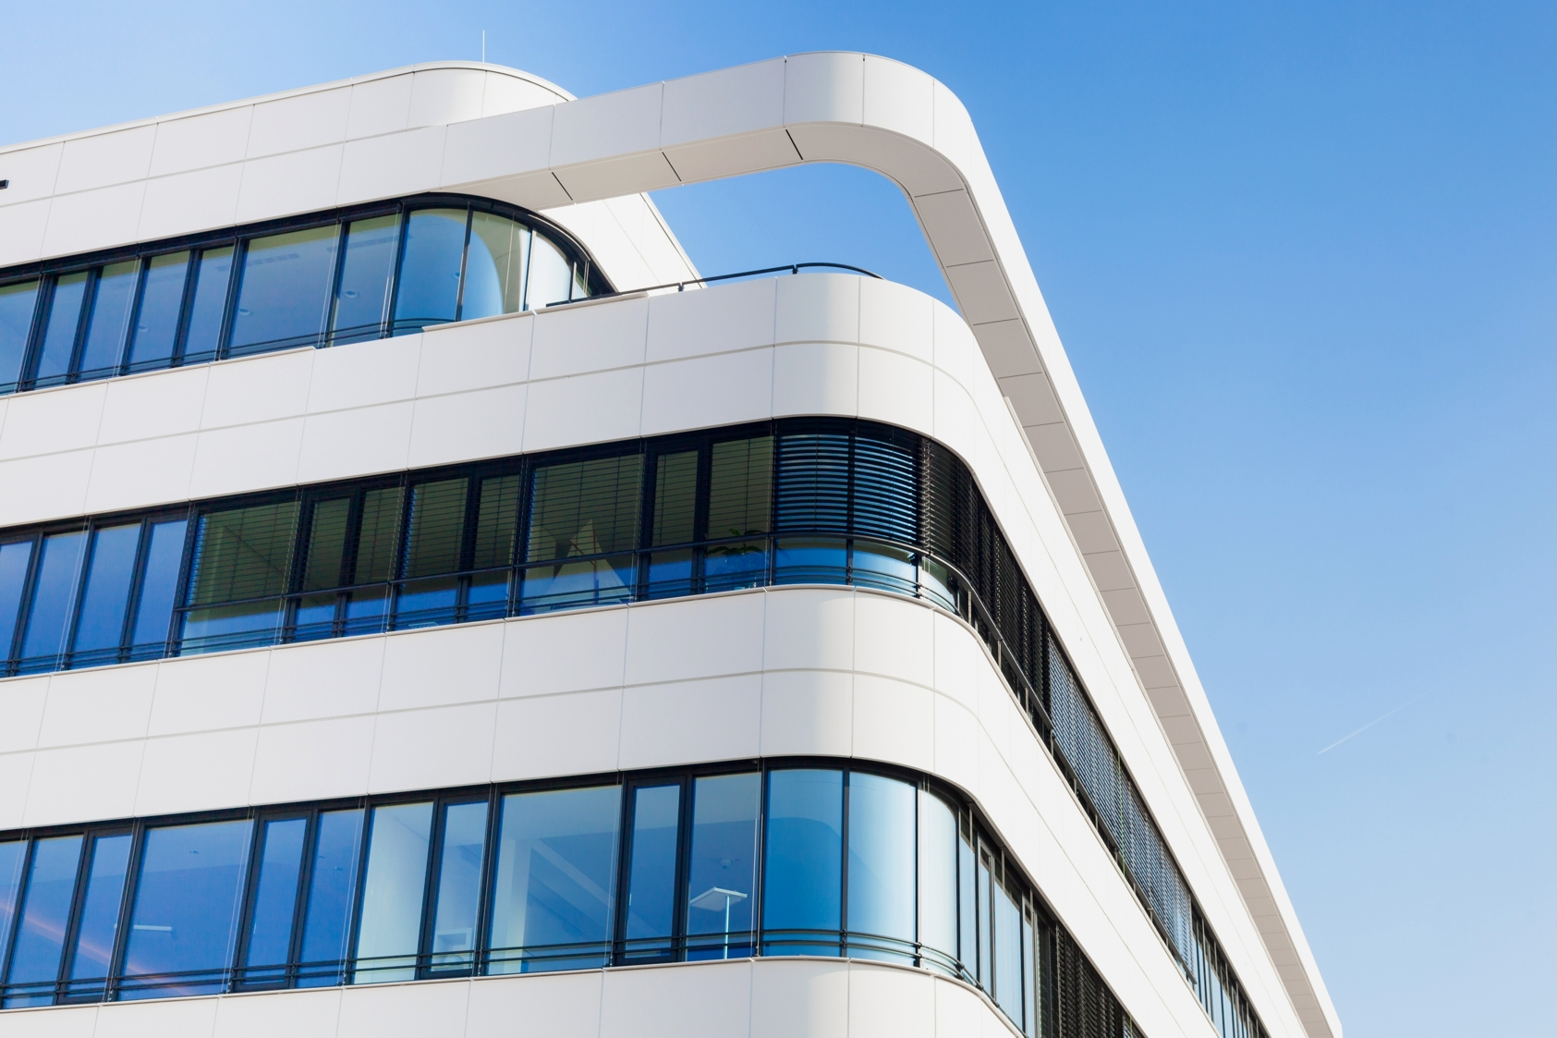
MIG-ESP® based on DHMb®-Technologie
(Energy Saving Products based on Double Hybrid Membran Lining System)
MIG-ESP® Exterior
Complete Facade Protection
MIG-ESP® Interior
Healthy Micro Climate
MIG-ESP® Exterior
Fire & Corrosion Protection

Slide 5
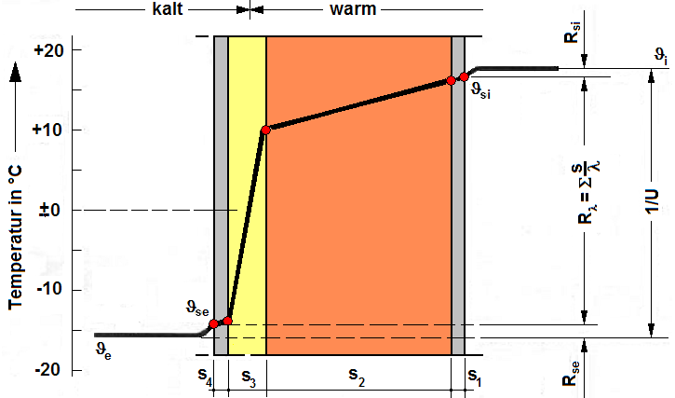
No insulation material works because the tests were carried out in the absence of moisture!!!
4% moisture in an mineral wool based insulation material means already 50% loss of effectiveness!
Sauna Water Infusion
Heat Conductivity of water =
25 times higher then air

Slide 6
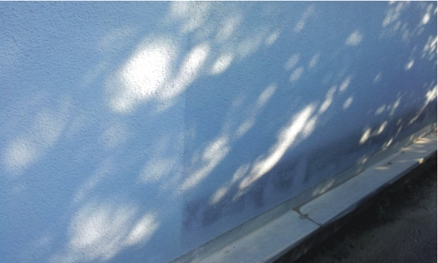
Brilliant long-lasting facades
Exterior facade after 5 years
MIG-ESP DHMb
brilliant colour
Conventional
High-Tech paint: Pollution, humidity

Slide 7
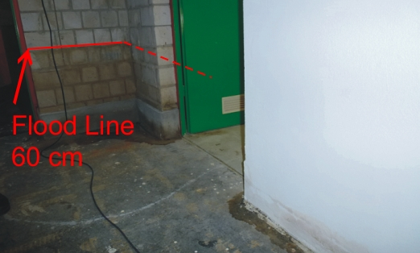
Flood catastrophe Münster July 2014
without plaster limestone:
Humidity, mould formation
MIG-ESP: Dry and brilliant colour

Slide 8
DHMb® Membrane Function
Function
Combination of heat reflection, moisture management and high breathability
Advantages
Dry walls
Hygienic climate
Energy saving
Bright and long lasting appearance

Slide 9
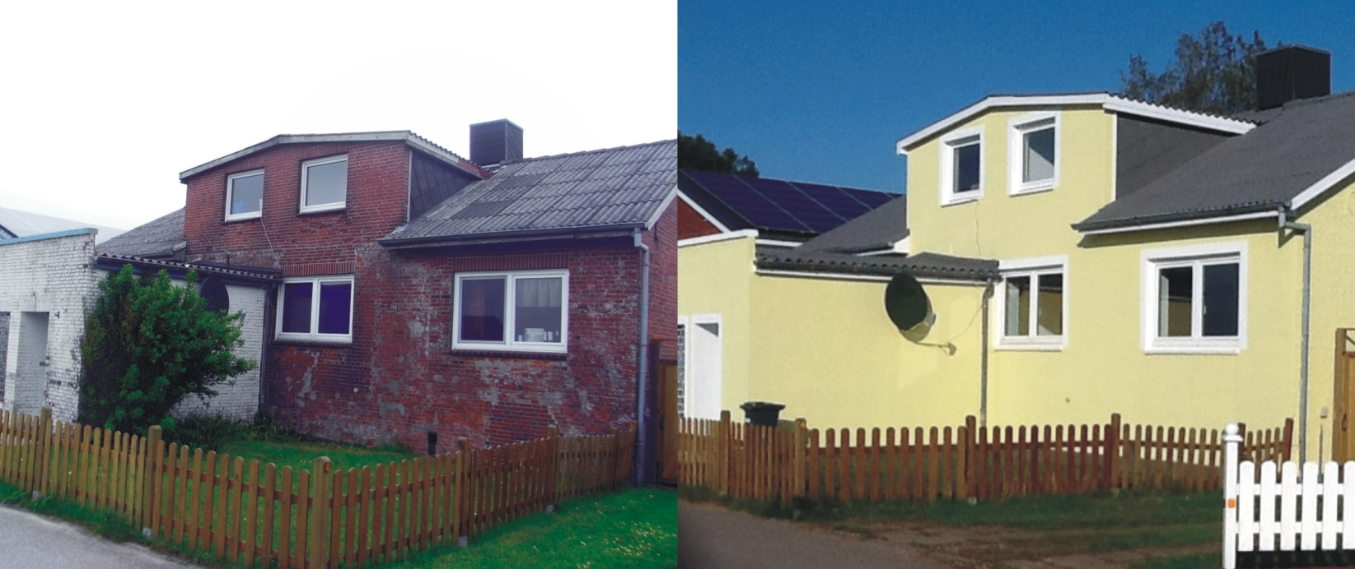
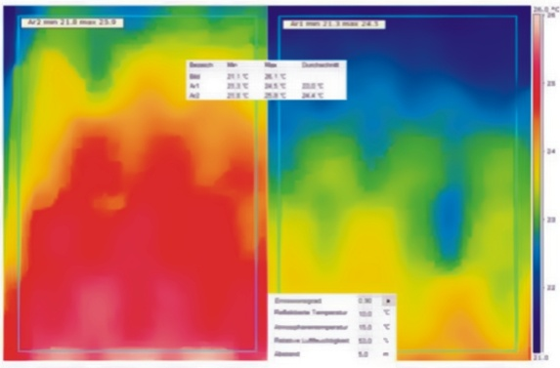
Energy saving up to 50%
Before After

Slide 10
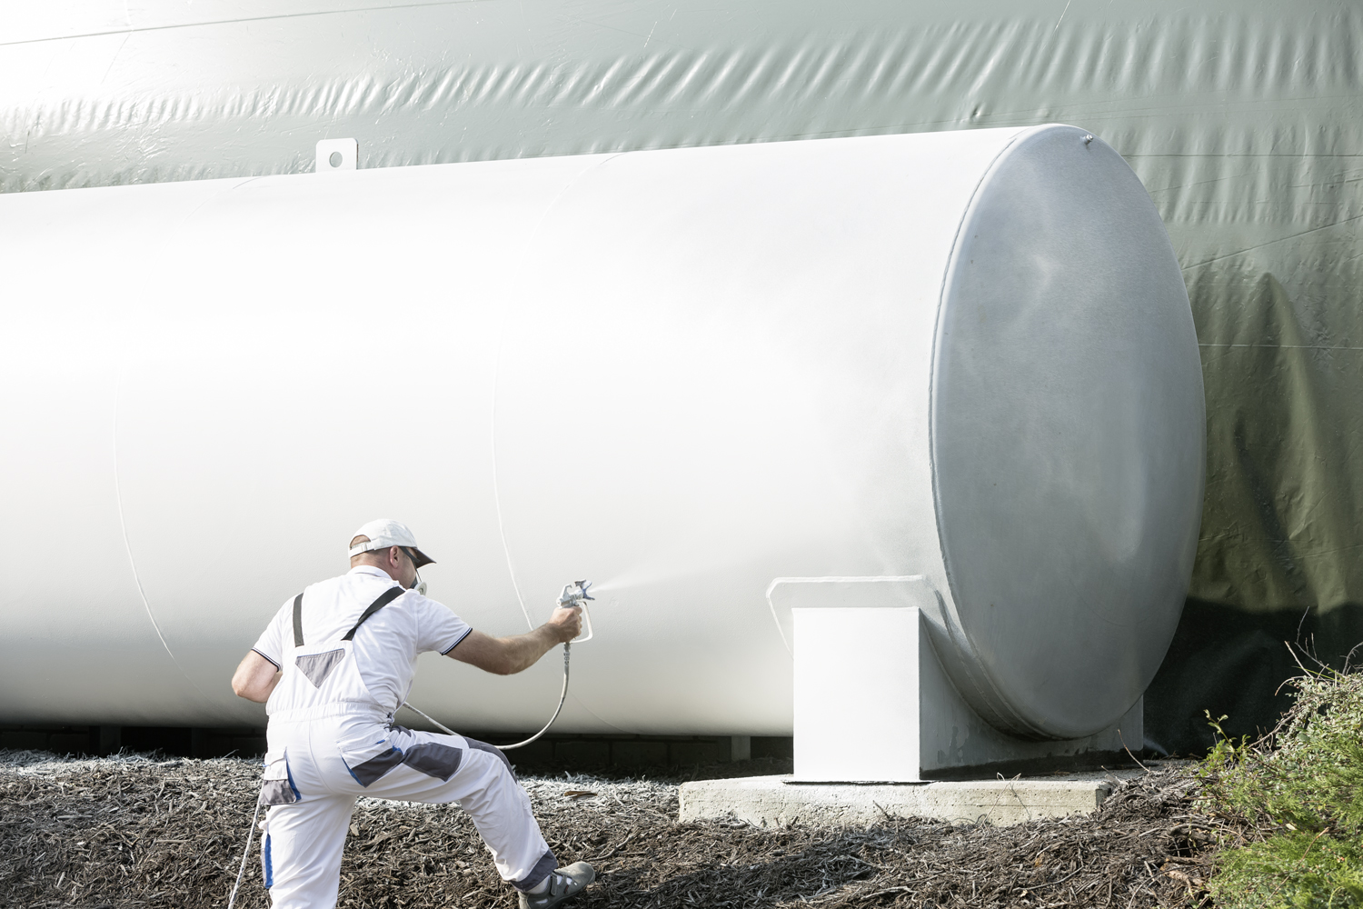
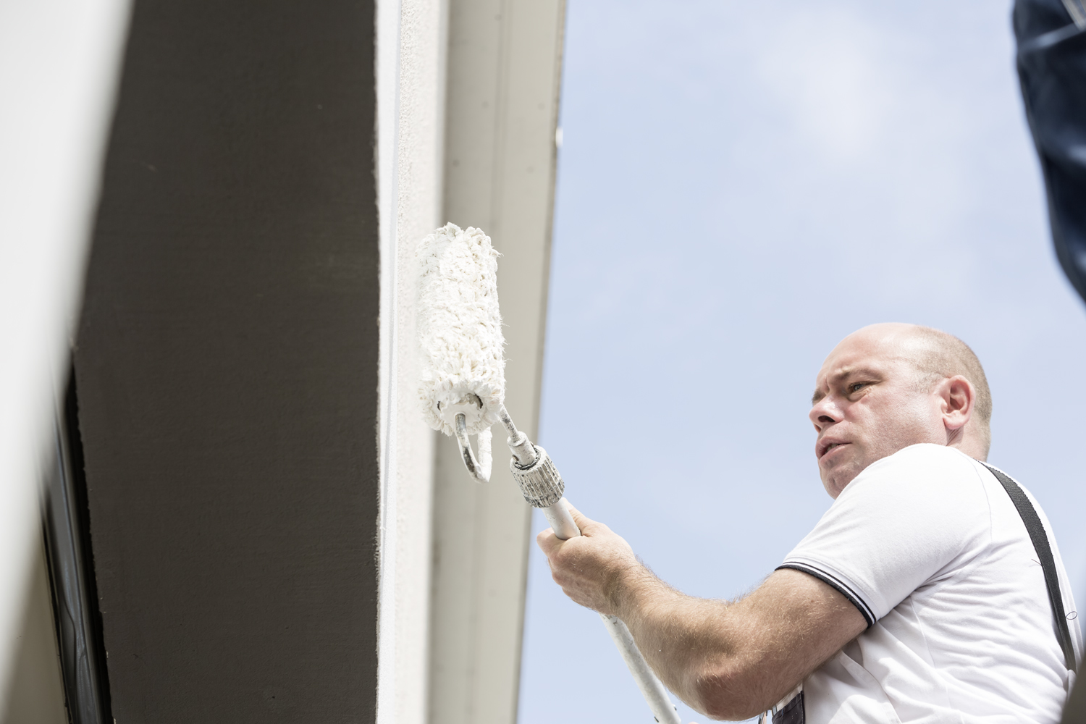
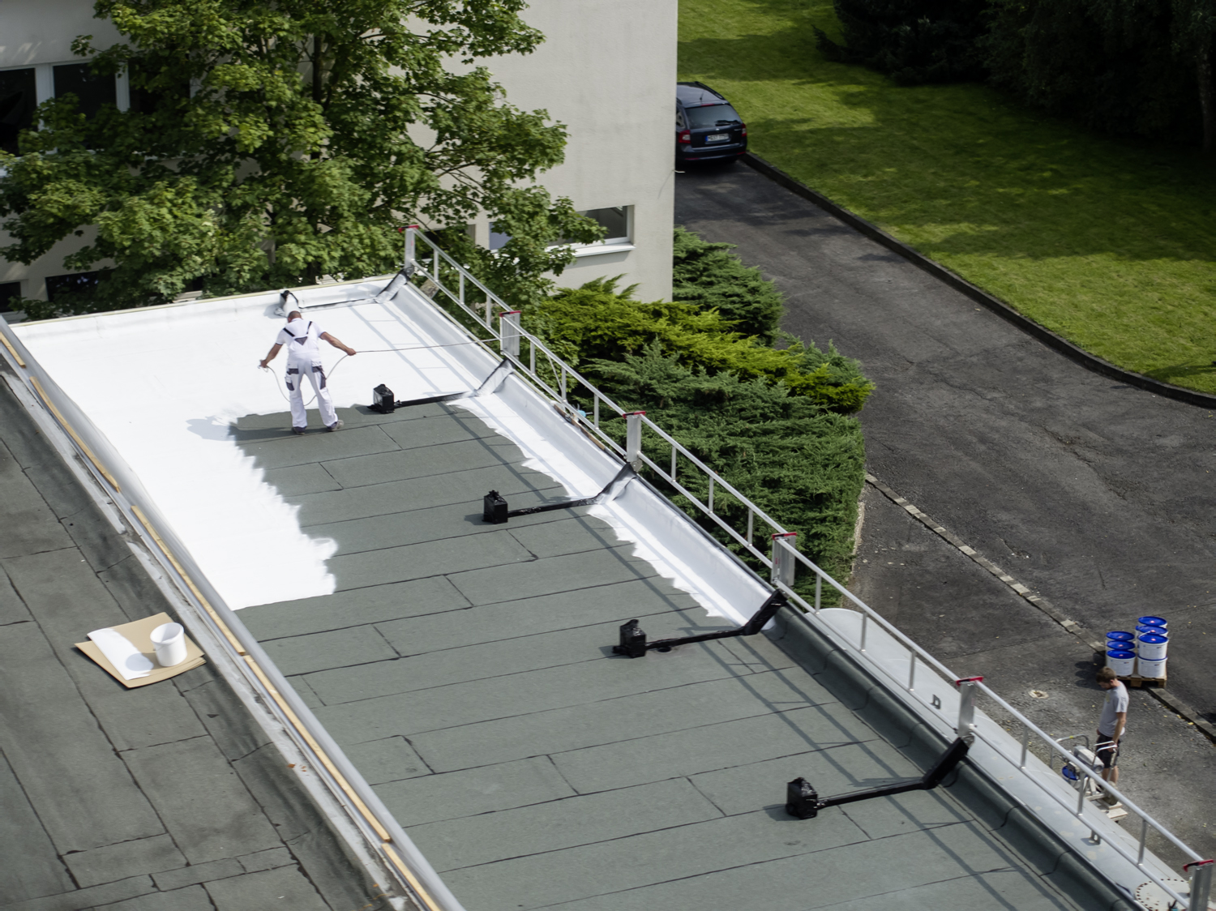
Easy to apply on several surfaces Beton, Metal, Wood, Plastic, Textil, Aluminum and Stone

Slide 11
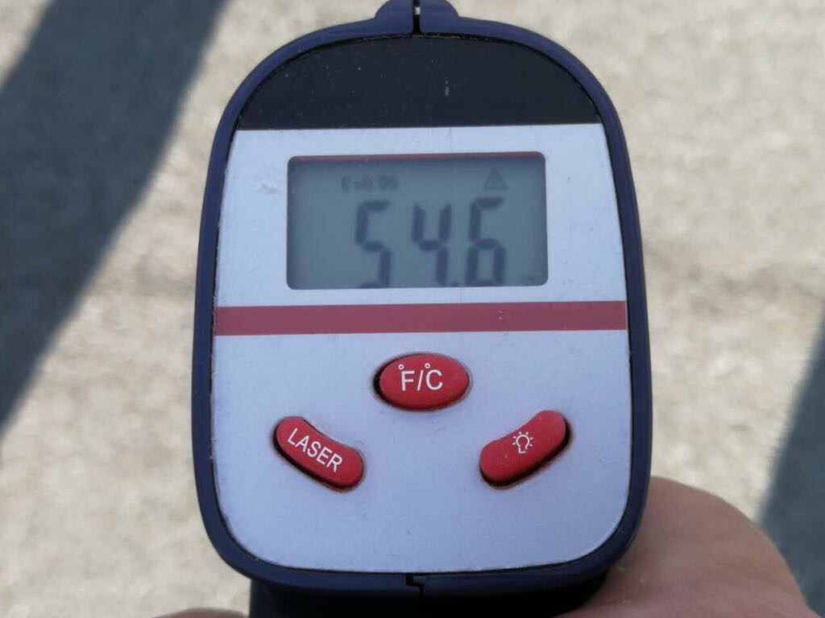
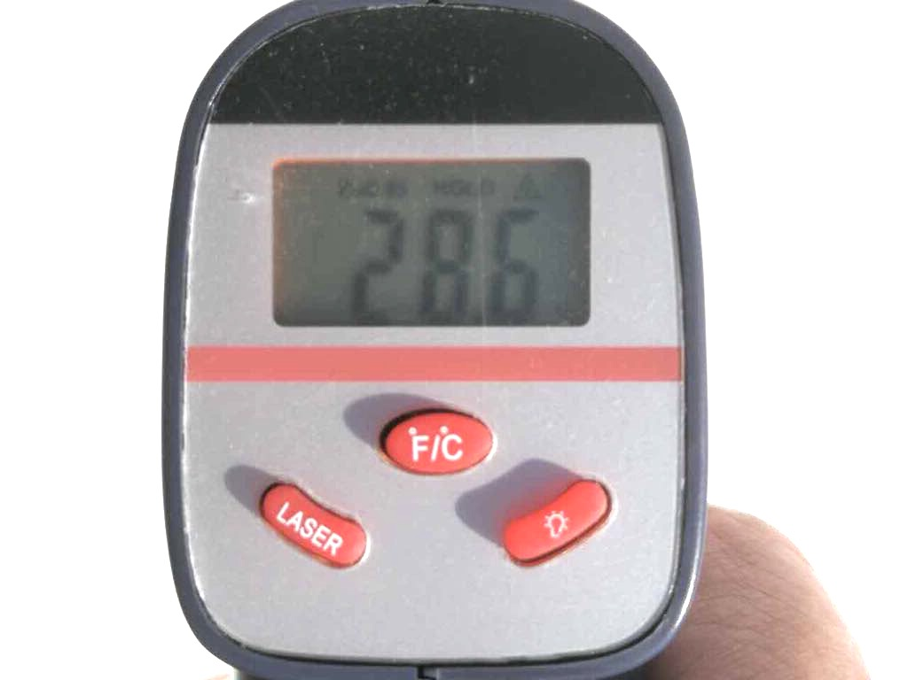
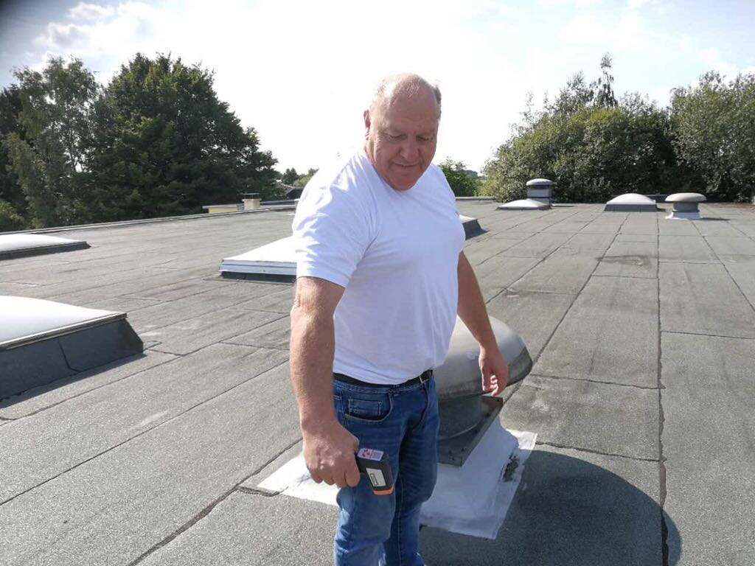
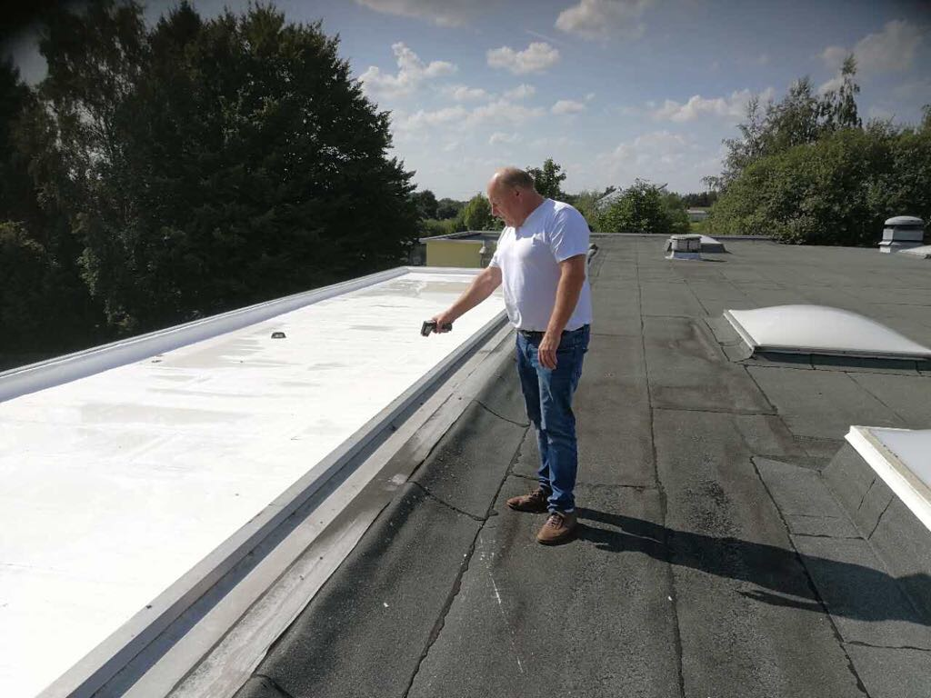

Slide 12
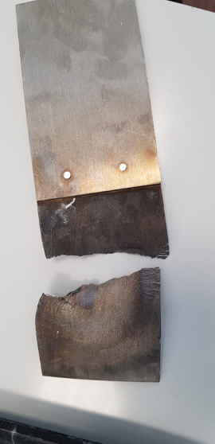
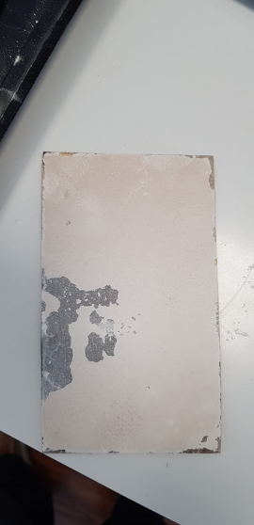
Aircraft Aluminum
Firetest with MIG-ESP V2
45 seconds by 2000 degrees 2 Hours by 2000 degrees
Totally destroyed and broken. DHMb-Technology MIG-ESP V2

Slide 13
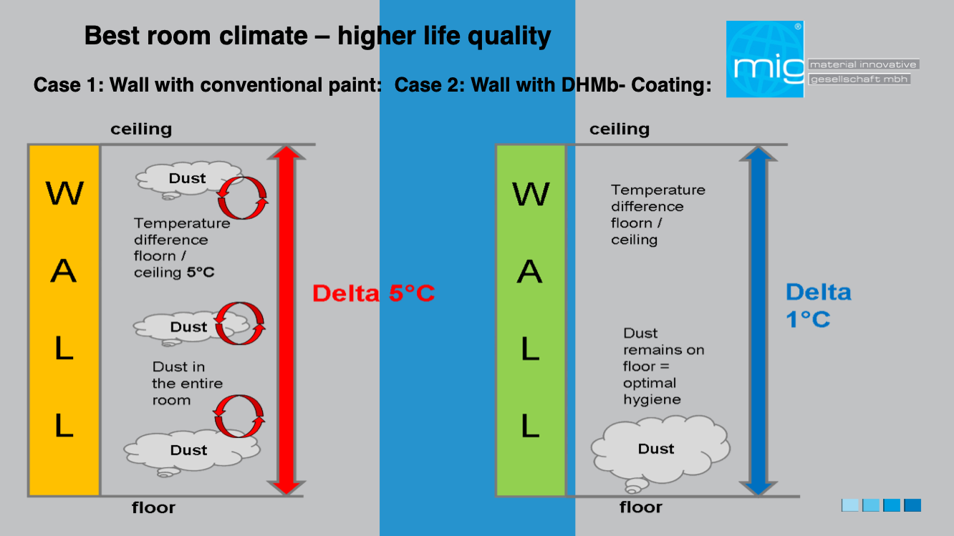

Slide 14
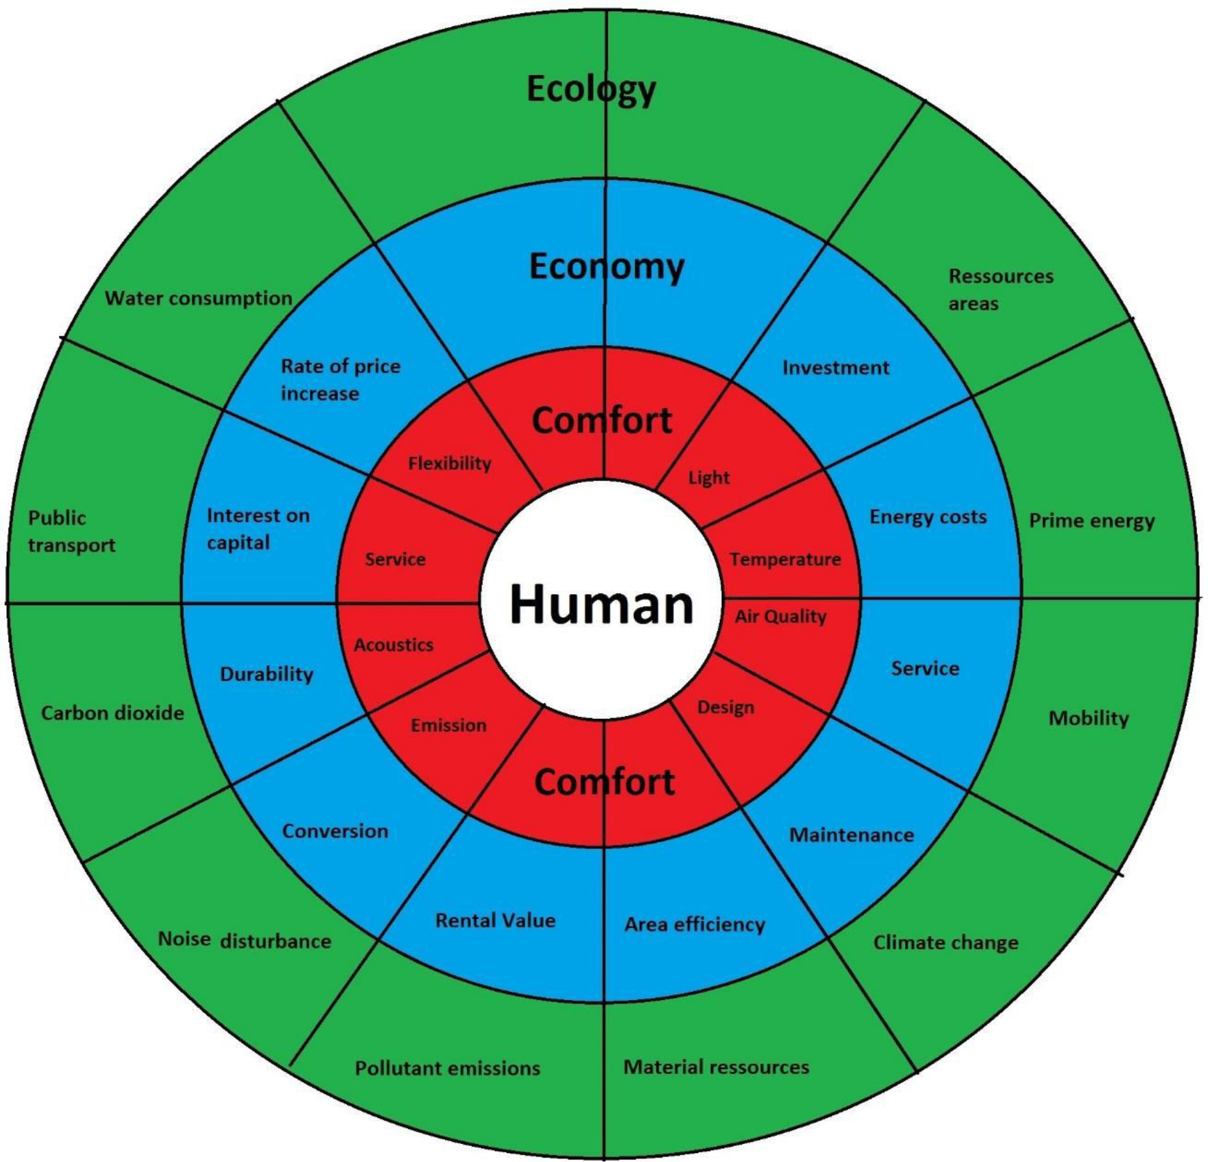
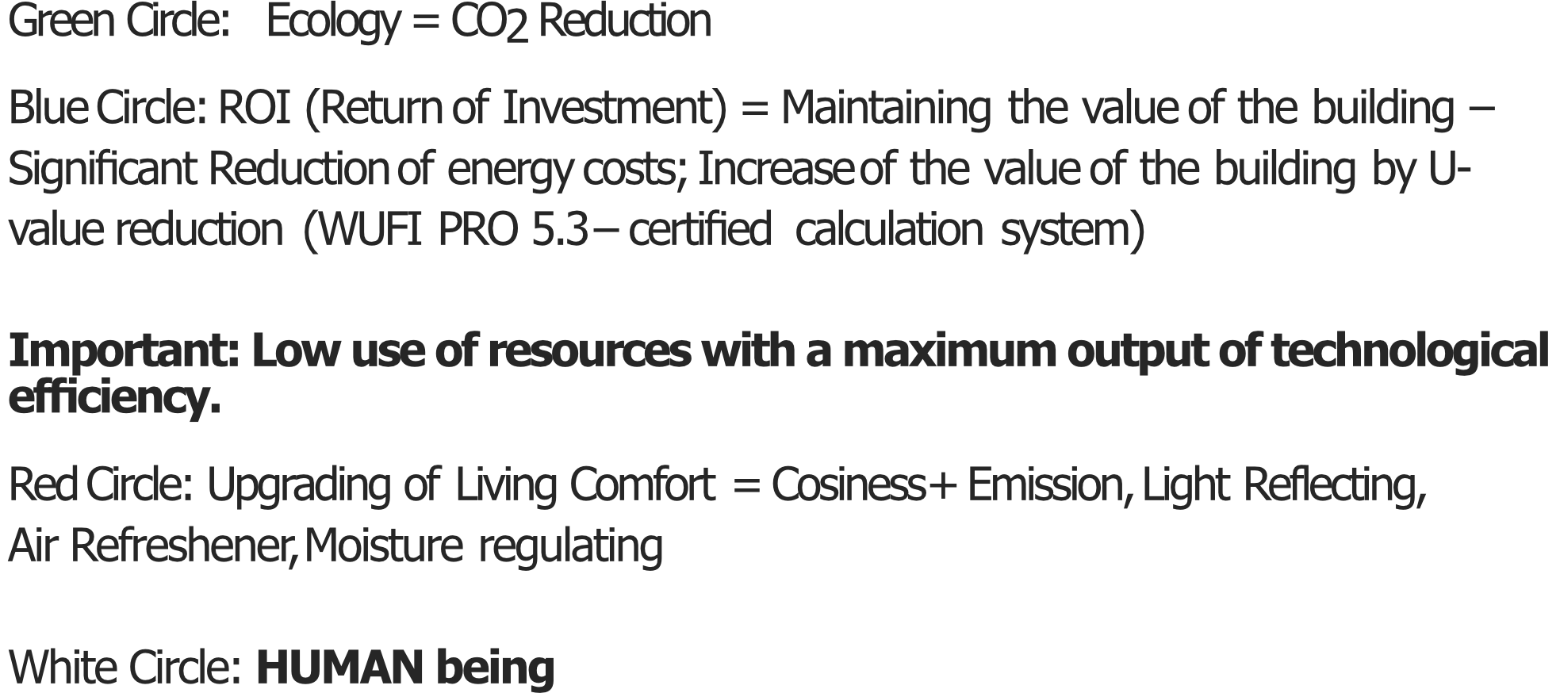

Slide 15
References
•Industrial Buildings •Architecture •Historical Buildings

Slide 16
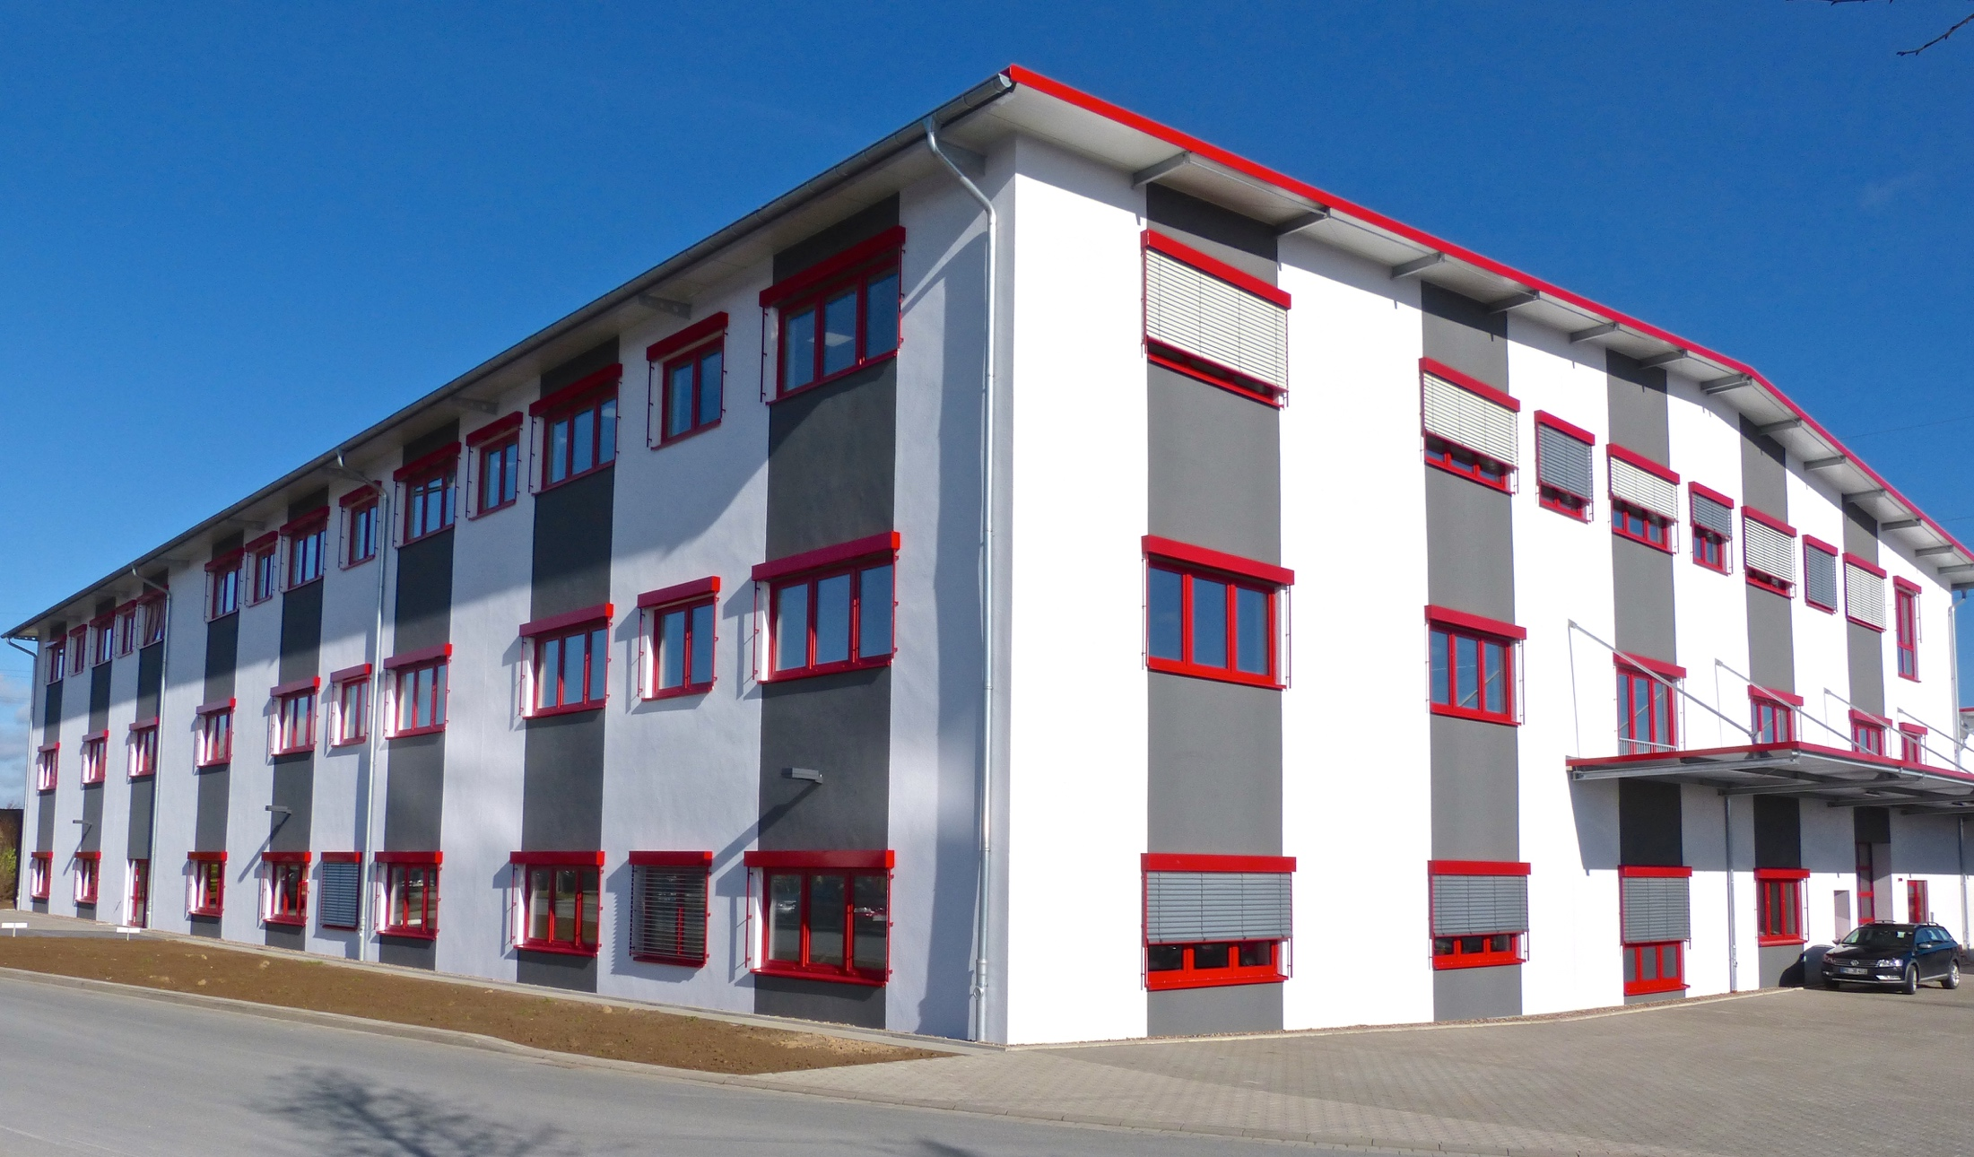
Electronic Müller
3.000 m² Exterior
9.000 m² Interior

Slide 17
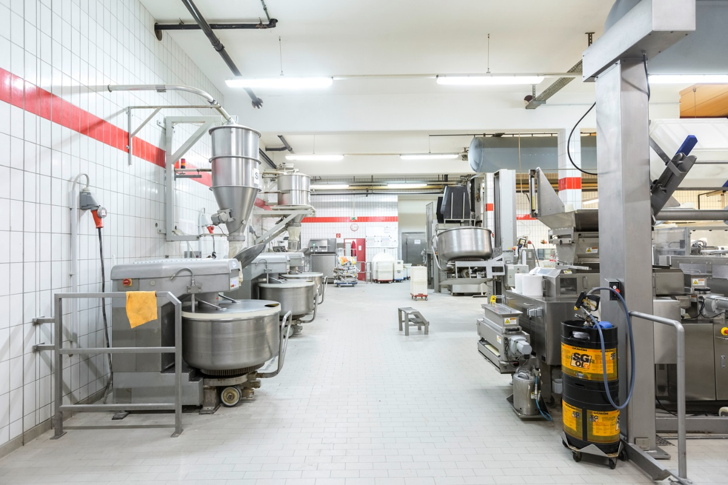
Industrial Buildings
Ceiling of industrial
bakery chain

Slide 18
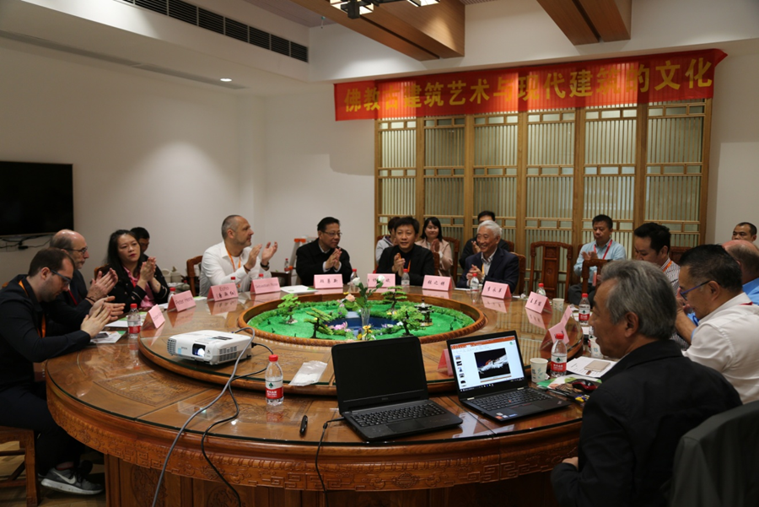
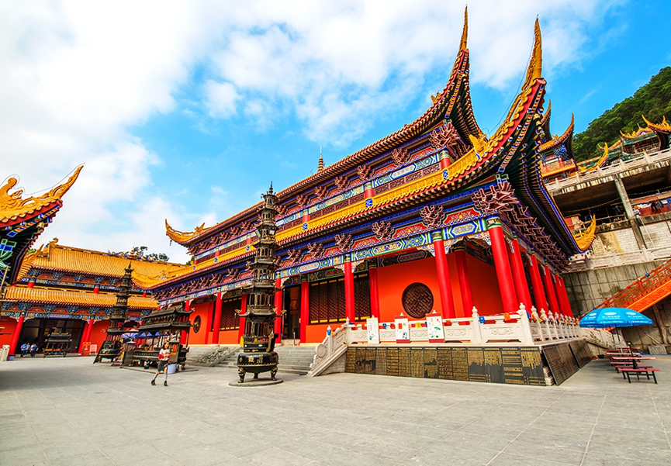
Temple Dongguan, China
VIP Restaurant inside the Temple Dongguan

Slide 19
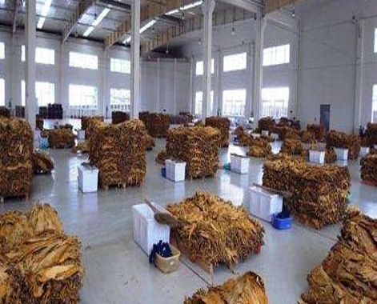
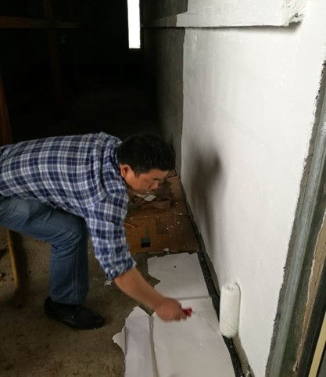
Tobacco plantation, China
Significant reduction in rejection rates due to mold
Improvement of room climate
Reduction in heating fuel consumption
Faster achievement of target temperature
Increasing the quality of tobacco leaves (from grade C to B)

Slide 20
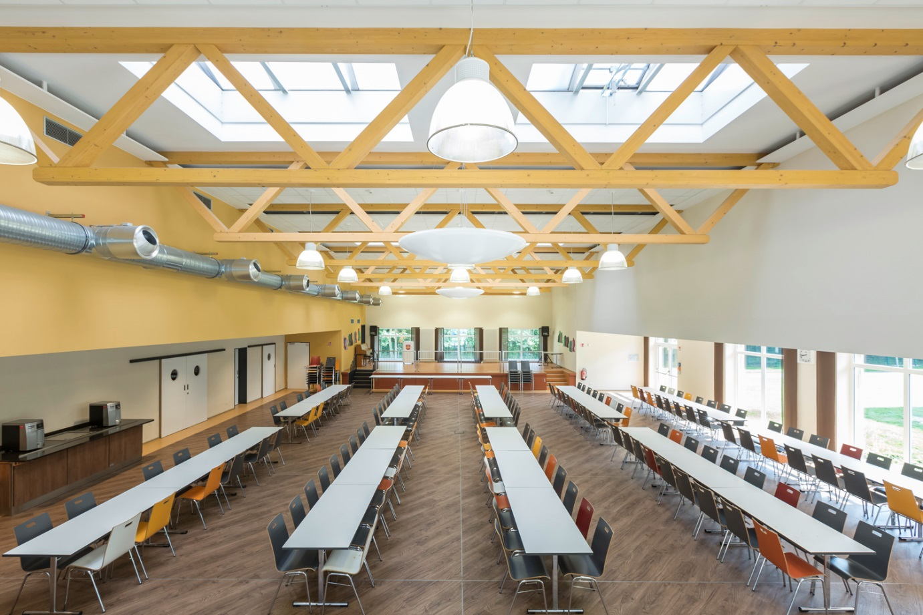
School Mensa
Mensa for 400 pupil
No Dust, No Smell

Slide 21
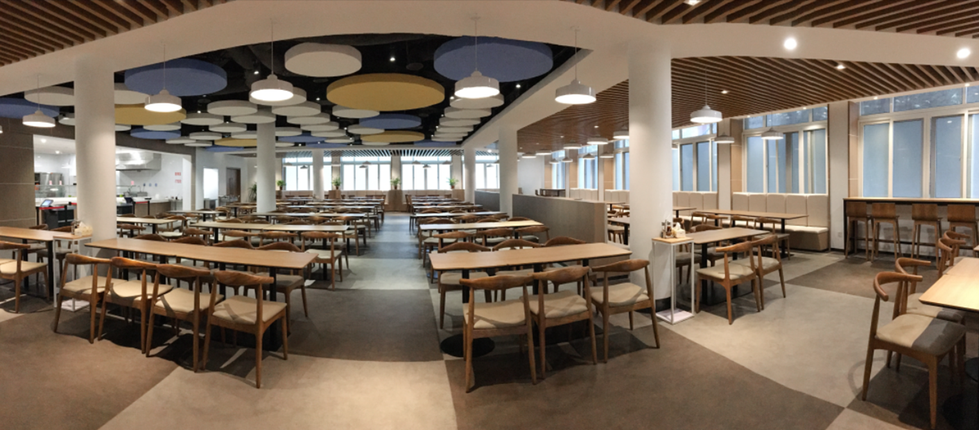
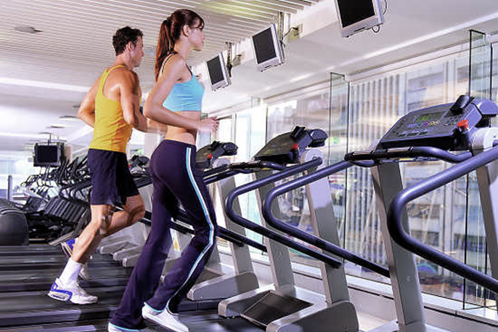
Restaurant and Fitness Club
Smell reduction
Healthy Microclimate

Slide 22
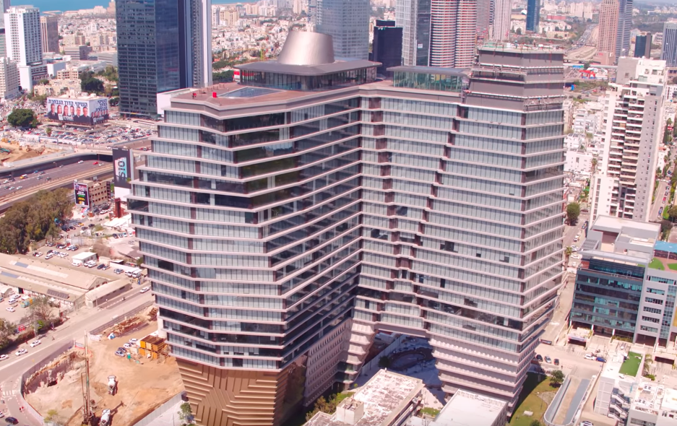
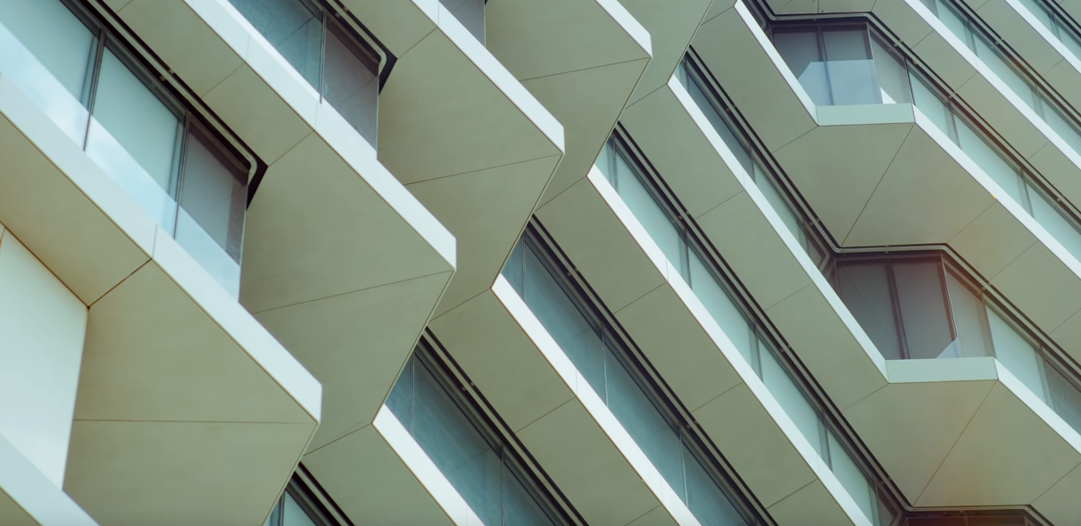
ToHA Building, Tel Aviv
MIG-ESP® Exterior instead of mineral wool
bright and long lasting appearance
No discoloration
Non-flammable

Slide 23
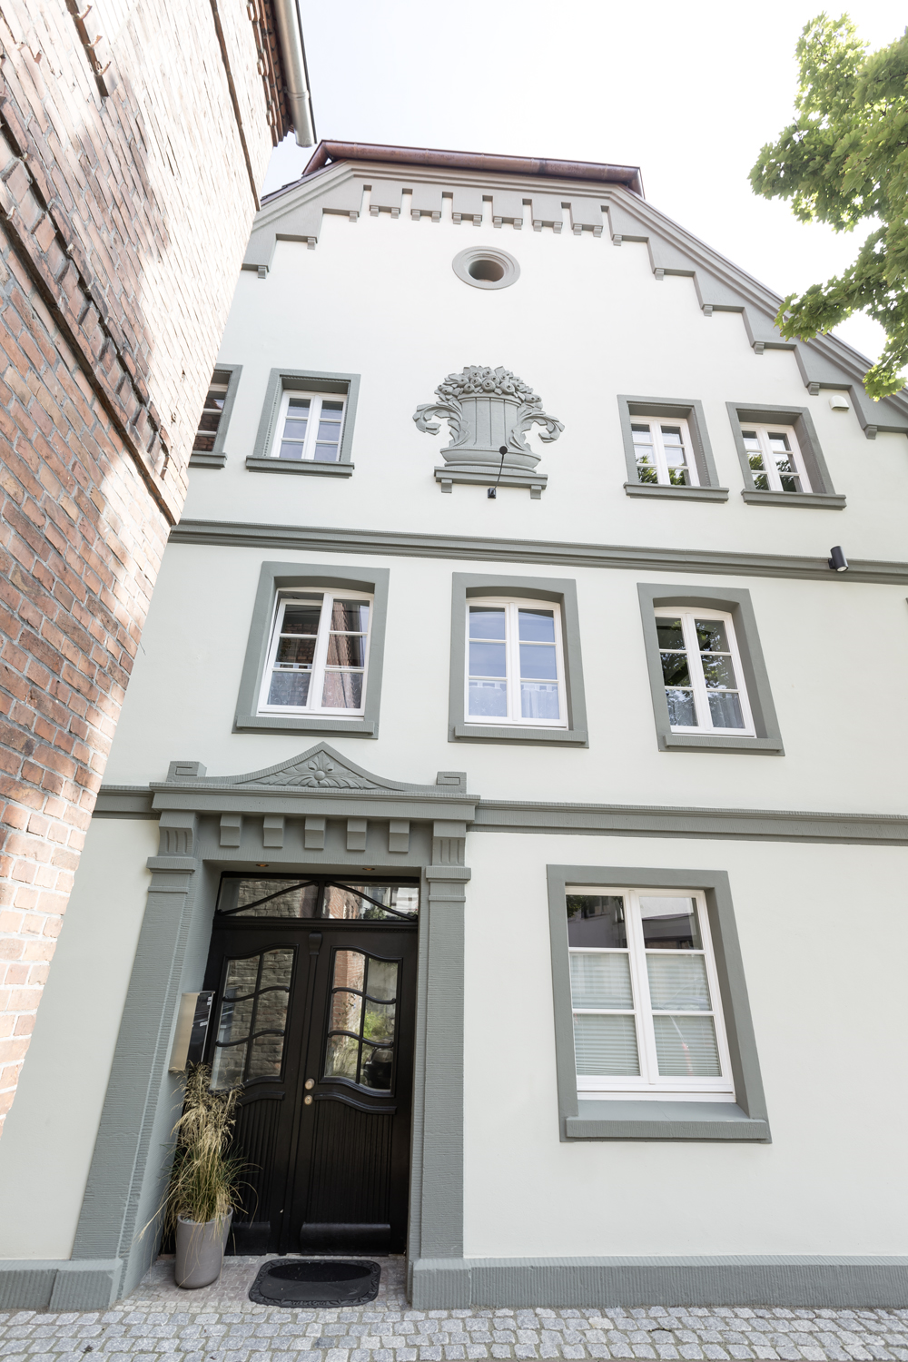
Salinator Penning House anno 1563
MIG products have been approved
by the States Monument Office in Münster
Claims for this project
Non-flammable
Solvent-free
Thin-Layer isolation to remain the historical fassade in combination with energy efficiency
This reference won a facade competition

Slide 24
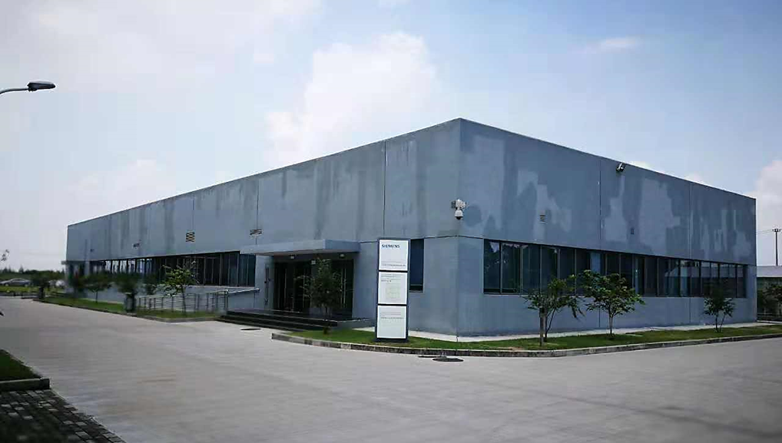
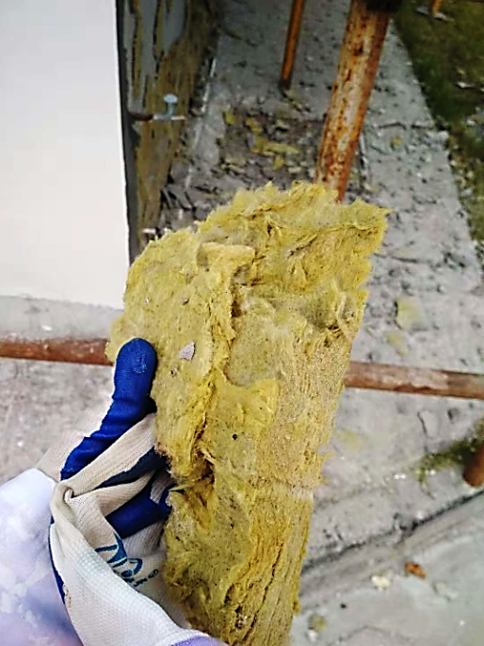
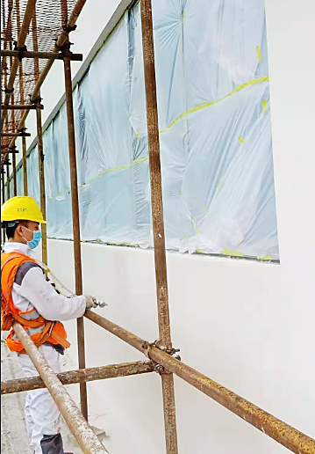
Siemens office Shanghai
Siemens office in Shanghai, Jinshan
Interior and Exterior
Replacement of wet mineral wool to MIG products

Slide 25
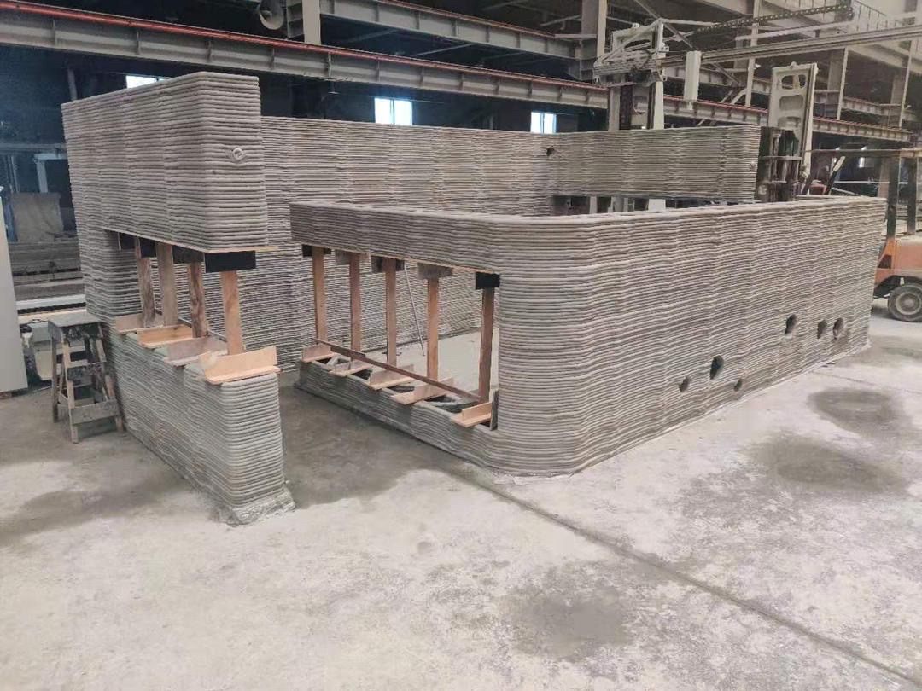
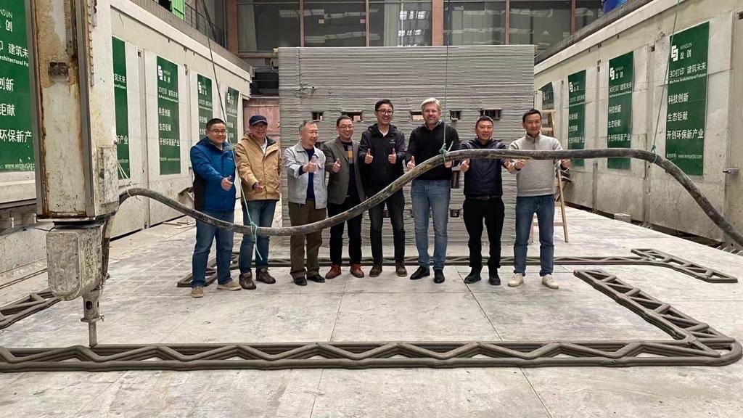
Future Construction 3D Printer
Siemens China

Slide 26
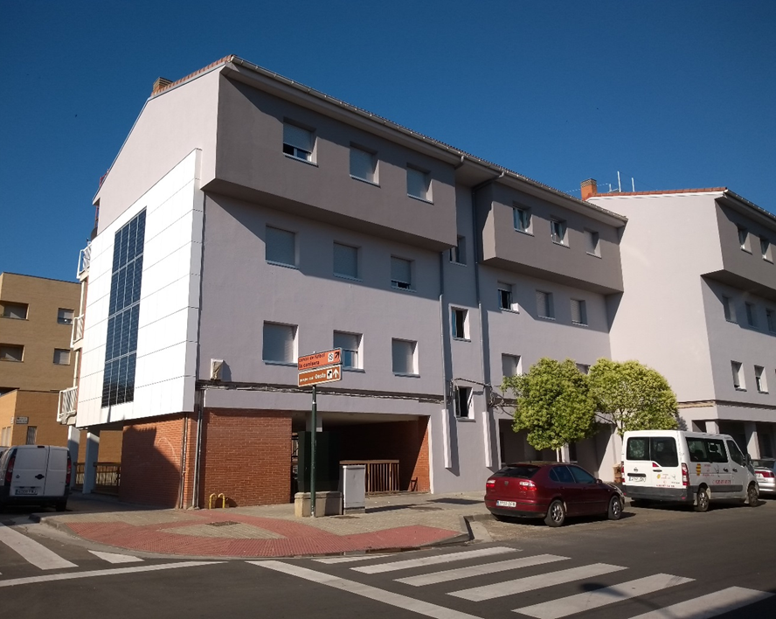
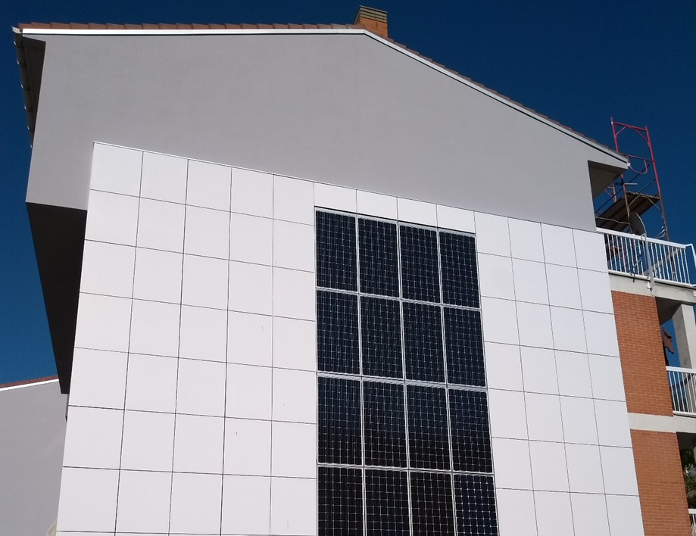
EU Project Saragossa, Spain
This project has received funding from the European Union’s Horizon 2020 research and innovation program under grant agreement N°680658.
Project start 2015 60 residential units
https://www.innoradar.eu/innovator/934661058

Slide 27
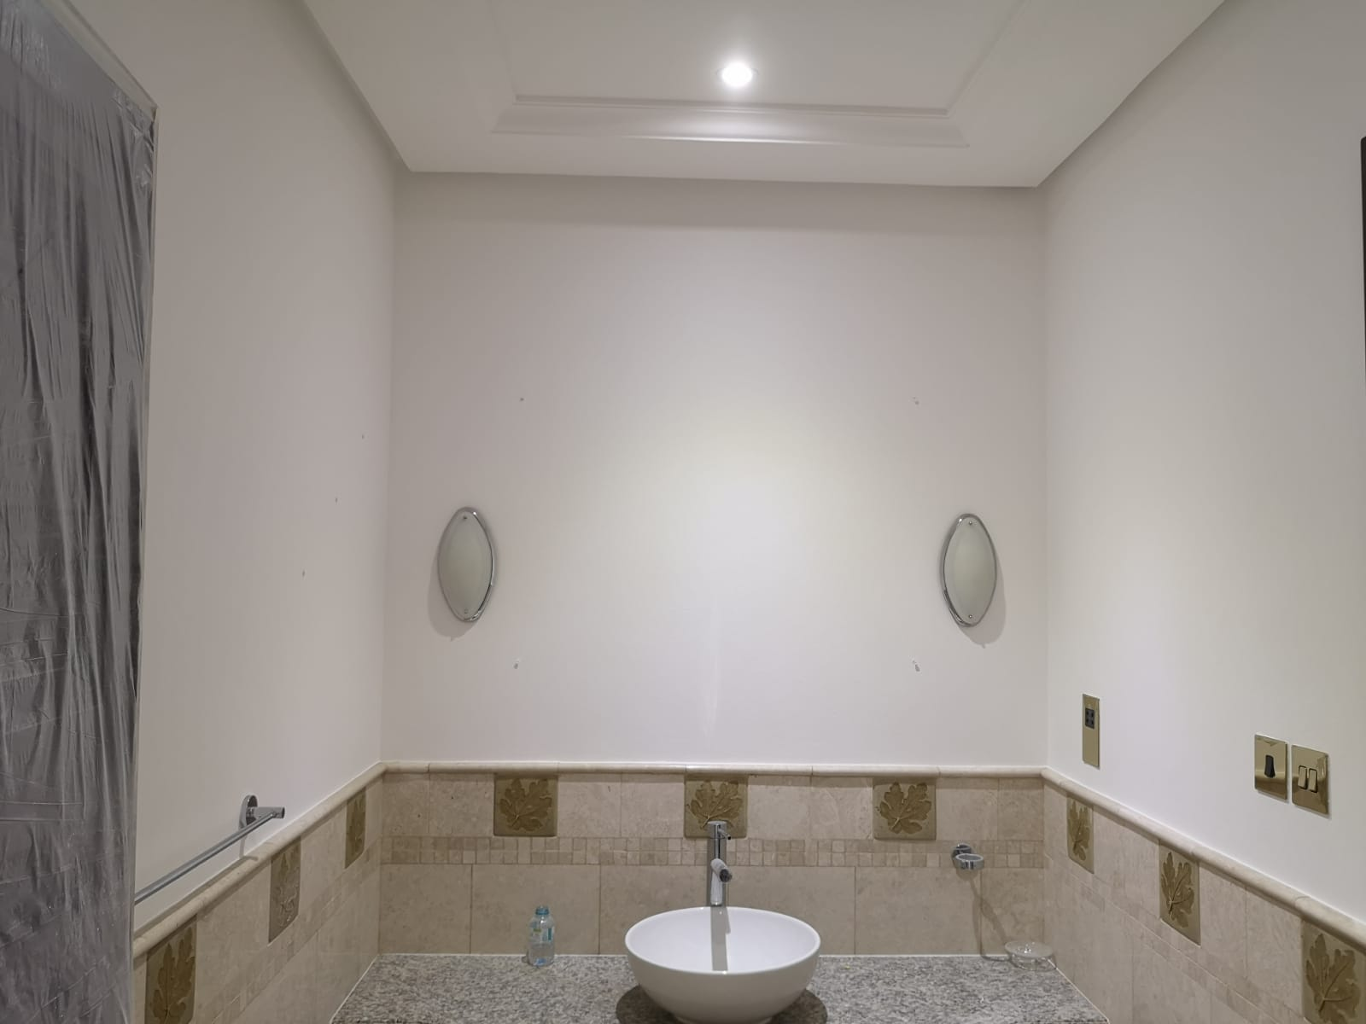
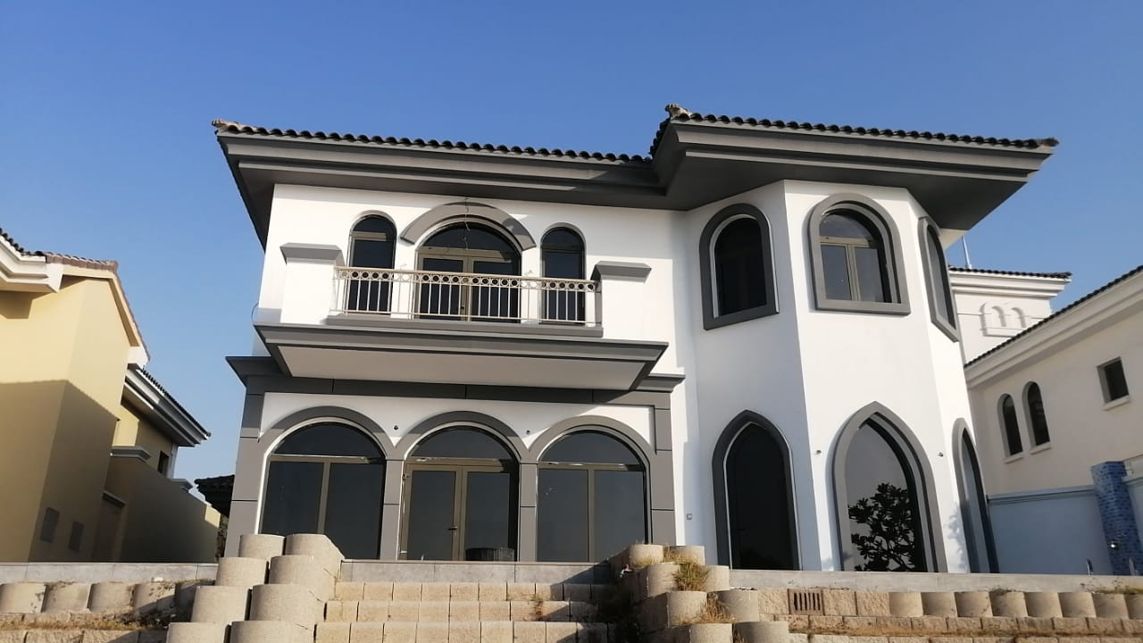
Villa L10 Palme Dubai Jumeirah with MIG

Slide 28
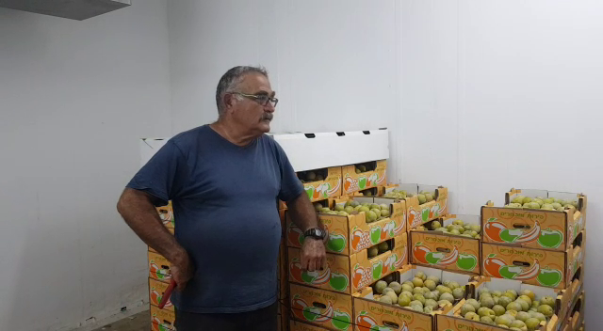
Test of Energy Consumption
Refrigerated Container for Food
Cooling
Action
Reference Container
without MIG DHMb® coating
25,8°C
Time: 76 min
Energy: 5,5 kW
With MIG-ESP® Interior, white
Time: 36 min
Energy: 3,19 kW
Size of Container: 4 x 5 m, height = 2,20 m
Dry ceiling and walls still after 12 months.
2,0°C

Slide 29
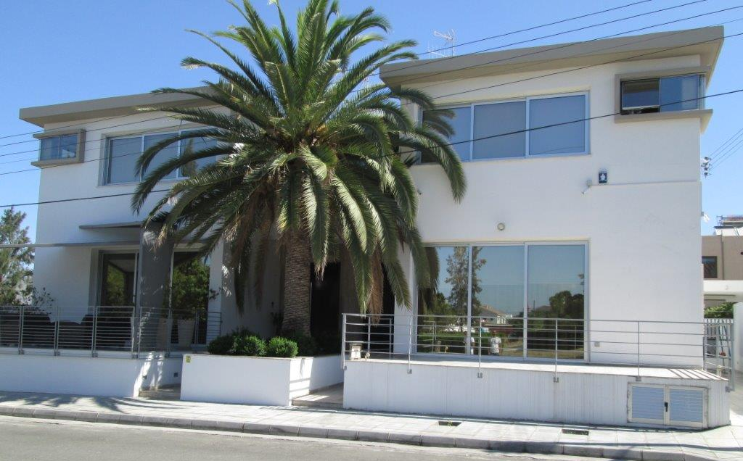
Comparison of heating oil consumption
House A and House B are identical in size, interior design and wall and ceiling construction.
3 floors
Interior surfaces: 250 m²
Year of construction 1988
Location: Nicosia (Cyprus)
A
B

Slide 30
Comparison of heating oil consumption
 | Winter Period | House A |  | House B
1 | Winter 2010/2011 | 2450 Liters |  | 2500 Liters
2 | Winter 2011/2012 | 2400 Liters |  | 2500 Liters
 | After application of MIG-ESP®
MIG-ESP® | Type of application |  | Interior & Exterior | Exterior
3 | Winter 2012/2013 |  | 1400 Liters | 1780 Liters
4 | Winter 2013/2014 |  | 1500 Liters | 1830 Liters
Average savings | Liter / Year Percentage share % |  | 975 Liters 40 % | 695 Liters 28%

Slide 32
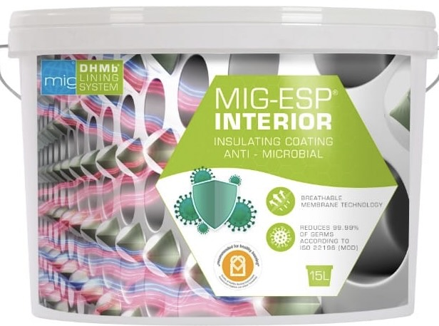
Hygiene & Desinfection
We had our product MIG-ESP® Interior tested by the testing institute Quality Lab - Biomaterial Testing, for Escherichia coli DSM and Staphylococcus aureus DSM (MRSA).
The antibacterial activity of the germs was tested on a plastic surface coated with MIG-ESP® Interior.
The result confirms an
antimicrobial reduction of 99.99%
Test report according to ISO 22196 (Mod)
Measurement Staphylococcus aureus DSM: 191203-10313-22196-01
Measurement Escherichia coli DSM: 191203-10313-22196-02

Slide 33
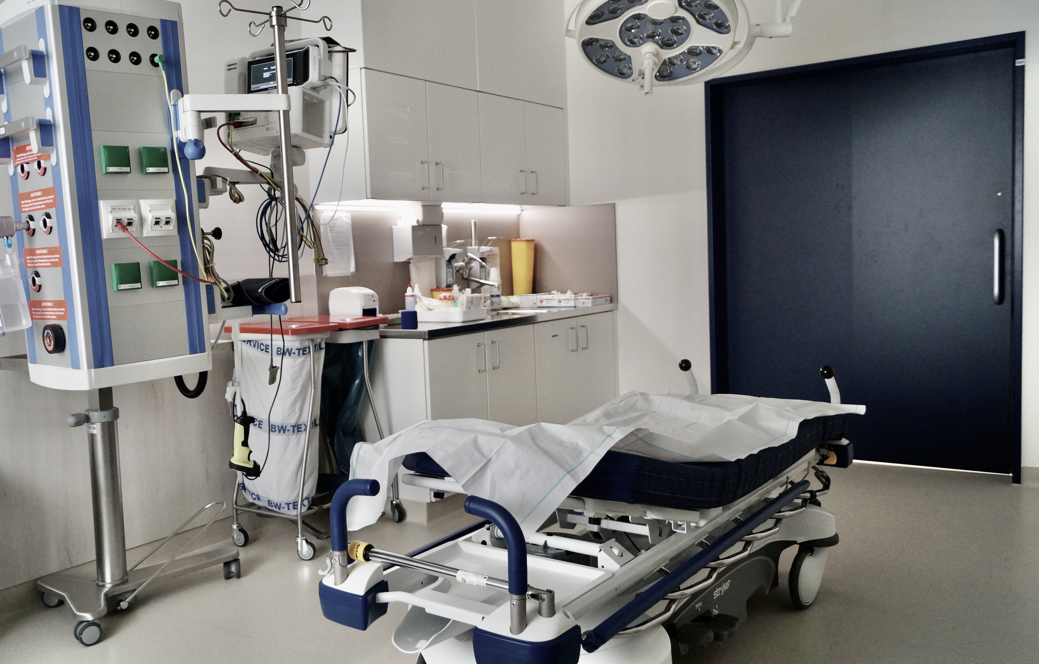
Antimicrobial Zollernalbklinik ZNA
central emergency room

Slide 34
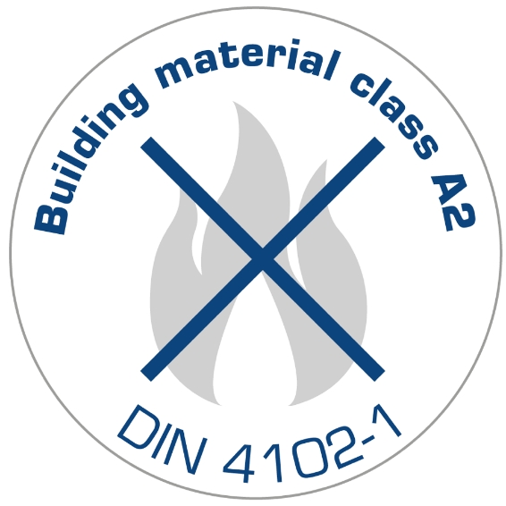
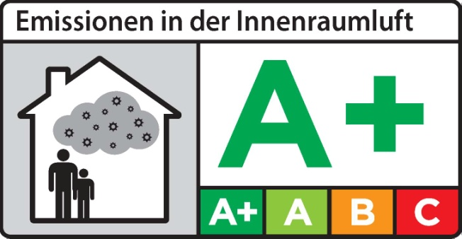
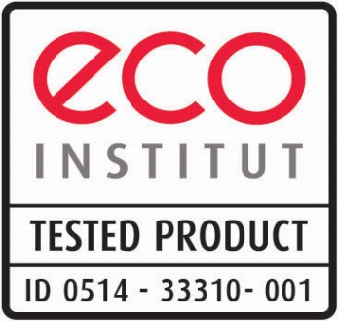
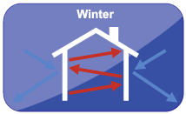
Healthcare (Fine Dust and
Pathogen Reduction 99,99 %)
Energy-Efficiency up to 50%
Surface-Protection
Noise-Reduction
Indoor Microclimate
Fire-Protection
Non-Toxic
Odor-Neutralizing
UV+IR Radiation Reflection 95 %

Slide 35
Our international Partners
Australia
Canada
China
Egypt
France
Hong Kong
Indonesia
Israel
Italy
Kuwait
Lithuania
Montenegro
Portugal
Switzerland
Serbia
Thailand
VAE

Slide 36
Thank you for your Attention!

