Slide 1

Efficienza energetica in edilizia: tecnologie, soluzioni e sfide nel contesto italo-tedesco
Il contesto normativo per la promozione dell’efficienza energetica
Avv. e RAin Svenja Bartels
2.03.2021

Slide 2

AGENDA
 | Our area of activity
 | Potential of Italian energy efficiency market
 | Subsidies for EnEff
 | Our services

Slide 3

1. OUR ACTIVITY

Slide 4
1. OUR AREA OF ACTIVITY
Energy generation and transmission
Development of energy plants and infrastructures (including storage) related project’s contracts, Due Diligence, related tax consulting.
M&A
Sale and purchase of projects, secondary market RES plants and energy infrastructures
  Purchase and sale of projects, plant and infrastructure and equity investments in companies
Infrastructure and project financing
Project financing, leasing or alternative means of funding, assistance to investment funds, banks and investors
Energy trading
Energy trading on energy exchange marcets, OTC negotiation (PPA), contracts for physical and virtual trading

Slide 5
1. OUR AREA OF ACTIVITY
Controversy and arbitration
Assistance before administrative courts in matters of urban development, environmental and energy law, as well as before ordinary courts and in arbitration (national and international)
Surveys and regulatory compliance
Consultation on regulatory issues and on obtaining state and European incentives, assistance in proceedings with public authorities and on the matter of compliance, 231 and privacy
  Purchase and sale of projects, plant and infrastructure and equity investments in companies
Tax services
  Accounting and tax outsourcing, Reporting Asset Management
Energy efficiency
Consultation to public and private authorities in energy efficiency projects, contracting, consultancy in public procurement procedures

Slide 6

2. Potential of Italian energy efficiency market

Slide 7
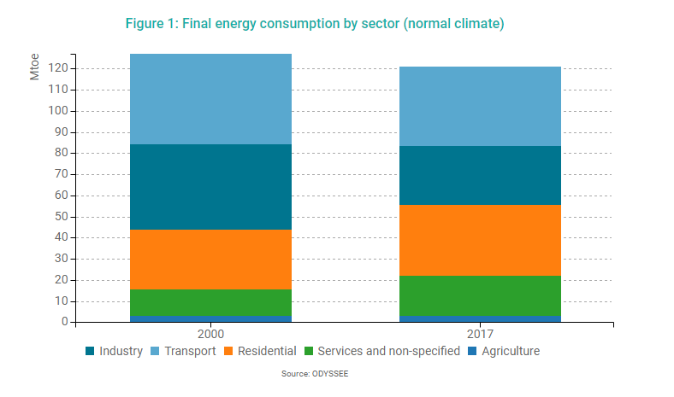
2. Final energy consumption by sector
Focus on residential and services

Slide 8
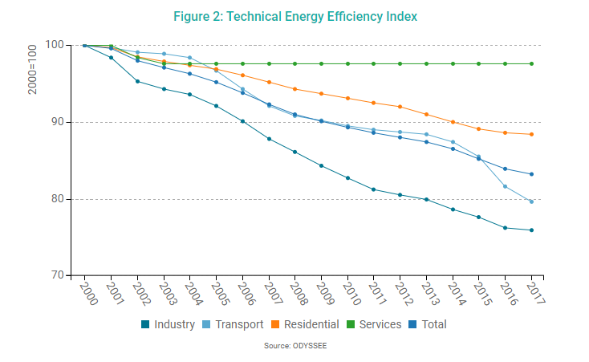


2. Energy efficiency improvement per sector

Slide 9
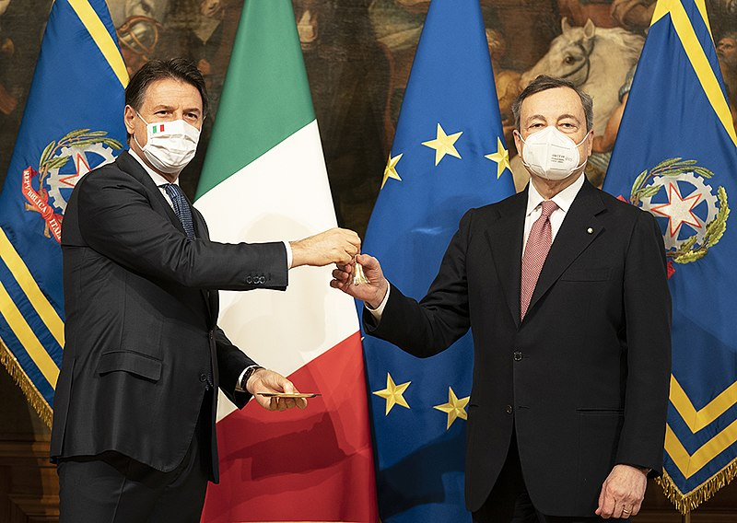
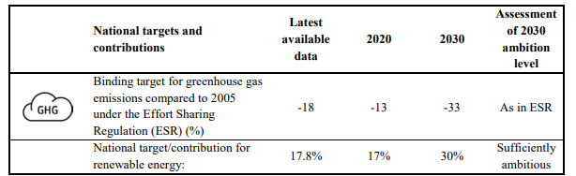
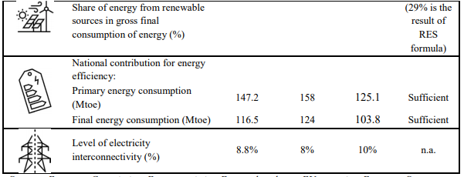

2. National Energy and Climate Plan (NECP - PNIEC)
Current policy to be continued, with stepping up and reforms of single instruments
More efforts for decarburization required
Improve Superbonus
Long term strategy for building renovation required

Slide 10
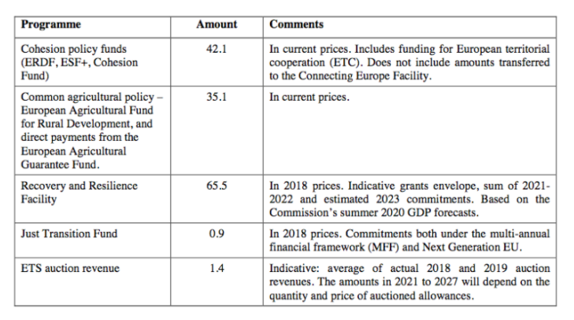
2. EU-Funds for italy until 2027
Good
conditions
in Italy

Slide 11

3. Subsidies for EnERGY EffICIENCY

Slide 12
3. OVERVIEW MAJOR SUBSIDIES
Tax deduction /
Detrazioni fiscali (Ecobonus ed altri)
-> for buildings
Since 2020: Tax deduction / Superbonus 110 %
-> for buildings
SUPPORTS FOR ENERGY EFFICIENCY IN ITALY
Investment Contribution / Conto Termico 2.0
-> for public entities
White Certificates / Certificati Bianchi
-> for industry
Indirect support by several laws on technical standards, for example minimum standards for buildings

Slide 13
3. Superbonus 110%
Incentives are…
… for specific entities
... for specific buildings
… for specific technologies
… limited to maximum amount of costs
limited timewise
Rules are more and more detailed

Slide 14
3. Superbonus 110%
Date | Act | Content
19.05.2020 | Leg. D. n. 34, Law n. 77 (so-called Decreto Rilancio) | Introduction of Superbonus 110% • Subsidies for energy efficiency, earthquake reinforcement, pv and charging stations for electric vehicles • option for the transfer or discount in lieu of the deduction
July 2020 | Guidelines of fiscal authority | Details for obtaining Superbonus
6.08.2020 | Decree of Ministry of economic development | Technical requirements to obtain Ecobonus
6.08.2020 | Decree of Ministry of economic development | Requirements of the sworn statement for Ecobonus
8.8.2020 | Fiscal authority | First clarifications on specific questions concerning Deduction for energy efficiency measures and reduction of seismic risk of buildings, as well as option for the transfer or discount in lieu of the deduction
30.12.2020 | Budget Law 2021 | Expands the scope of application of the super bonus amends mechanism

Slide 15



3. BUSINESS MODEL SUPERBONUS (1)
ESCOS
Construction
Companies
EPC-contract
Energy efficiency
For example:
  building insulation
  Heating
Seismic improvement
PV + Charging station
Condos
Private individuals
Other specific
legal entities
Cash back
Assignment of
tax credit
Banks

Slide 16



3. BUSINESS MODEL SUPERBONUS (2)
Framework Agreement
EPC with discount in invoice
Big player
Real estate service providers
example
ENELX, ENI
ESCOS
Construction Companies
Condas
Private individual
Other specific
legal entities
marketing
Esco obtains tax deductions from tax authorities
Assignment of receivables to

Slide 17
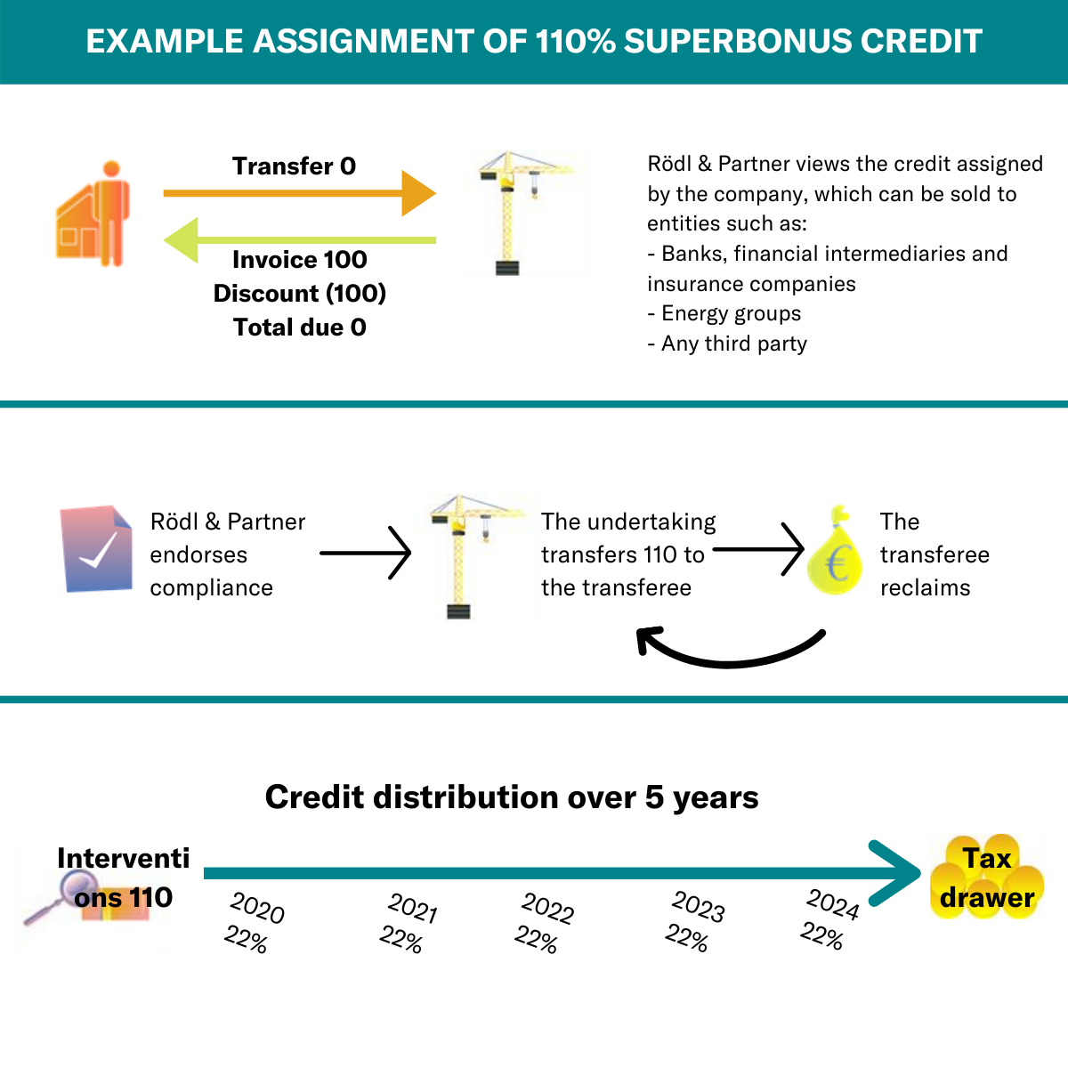
3. Example credit certification
R&P confirms credit
Company transfers credit to bank
Cashback
by bank

Slide 18

3. Fondo Nazionale per l’efficienza energetica

Slide 19
4. Our services

Slide 20

4. our services
Audit
Tax
Legal
Compulsory audits and legal declarations
Audit of financial statements and consolidated financial statements
Audit and certification of financial plans drawn up in the event of crisis
Voluntary audits
Agreed Upon Procedures
Periodic checking of due corporate bookkeeping
Corporate
Litigation
Labour Law
Retail contracts
Administrative Law
Food Law
Pharma Law
IP Law
Data protection
Information Technology
Digital Law
Energy Law
International tax planning
Group taxation
Patent box
Indirect tax
Tax litigation
Extraordinary transactions
Expat taxation
Transfer pricing
Project Financing
Our services
Business Process Outsourcing
OUR CLIENTS
General and analytical accounting
Cash management
Drawing up financial and economic reports
Drawing up the financial statements
Processing of payroll and relative forms
Managing and administration of the employees
Transactions
Tax, financial e legal due diligence
Private equity and venture capital
M&A
Company share purchase contracts
Contracts for company sale and business branches sale
Anti-trust law
Mergers, spin-off, takeovers and asset contributions
Local and international tax-planning
Labour consulting
Staff costing and analysis
Contributions settlements
Industrial relations
Union bargaining
Management of redundancies and union procedures for "cigs“
Social security and end of service management concerning agency agreements
Advisory and support concerning workplaces' health and safety

Slide 21

4. Contact
SVENJA BARTELS
Partner
Attorney at Law (D), (I)
T +39 049 80 46 911
Mobile +39 3406888989
svenja.bartels@roedl.com

Slide 22
Avvocati, Dottori Commercialisti, Revisori
Legali e Consulenti del Lavoro
Attorneys-at-Law, Tax Consultants, Certified Public Accountants and Labour Consultancy
Rechtsanwälte, Steuerberater,
Wirtschaftsprüfer, Arbeitsrechtsberater
MILANO
Rödl & Partner
Largo Donegani 2
I-20121 Milano
T +39-02-6328841
Fax +39-02-63288420
info@roedl.it
PADOVA
Rödl & Partner
Via F. Rismondo, 2/E
35131 Padova
T +39-049-804 6911
Fax +39-049-8046920
padova@roedl.it
ROMA
Rödl & Partner
P.zza S.Anastasia, 7
00186 Roma
T +39-06-96701270
Fax +39-06-3223394
roma@roedl.it
BOLZANO
Rödl & Partner
P.zza Walther- von- der- Vogelweide 8
39100 Bolzano
T +39-0471-1943200
Fax +39-0471-1943220 bolzano@roedl.it

