Slide 1
Renewable energy projects for location-based supply

Slide 2
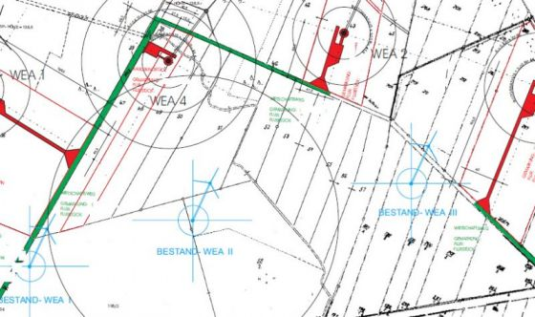
ZWE Group has been an initiator and participant in regional wind energy, photovoltaic, storage and electromobility projects for more than 20 years
Focus is on small projects without "heavy" overhead
For several years, increased international activities including the establishment and operation of a project company in Iran
Current potential for the development of projects in Senegal, Gambia, Kenya and the Middle East
Goal: Implementation of self-sufficient wind / PV energy supply systems in microprojects (island solutions)
Objective: Consumption of electricity generated at the site in concrete applications (for example seawater desalination)
Goal: Distribution of a robust product range for the corresponding markets within the framework of emerging countries

Slide 3
Our services:
zWe is well experienced in assessing RE projects of any kind
We prepare feasibility studies to provide the efficient path into RE projects
We support you with project development, technology assessment, financing of your project
We connect you with our partners and act as a „funnel“ to work up information for you

Slide 4
Current Challenges:
Bankability of ppa‘s → zWe‘s network partners are able to generate a financing for renewable energy projects in Vietnam
Technology configuration → zWe has access to various reputable manufacturers in the wind and solar sector
Logistic limitations → with access to creative solutions zWe overcomes usual logistic limitations in RE projects
Flexibility → zWe is a small unit and highly adaptable to local requirements

Slide 5
Our Technologies:
QREON → island solution wind energy turbine and storage technology on 2 MW platform
W2E → wind turbine developer with licensees all over the world offering technologies from 2 – 4+ MW
ZENIA → small wind turbine technology (<30kW) for individual energy supply
Caroon Energy → provider of PV technologies
Water desalination, water treatment and purification technologies
Port New → Electromobility technologies and solutions

Slide 6
Objectives in Vietnam:
zWe appreciates the chance to be in Vietnam and is looking for partners in the following fields:
Project developer for wind energy, PV, energy storage and e-mobility with a need in technology and experience transfer
Industrial energy consumers that look for grid support by RE (e.g. small wind farm within facility‘s grid)
Holder of rights for land use
Regional energy supplier for questions of grid expansion / stability and partnership for joint RE projects

Slide 7
André Winkler ALTER HOLZHAFEN 3 23966 Wismar FON +49(0)3841/40336 MOB +49(0)177/6640336 FAX +49(0)3841/40338 INTERNET http://www.zwe-i.de

