Slide 2
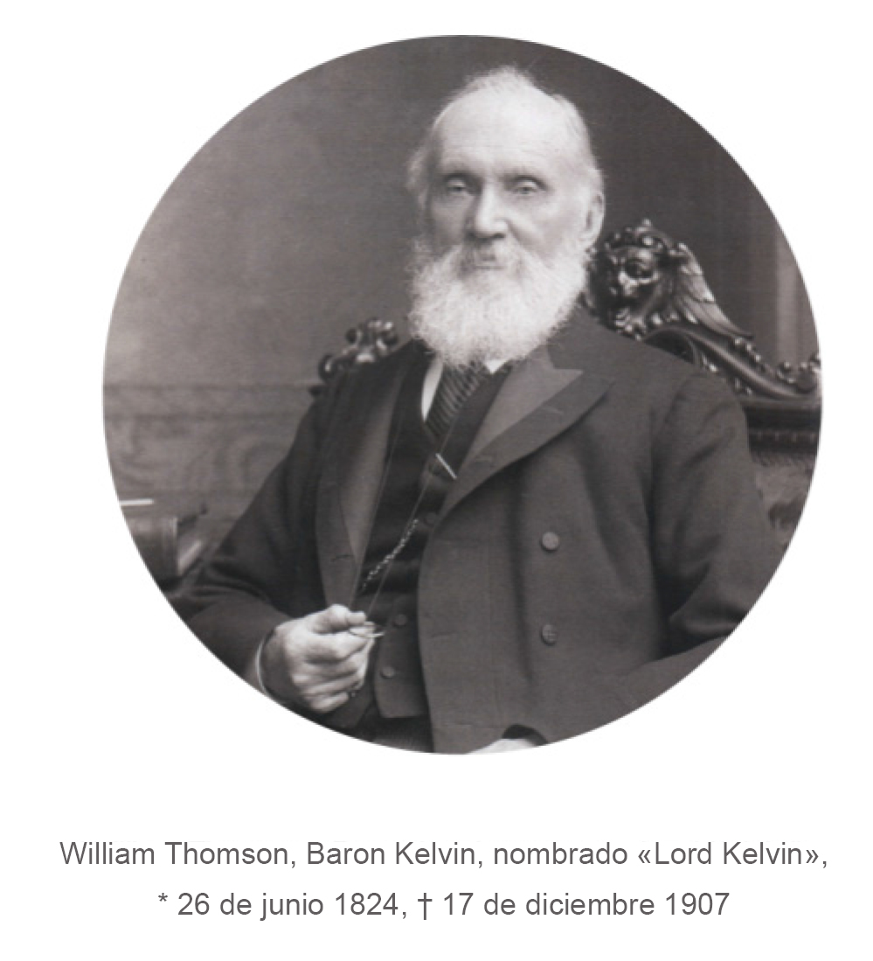
NO INCREASE IN ENERGY EFFICIENCY WITHOUT FULL TRANSPARENCY
«Lo que no se puede medir, no se puede mejorar»
„If you can‘t measure it, you can‘t improve it“

Slide 3
ABOUT JANITZA ELECTRONICS GMBH
German company based in Lahnau
with approximately 220 employees
Products developed and manufactured in Germany
approx. 120 000 measurement devices delivered every year
Over 50 years of experience
Development, manufacturing and distribution of solutions for energy management and
power quality monitoring
Janitza measurement devices already successfully in place in more than 60 coutries worldwide

Slide 4
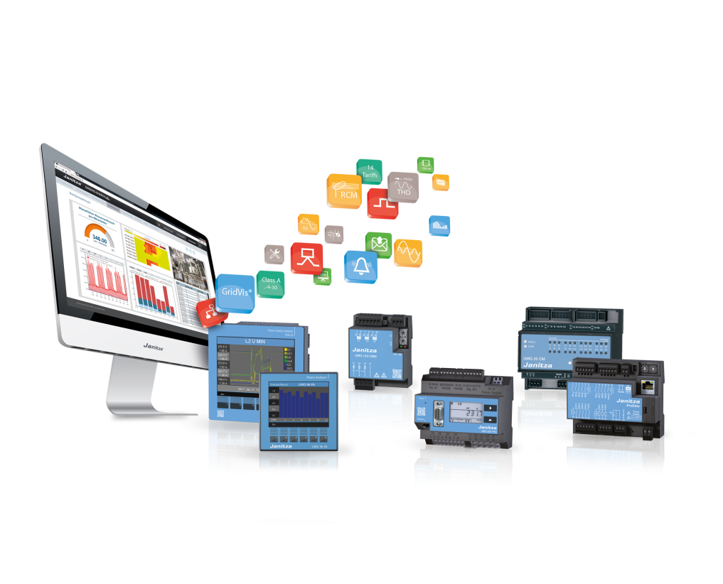
THREE SOLUTIONS IN ONLY ONE SYSTEM
Energy Management ISO 50001
Residual Current Monitoring (RCM)
Power Quality EN 50160

Slide 5
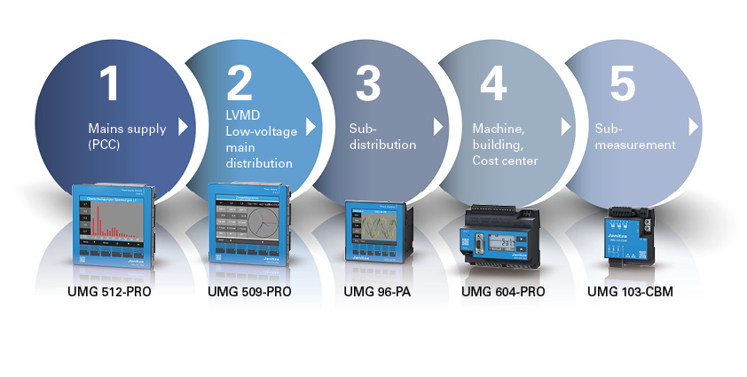
MEASUREMENT OVER 5 DIFFERENT LEVELS
Maximum transparency with Janitza measurement devices – on 5 levels – from the energy supplier down to sub-measurements, like for example directly on motors or machinery

Slide 6
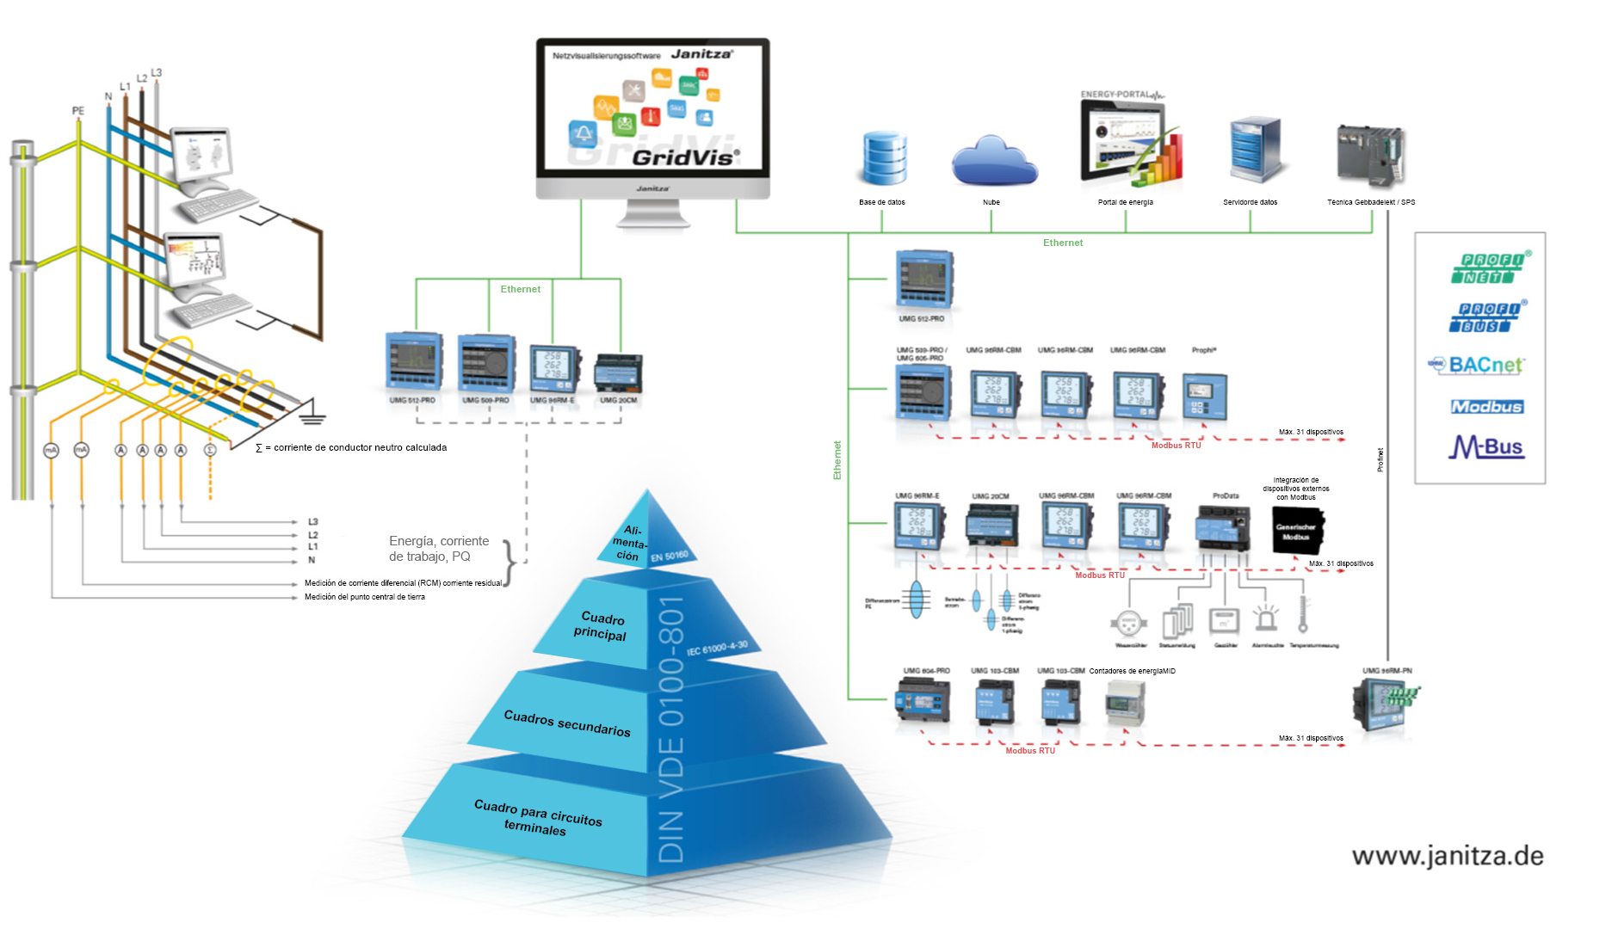
MAXIMUM TRANSPARENCY WITH JANITZA ENERGY MEASUREMENT DEVICES

Slide 7
ADVANTAGES OF CUSTOMIZED ENERGY MANAGEMENT
Reduction of
energy costs
Increased safety and
improved availability of the system with reduction
of fire hazard
Load curve analysis: costs reduction through avoidance of consumption peaks
Increase of
efficiency
ENERGY MANAGEMENT
Protect the environment: reduction of CO₂ footprint
Uncover the full cost saving potential
Improvement of company image through energy awareness
Precondition for
tax savings
Optimize processes
in the long term
Increase in productivity

Slide 8
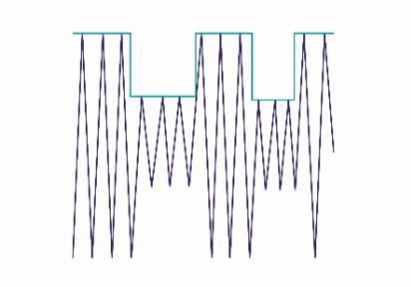
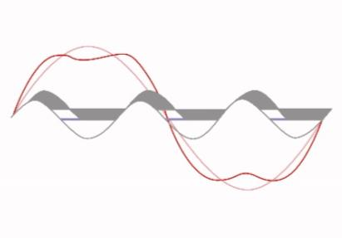
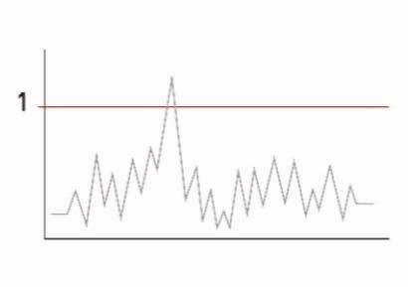
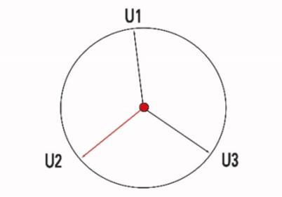
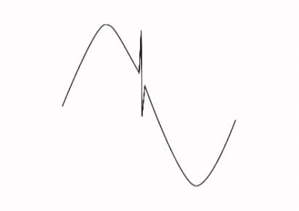
TYPICAL POWER QUALITY PARAMETERS
Voltage fluctuations
Harmonic oscillations
Flicker
Unbalances
Frequency fluctuations
Transients and
short-time interruptions

Slide 9
SAVING POTENTIAL
Typical practical values
10–20 %
Energy costs savings
Investment in measurement technology follows the return model or object after the ROI through long-term savings
12–36 months
ROI

Slide 10
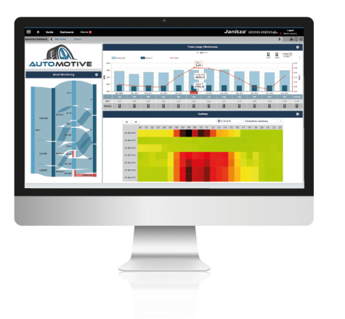
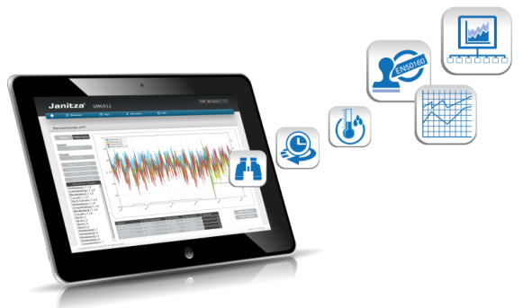
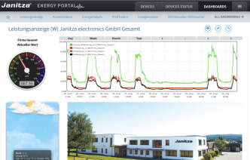
JANITZA SOFTWARE
GridVis® Software– Visualization software for energy management and power quality monitoring systems by Janitza
Energy Portal – the Cloud solution for energy management
anitza APPs – Extensions
with specialized functions

Slide 12
Who are we looking for and what do we offer?
We are looking for customers and sales partners in Italy with:
Direct competency and activities in the energy efficiency market
Projects and requirements of monitoring, management and saving systems
Passion for technology, energy saving and advanced solutions
We offer highest-quality products, leader in the European market, technical training, technical and commercial support and flexible solutions for specific requirements

