Slide 1
Workshop at the German-Arab Chamber of Industry and Commerce
PROCCESSING A SCHENGEN VISA

Slide 2
Workshop at the German-Arab Chamber of Industry and Commerce
German Embassy Cairo
Processed visa in 2019
C-Visa 41.154
D-Visa 7.553
Total 48.707
12th biggest visa department in the MOFA

Slide 3
Workshop at the German-Arab Chamber of Industry and Commerce
Acceptance of applications at the TLScontact
DELIVERY NEXT DAY TO THE EMBASSY VIA MESSENGER

Slide 4
DATA ENTRY AND PRELIMINARY EXAMINATION
Messenger of Chamber submits applications at TLScontact VAC; next day delivery to the embassy in the morning
Data entry and preliminary examination for completeness of the application (signed, all required documents?)
if application is consistent
Report and data sent into the VIS (Visa Information System of Schengen)

Slide 5
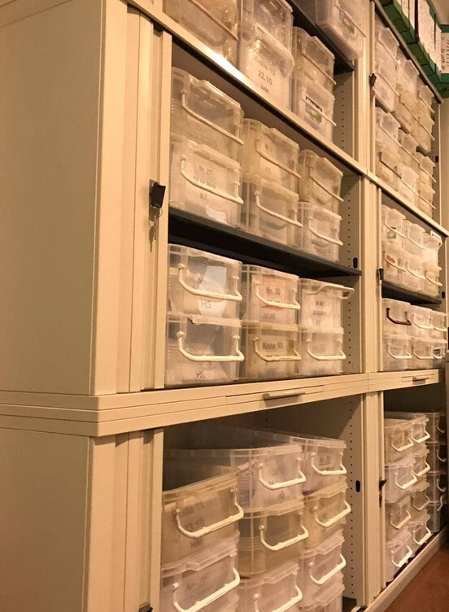
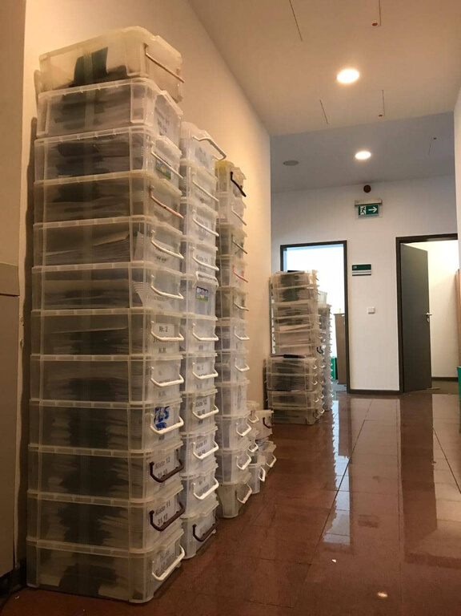
INTERMEDIATE STORAGE
Intermediate storage waiting for the answers from Schengen partners
200 x 7 days = 1.400 applications waiting

Slide 6
Assessment of the application
TEAM OF 4 GERMAN STAFF MEMBERS FOR SCHENGEN ONLY
PURPOSE OF THE VISIT PLAUSIBLE ?
BUSINESS TIES CREDIBLE ?
EXAMINATION IF THE TRIP IS FINANCIALLY COVERED BY THE INVITER OR THE TRAVELLER
ANALYSIS OF THE APPLICATION

Slide 7
Assessment of the application
EVALUATION OF APPLICANTS FINANCIAL TIES WITH EGYPT
EVALUATION OF THE RISK OF ILLEGAL IMMIGRATION
IF APPLICABLE EVALUATION OF APPLICANTS FAMILY TIES WITH EGYPT

Slide 8
Assessment of the application
IF DISCREPANCIES IN THE DOCUMENTS – FILE GOES TO THE INSPECTION TEAM
DEPENDING ON THE CASE + 1 – 7 EXTRA DAYS IN PROCESSING
3 DOCUMENT ADVISORS OF THE FEDERAL POLICE + 2 LOCAL STAFF

Slide 9
DECISION

Slide 10
DECISION
If application is plausible and credible –
positive decision is taken immediately
DECISION
If discrepancies are various, or documents missing – negative decision is also taken immediately

Slide 11
PRINT AND DELIVERY
ALL VISAS ARE PRINTED AND AFFIXED TO THE PASSPORTS AND
All responses (granted visas as well as refusals) are placed into envelopes = 200 PER DAY
BY ONE PERSON

Slide 12
PRINT AND DELIVERY
DELIVERY TO TLS EVERY MORNING

Slide 13
DISTRIBUTION

Slide 14
DISTRIBUTION
TLS SAME DAY –
AUTOMATIC SMS reminder when ready for collection
MAY BE NEXT DAY IF TNT WAS USED

Slide 15
VISA PROCESS
Acceptance
Delivery next Day
Processing time of minimum 10 days starts next day
Print
Workshop at the German-Arab Chamber of Industry and Commerce
Delivery (distribution the same day)
15 days IF everything goes smoothly

Slide 16
Thank you for your attention!
Any questions?

